Slide 1
Influence and Homophily
Social Media Mining

Slide 2
Social Forces
Social Forces connect individuals in different ways
Among connected individuals, one often observes high social similarity or assortativity
In networks with assortativity, similar nodes are connected to one another more often than dissimilar nodes.
In social networks, a high similarity between friends is observed
This similarity is exhibited by similar behavior, similar interests, similar activities, and shared attributes such as language, among others.
Friendship networks are examples of assortative networks

Slide 3
Why connected people are similar?
Influence
Influence is the process by which an individual (the influential) affects another individual such that the influenced individual becomes more similar to the influential figure.
If most of one’s friends switch to a mobile company, he might be influenced by his friends and switch to the company as well.
Homophily
It is realized when similar individuals become friends due to their high similarity.
Two musicians are more likely to become friends.
Confounding
Confounding is environment’s effect on making individuals similar
Two individuals living in the same city are more likely to become friends than two random individuals

Slide 4
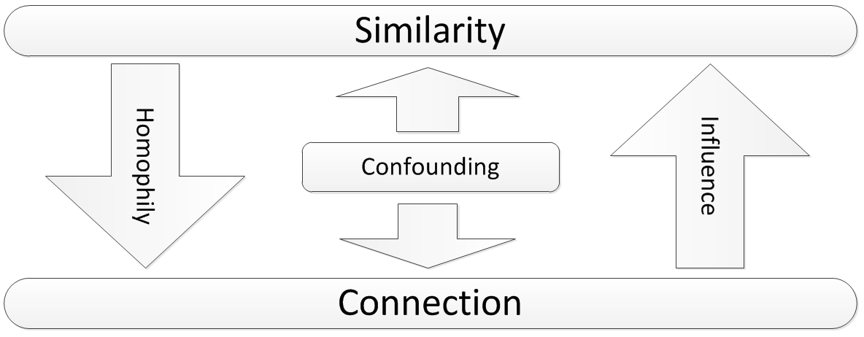
Influence, Homophily, and Confounding

Slide 5
Source of Assortativity in Networks
Both influence and Homophily generate similarity in social networks but in different ways
Homophily selects similar nodes and links them together
Influence makes the connected nodes similar to each other

Slide 6
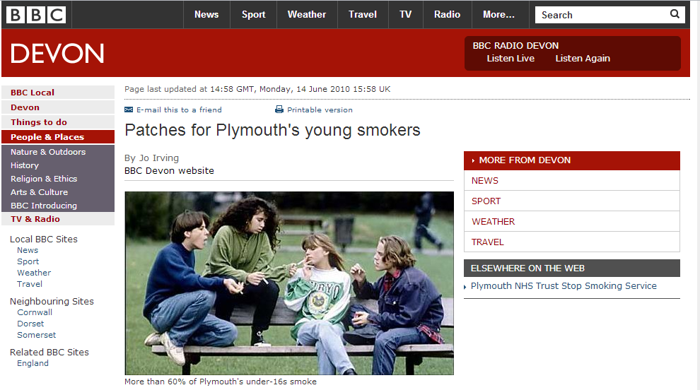
Assortativity: An Example
The city's draft tobacco control strategy says more than 60% of under-16s in Plymouth smoke regularly
Notes:
http://news.bbc.co.uk/local/devon/hi/people_and_places/newsid_8738000/8738850.stm

Slide 7
Smoking Behavior In a Group of Friends: why is happening?
Smoker friends influence their non-smoker friends
Smokers become friends
There are lots of places that people can smoke
Influence
Homophily
Confounding

Slide 8
Our goal in this chapter?
How can we measure assortativity?
How can we measure influence or homophily?
How can we model influence or homophily?
How can we distinguish the two?

Slide 9
Measuring Assortativity

Slide 10
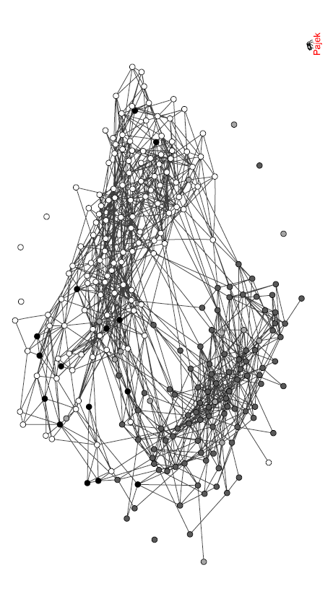
Assortativity: An Example
The friendship network in a high school in the US in 1994
Colors in represent races,
Whites are white,
Blacks are grey
Hispanics are light grey
Others are black
There is a high assortativity between individuals of the same race

Slide 11
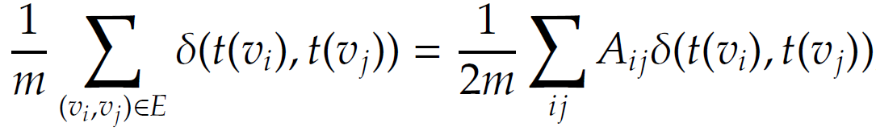
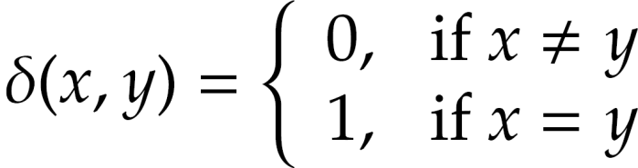
Measuring Assortativity for Nominal Attributes
Where nominal attributes are assigned to nodes (race), we can use edges that are between nodes of the same type (i.e., attribute value) to measure assortativity of the network
Node attributes could be nationality, race, sex, etc.
t(v_{i}) denotes type of vertex v_{i}
Kronecker delta function

Slide 12
Assortativity Significance
Assortativity significance measures the difference between the measured assortativity and its expected assortativity
The higher this value, the more significant the assortativity observed
Example
Consider a school where half the population is white and half the population is Hispanic. It is expected for 50% of the connections to be between members of different races. If all connections in this school were between members of different races, then we have a significant finding

Slide 13
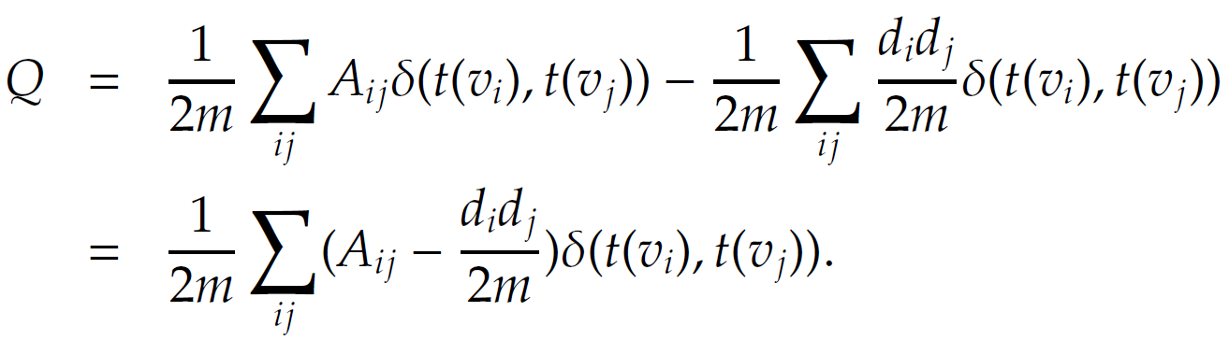
Assortativity Significance: Measuring
Assortativity
The expected assortativity in the whole graph
This measure is called modularity

Slide 14
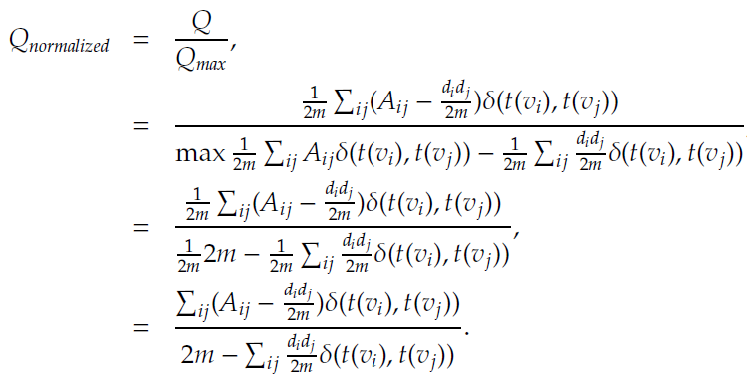
Normalized Modularity
The maximum happens when all vertices of the same type are connected to one another
Notes:
For the max function in the denominator, iif there is an edge between two nodes, their types are the same.

Slide 15
Modularity: Matrix Form
Let denote the indicator matrix and let k denote the number of types
The Kronecker delta function can be reformulated using the indicator matrix
Therefore,

Slide 16
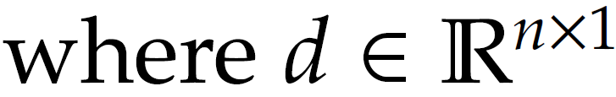

Normalized Modularity: Matrix Form
Let Modularity matrix be:
Is the degree vector
Then, modularity can be reformulated as

Slide 17
Modularity Example
the number of edges between nodes of the same color is less than the expected
number of edges between them

Slide 18
Measuring Assortativity for Ordinal Attributes
A common measure for analyzing the relationship between ordinal values is covariance.
It describes how two variables change together.
In our case we are interested in how values of nodes that are connected via edges are correlated.

Slide 19
Covariance Variables
We construct two variables X_{L} and X_{R}, where for any edge (v_{i}; v_{j}) we assume that x_{i} is observed from variable X_{L} and x_{j} is observed from variable X_{R}.
In other words, X_{L} represents the ordinal values associated with the left node of the edges and X_{R} represents the values associated with the right node of the edges
Our problem is therefore reduced to computing the covariance between variables X_{L} and X_{R}

Slide 20
Covariance Variables: Example
List of edges:
((A, C),
(C, A),
(C, B),
(B, C))
X_{L} : (18, 21, 21, 20)
X_{R} : (21, 18, 20, 21)
→

Slide 21
Covariance
For two given column variables X_{L} and X_{R} the covariance is
E(X_{L}) is the mean of the variable and E(X_{L} X_{R}) is the mean of the multiplication

Slide 22
Covariance

Slide 23
Normalizing Covariance
Pearson correlation P(X,Y) is the normalized version of covariance
In our case:
Notes:
\sigma = E(X-E(X))^2

Slide 24
Correlation Example

Slide 25
Social Influence
Measuring Influence
Modeling Influence

Slide 26
Social Influence: Definition
the act or power of producing an effect without apparent exertion of force or direct exercise of command

Slide 27
Measuring the Influence

Slide 28
Measuring Influence
Measuring influence is assigning a number to each node that represents the influential power of that node
The influence can be measured either based on prediction or observation

Slide 29
Prediction-based Measurement
In prediction-based measurement, we assume that an individual’s attribute or the way she is situated in the network predicts how influential she will be.
For instance, we can assume that the gregariousness (e.g., number of friends) of an individual is correlated with how influential she will be. Therefore, it is natural to use any of the centrality measures discussed in Chapter 3 for prediction-based influence measurements.
An example:
On Twitter, in-degree (number of followers) is a benchmark for measuring influence commonly used

Slide 30
Observation-based Measurement
In observation-based we quantify influence of an individual by measuring the amount of influence attributed to the individual
When an individual is the role model
Influence measure: size of the audience that has been influenced
When an individual spreads information:
Influence measure: the size of the cascade, the population affected, the rate at which the population gets influenced
When an individual increases values:
Influence measure: the increase (or rate of increase) in the value of an item or action

Slide 31
Case Studies for Measuring Influence in Social Media
Measuring Social Influence on Blogosphere
Measuring Social Influence on Twitter

Slide 32
Measuring Social Influence on Blogosphere
The goal of measuring influence in blogosphere is to figure out most influential bloggers on the blogosphere
Due to limited time an individual has, following the influentials is often a good heuristic of filtering what’s uninteresting
One common measure for quantifying influence of bloggers is to use indegree centrality
Due to the sparsity of in-links, more detailed analysis is required to measure influence in blogosphere
Notes:
(Indegree is the number (in-)links that point to the blog)

Slide 33
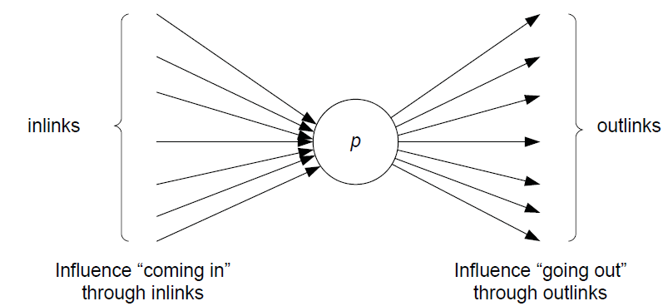
iFinder: A System to measure influence on blogsphore
Notes:
Nitin Agarwal’s WSDM2008 work

Slide 34
Social Gestures
Recognition
Recognition for a blogpost is the number of the links that point to the blogpost (in-links).
Let I_{p} denotes the set of in-links that point to blogpost p.
Activity Generation
Activity generated by a blogpost is the number of comments that p receives.
c_{p} denotes the number of comments that blogpost p receives.
Novelty
The blogpost’s novelty is inversely correlated with the number of references a blogpost employs. In particular the more citations a blogpost has it is considered less novel.
O_{p} denotes the set of out-links for blogpost p.
Eloquence
Eloquence is estimated by the length of the blogpost. Given the unformal nature of blogs and the bloggers tendency to write short blogposts, longer blogposts are believed to be more eloquent. So the length of a blogpost l_{p} can be employed as a measure of eloquence

Slide 35
Influence Flow
Influence flow describes a measure that accounts for in-links (recognition) and out-links (novelty).
I(.) denotes the influence a blogpost and w_{in} and w_{out} are the weights that adjust the contribution of in- and out-links, respectively
p_{m} is the number of blogposts that point to blog post p and p_{n} is the number of blog posts referred to in p

Slide 36
Blogpost Influence
w_{length} is the weight for the length of the blogpost.
w_{comment} describes how the number of comments is weighted in the influence computation
Weights w_{in}, w_{out}, w_{comments}, and w_{length} can be tuned to make the model suitable for different domains

Slide 37
Measuring Social Influence on Twitter
In Twitter, users have an option of following individuals, which allows users to receive tweets from the person being followed
Intuitively, one can think of the number of followers as a measure of influence (in-degree centrality)

Slide 38
Measuring Social Influence on Twitter: Measures
Indegree
The number of users following a person on Twitter
Indegree denotes the “audience size” of an individual.
Number of Mentions
The number of times an individual is mentioned in a tweet, by including @username in a tweet.
The number of mentions suggests the “ability in engaging others in conversation”
Number of Retweets:
Tweeter users have the opportunity to forward tweets to a broader audience via the retweet capability.
The number of retweets indicates individual’s ability in generating content that is worth being passed on.

Slide 39
Measuring Social Influence on Twitter: Measures
Each one of these measures by itself can be used to identify influential users in Twitter.
This can be performed by utilizing the measure for each individual and then ranking individuals based on their measured influence value.
Contrary to public belief, number of followers is considered an inaccurate measure compared to the other two.
We can rank individuals on twitter independently based on these three measures.
To see if they are correlated or redundant, we can compare ranks of an individuals across three measures using rank correlation measures.

Slide 40
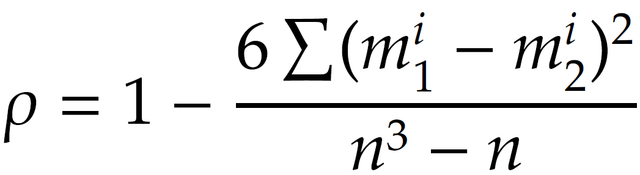

Comparing Ranks Across Three Measures
In order to compare ranks across more than one measure (say, indegree and mentions), we can use Spearman’s Rank Correlation Coefficient
Notes:
Indegrees vs. mentions, mentions vs. retweets, retweets vs. indegrees

Slide 41
Spearman’s rank correlation is the Pearsons correlation coefficient for ordinal variables that represent ranks (i.e., takes values between 1. . . n); hence, the value is in range [-1,1].
Popular users (users with high in-degree) do not necessarily have high ranks in terms of number of retweets or mentions.

Slide 42
Influence Modeling

Slide 43
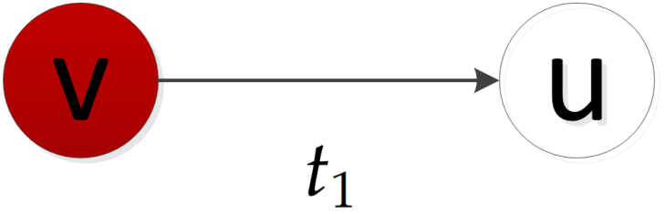
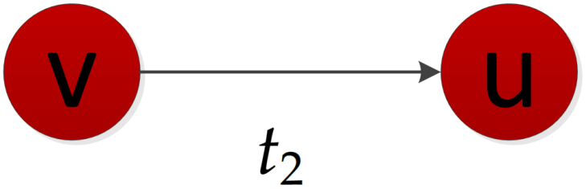
Influence Modeling
At time stamp t₁, node v is activated and node u is not activated
Node u becomes activated at time stamp t₂, as the effect of the influence
Each node is started as active or inactive;
A node, once activated, will activate its neighboring nodes
Once a node is activated, this node cannot be deactivated

Slide 44
Influence Modeling: Assumptions
In general we can assume that the influence process takes place in a network of connected individuals.
Sometimes this network is observable (an explicit network) and sometimes not (an implicit network).
In the observable case, we can resort to threshold models such as the linear threshold model
In the case of implicit networks, we can employ methods such as the Linear Influence Model (LIM) that take the number of individuals who get influenced at different times as input, e.g., the number of buyers per week

Slide 45
Threshold Models
Threshold models are simple, yet effective methods for modeling influence in explicit networks
In threshold model actors make decision based on the number or the fraction (the threshold) of their neighborhood that have already decided to make the same decision
Using a threshold model, Schelling demonstrated that minor preferences in having neighbors of the same color leads to complete racial segregation
http://www.youtube.com/watch?v=dnffIS2EJ30

Slide 46
Linear Threshold Model (LTM)
An actor would take an action if the number of his friends who have taken the action exceeds (reach) a certain threshold
Each node i chooses a threshold ϴ_{i} randomly from a uniform distribution in an interval between 0 and 1.
In each discrete step, all nodes that were active in the previous step remain active
The nodes satisfying the following condition will be activated

Slide 47
Linear Threshold Model- An Example (Threshold are on top of nodes)

Slide 48
Influence in Implicit Networks
An implicit network is one where the influence spreads over nodes in the network
Unlike the threshold model, one cannot observe individuals who are responsible for influencing others (the influentials), but only those who get influenced
The information available is:
The set of influenced individuals at any time, P(t)
Time t_{u}, where each individual u gets initally influenced (activated)

Slide 49
Influence in Implicit Networks
Assume that any influenced individual u can influence I(u, t) non-influenced individuals at time t.
Assuming discrete timesteps, we can formulate the size of influence population as

Slide 50
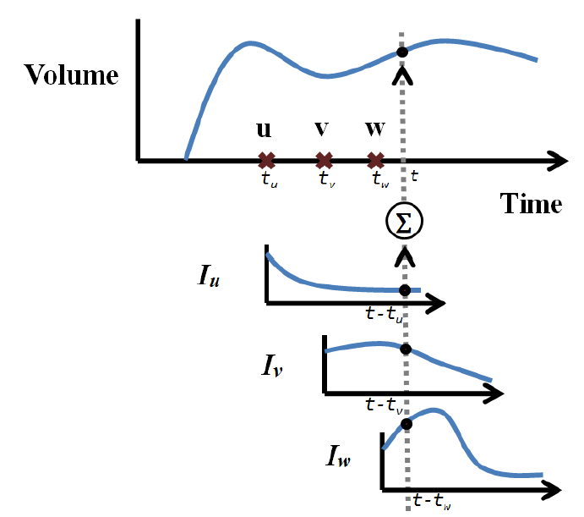
The Size of the Influenced Population
At time t, the total number of influenced individuals is the summation of influence functions I_{u}, I_{v}, and I_{w} at time steps t - t_{u}, t - t_{v}, and t - t_{w}, respectively
The size of the influenced population as a summation of individuals influenced by activated individuals
Individuals u, v, and w are activated at time steps t_{u}, t_{v}, and t_{w}, respectively

Slide 51
Size of the Activated Nodes
The goal is to estimate I(., .) given activation time and the number of influenced individuals at any time
Parametric estimation
Non-Parametric estimation

Slide 52
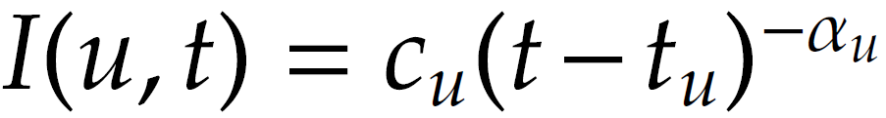
Parametric Estimation
Use some distribution to estimate I function. Assume that all users influence others in the same parametric form
For instance, one can use the powerlaw distribution to estimate influence:
Here we need to estimate the coefficients

Slide 53
Non-Parametric Estimation
Assume that nodes can get deactivated over time and can no longer influence others.
Let A(u, t) = 1 denote node u is active at time t
A(u, t) = 0 denotes that u is either deactivated or still not influenced,
|V| is the total size of population and T is the last time stamp
This can be solved using non-negative least square methods.

Slide 54

Homophily
“Birds of a feather flock together”

Slide 55
Homophily- Definition
Homophily (i.e., "love of the same") is the tendency of individuals to associate and bond with similar others
People interact more often with people who are “like them” than with people who are dissimilar
What leads to Homophily?
Race and ethnicity, Sex and Gender, Age, Religion, Education, Occupation and social class, Network positions, Behavior, Attitudes, Abilities, Believes, and Aspirations
Notes:
From wikipedia

Slide 56
Measuring Homophily: Idea
To measure homophily, one can measure how the assortativity of the network changes over time
Consider two snapshots of a network Gt(V, E) and Gt’ (V, E’) at times t and t’, respectively, where t’ > t
Assume that the number of nodes stay fixed and edges connecting them are added or removed over time.

Slide 57
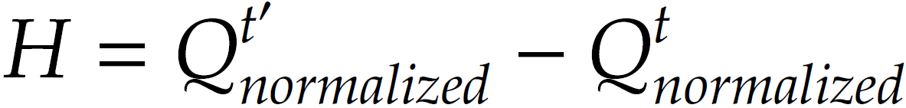
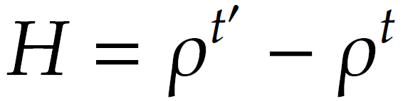
Measuring Homophily
For nominal attributes, the homophily index is defined as
For ordinal attributes, the homophily index can be defined as the change in Pearson correlation

Slide 58
Modeling Homophily
We model homophily using a variation of Independent Cascade Model
At each time step, a single node gets activated.
A node once activated will remain activated.
P_{v,w} in the ICM model is replaced with the similarity between nodes v and w, sim(v,w).
When a node v is activated, we generate a random tolerance value θ_{v} for the node, between 0 and 1.
The tolerance value defines the minimum similarity, node v tolerates or requires for being connected to other nodes.
Then for any edge (v, u) that is still not in the edge set, if the similarity sim(v, w) > θ_{v}, the edge (v, w) is added.
This continues until all vertices are visited.

Slide 59
Distinguishing influence and Homophily

Slide 60
Distinguishing Influence and Homophily
We are often interested in understanding which social force (influence or homophily) resulted in an assortative network.
To distinguish between an influence-based assortativity or homophily-based one, statistical tests can be used
Note that in all these tests, we assume that several temporal snapshots of the dataset are available (like the LIM model) where we know exactly, when each node is activated, when edges are formed, or when attributes are changed

Slide 61
Shuffle Test
IDEA: The basic idea behind the shuffle test comes from the fact that influence is temporal. In other words, when u influences v, then v should have been activated after u. So, in shuffle test, we define a temporal assortativity measure. We assume that if there is no influence, then a shuffling of the activation timestamps should not affect the temporal assortativity measurement.
a is the number of active friends,
α the social correlation coefficient and β a constant to explain the innate bias for activation

Slide 62
Shuffle Test
Assume the probability of activation of node v depends on a, the number of already-active friends of v.
We assume that his probability can be estimated using a logistic function
a is the number of active friends,
α the social correlation coefficient (variable) and β (variable) a constant to explain the innate bias for activation

Slide 63
Activation Likelihood
Suppose at one time point t , y_{a,t} users with a active friends become active, and n_{a,t} users who also have a active friends yet stay inactive at time t .
The likelihood function is
Given the user’s activity log, we can compute a correlation coefficient α and bias β to maximize the above likelihood (optional: using a maximum likelihood iterative method).

Slide 64
Shuffle Test
The key idea of the shuffle test is that if influence does not play a role, the timing of activations should be independent of users. Thus, even if we randomly shuffle the timestamps of user activities, we should obtain a similar α value.
User | A | B | C
Time | 1 | 2 | 3
User | A | B | C
Time | 2 | 3 | 1
Test of Influence:
After we shuffle the timestamps of user activities, if the new estimate of social correlation is significantly different from the estimate based on the user’s activity log, there is evidence of influence.

Slide 65
The Edge-reversal Test
If influence resulted in activation, then the direction of edges should be important (who influenced whom).
Reverse directions of all the edges
Run the same logistic regression on the data using the new graph
If correlation is not due to influence, then α should not change
C
C
A
A
B
B

