Slide 1
Experiments
Diferent ways of computing the loss based on different approaches:
Shape of X (Input) = [25, 192, 192, 4] → [Batch, Height, Width, Channels]
Shape of Y (Label) = [25, 192, 192, 1] → 25 images of 192 *192 with pix.values {0,1,2,3}
Shape of A (Pred) = [25,192,192,4] →
0.1 0.2 …. n x m (192 * 192 x 25)
0.2 0.6 ………………………..
0.0 0.1 ………………………..
0.7 0.1 ………………………..
1 1
All the pixels from the same 25 images flatten out with the probability of belonging to each class
PROBLEM?
FORGOT TO APPLY SOFTMAX, PREDICTIONS ARE BAD
Softmax for 4 clases at pixel level

Slide 2
Experiments
Diferent ways of computing the loss based on different approaches:
Shape of X (Input) = [25, 192, 192, 4] → [Batch, Height, Width, Channels]
Shape of Y (Label) = [25, 192, 192, 1] → 25 images of 192 *192 with pix.values {0,1,2,3}
Shape of A (Pred) = [25,192,192,1] →
0.8 0.2 0.1 …. n x m (192 * 192 x 25)
25 images flatten out in a neurone with the probability of belonging to the first class and 1-P of belonging to the second class
SOLUTION
Sigmoid for 2 classes at pixel level
SIMPLIFY PROBLEM BY BINARIZING THE PREDICTIONS: TUMOUR/NON-TUMOUR

Slide 3
Experiments
Diferent ways of computing the loss based on different approaches:
Shape of Y (Label) = [25, 192, 192, 1] → 1 channel represents 4 classes
1 3 2 0 2 …. n x m (192 * 192 x 25)
PROBLEM?
CAN’T USE IoU METRICS, ONLY LEARNING CURVES TO DIAGNOSE

Slide 4
Experiments
Diferent ways of computing the loss based on different approaches:
Shape of Y (Label) = [25, 192, 192, 4] →
one-hot matrix
0 0 0 1 0 …. n x m (192 * 192 x 25)
1 0 0 0 0 …. n x m (192 * 192 x 25)
0 0 1 0 1 …. n x m (192 * 192 x 25)
0 1 0 0 0 …. n x m (192 * 192 x 25)
SOLUTION
CONVERT TO ONE-HOT ENCODING

Slide 5
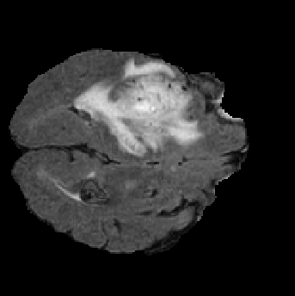

Slide 6
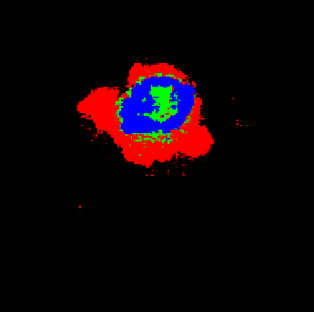

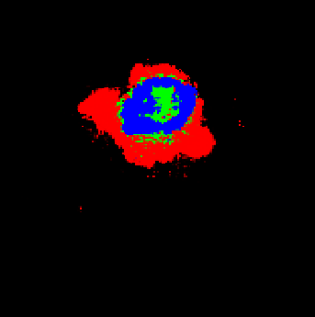

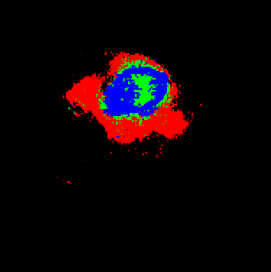
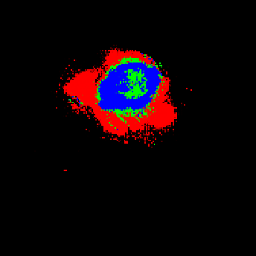
Keras no-one-hot + 2 classes
Keras no-one-hot + 4 classes
Keras one-hot + 4 classes
Tensorflow no-one-hot + 2 classes
Tensorflow no-one-hot + 4 classes
Tensorflow one-hot + 4 classes

Slide 7
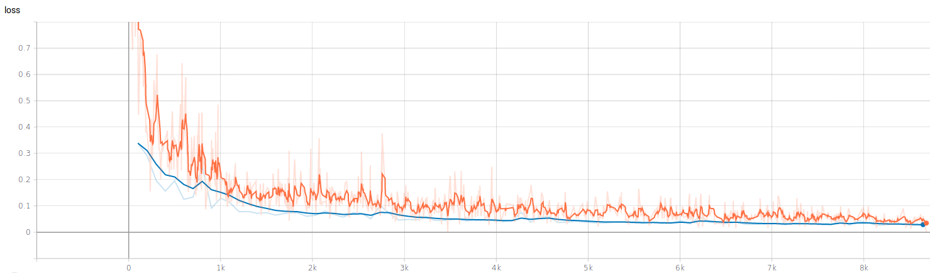
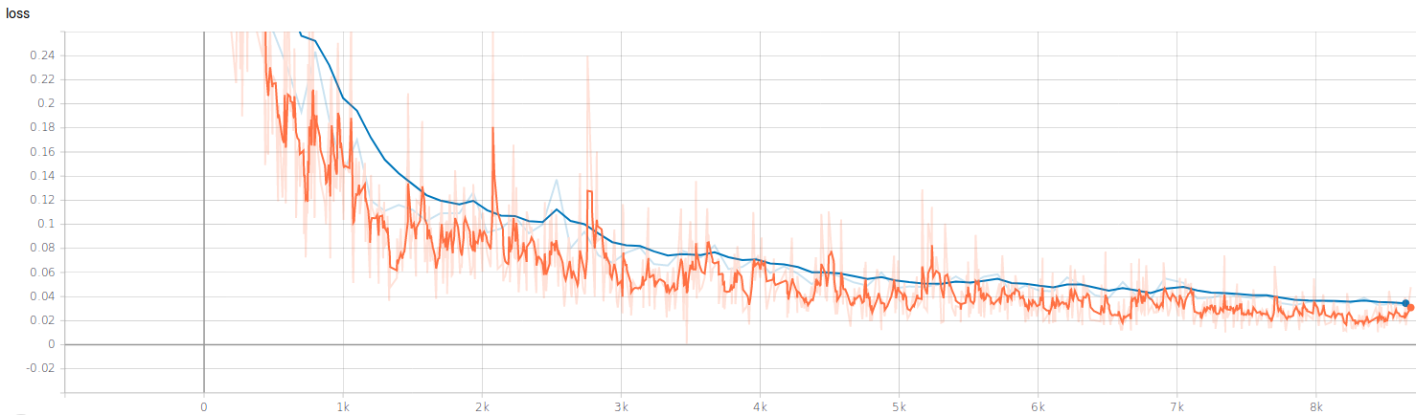
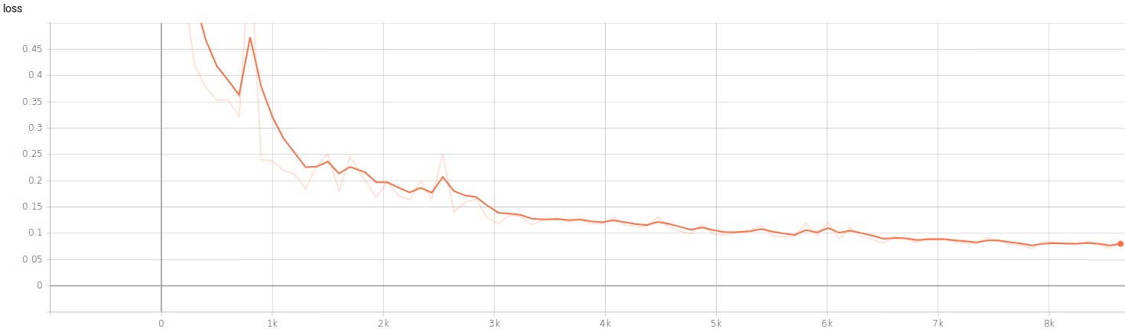
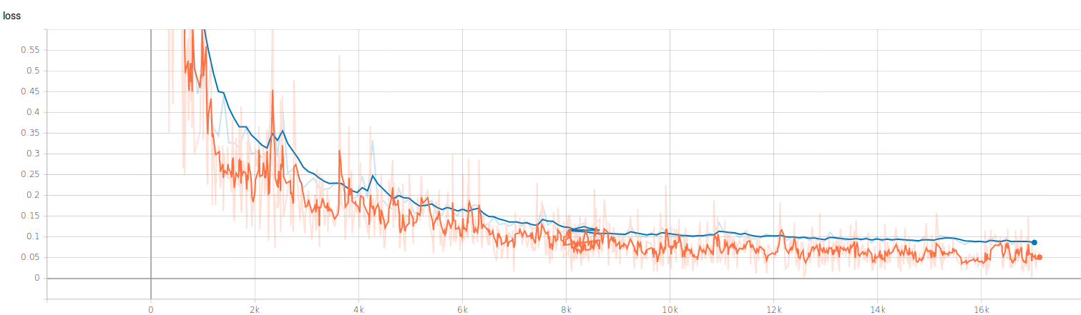
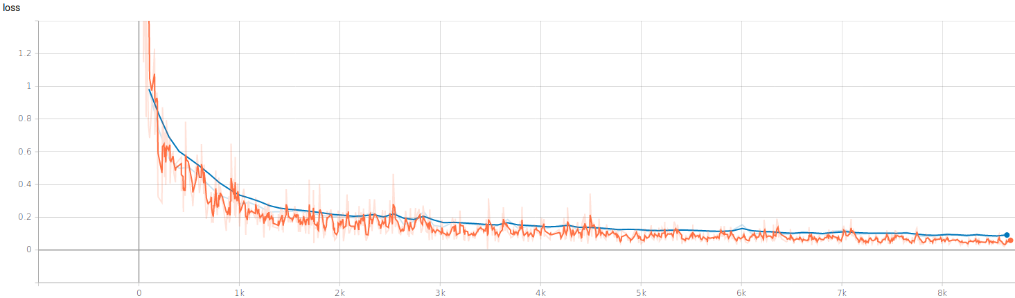
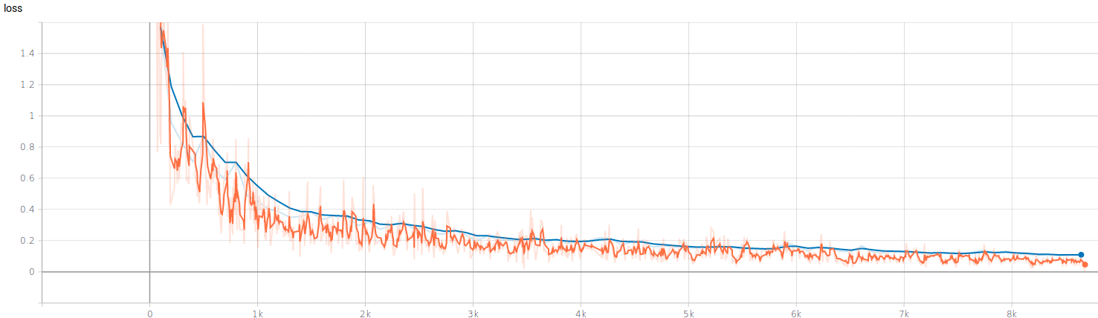
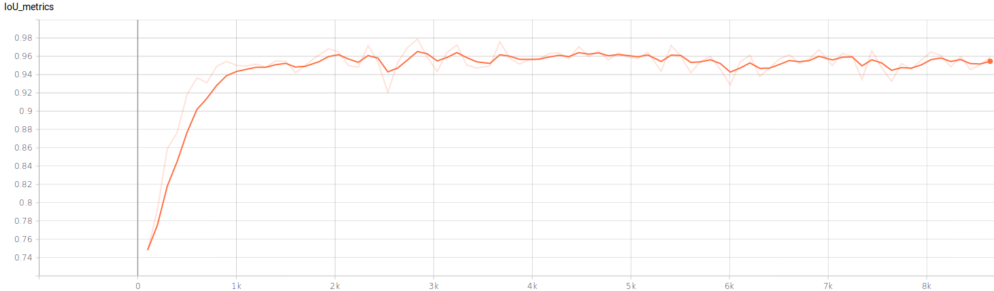
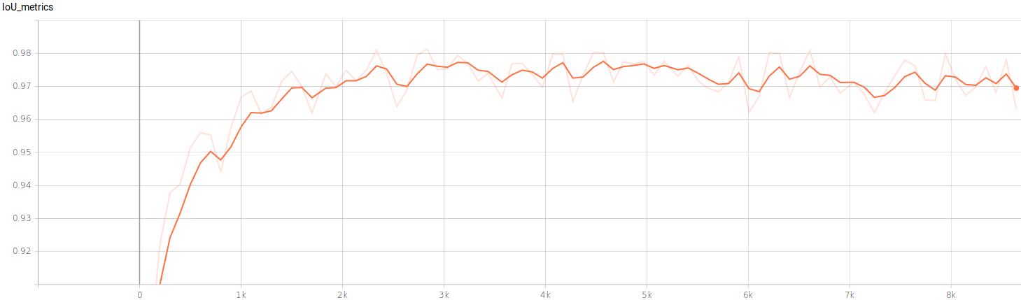
Keras
Tensorflow
No-one-hot 2 class
No-one-hot 2 class
No-one-hot 4 class
No-one-hot 4 class
One-hot 4 class
One-hot 4 class
IoU metric
IoU metric

