Slide 1
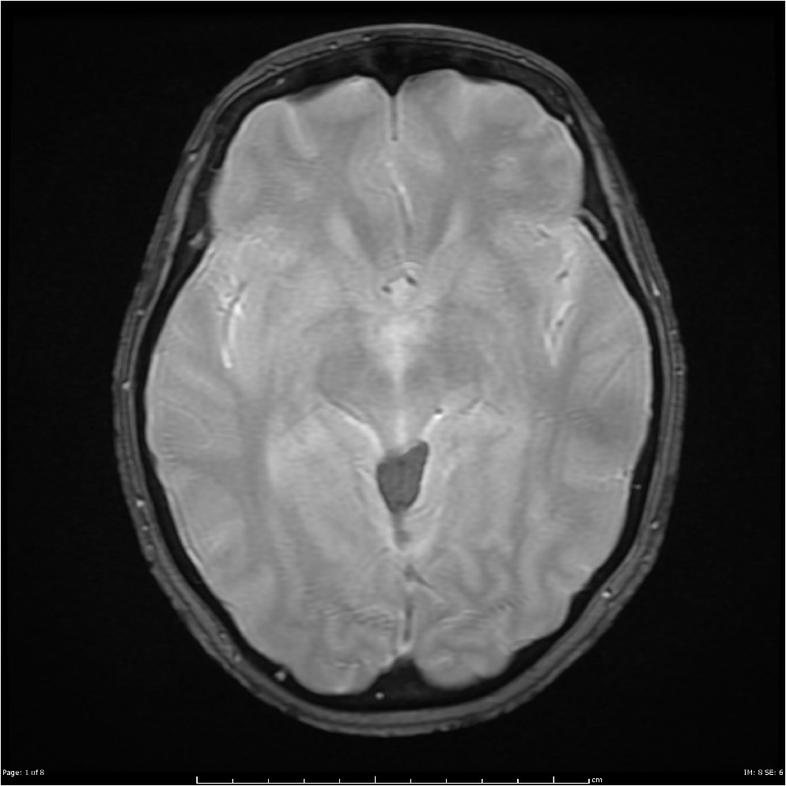
BrainScan’19
David García, Aitor Jara, Eduard Mainou and Núria Sánchez
Advisor: Santi Puch
Artificial Intelligence with Deep Learning
UPC School
July 2019

Slide 2
Contents
Setting the task
Preprocessing
Implementation
Dataset
Train.py
Test.py
Experiments
Demo
Q&A

Slide 3
Setting the task
GOAL: Segmentation of images displaying a brain with a tumour.

Slide 4
Setting the task
GOAL: Segmentation of images displaying a brain with a tumour.
DATASET: BRATS challenge
484 Training Patients & 266 Testing Patients
Information stored in a single patient: Four 3D images + One 3D image (ground truth)
Segmentation: Voxel-level classification in the set {0, 1, 2, 3}.

Slide 5
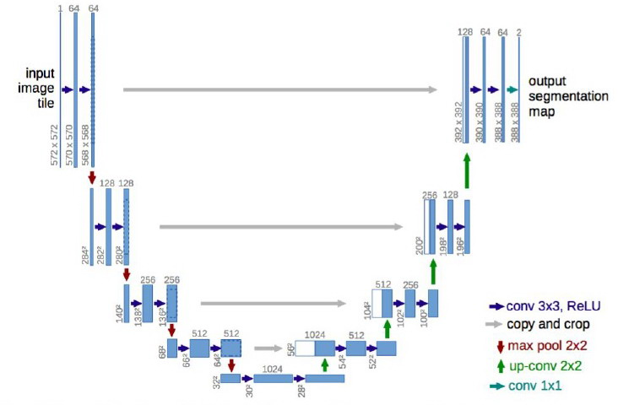
Setting the task
GOAL: Segmentation of images displaying a brain with a tumour.
DATASET: BRATS challenge
484 Training Patients & 266 Testing Patients
Information stored in a single patient: Four 3D images + One 3D image (ground truth)
Segmentation: Voxel-level classification in the set {0, 1, 2, 3}.
ARCHITECTURE: U-Net

Slide 6
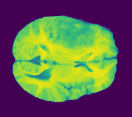
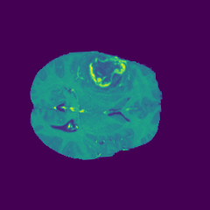
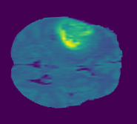
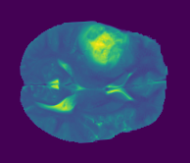
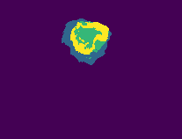
INPUT
Slice by slice comparison: blocks with 4 channels
Example: 4th Patient slices 77th

Slide 7
INPUT
Slice by slice comparison: blocks with 4 channels
Example: 4th Patient slices 77th
OUTPUT:
Four classes: {0, 1, 2, 3}
Binarizing the labels: non-tumour / tumour

Slide 8
Preprocessing
Trainig: 484 Volumes * 155 slices * (4 Images + label) = 375.100 Images
Test: 266 Volumes * 155 slices * 4 images = 164.920‬ Images
> 500.000 Images

Slide 9
Preprocessing
Trainig: 484 Volumes * 155 slices * (4 Images + label) = 375.100 Images
Test: 266 Volumes * 155 slices * 4 images = 164.920‬ Images
> 500.000 Images
Solution: TFRecords.
Is a simple format for storing a sequence of binary records.
You need specify the structure of your data before you write it to the file
Advantages:
1 file per patient. Total 484 + 266 = 750 files
Save memory
Faster Reading
TF Native
Multi-platform

Slide 10
Preprocessing
TFRecordWriter to write it to disk
writer = tf.python_io.TFRecordWriter(outputFile)
Example is a data structure for representing a record
example = tf.train.Example(features = tf.train.Features(feature = {
'image': _bytes_feature(frames.tostring()),
'label': _bytes_feature(label.tostring()),
'PatientID': _int64_feature(int(self.get_patient_id(inputFileVolume))),
'Slide': _int64_feature(i),
'height': _int64_feature(self.HEIGHT),
'width': _int64_feature(self.WIDTH),
'depth': _int64_feature(self.DEPTH),
}))
writer.write(example.SerializeToString())

Slide 11
Preprocessing
Preprocessing considerations:
Images are joined creating a 240x240x4 vector
20% of volumes for validation
Exclusion of empty images
50% images with tumor and 50% images without tumor
Added aditional information (PatientID, Slide No., height, width, depth )

Slide 12
Implementation
Dataset
TFRecordDataset
dataset = tf.data.TFRecordDataset(filenames=filenames)
map_func determine the structure of each element in the returned dataset.
dataset = dataset.map(_parse_function)
Data augmentation and options
Central crop
Optional Binarize
Optional One Hot
Other parameters
Perform shuffle
Batch size

Slide 13
Implementation
Train.py Trains the model
Main.py
Test.py Inference purposes
Notes:
So after we’ve got the dataset and the input pipeline created we diferenciate between inference and training to keep separet Tensorflow sessions since it is les problematic and more convenient.

Slide 14
Implementation
Train.py Trains the model
Main.py
Test.py Inference purposes
print("Are we testing or training? True for training, False for testing")
training = input('Enter your input:')
print(type(training))
if training == "True" :
train.main(args.trainingdir, args.model, args.num_epochs, args.size_batch_train, args.size_batch_valid, args.step_metrics, args.steps_saver, args.learning_rate, args.logdir, args.restore_weights,args.perform_one_hot,args.binarize_labels)
else:
test.main(args.trainingdir, args.model, args.num_epochs, args.size_batch_test, args.logdir, args.logdir_w, args.perform_one_hot, args.binarize_labels)
Notes:
So after we’ve got the dataset and the input pipeline created we diferenciate between inference and training to keep separet Tensorflow sessions since it is les problematic and more convenient.

Slide 15
Train.py
import tensorflow as tf
def unet(inputs, training=False,label_output_size=1):
“All layers”
conv10 = tf.keras.layers.Conv2D(label_output_size, 1)(conv9)
if label_output_size==1:
conv10_soft = tf.keras.activations.sigmoid(conv10)
else:
conv10_soft = tf.keras.activations.softmax(conv10)
return conv10, conv10_soft
Notes:
As explained before we have chosen the Unet architecture, doing so we have applied to keras said architecture in the resulting model.
Basically a function with all the layers and one extra argument to chose between a sigmoid final activiation or a softmax activitaion.
Just a lessons learned, basically since we are using Unet which has up level conections to the low level layers, we mainttain a lot of high level features, which made us not detect and error in which we were representing the output fo the model without the activation directly to the tensorboard.

Slide 16
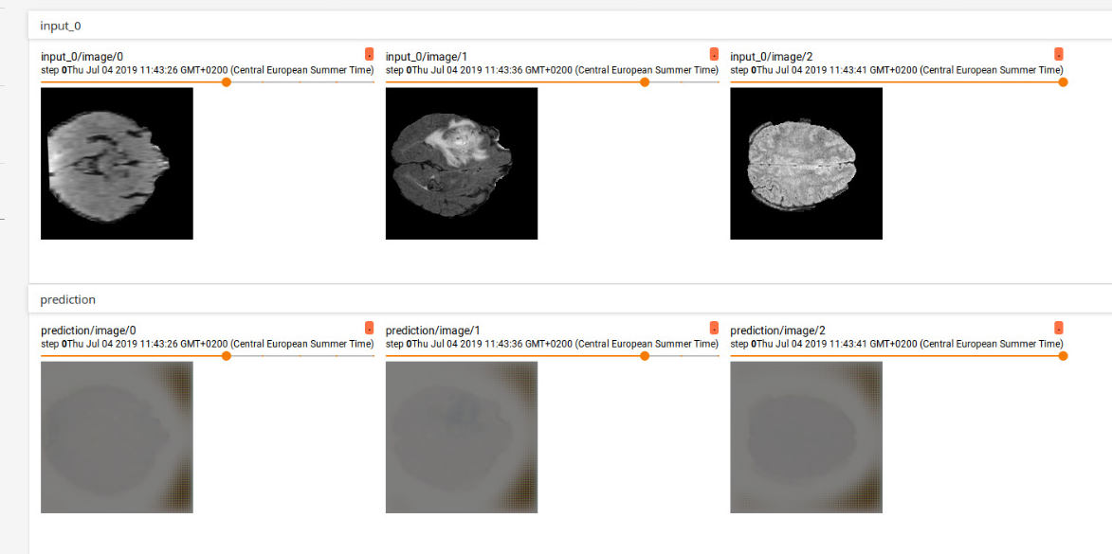
Train.py
Notes:
As explained before we have chosen the Unet architecture, doing so we have applied to keras said architecture in the resulting model.
Basically a function with all the layers and one extra argument to chose between a sigmoid final activiation or a softmax activitaion.
Just a lessons learned, basically since we are using Unet which has up level conections to the low level layers, we mainttain a lot of high level features, which made us not detect and error in which we were representing the output fo the model without the activation directly to the tensorboard.

Slide 17
Train.py
One Hot | BinaryLabels | Loss | Layer Input Size | Layer Output Size
True | True | softmax_cross_entropy | 2 | 2
True | False | softmax_cross_entropy | 4 | 4
False | True | softmax_cross_entropy | 1 | 1
False | False | sparse_softmax_cross_entropy | 1 | 4
Notes:
We use multiple losses depending on the parameters that we introduce on the dataset creation, it being one hot encoding or not, being binarized labels or not.
Only the ones with a input size more than 1, aKA not one hot ones, have metrics

Slide 18
Train.py
if label_input_size>1: #OneHotEncoding
loss_op= tf.reduce_mean(tf.losses.softmax_cross_entropy(onehot_labels=y, logits=logits))
else: #labelEncoding
if label_output_size==1:
loss_op=tf.reduce_mean(tf.losses.sigmoid_cross_entropy(multi_class_labels=y, logits=logits))
else:
loss_op= tf.reduce_mean(tf.losses.sparse_softmax_cross_entropy(labels=y, logits=logits))
if label_input_size>1: #OneHotEncoding
IoU_metrics, IoU_metrics_update = tf.metrics.mean_iou(labels=y, predictions=logits_soft, num_classes=label_input_size, name='my_metric_IoU')
running_vars = tf.get_collection(tf.GraphKeys.LOCAL_VARIABLES, scope="my_metric_IoU")
running_vars_initializer = tf.variables_initializer(var_list=running_vars)
Notes:
We use multiple losses depending on the parameters that we introduce on the dataset creation, it being one hot encoding or not, being binarized labels or not.

Slide 19
Train.py
handle = tf.placeholder(tf.string, shape = [])
iterator = tf.data.Iterator.from_string_handle(handle, train_dataset.output_types, train_dataset.output_shapes)
Notes:
The handle mechanism that very well explainen Issey to us.
Training placeholder per si estem entrenant o no i els diferents operands de metriques I loss corresponents.

Slide 20
Train.py
handle = tf.placeholder(tf.string, shape = [])
iterator = tf.data.Iterator.from_string_handle(handle, train_dataset.output_types, train_dataset.output_shapes)
train_handle = sess.run(train_iterator.string_handle())
validation_handle = sess.run(validation_iterator.string_handle())
Notes:
The handle mechanism that very well explainen Issey to us.
Training placeholder per si estem entrenant o no i els diferents operands de metriques I loss corresponents.

Slide 21
Train.py
handle = tf.placeholder(tf.string, shape = [])
iterator = tf.data.Iterator.from_string_handle(handle, train_dataset.output_types, train_dataset.output_shapes)
train_handle = sess.run(train_iterator.string_handle())
validation_handle = sess.run(validation_iterator.string_handle())
_,cost,summary_val,step_gl,logits_val,_ = sess.run([train_op,loss_op,summary_op,global_step,logits,logits_soft], feed_dict={handle: train_handle,training_placeholder: True})
cost_valid, _ = sess.run([loss_op, IoU_metrics_update], feed_dict={handle: validation_handle,training_placeholder: False})
Notes:
The handle mechanism that very well explainen Issey to us.
Training placeholder per si estem entrenant o no i els diferents operands de metriques I loss corresponents.

Slide 22
Test.py
test_dataset = create_dataset(filenames=test_list,mode="testing", num_epochs=1, batch_size=size_batch_test,perform_one_hot=perform_one_hot,binarize_labels=binarize_labels)
test_iterator = test_dataset.make_initializable_iterator()
Notes:
Training placeholder per si estem entrenant o no i els diferents operands de metriques I loss corresponents.

Slide 23
Test.py
test_dataset = create_dataset(filenames=test_list,mode="testing", num_epochs=1, batch_size=size_batch_test,perform_one_hot=perform_one_hot,binarize_labels=binarize_labels)
test_iterator = test_dataset.make_initializable_iterator()
handle = tf.placeholder(tf.string, shape = [])
iterator = tf.data.Iterator.from_string_handle(handle, test_dataset.output_types, test_dataset.output_shapes)
x, _ = iterator.get_next()
Notes:
Training placeholder per si estem entrenant o no i els diferents operands de metriques I loss corresponents.

Slide 24
Test.py
test_dataset = create_dataset(filenames=test_list,mode="testing", num_epochs=1, batch_size=size_batch_test,perform_one_hot=perform_one_hot,binarize_labels=binarize_labels)
test_iterator = test_dataset.make_initializable_iterator()
handle = tf.placeholder(tf.string, shape = [])
iterator = tf.data.Iterator.from_string_handle(handle, test_dataset.output_types, test_dataset.output_shapes)
x, _ = iterator.get_next()
saver.restore(sess, tf.train.latest_checkpoint(logdir))
test_handle = sess.run(test_iterator.string_handle())
sess.run(test_iterator.initializer)
Notes:
Training placeholder per si estem entrenant o no i els diferents operands de metriques I loss corresponents.

Slide 25
Test.py
try:
while True:
summary_val,logits_test = sess.run([summary_test,logits_soft],feed_dict={handle: test_handle, training_placeholder:False})
writer.add_summary(summary_val)
except tf.errors.OutOfRangeError:
pass
Notes:
As explained before we have chosen the Unet architecture, doing so we have applied to keras said architecture in the resulting model.
Basically a function with all the layers and one extra argument to chose between a sigmoid final activiation or a softmax activitaion.
Just a lessons learned, basically since we are using Unet which has up level conections to the low level layers, we mainttain a lot of high level features, which made us not detect and error in which we were representing the output fo the model without the activation directly to the tensorboard.

Slide 26
Experiments
Diferent ways of computing the loss based on different approaches:
Shape of X (Input) = [25, 192, 192, 4] → [Batch, Height, Width, Channels]
Shape of Y (Label) = [25, 192, 192, 1] → 25 images of 192 *192 with pix.values {0,1,2,3}
Shape of A (Pred) = [25,192,192,4] →
0.1 0.2 …. n x m (192 * 192 x 25)
0.2 0.6 ………………………..
0.0 0.1 ………………………..
0.7 0.1 ………………………..
1 1
All the pixels from the same 25 images flatten out with the probability of belonging to each class
PROBLEM?
FORGOT TO APPLY SOFTMAX, PREDICTIONS ARE BAD
Softmax for 4 clases at pixel level

Slide 27
Experiments
Diferent ways of computing the loss based on different approaches:
Shape of X (Input) = [25, 192, 192, 4] → [Batch, Height, Width, Channels]
Shape of Y (Label) = [25, 192, 192, 1] → 25 images of 192 *192 with pix.values {0,1,2,3}
Shape of A (Pred) = [25,192,192,1] →
0.8 0.2 0.1 …. n x m (192 * 192 x 25)
25 images flatten out in a neurone with the probability of belonging to the first class and 1-P of belonging to the second class
SOLUTION
Sigmoid for 2 classes at pixel level
SIMPLIFY PROBLEM BY BINARIZING THE PREDICTIONS: TUMOUR/NON-TUMOUR

Slide 28
Experiments
Diferent ways of computing the loss based on different approaches:
Shape of Y (Label) = [25, 192, 192, 1] → 1 channel represents 4 classes
1 3 2 0 2 …. n x m (192 * 192 x 25)
PROBLEM?
CAN’T USE IoU METRICS, ONLY LEARNING CURVES TO DIAGNOSE

Slide 29
Experiments
Diferent ways of computing the loss based on different approaches:
Shape of Y (Label) = [25, 192, 192, 4] →
one-hot matrix
0 0 0 1 0 …. n x m (192 * 192 x 25)
1 0 0 0 0 …. n x m (192 * 192 x 25)
0 0 1 0 1 …. n x m (192 * 192 x 25)
0 1 0 0 0 …. n x m (192 * 192 x 25)
SOLUTION
CONVERT TO ONE-HOT ENCODING

Slide 30
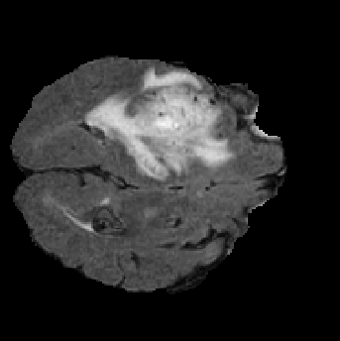

Slide 31
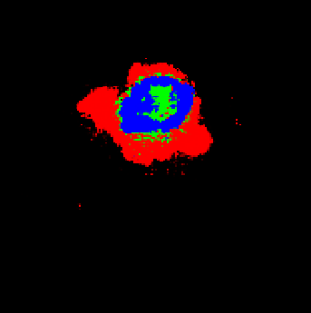
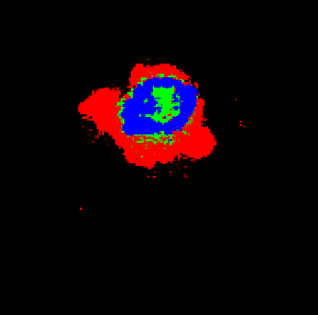

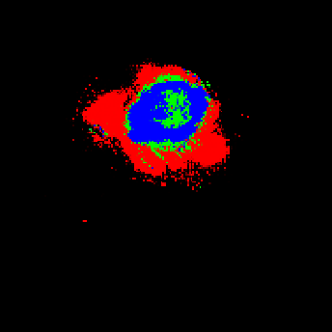

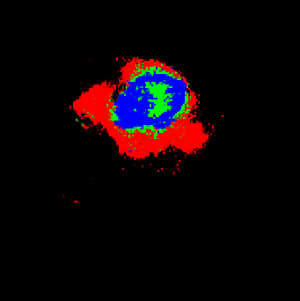
Keras no-one-hot + 2 classes
Keras no-one-hot + 4 classes
Keras one-hot + 4 classes
Tensorflow no-one-hot + 2 classes
Tensorflow no-one-hot + 4 classes
Tensorflow one-hot + 4 classes

Slide 32

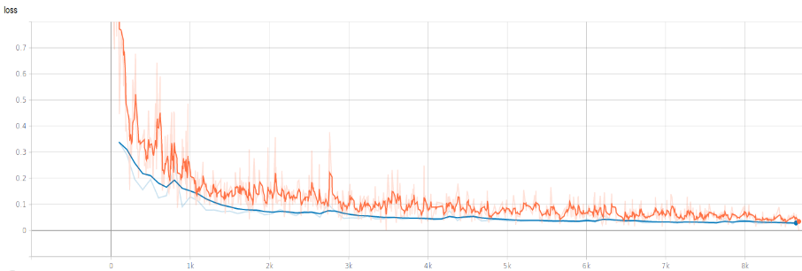

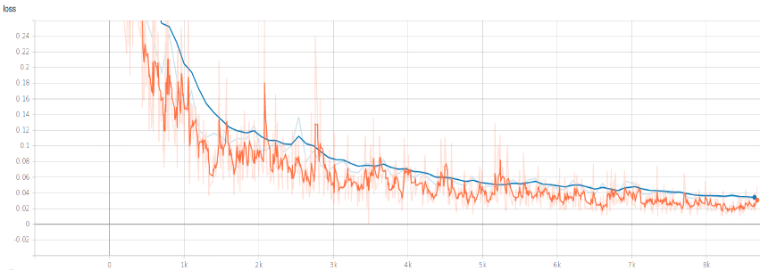
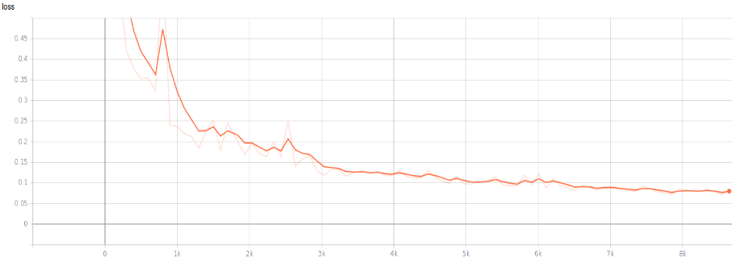
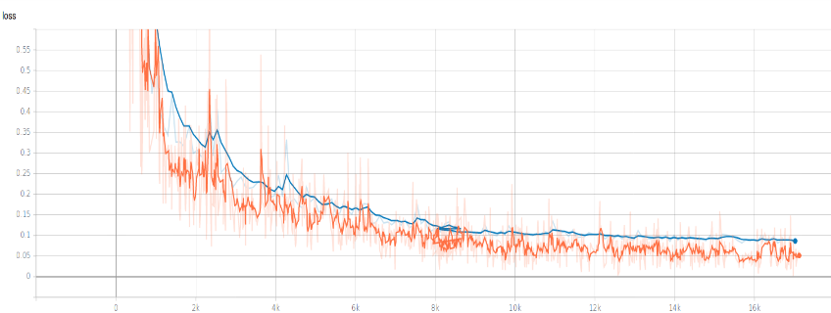
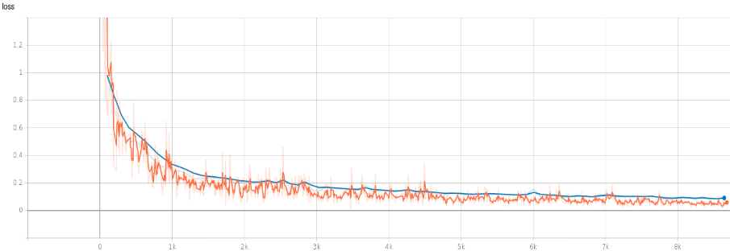
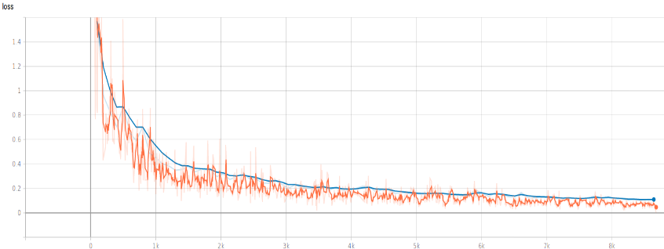
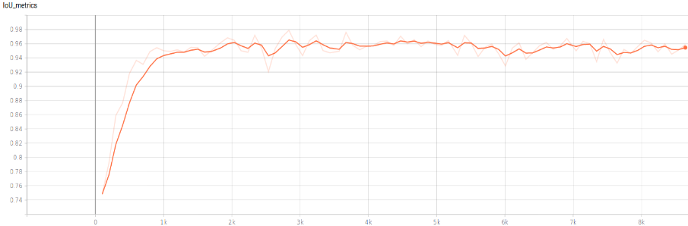
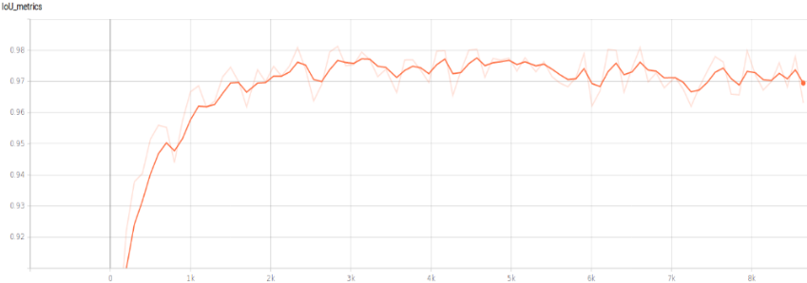
Keras
Tensorflow
No-one-hot 2 class
No-one-hot 2 class
No-one-hot 4 class
No-one-hot 4 class
One-hot 4 class
One-hot 4 class
IoU metric
IoU metric

Slide 33
Q&A
¿?

