Slide 1
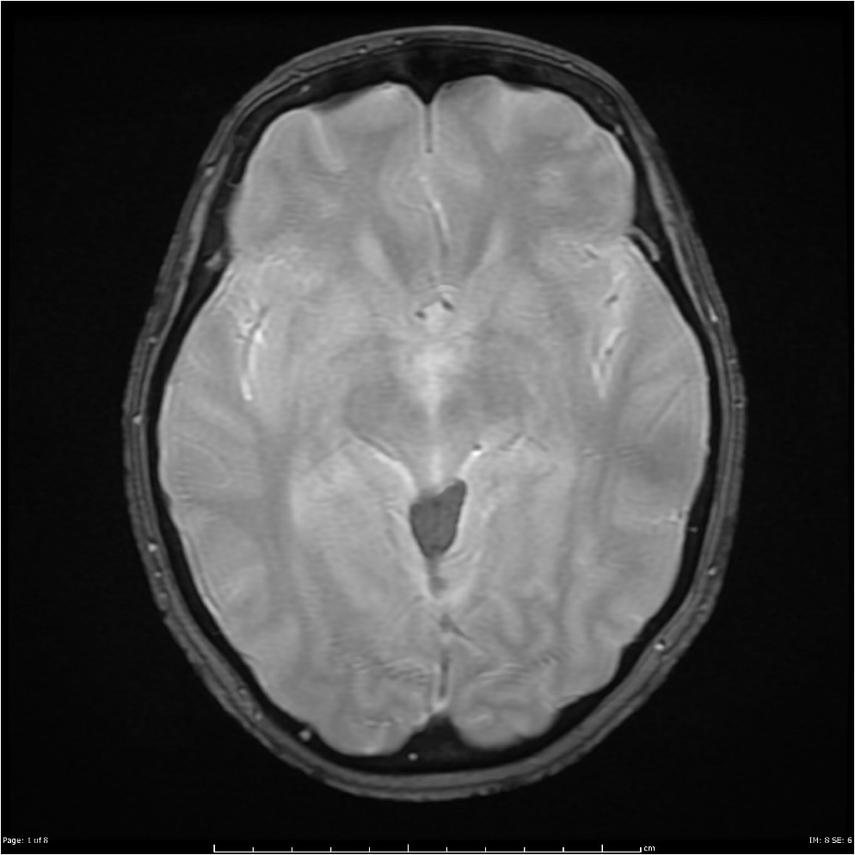
BrainScan’19
David García, Aitor Jara, Eduard Mainou and Núria Sánchez
Advisor: Santi Puch
Artificial Intelligence with Deep Learning
UPC School
July 2019

Slide 2
Contents
Setting the task
Implementation
Dataset
Code structure
Issues
Demo

Slide 3
SETTING THE TASK
GOAL: Segmentation of images displaying a brain with a tumour.

Slide 4
SETTING THE TASK
GOAL: Segmentation of images displaying a brain with a tumour.
DATASET: BRATS challenge
484 Training Patients & 266 Testing Patients
Information stored in a single patient: Four 3D images + One 3D image (ground truth)
Segmentation: Voxel-level classification in the set {0, 1, 2, 3}.

Slide 5
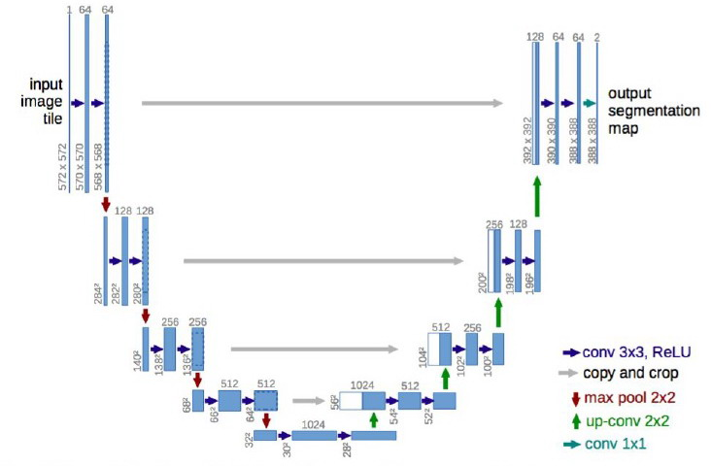
SETTING THE TASK
GOAL: Segmentation of images displaying a brain with a tumour.
DATASET: BRATS challenge
484 Training Patients & 266 Testing Patients
Information stored in a single patient: Four 3D images + One 3D image (ground truth)
Segmentation: Voxel-level classification in the set {0, 1, 2, 3}.
ARCHITECTURE: U-Net

Slide 6
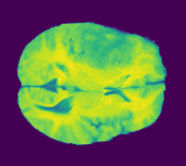
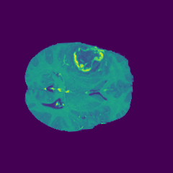
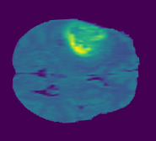
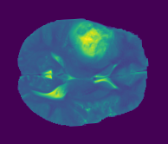
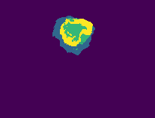
INPUT
Slice by slice comparison: blocks with 4 channels
Example: 4th Patient slices 77th

Slide 7
INPUT
Slice by slice comparison: blocks with 4 channels
Example: 4th Patient slices 77th
OUTPUT:
Four classes: {0, 1, 2, 3}
Binarizing the labels: non-tumour / tumour

