Slide 1
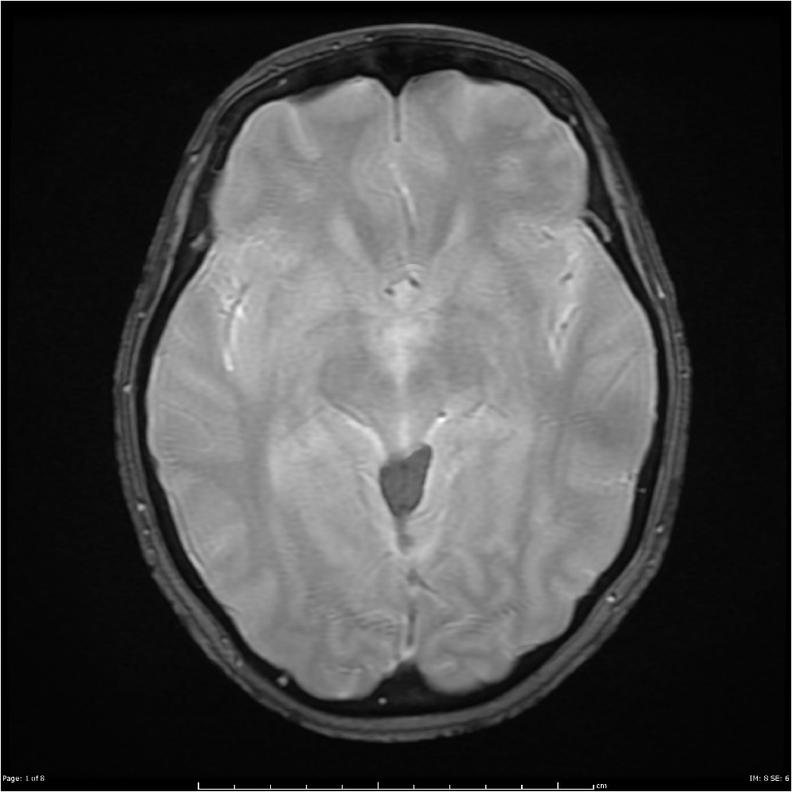
BrainScan’19
David García, Aitor Jara, Eduard Mainou and Núria Sánchez
Advisor: Santi Puch
Artificial Intelligence with Deep Learning
UPC School
July 2019

Slide 2
Contents
Motivation
Description
Database
Model
Implementation
Dataset
Code structure
Issues
Demo

Slide 3
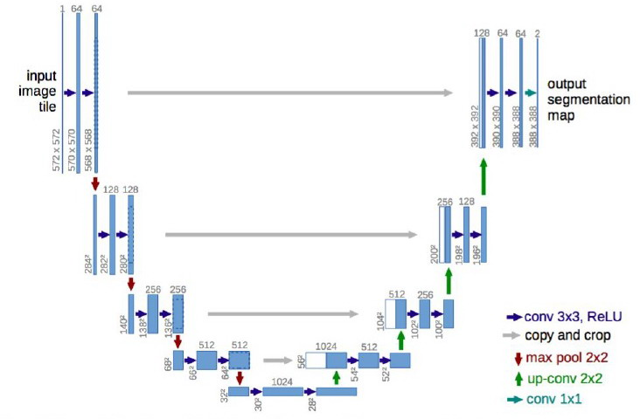
SETTING THE TASK
GOAL: Segmentation of images displaying a brain with a tumour.
DATASET: BRATS challenge
484 Training Patients & 266 Testing Patients
Information stored in a single patient: Four 3D images + One 3D image (ground truth)
Segmentation: Voxel-level classification in the set {0, 1, 2, 3}.
ARCHITECTURE: U-Net

Slide 4
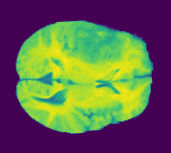
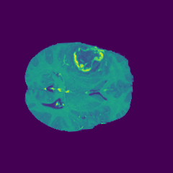
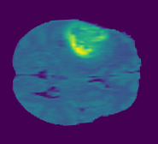
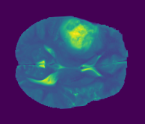
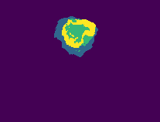
INPUT
Slice by slice comparison: blocks with 4 channels
Example: 4th Patient slices 77th
OUTPUT:
Four classes: {0, 1, 2, 3}
Binarizing the labels: non-tumour / tumour

Slide 5
Preprocessing
Basically how we used and created the dataset using the database
LITTLE ISSUES,. INT64 QUE OCUPA LA DE DIOS
50/50
Treure els negres
DAVID

Slide 6
Implementation
How we implemented the model (dataset lin47….)
Crop
DAVID

Slide 7
Implementation
Model, train and test
Edward

Slide 8
Implementation
Model, train and test
Logits and logits soft issue.
Issue of dimensions with xxhixhiahu binary represaentation.
Edward

Slide 9
Experiments
List and brief explanation of all the experiments we have done.
Photos
AITOR

Slide 10
DEMO
Test
Binari
RGB

Slide 11
Q&A

