Slide 1
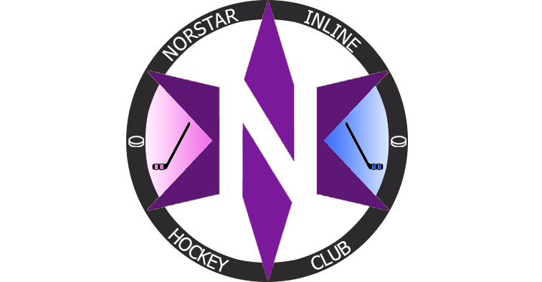
Club Development Plan 2026 / 27 Season
Coaching Structure and Ethos

Slide 2
Our Ethos
Norstar Inline Hockey Club
At Norstar Inline Hockey Club, our priority is the long-term development of every player in a positive, inclusive and enjoyable environment.
Guided by these principles we focus on age-appropriate skill acquisition, individual growth, and a lifelong love of the game.
Success is measured not only by results, but by the development of confident, skilled and respectful athletes who are encouraged to reach their full potential both on and off the rink.
Development of all our players rather than a focus on the select few. Creating depth and scope for future success.

Slide 3
Our Focus
What we prioritise, every session
Player development before results
Age-appropriate training and competition
Building strong fundamental skills
Encouraging teamwork, respect and sportsmanship
Creating a fun, safe and inclusive environment
Supporting each player’s long-term growth and enjoyment of hockey

Slide 4
U14 Academy Vision
Our ambitions for the season ahead
Defend our title as reigning champions
Finish in the top four to secure a playoff spot
Improve collectively as a group in all aspects of the game
Raise standards in skating, puck skills and game sense
Compete with discipline, resilience and respect
Develop every player so the squad grows stronger together

Slide 5
U12 Vision
Our ambitions for the season ahead
Strive to reach the playoffs as a team
Improvement first, results second
Build strong foundational skills in every player
Healthy, positive competition for selection
Opportunities for everyone to be their best self
Enjoy the game and grow together as a group

Slide 6
One Club, One Vision
How our U12 and U14 pathways connect
A shared pathway from U12 foundations to U14 performance
Development first at every age, results follow
Consistent coaching standards across both squads
Healthy competition that raises the whole group
Player Behaviours that translate into everyday habits
Every player supported to be their best version of them

Slide 7
How We Train
Our training model.
Station-based practices
Small groups, short rotations, high repetition – everyone moving, no long queues
Cross-hall and half-hall play
Age-appropriate space for younger players: more touches, battles and confidence
Small-area games
Game-like decision making, creativity and puck skills under pressure
Core skill blocks
Skating, puck control, passing and shooting built into every session. Goalkeeper skills and fundamentals.
Train more, play smart
A practice-weighted weekly balance rather than a games-first schedule
Long-term development
Age-stage goals, seasonal progression and multi-sport encouragement

Slide 8
Core Skills
The fundamentals we build in every age group.
Skating
Efficient stride, changing direction, balance, agility and speed – the foundations every other skill is built on
Puck Control
Close stickhandling, protection and confidence carrying the puck under pressure
Passing & Receiving
Accurate passes, soft hands and moving the puck quickly in tight space
Shooting
Shot variety, accuracy and quick release from a range of angles
Hockey Sense
Reading play, support, positioning and smart decisions with and without the puck
Compete & Confidence
Battle skills, resilience and the courage to try, fail and improve

Slide 9
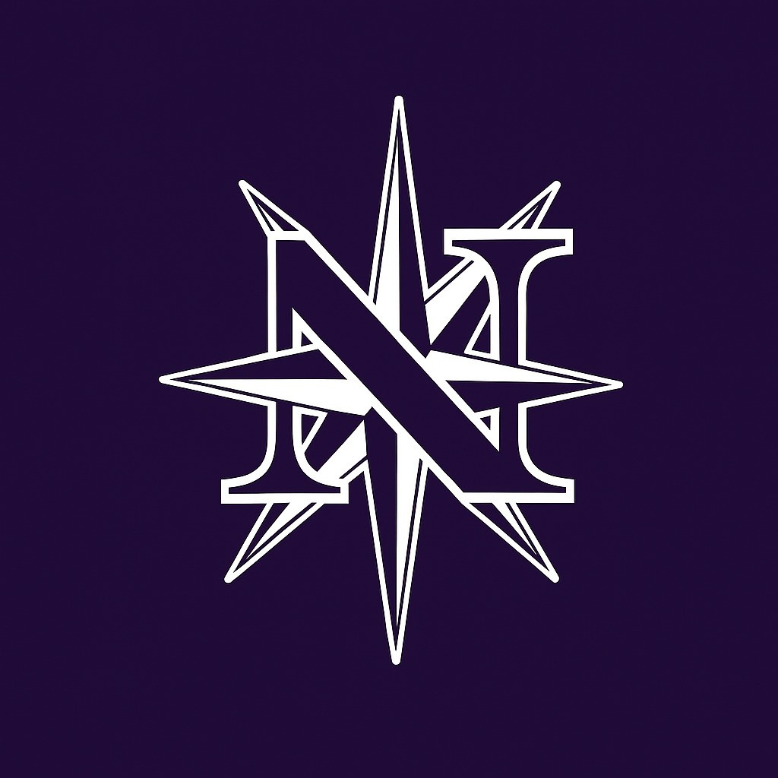
Club Chairman
Club Coaching Co-Ordinator – Scott Muir
U12 Norstar
U14 Norstar Academy
Head Coach – Ivan Troy
Coaches –
David
Jonny
Andrew
Scott
Club Support Staff
Club Secretary – Wendy Muir
Child Protection Staff –
Caroline Morrison
Shauna Browne
Head Coach – Jozef Fotta
Coaches-
Scott
Stephen
Ciaran
Alex
Team Manager 2
Jamie Corsby
Team Manager 1
Renata Kazulek
Team Manager 2
Karen Dickey
Team Manager 1
Louise Glenholmes

