Slide 1



Team Cape Town
JAVA QUIZ GAME
PRESENTATION

Slide 2

Hard times came,
the test is near and no one knows anything about Java ... Sadness did not end…
And then Cape Town came and things changed….
They create Java Quiz and saved the galaxy Soft & Uni way ...
They brought a ray of hope and students become wiser ...

Slide 3




Our team:
Ivan Ivanov
Gergan Gospodinov
Diman Stamatov
Bilyana Tsenkova

Slide 4
We wanted:
To create original and funny game
Every one of the team to take place in the project and write a lot of quality code
Show you the best presentation you have ever seen…..
But instead of that we made Java Quiz game. One part of the team still don’t know what the f**k is class in Java?!?!

Slide 5
Responsibilities:
Ivan – I/O classes, Question/Question Catalog class, Controllers, UI
Gergan – Player class, Player Catalog Class and Rank list class
Diman – I/O classes
Bilyana – Questions /Question Catalog, presentation of the game

Slide 6
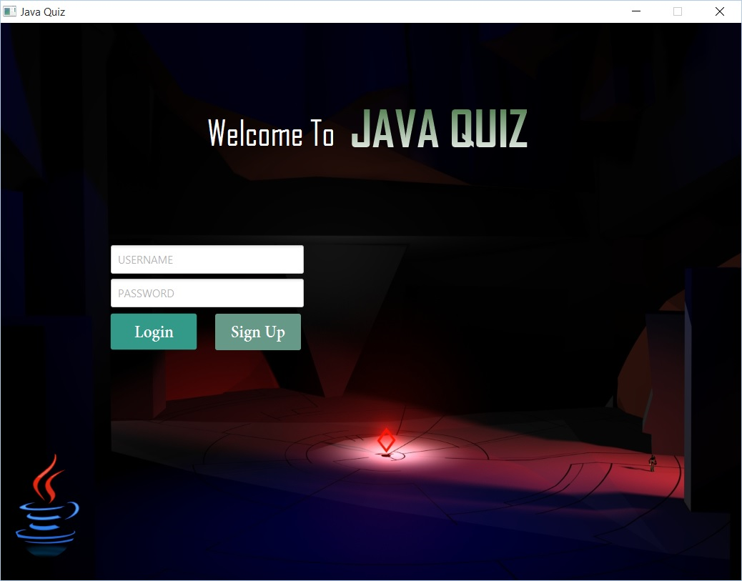

Slide 7
About the way we made game…
JAVA QUIZ GAME is made with JavaFX. JavaFX is a set of graphics and media packages that enables us to:
Design
Create
Debug the game and finally start it.
JavaFX is a software platform for creating and delivering desktop applications, as well as rich internet applications (RIAs) that can run across a wide variety of devices.
JavaFX has support for desktop computers, smartphones, web browsers on Microsoft Windows, Linux, and Mac OS X.

Slide 8
What is Java Quiz Game?
Java Quiz game allows you to play in two different varieties:
Single game – you can play the game and test your knowledge about Java. You win points for every correct answer but you do not participate at the final rating of players.
2. Challenge :
You can select type of the quiz and you will answer questions in this area.
For every correct answer you receive points
You can see the list of winners with there scores
Finally you can add new questions in the quiz – only for users with max scores

Slide 9
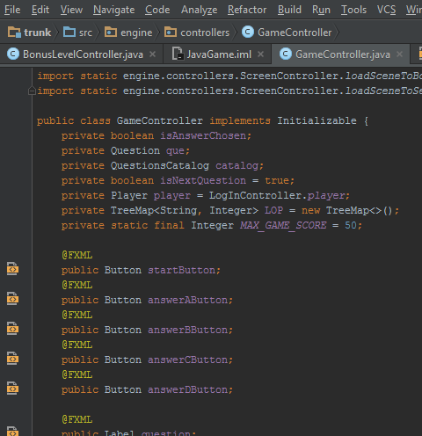
Details about the game
Java Quiz game exists thanks to the classes which manage the game. Here are one of them:
Game Controller class - this class stores very import code about:
Creating buttons and labels for questions and answers
Buttons layout and effects
Windows layout and appearance
Setting images /backgrounds/ and font style
Others

Slide 10
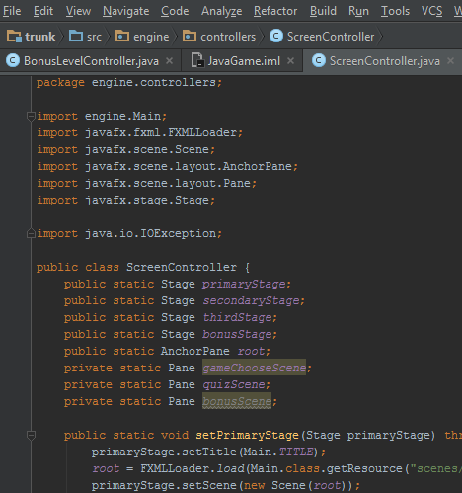
Details about the game
Java Quiz game exists thanks to the classes which manage the game. Here are one of them:
Screen Controller class – this class holds code for:
Loading different primary stages
Setting titles, size and scenes for each window
Others

Slide 11
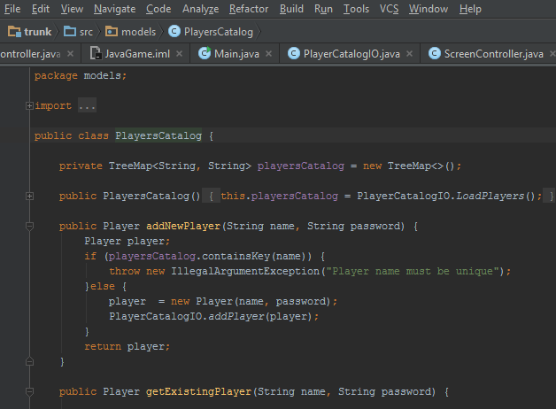
Details about the game
Java Quiz game exists thanks to the classes which manage the game. Here are one of them:
Player and Players Catalog – These classes stores the hole information about the players in the game:
Usernames – adding new user for new player or getting data for existing one
Passwords – set passwords for new players and check for correctness of existing one
Validation of the data when user is trying to log in the game
Scores and others…

Slide 12
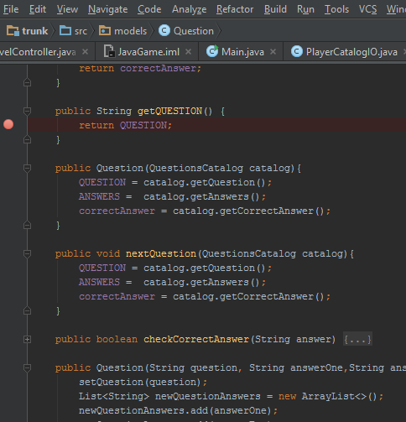
Details about the game
Java Quiz game exists thanks to the classes which manage the game. Here are one of them:
Questions Catalog and Questions –
theses classes stores the code about:
Getting and setting answers
Getting and setting questions for the quiz
Check for correct answer
Adding new questions, possible answers and correct answer in the list of questions

Slide 13
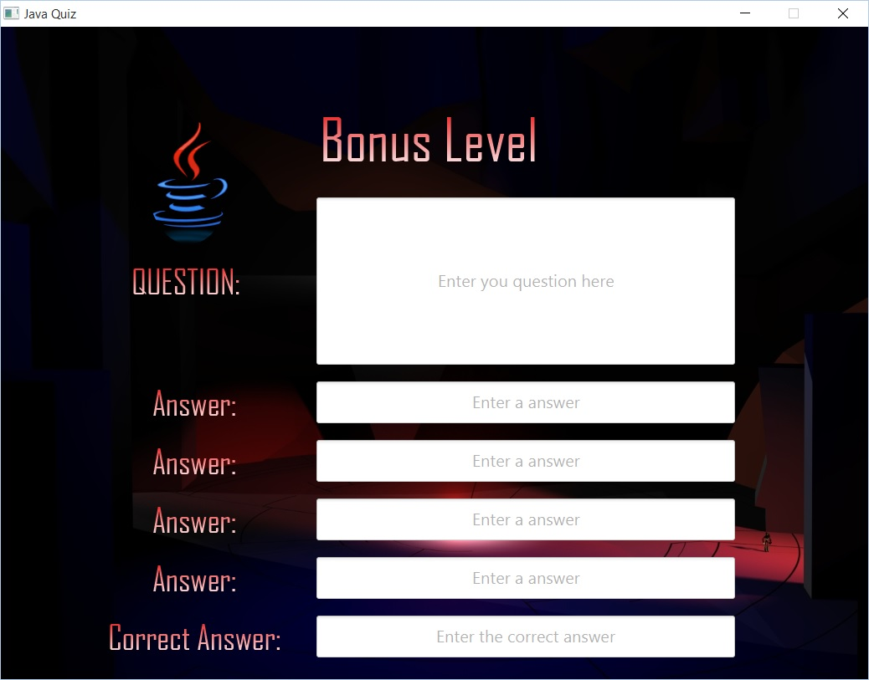
LIVE DEMO

Slide 14
KEEP
CALM
AND
STUDY
HARD

Slide 15
Thanks for listen
and watching!!!

