Slide 1
A4BP - Introduction
Assessment for Business Process

Slide 2
Agenda
Goals ( The problem and the opportunity).
Challengers
Demo

Slide 3
The problem
Identifying the main concerns associated with the development of Business processes in enterprise architecture environments

Slide 4

Problem 1: Lack of complexity metrics.
Problem 2: Estimation unassertive.
Problem 3: Verification and Validation insufficient quality question ?.
Problem 4: Limited for troubleshooting display.
Understanding BPEL, BPMN code
Debugging code
Maintenance over time
Verification and Validation (Software - Testing)

Slide 5
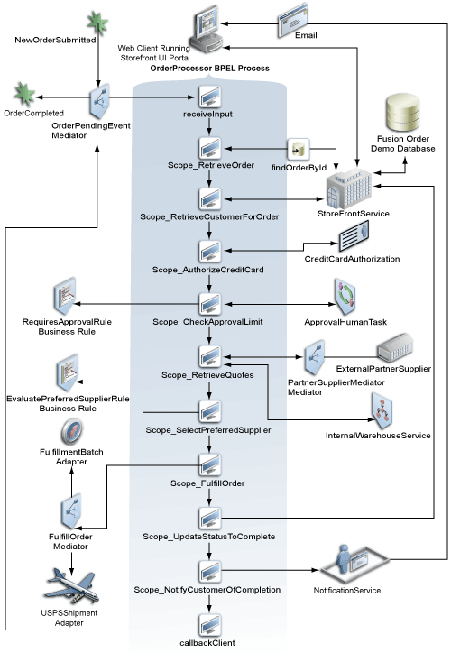
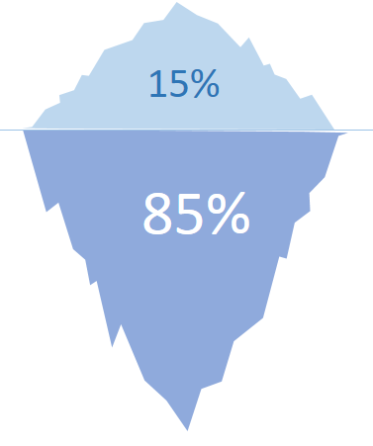
Process complexity
PERSPECTIVES OF PROCESS COMPLEXITY
Control Flow Complexity ( CFC)
Data-Flow Complexity ( DFC )
Resource Complexity ( RC )
Activity Complexity ( AC )
Exits more Deep analysis to discover
Example in dynamics analysis

Slide 6
No functionality qualities in assessment process IBM ( visión)
Type attribute | type attribute
Accessibility | Installation
Auditing and Control | Interoperability
Availability | Load volume
Compatibility | Maintainability
Documentation | Performance
Reliability | Scalability
Security | Usability
Notes:
Indicar la aproximación a las preocupaciones de la arquitectura en función de los procesos que transcurren

Slide 7
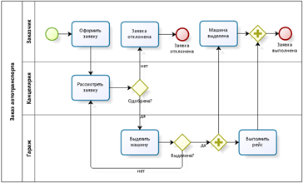
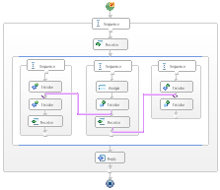

Boundaries
static
dynamic
Metamodel
Code – Model
Metrics
Complexity flow
Relations
Execution
Ontime
Process Logs
Simulations

Slide 8
Solution strategy

Slide 9
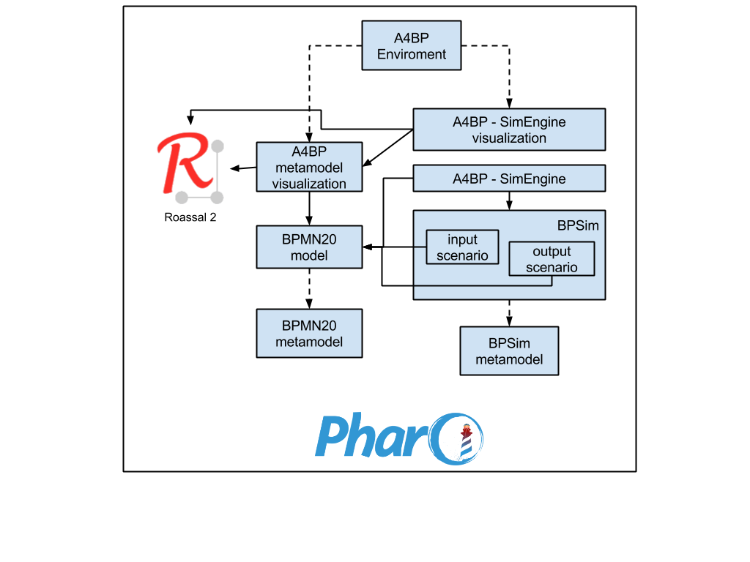
Logic Architecture view

Slide 10
KeyWords
Exploration ( EXPLORACIÓN)
Visualization (VISUALIZACIÓN)
Indicators-KPI (INDICADORES)
Complexity (COMPLEGIDAD)
Bussines conceptualization ( COMPRENSION DEL NEGOCIO)
Quality (CALIDAD)
La visión de la solución debe responder a etas palabras claves

Slide 11
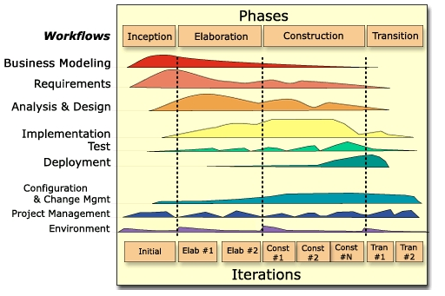
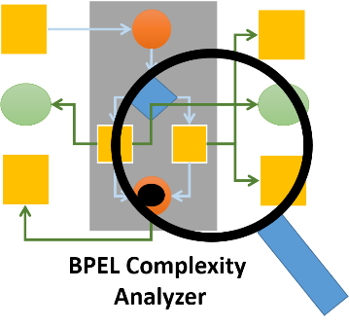

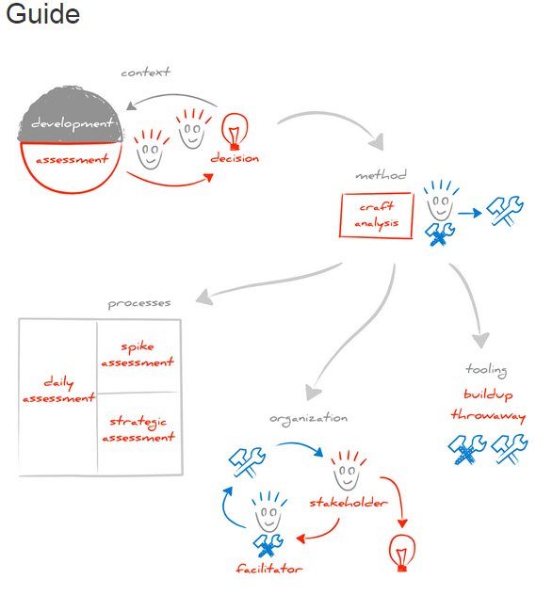
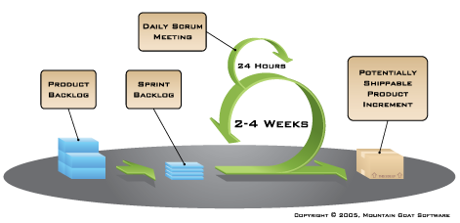
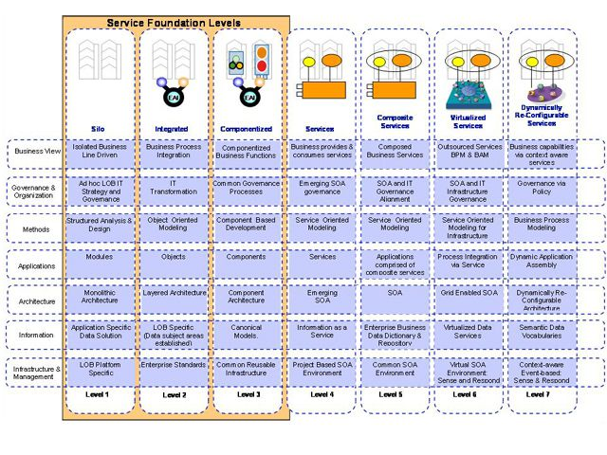
Como adoptar un proceso de “assessment”
Reference strategy
Introduciendo actividades dentro del proceso

Slide 12
Disciplinas involucradas
Development
Desing and Analisis
Quality

Slide 13
Examples

Slide 14
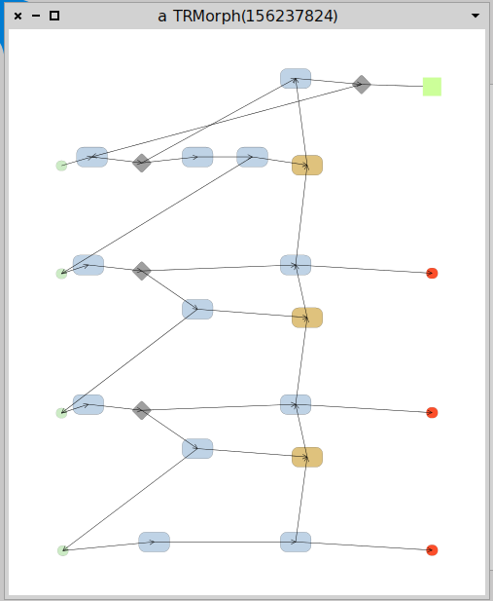
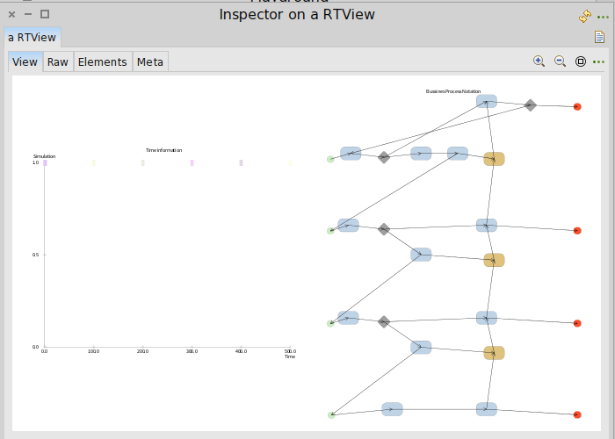

Slide 15
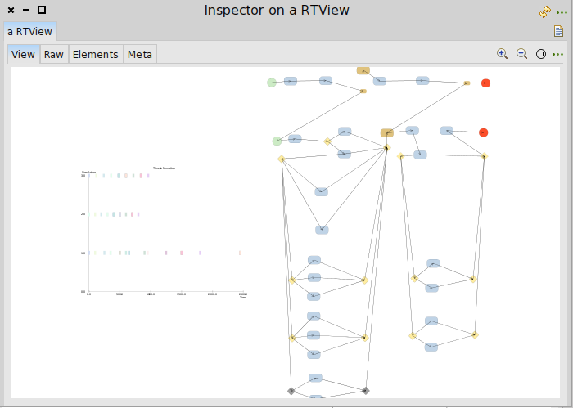
Tsunami simulator engine process

Slide 16
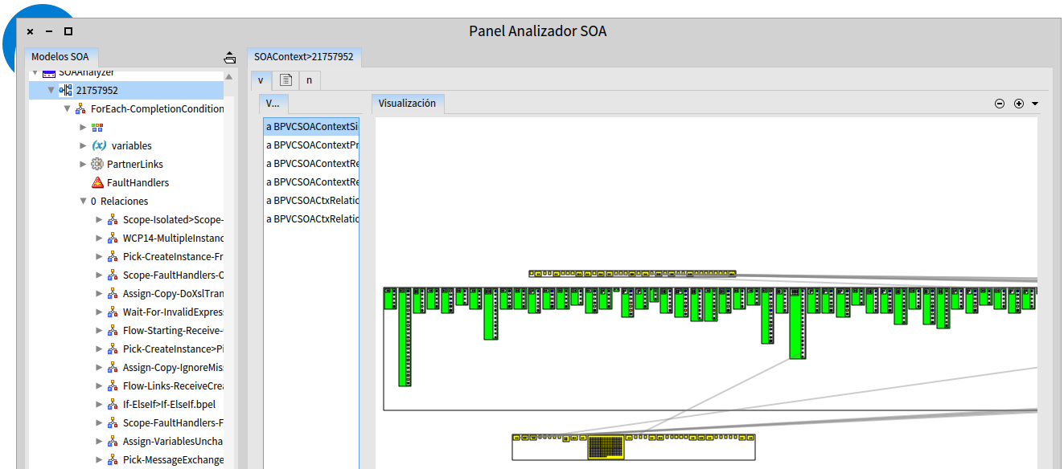

Slide 17
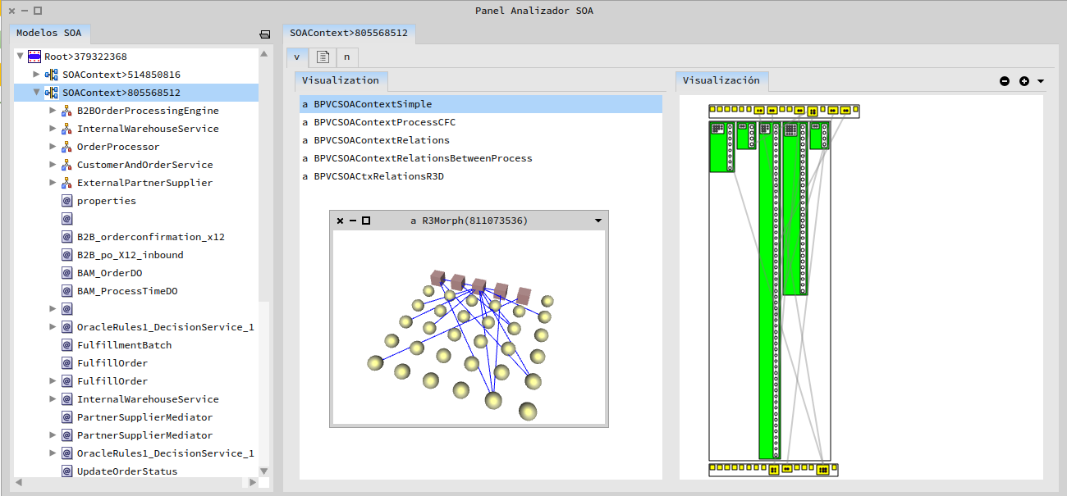
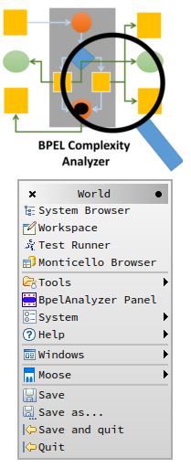
Panel de visualización
Podemos navegar y explorer cada elemento de trabajo dentro del codigo bpel, detallado sus relaciónes y complejidades

Slide 18
Available in smalltalkhub
Gofer new smalltalkhubUser: 'ajperalt' project: 'A4BP'; package: 'ConfigurationOfA4BP'; load.
(Smalltalk at: #ConfigurationOfA4BP) loadDevelopment.
To be use, you need to download www.moosetechnology.org pharo image.

