Slide 1
DEMO VIDEO
BPEL Complexity
Analyzer

Slide 2
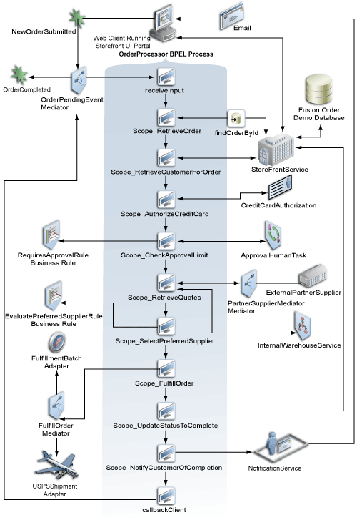
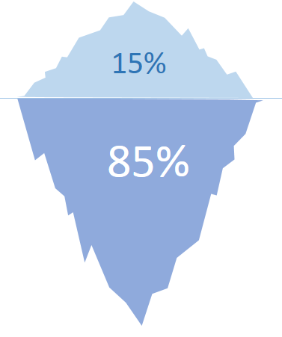
About of BPEL Complexity
PERSPECTIVES OF PROCESS COMPLEXITY
Control Flow Complexity ( CFC)
Data-Flow Complexity ( DFC )
Resource Complexity ( RC )
Activity Complexity ( AC )
Exits more Deep analysis to discover

Slide 3
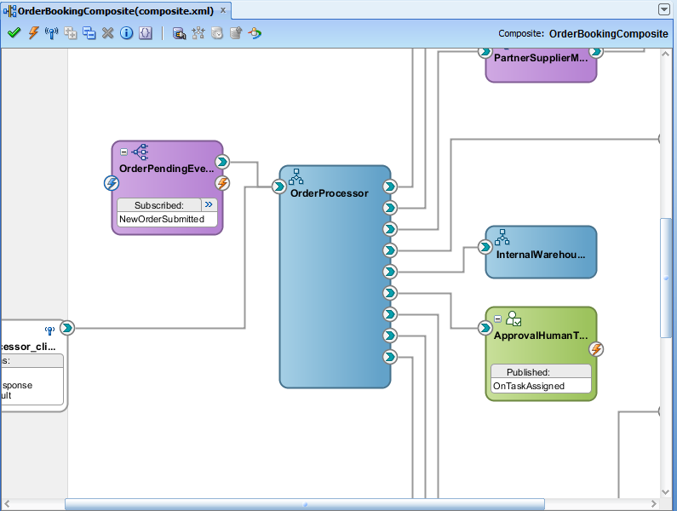
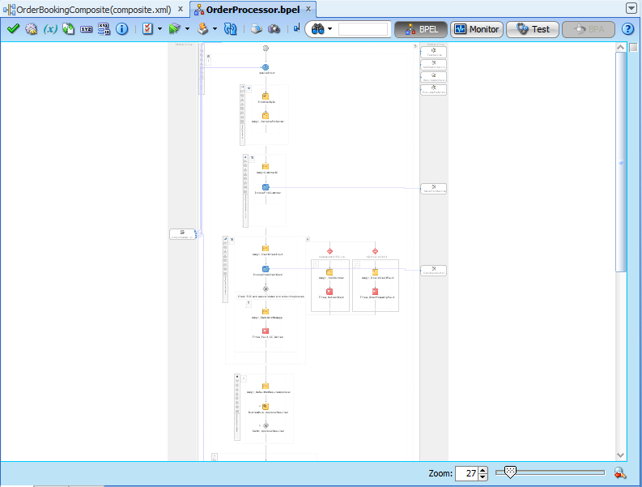
Vendor representation of the bpel process
Zoom 27 %

Slide 4
Introduce to BCA

Slide 5
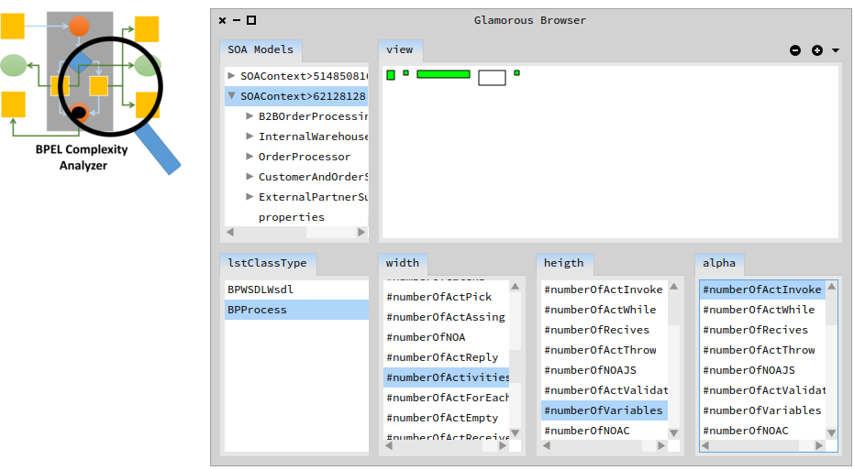
Visual helper analytic
First Analytic example in a SOAcontext with the complexity of BPEL Process.

Slide 6
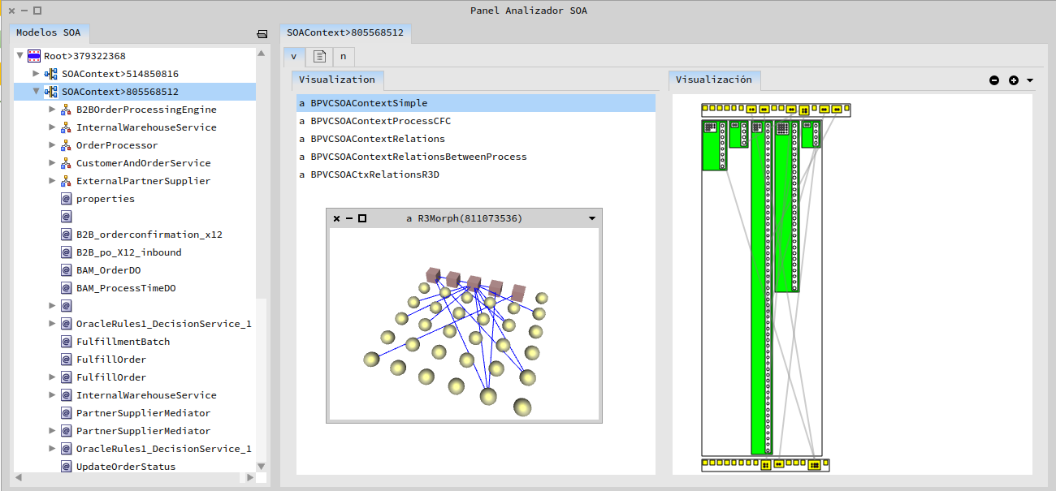
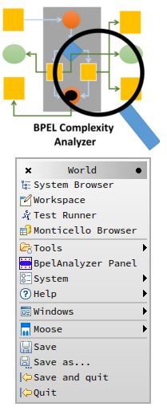
The BCA PANEL
We can control every artifact in the SOA Context to evaluate the complexity and their relations

Slide 7
Available in smalltalkhub
MCHttpRepository
location: 'http://smalltalkhub.com/mc/ajperalt/BpelAnalyzer/main'
user: ''
password: ''
To be use, you need to download www.moosetechnology.org pharo image.

