Slide 1
Contd..
Figure 3 (a): Sequence of transformation in viewing pipeline
Figure 3 (b): 2D coordinate system to physical device coordinates transformation

Slide 2
Computer Graphics
Computer graphics deals with all aspects of creating images with a computer
Hardware
Software
Applications

Slide 3
Preliminary Answer
Application: The object is an artist’s rendition of the sun for an animation to be shown in a domed environment (planetarium)
Software: Maya for modeling and rendering but Maya is built on top of OpenGL
Hardware: PC with graphics card for modeling and rendering

Slide 4
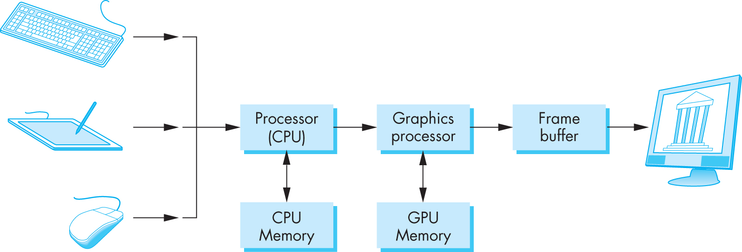
Basic Graphics System
Output device
Input devices
Image formed in frame buffer

Slide 5
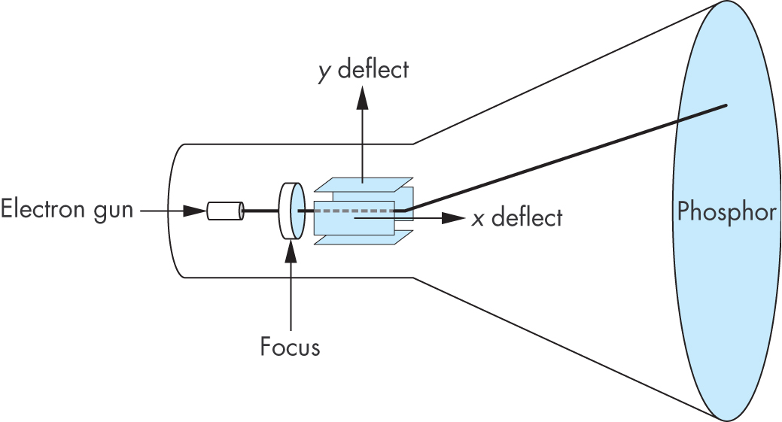
CRT
Can be used either as a line-drawing device (calligraphic) or to display contents of frame buffer (raster mode)

Slide 6
Picture elements
A picture element is the smallest possible quantitative part of an image, whether it is one that is printed or a digital image on a monitor or television screen.

Slide 7
What is a Pixel?
The word “Pixel” comes from the words “Picture Element” (pix = picture, el = element).
They are small tiny dots of lights that are grouped together to form digital images on your digital display device. These devices can be anything from your computer screen to your mobile phone. This is the smallest visible unit of measure on a digital display. The screen that you see, be it a flat-screen or the tube monitors, each has thousands or millions of Pixels grouped together to form your display.

Slide 8
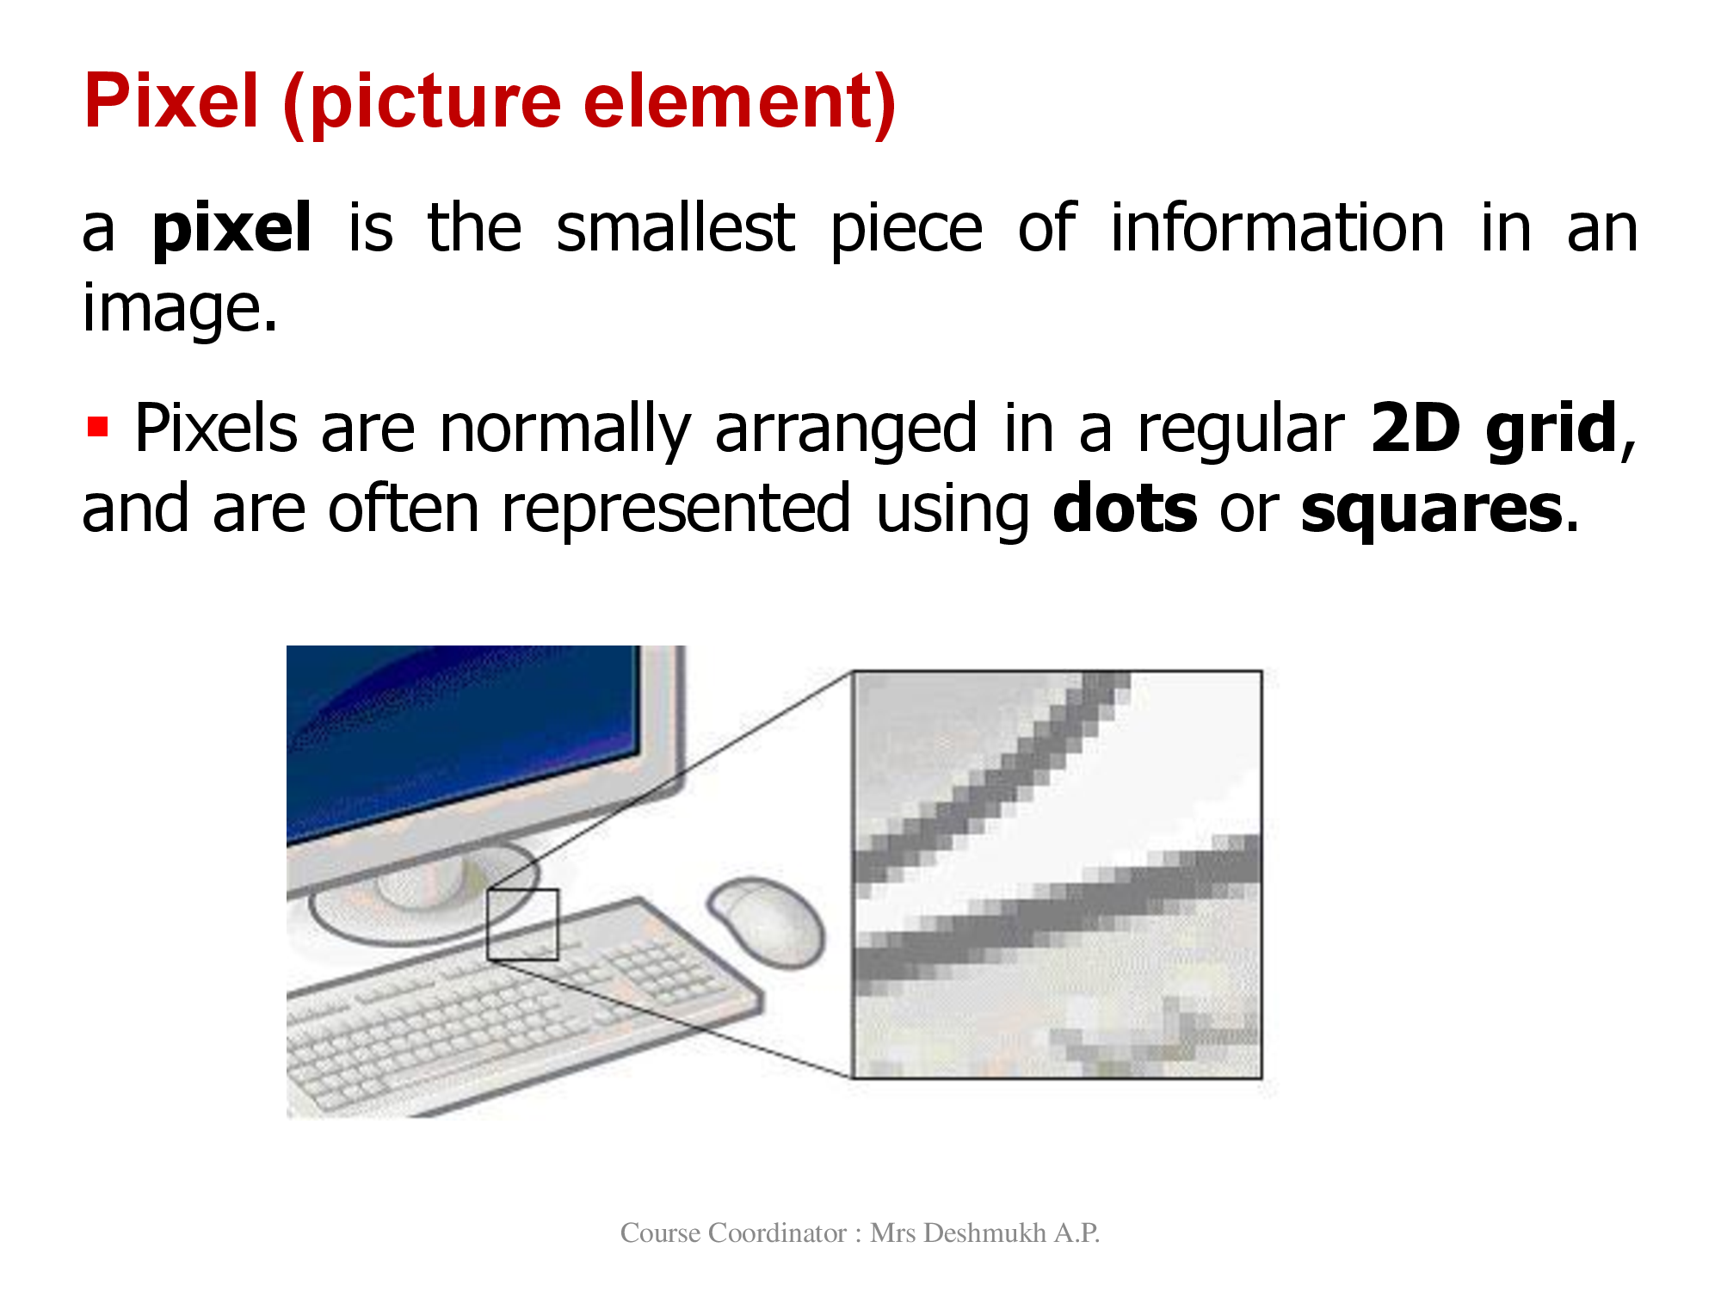

Slide 9
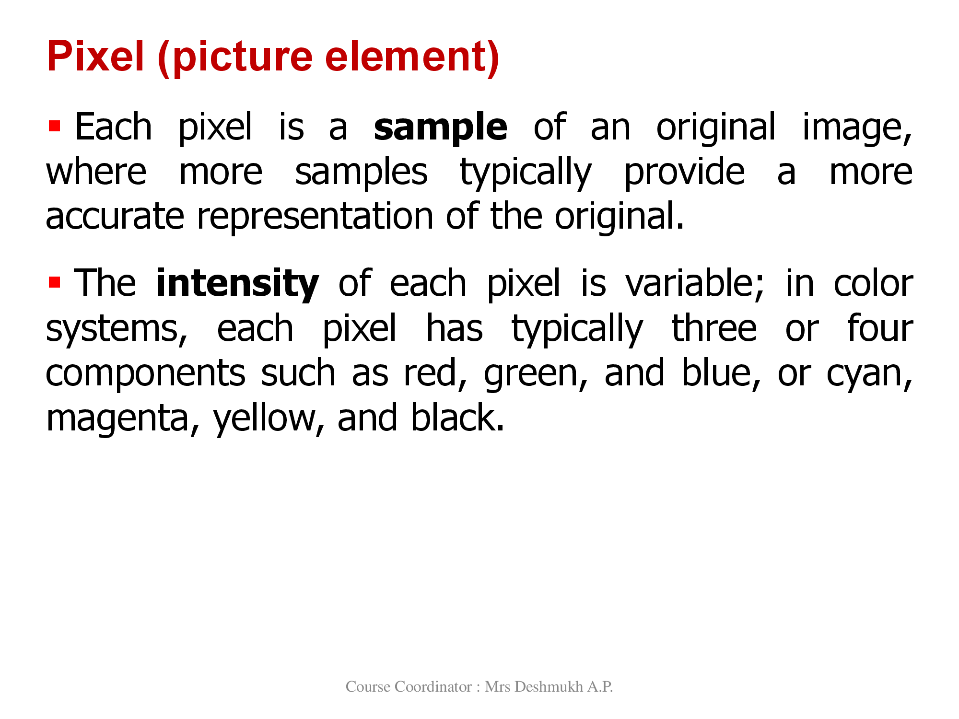

Slide 10
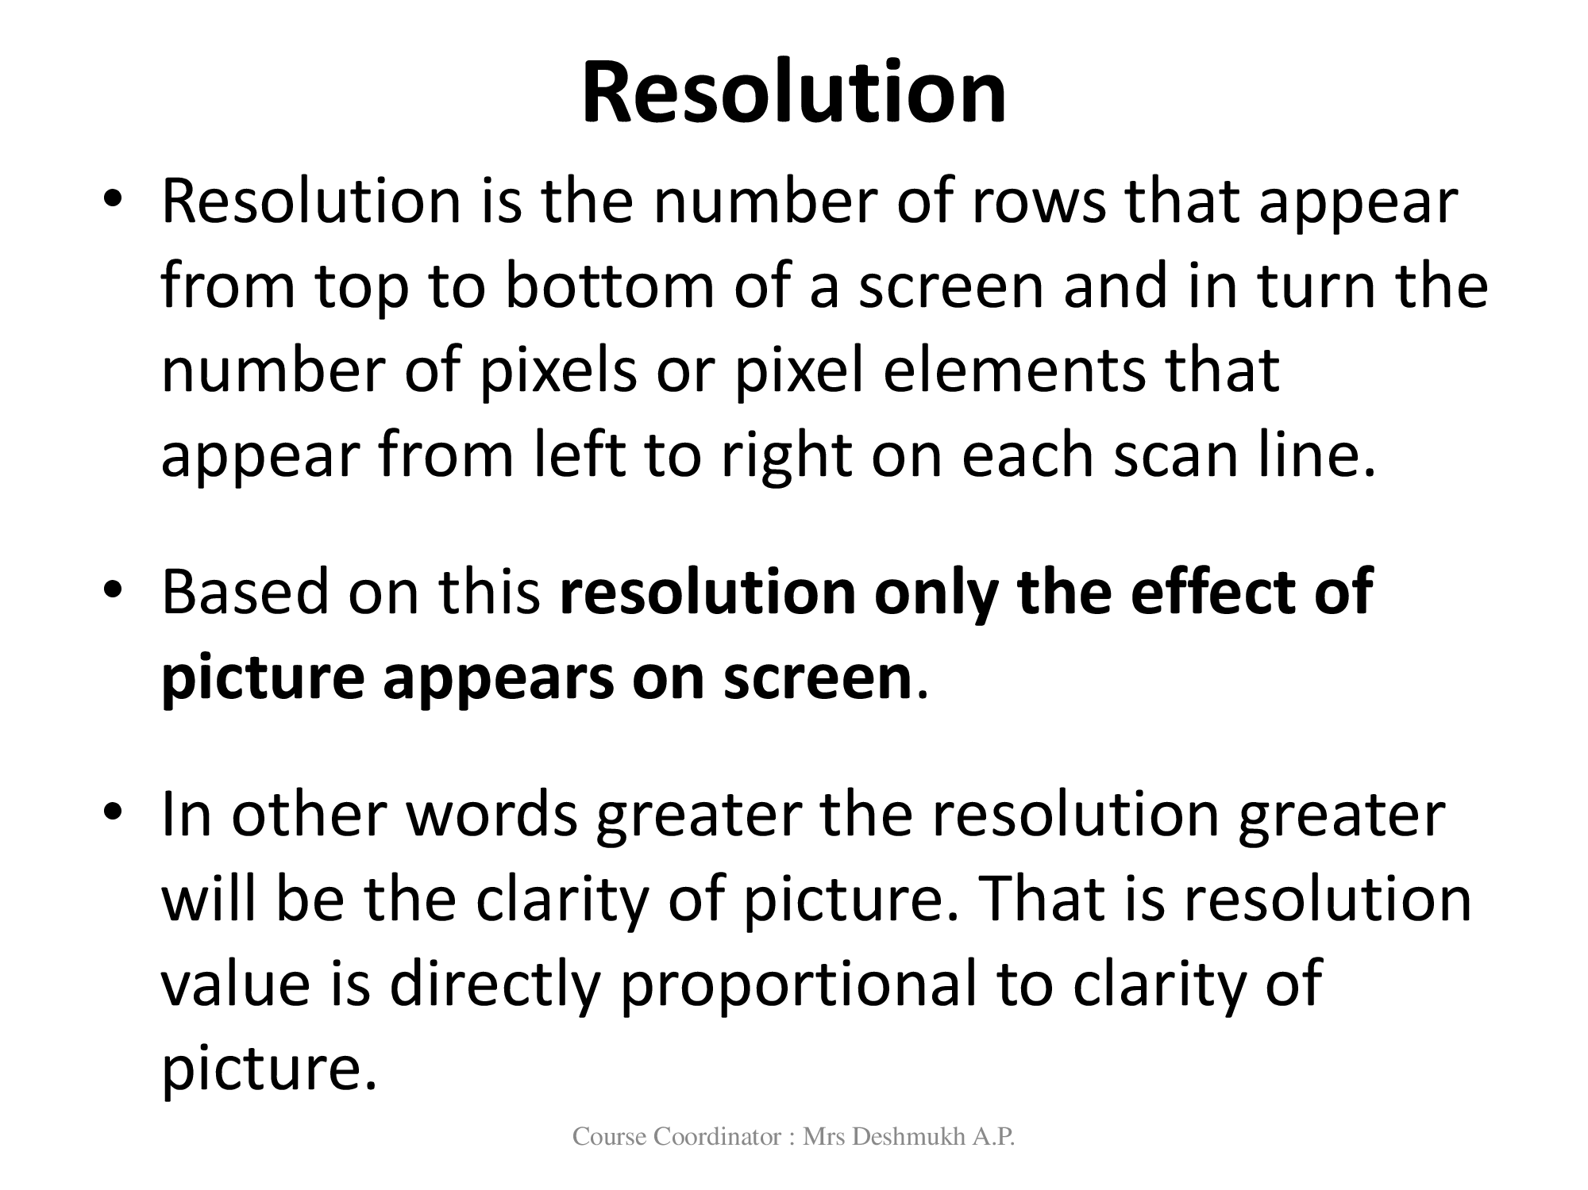

Slide 11
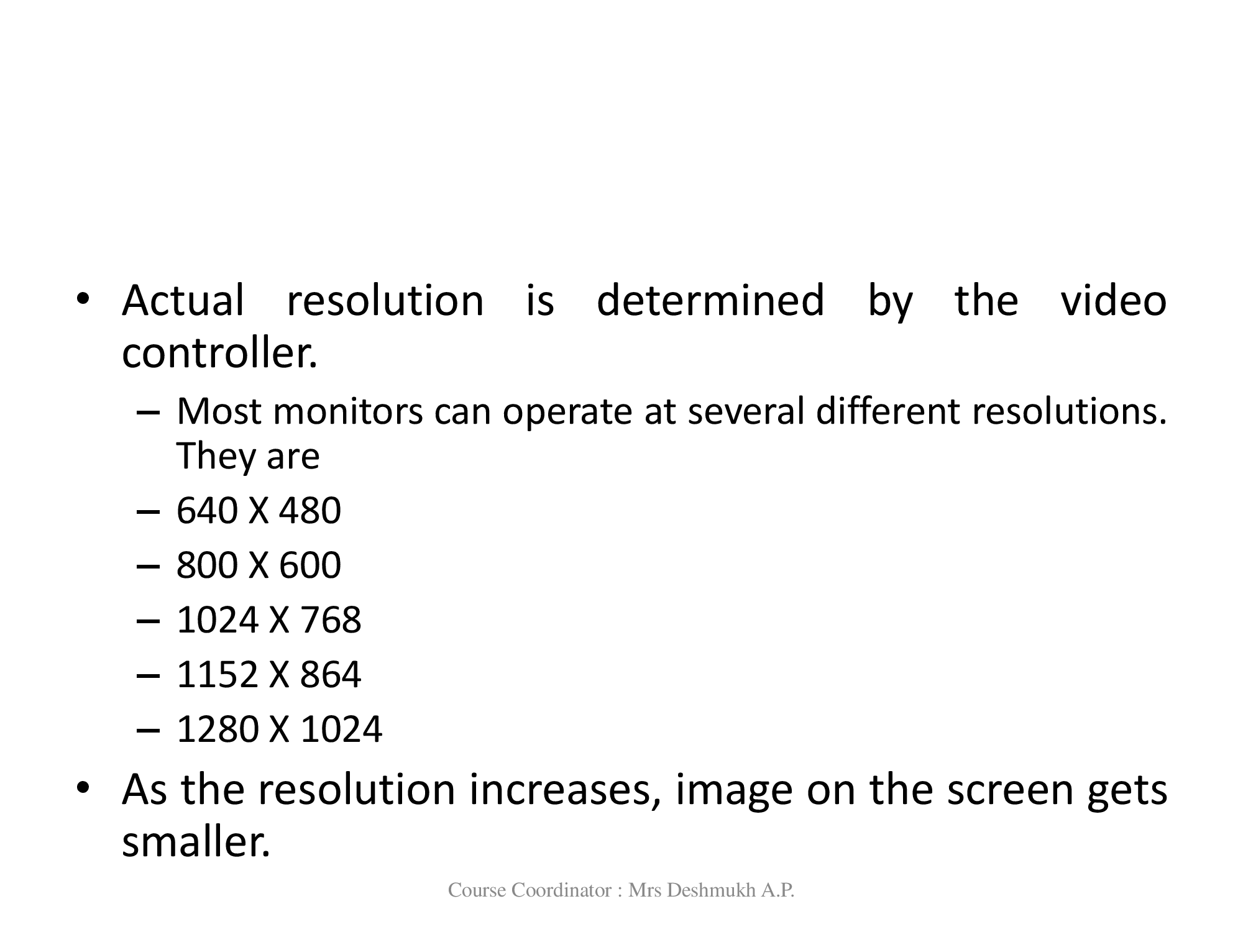

Slide 12
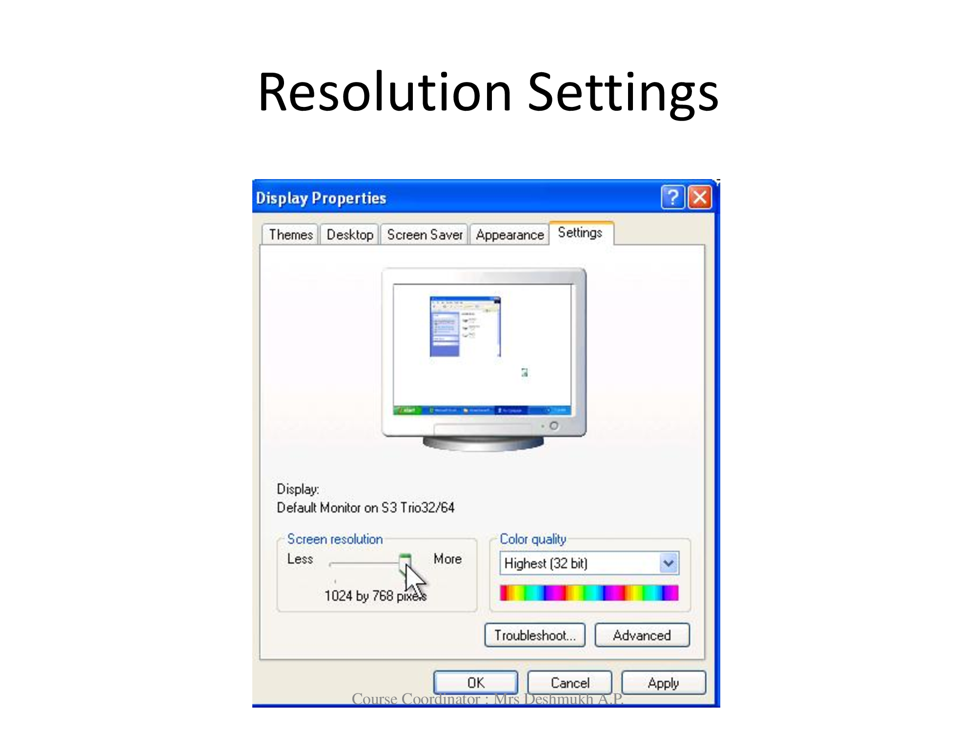

Slide 13
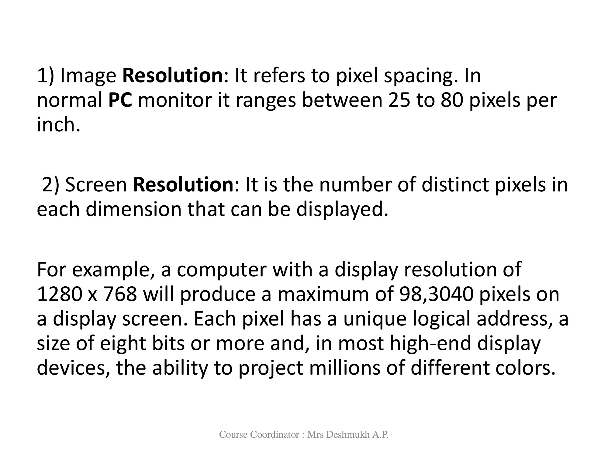

Slide 14
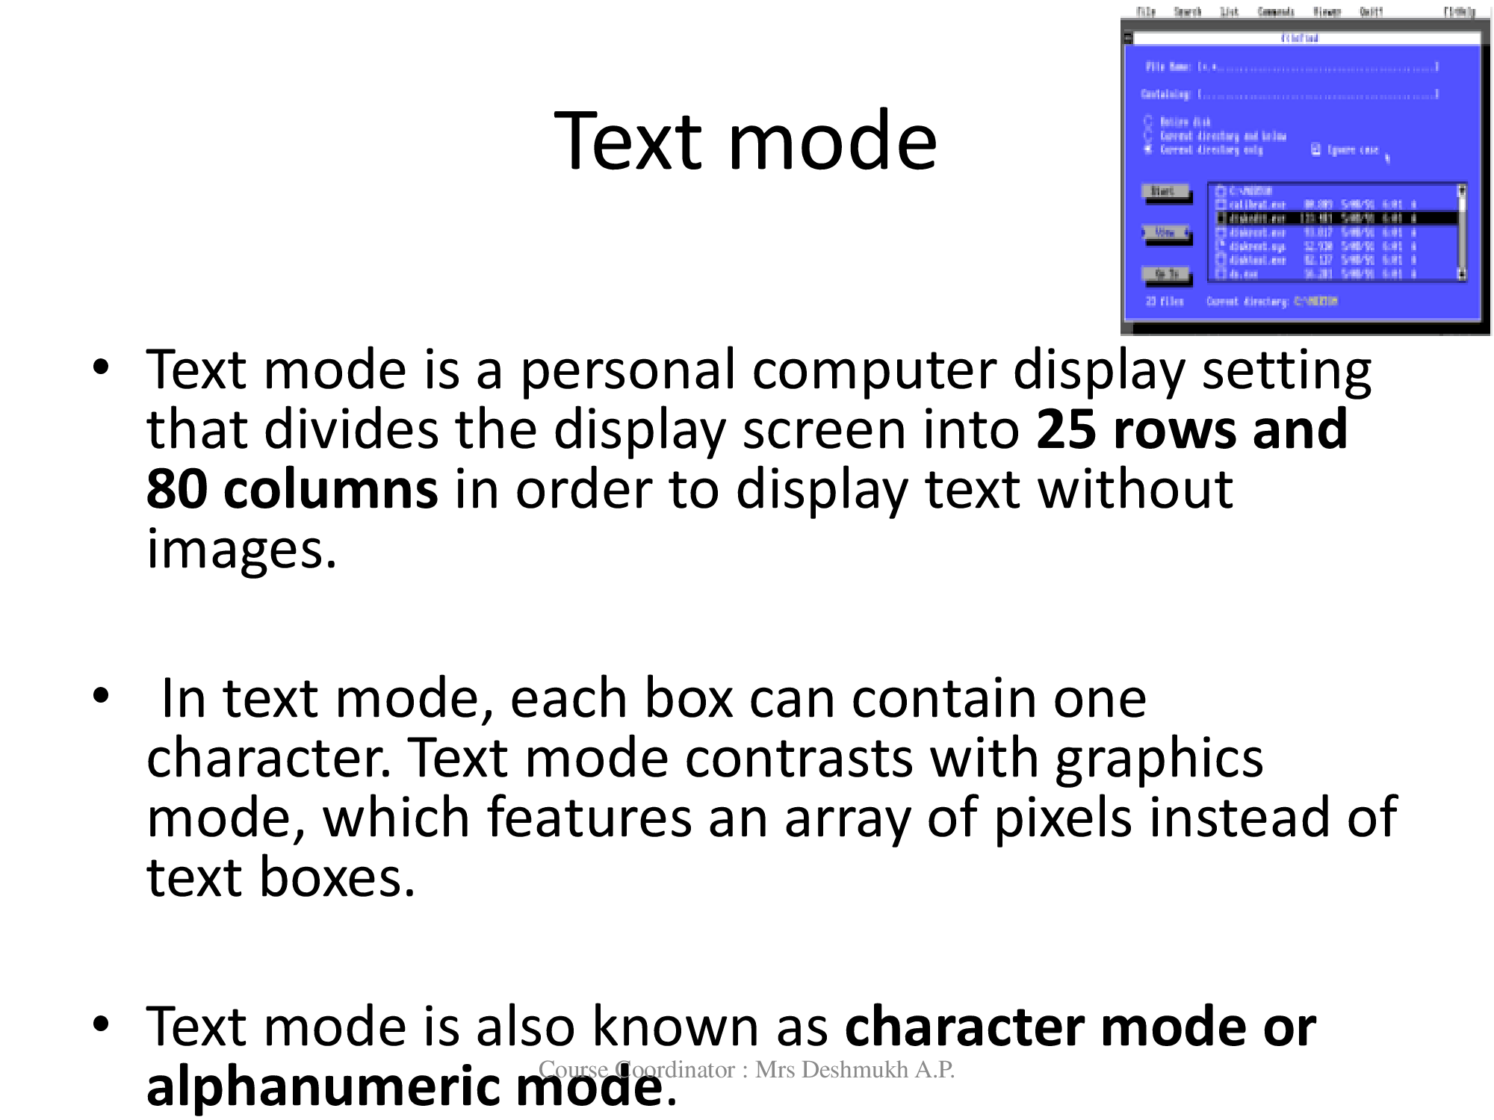

Slide 15
