Slide 1
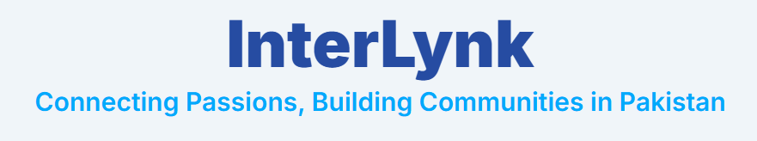
Group Members:
• M. Umar Khan – L1F20BSSE0156
• Asharib Hashmi – L1S23BSSE0056

Slide 2
The Digital Divide for Hobbyists
In Pakistan's vast digital landscape, a significant gap exists. Niche hobby communities are scattered and underserved, lacking a dedicated platform to connect, share, and grow. This fragmentation stifles passion and limits opportunity.

Slide 3
Executive Summary
Problem: Lack of dedicated platforms for niche hobby communities in Pakistan, leading to fragmentation and limited growth opportunities.
Solution: InterLynk – A hybrid of Pinterest (visual discovery) and LinkedIn (community building), tailored for Pakistani hobbyists.
Core Features: Personalized profiles, dynamic content feeds, organized event listings, interactive discussion forums.

Slide 4
Vision & Mission
Vision: To become the most trusted and vibrant digital platform for niche interests, empowering individuals and fostering thriving communities globally.
Mission: To connect individuals through shared passions, facilitate seamless content sharing, and enable the organic growth of supportive communities by providing intuitive tools and a supportive environment.

Slide 5
Nature & Scope of Business
Type: Specialized social networking platform.
Core Features:
Interactive Forums (discussion spaces)
Event Listings (discovery & management)
Interest Discovery (new hobbies)
Target: Ages 15–45 in Pakistan, passionate about niche hobbies

Slide 6
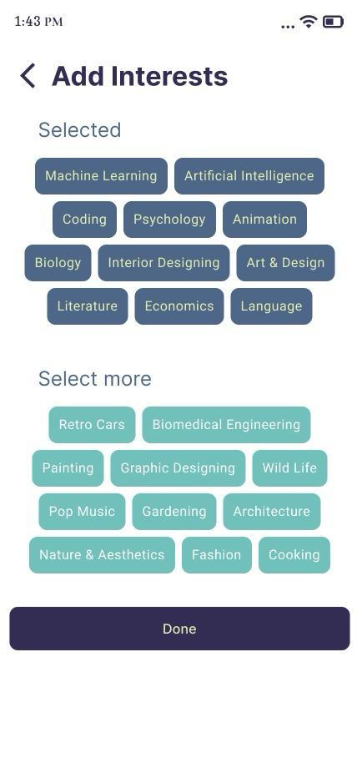

Slide 7
Market Analysis : Global Reach
Observation: Global platforms fragmented for niche interests.
Opportunity: No true hybrid platform exists globally.
InterLynk Potential: Global scalability by filling this niche.

Slide 8
Market Analysis – Local Presence
Digital Landscape: 87.35M+ internet users.
Market Gap: Lack of local hobby apps.
Local Strategy:
Phased Rollout: Major cities (Lahore, Karachi, Islamabad).
Bilingual Support: English & Urdu.
Student Outreach: Early adopters.

Slide 9
Capital Structure – Initial Investment
MVP(min-value product) Dev: Rs. 2,50,000
Hosting: Rs. 80,000
Marketing: Rs. 1,50,000
Legal + Tools: Rs. 50,000
Total: Rs. 5,30,000 – Self-funded initially

Slide 10
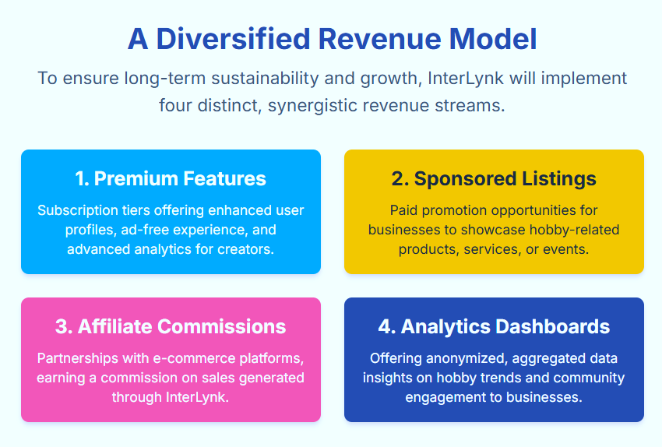

Slide 11
Financial Management
Budget Categories: Fixed, Variable, Unexpected.
Tracking: Google Sheets → Professional software (MongoDB / ConvexDB).
Reviews: Monthly reviews for goal realignment.

Slide 12
Risk Management – Risks
Low user retention
Content moderation issues
Technical bugs
Funding and competition threats

Slide 13
Risk Management – Mitigation
User Retention: Gamification, engagement tools.
Content Moderation: AI filters, moderation team.
Technical Stability: Robust testing, CI/CD.
Funding/Competition: Diverse revenue, strong value, innovation.

Slide 14
Leadership & Management
Founding Team: Comprises CEO, CTO, CMO, and CXO, covering core areas: tech, business, marketing, and UX.
Employee Growth: Training, mentorship, learning culture.
Culture: Experimentation, adaptation, performance feedback.

Slide 15
Exit Strategy
Long-Term Vision: Future growth and liquidity.
Avenues: Initial Public Offering (IPO)Acquisition by larger platforms (e.g., Pinterest, Meta)
Priority: Preserve core mission post-exit.

