Slide 1
MINI_PROJECT_1
Store Sales Prediction

Slide 2
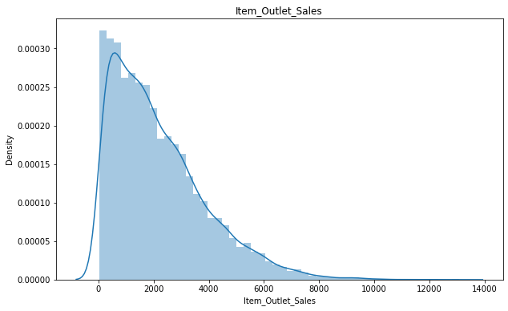
Distribution Of Sales
Interpretation The data of Outlet Sales is skewed towards the right side i.e. Data is saturated towards left.

Slide 3
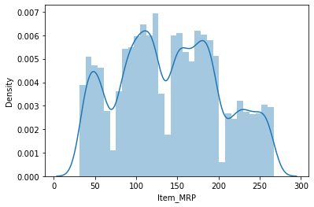
Distribution Of MRP
Interpretation The data of MRP is Not Normally Distributed as it is fluctuating.

Slide 4
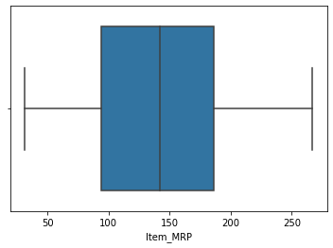
Distribution Of MRP
Interpretation The data of MRP is Not Normally Distributed as it is fluctuating.

Slide 5
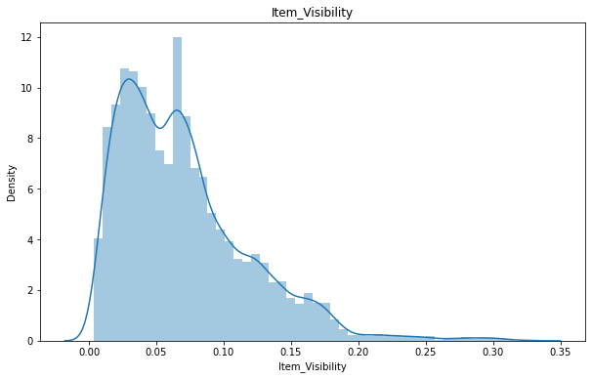
Distribution Of Item Visibility
Interpretation The data shows some items are not clearly visible to the customers, so this may be taken into account for improvement.

Slide 6
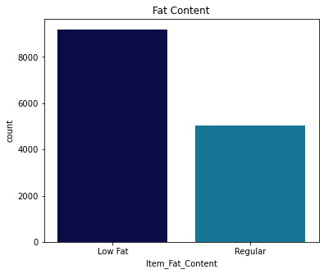
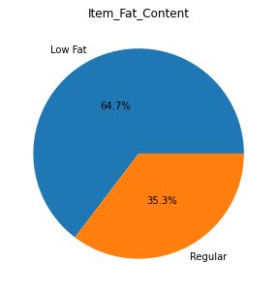
Distribution Of Item Fat Content
Interpretation The data shows that Items with Low fat content are 64.7% Items with regular fat are 35.3%

Slide 7
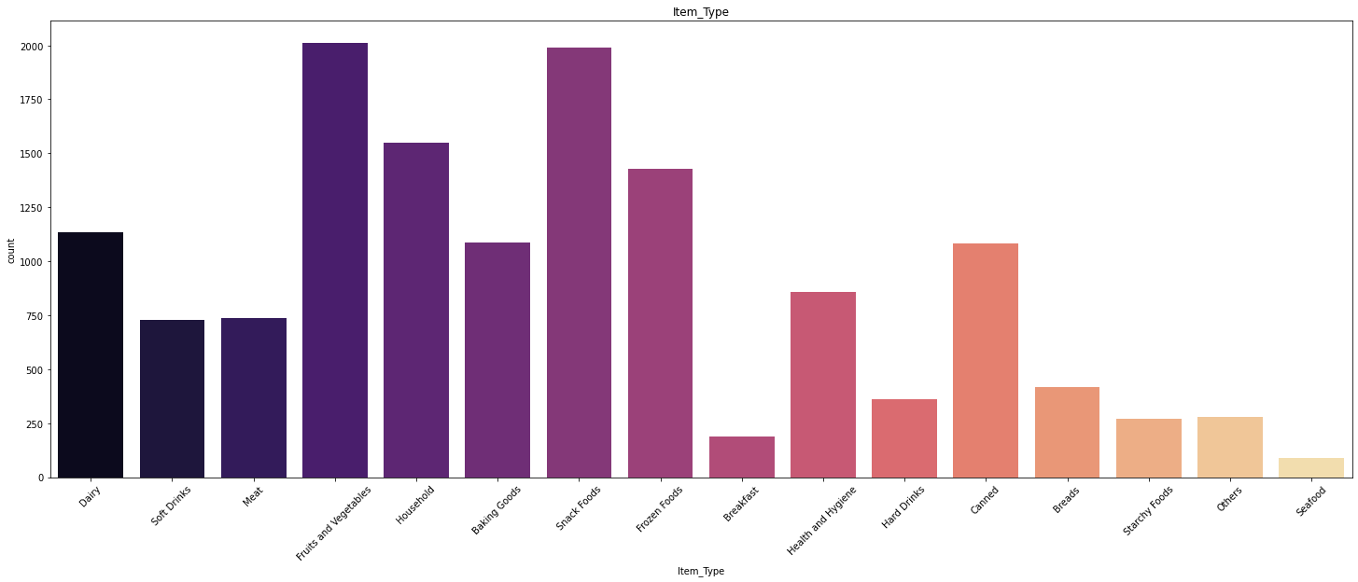
Item Type
Interpretation The data shows that Fruits, Vegetables and snacks have the majority sales Seafood has the least sales

Slide 8
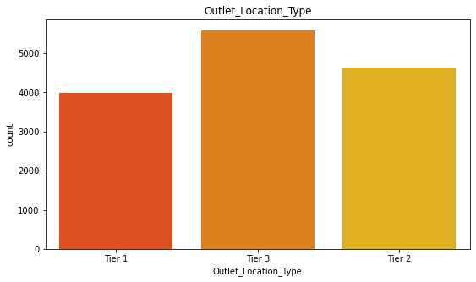
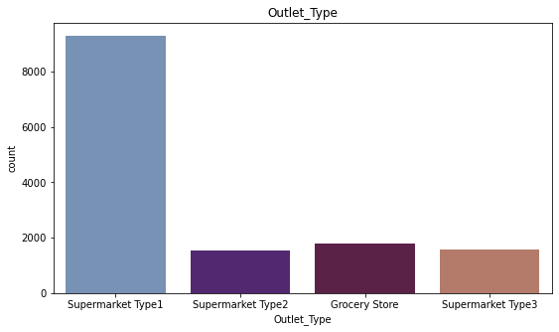
Outlet and Location Type
Interpretation The data shows that Tier 3 have the majority location type Supermarket type 1 has the majority in Outlet Type

Slide 9
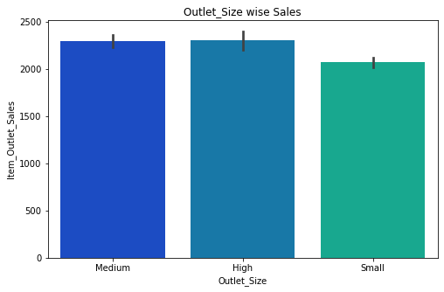
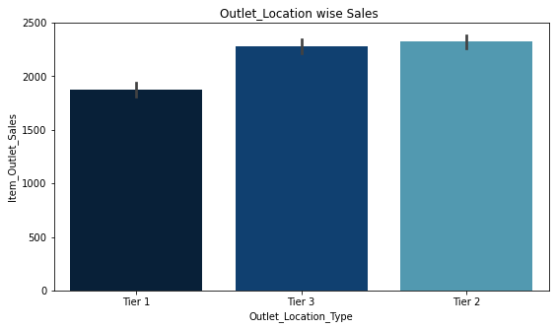
Outlet and Location Vs Sales
Interpretation The data shows that Tier 3 and 2 have the majority Sales Medium and High outlet size has the majority sales vs Outlet Size

Slide 10
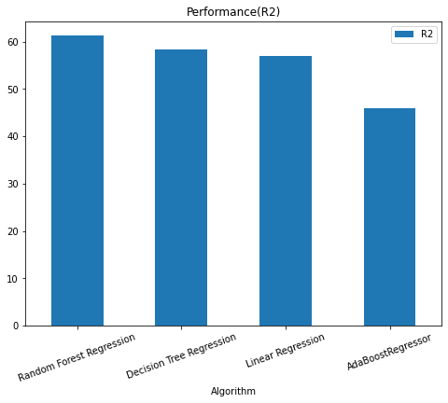
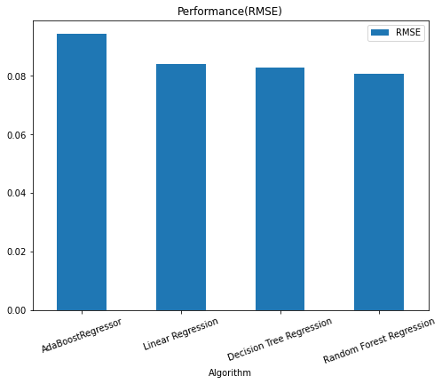
Model
Interpretation The R2 value is Higher in Random Forest Regressor have the majority Sales The RMSE is Highest for the AdaBoost

Slide 11
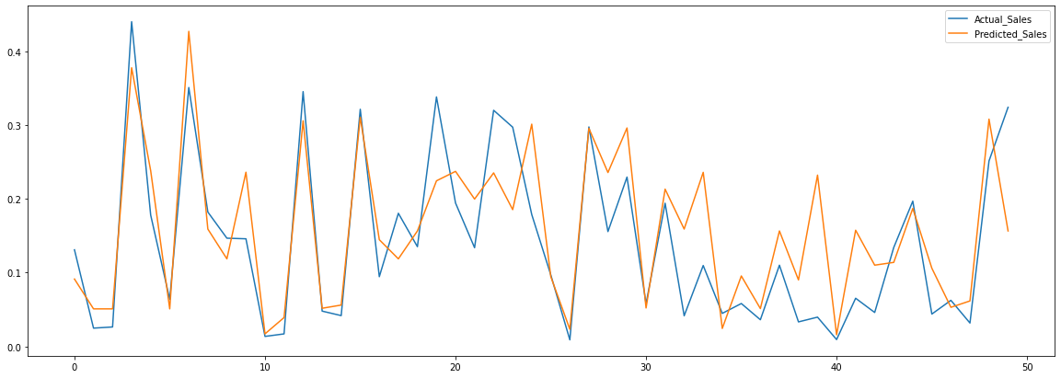
Actual & Predicted Sales

Slide 12
THANK YOU

