Slide 1
CLUSTERING_MALL_CUSTOMERS
MINI_PROJECT_3

Slide 2
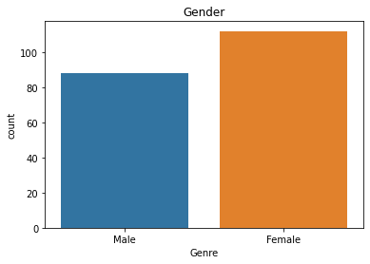
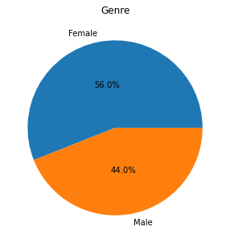
COUNT OF GENDER
Interpretation
This Data shows that Female are the majority with 56% count
Male have 44% count and are less in number than Female

Slide 3
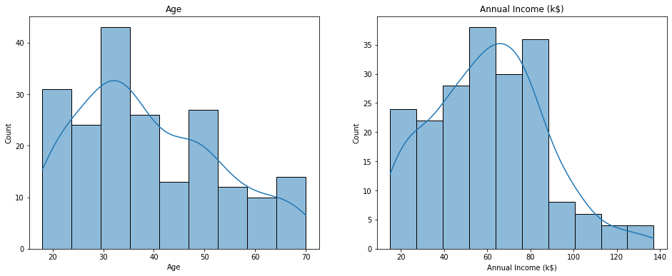
Distribution of Age & Income
Interpretation
This Data shows that people between age 20-50 are the majority
Highest no of people have their Annual salary between $20k-80k

Slide 4
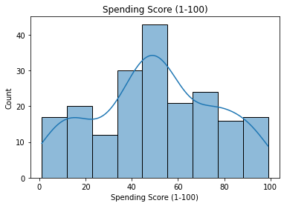
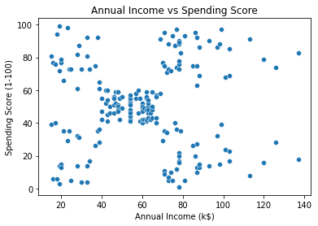
Income Vs Spending Score
Interpretation
This Data shows that people between score 20-80 are the majority
The Data is saturated between 40-60 where the spending score and annual income is same

Slide 5
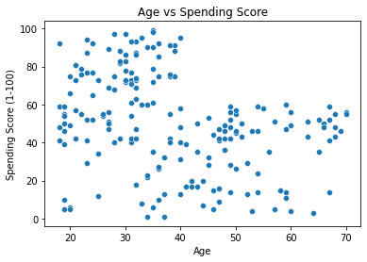
Age Vs Spending Score
Interpretation
This Data shows that people between age 20-40 have the highest spending score.
The Data shows that after age 40, people’s spending score is not exceeding 60

Slide 6
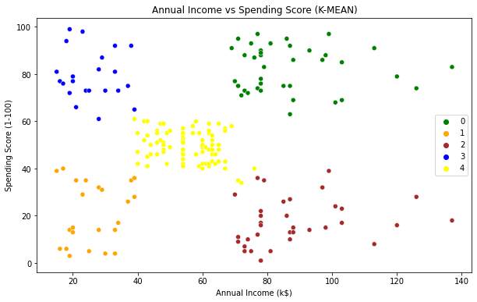
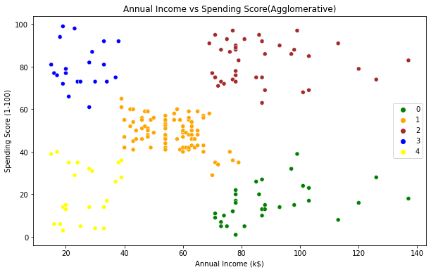
Income Vs Spending Score K-means
Interpretation
This Data shows that K-Means and Agglomerative Clustering have similar clusters (5 clusters)

Slide 7
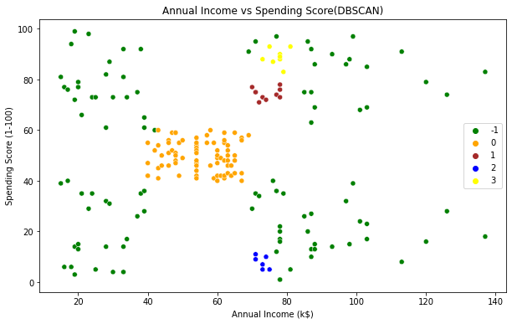
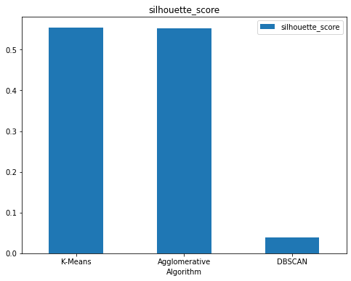
Income Vs Spending Score DBSCAN
Interpretation
This shows that DBSCAN Clustering is not segregating the clusters.
K-Means and Agglomerative have similar Silhouette Score.

