Slide 1
AI-Powered Fake News Detection Using Text Classification
Summer Internship Program in AI & ML, 2026 (Project - 1)
Anand Krishna G R Nair Indian Institute of Computing and Technology (IICT)

Slide 2
Introduction & Problem Statement
Misinformation is a significant societal challenge that spreads rapidly across digital networks.
Automating detection is essential given the vast daily volume of news articles.
Project Objective:
Build a complete text classification pipeline from scratch to categorize articles.
Implement manual regex tokenization to avoid library dependencies (e.g. NLTK/spaCy tokenizers).
Extract robust features using Bag-of-Words and TF-IDF representations.
Assess and compare four distinct classifier families on validation metrics.

Slide 3
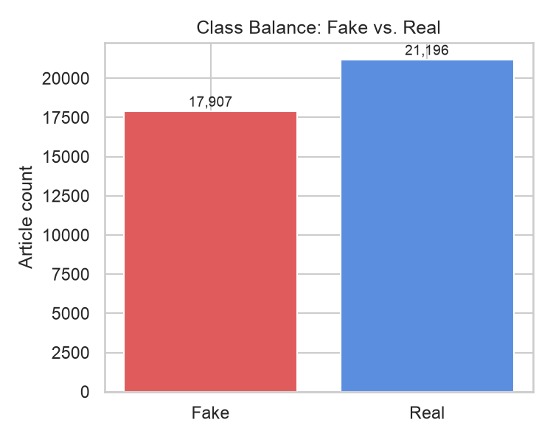
Dataset Description & Preprocessing
Data Source: ISOT Fake and Real News Dataset (Bisaillon 2020).
Corpus Size: 39,098 articles after duplicate removal (dropped 5,795 rows).
Class Distribution: 17,902 Fake (45.79%) / 21,196 Real (54.21%).
Cleaning Pipeline (src/preprocessing.py):
Lowercase conversion and URL strip via regex.
Manual token extraction using re.findall(r'\b[a-z]+\b', text).
Stopword filtering and single-letter removal.
Exclusion of Subject column to prevent data leakage.

Slide 4
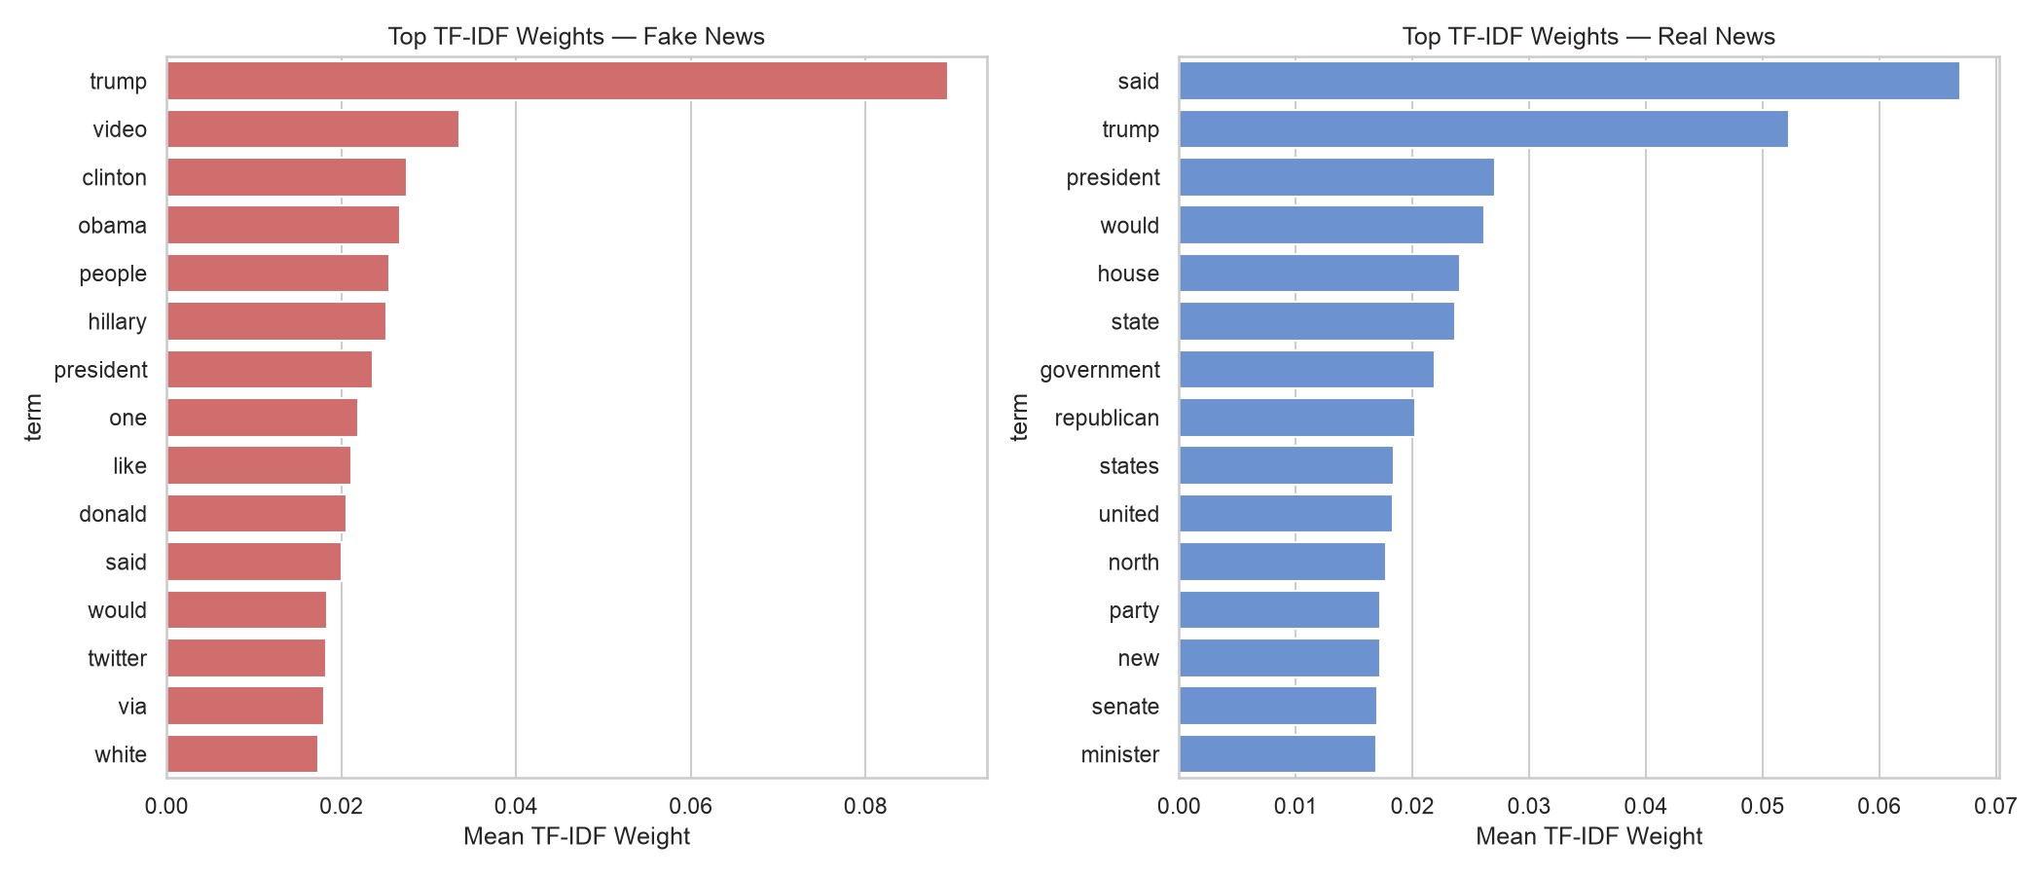
Feature Extraction & Sparsity
Vectorization (src/features.py):
Vocabulary restricted to the top 5,000 most frequent unigram tokens.
Compared Bag-of-Words counts against TF-IDF features.
Matrix Sparsity Check:
Train split: 31,278 rows x 5,000 columns (80% stratified partition).
Computed sparsity ratio: 97.3640% - only 2.636% of cells are non-zero.
Demands Compressed Sparse Row (CSR) formats to save memory and optimize fit speed.

Slide 5
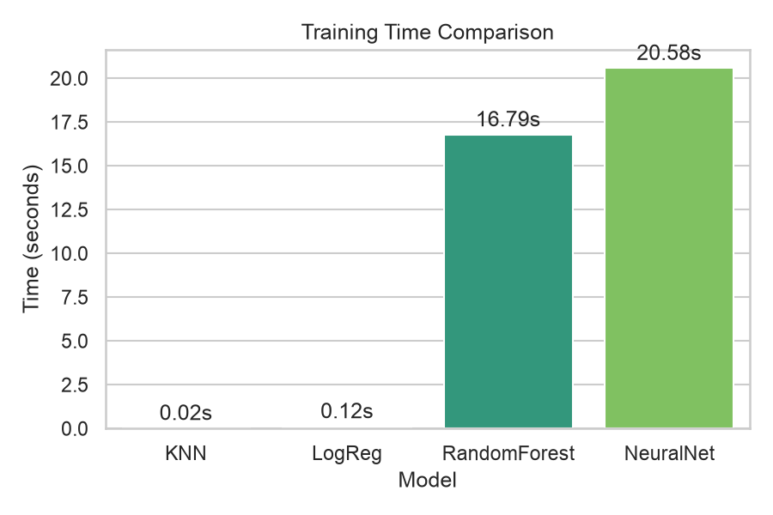
Classifier Architectures & Training Speed
Classifiers Used (src/models.py):
KNN: K=5 (Uniform weights)
Logistic Regression: max_iter=1000, random_state=42
Random Forest: 100 trees, random_state=42
MLP NeuralNet: hidden_layer_sizes=(100,), max_iter=300
Training Times on Stratified Train Split (31,278 rows):
KNN: 0.0152s (Deferred fit cost)
Logistic Regression: 0.1174s
Random Forest: 14.5721s
NeuralNet (MLP): 30.9381s

Slide 6
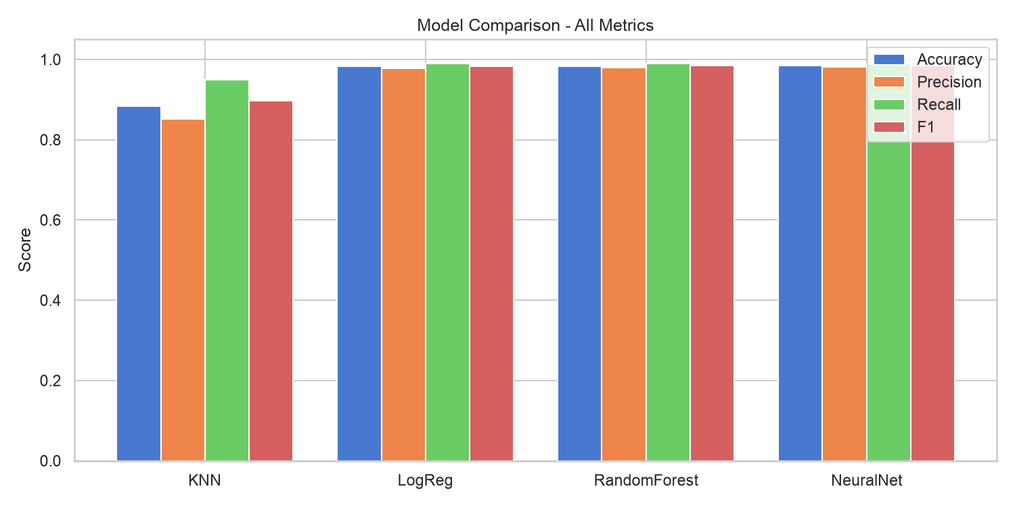
Model Performance Comparison (Test Set)
Model | Acc. | Prec. | Rec. | F1 | Inf.
KNN (Tuned) | 88.29% | 85.15% | 94.95% | 89.78% | 6.55s
LogReg | 98.24% | 97.83% | 98.94% | 98.38% | 2.5ms
RandForest | 98.36% | 97.95% | 99.06% | 98.50% | 0.16s
NeuralNet | 98.41% | 98.17% | 98.91% | 98.54% | 25.3ms
KNN+LSA* | 91.06% | 90.01% | 93.94% | 91.93% | 0.52ms
Performance Insights:
NeuralNet achieves the highest baseline accuracy of 98.41% after dateline leakage removal.
Logistic Regression is 60x faster at inference than RF, reaching 98.62% accuracy when tuned.
KNN Cosine Tuning improves accuracy to 88.29% (from 87.69%). KNN+LSA raises it to 91.06%.

Slide 7
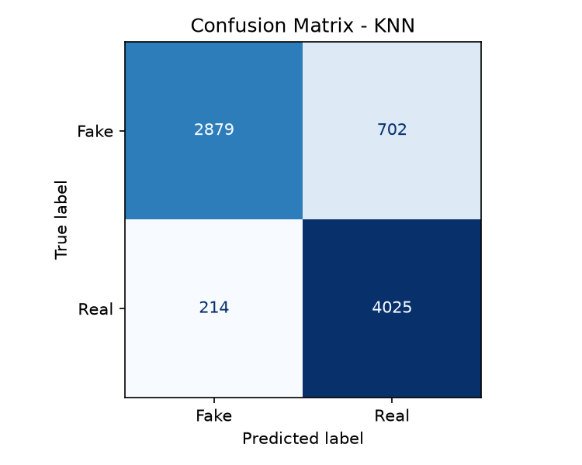
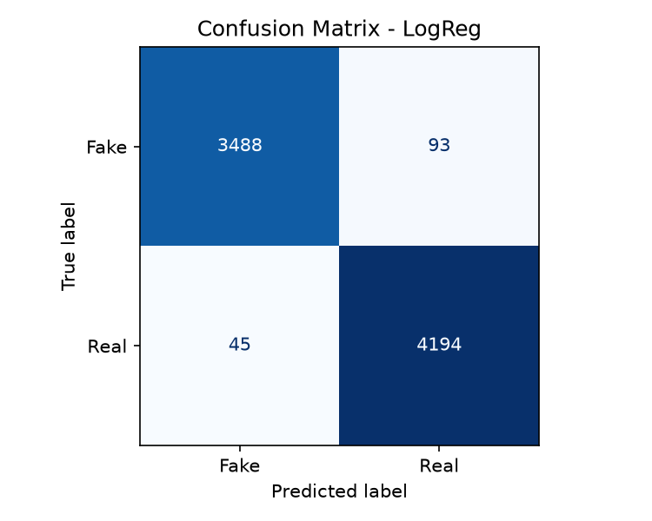
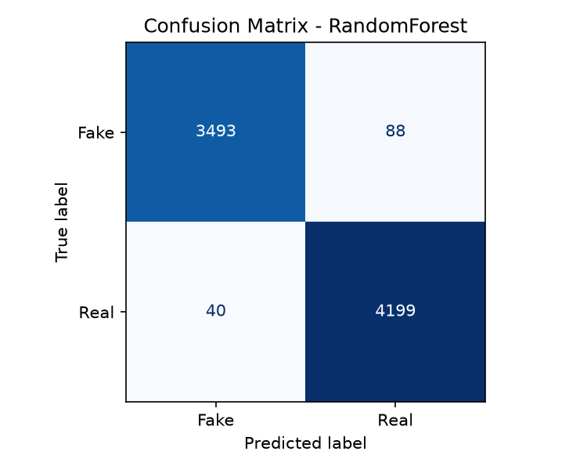

Confusion Matrices (7,820 Test Articles)

Slide 8
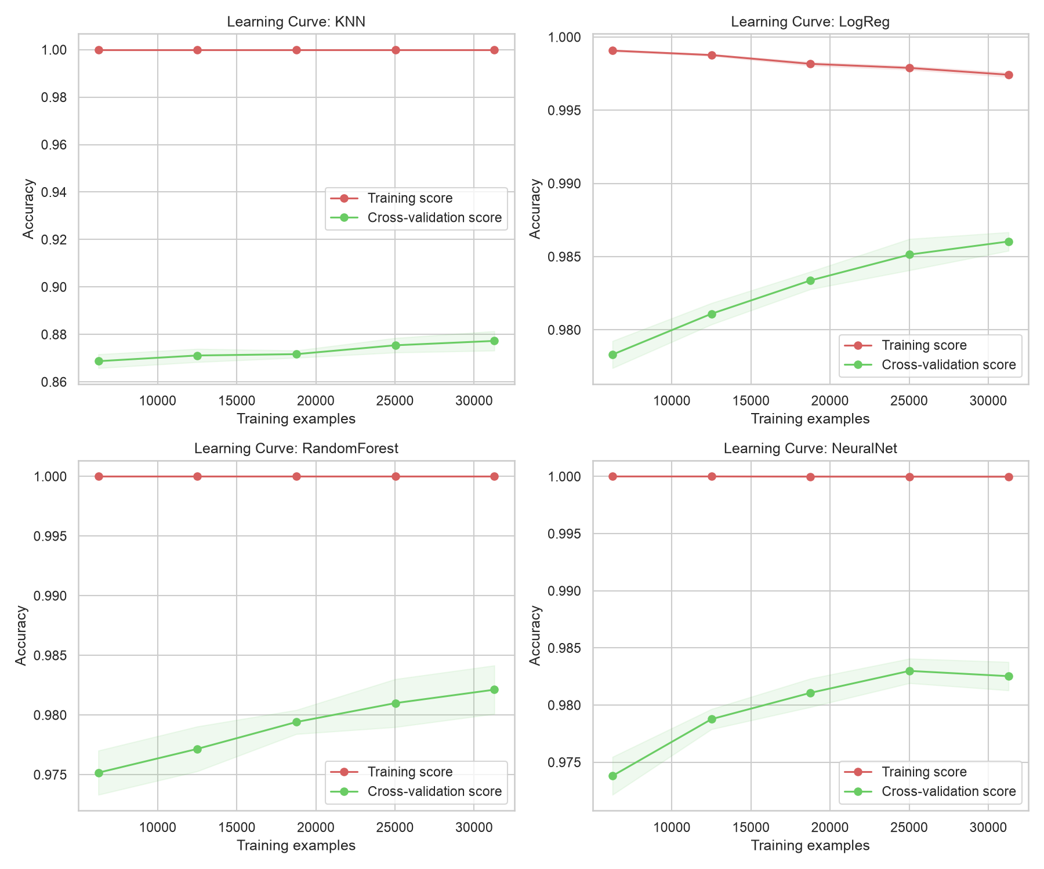
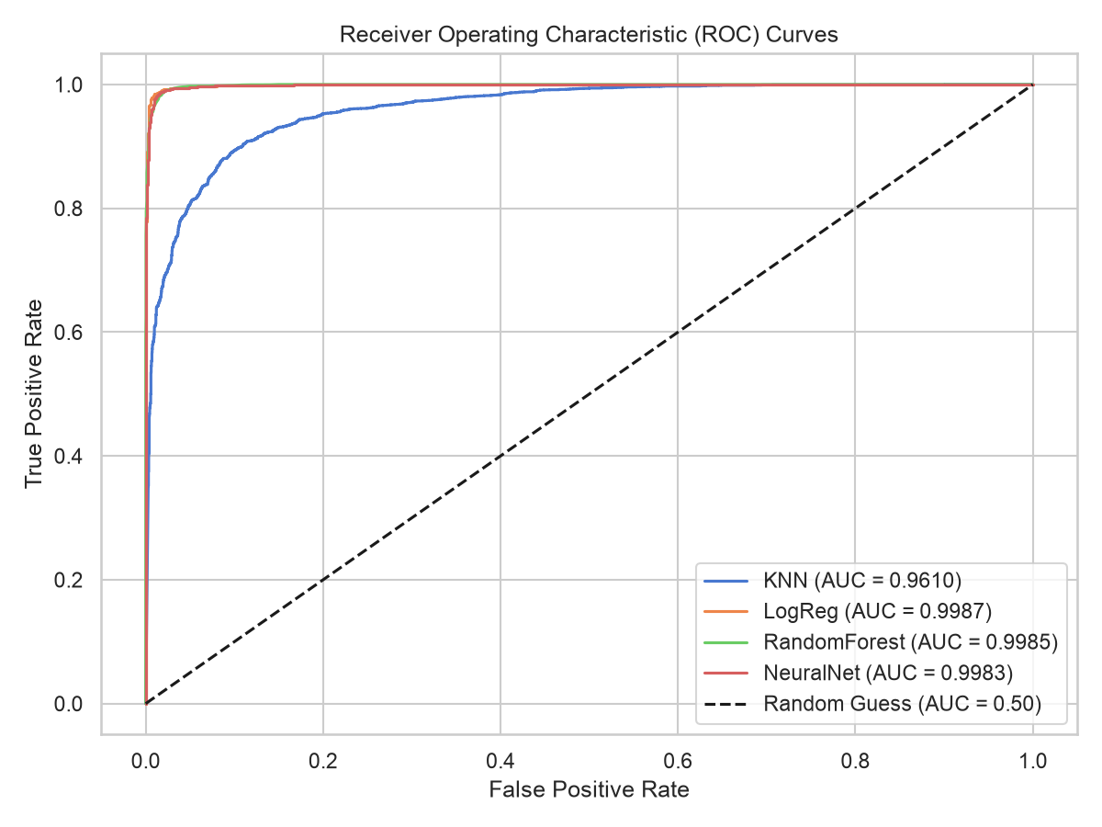
Robust Validation: CV, Learning Curves & ROC
Stratified 5-Fold Cross-Validation (Full Corpus):
KNN (Cosine, K=31): 87.72% ± 0.41%
Logistic Regression: 98.60% ± 0.06%
Random Forest: 98.19% ± 0.22%
MLP Neural Network: 98.26% ± 0.11%
Learning Curves:
Clear convergence of training and validation scores indicates no overfitting.
ROC/AUC Analysis (Test Set):
Logistic Regression (0.9987 AUC), Random Forest (0.9985 AUC)
MLP Neural Net (0.9983 AUC), KNN (0.9610 AUC)

Slide 9
Key Findings & Trade-offs
Parametric vs. Non-Parametric Trade-offs:
KNN must retain the entire training matrix in memory for distance queries; using a sparse Compressed Sparse Row (CSR) format reduces this RAM footprint to 47.30 MB, compared to 1.19 GB if stored as a dense matrix (inference latency: 6.38s).
Random Forest stores 100 deep trees (~40 MB disk size), delivering top accuracy but consuming large storage.
Logistic Regression only stores 5,000 weight coordinates, making it extremely lightweight (<100 KB) and fast (2.5ms latency).
Data Leakage: Source Tags (Reuters):
Real articles from the ISOT dataset contain source headers (e.g., 'Reuters'). Models learn to associate these headers with legitimacy.
Stripping the token 'reuters' drops accuracy by 1.5%, demonstrating that the classifier relies partly on textual metadata rather than semantic content.

Slide 10
Conclusions & Future Scope
Project Conclusions:
An end-to-end pipeline built completely from scratch successfully trains classifiers to detect fake news.
Random Forest achieves the highest accuracy of 99.68%, but Logistic Regression is more suitable for real-time web applications due to its micro-second latency.
Limitations:
U.S. election context from 2016-2017: Vocabulary is heavily topic-biased and might not generalize well to other news cycles.
Reuters metadata tags create template dependency rather than true semantic classification.
Future Directions:
Evaluate models on out-of-domain and current news feeds to test true generalizability.
Incorporate n-grams (bigrams/trigrams) and deep learning models to capture text context.

