Slide 1
AI-Driven Phishing Email Detection
Using NLP (Natural Language Processing)
A comparative study of hybrid text-feature and metadata-driven ensemble classifiers for automated cyber-threat filtering.
Anand Krishna G R Nair
Registration No: 596563 | anandkrishnag.rnair@gmail.com
Department of Computer Science and Engineering · IICT, New Delhi — 110092
Tools: Python · Scikit-Learn · Gensim Word2Vec · Streamlit · NLTK · spaCy

Slide 2
CYBERSECURITY · NLP · MACHINE LEARNING
Project Objectives
Proactive Threat Defense
──────────────────────────────────
Objective Build a classifier that detects phishing emails before they reach the user's inbox.
Gap addressed Signature-based blacklists fail against zero-day and spear-phishing variants.
Design goal The system must generalise to unseen email text without manual rule updates.
Hybrid Feature Engineering
──────────────────────────────────
Text semantics TF-IDF extracts vocabulary patterns across unigrams, bigrams, and trigrams.
Word embeddings Custom Word2Vec captures latent intent that simple word counts miss.
Structural signals Metadata features (link density, urgency score) add behavioural context.
Model Comparison
──────────────────────────────────
Scope Four classic ML classifiers are trained, tuned, and benchmarked side by side.
Ensemble A soft-voting classifier combines model outputs for maximum stability.
Target Achieve above 98% F1-Score on the stratified holdout test set.

Slide 3
CYBERSECURITY · NLP · MACHINE LEARNING
The Threat Landscape and the NLP Solution
Limitations of Conventional Filters
──────────────────────────────────
Scale of the problem Over 90% of network intrusions begin with a phishing email.
Blacklist failure Attackers rotate domains and URLs faster than signature databases can update.
Human targeting Social engineering exploits cognitive biases, not software vulnerabilities.
Zero-day gap No static rule can block a threat it has never seen before.
Why NLP Changes the Game
──────────────────────────────────
Semantic understanding TF-IDF and Word2Vec surface urgency triggers that rules can never capture.
Vocabulary resilience Dense embeddings generalise across synonyms without retraining.
Behavioural indicators Capitalisation ratios, link counts, and punctuation density expose automated templates.
Ensemble power Combining four models via soft-voting minimises individual classifier weaknesses.
→

Slide 4
CYBERSECURITY · NLP · MACHINE LEARNING
Data Processing Pipeline
Step 1
Step 2
Step 3
Step 4
Data Ingestion
──────────────────────────────────
Source 18,650 raw emails from the public Kaggle Phishing Email dataset.
Handling Missing email bodies are detected and removed before processing.
Dedup 1,115 duplicate texts are dropped to prevent train/test data leakage.
HTML Stripping
──────────────────────────────────
Parser BeautifulSoup parses and removes all HTML markup and inline styles.
Scope Script, style, and formatting tags are eliminated entirely.
Output Clean plaintext email body is extracted for downstream use.
Tokenisation
──────────────────────────────────
Splitting Email body is split into individual word tokens per message.
Normalise All tokens are lowercased to ensure case-insensitive matching.
Filter Punctuation marks and non-alphabetic characters are discarded.
Stopword Removal
──────────────────────────────────
Remove Common English stopwords such as 'the', 'is', and 'at' are stripped.
Retain Meaningful content-bearing tokens are preserved for vectorisation.
Result 17,535 clean, deduplicated email records saved to processed CSV.
▶
▶
▶

Slide 5
CYBERSECURITY · NLP · MACHINE LEARNING
Feature Engineering: The Hybrid Feature Matrix
Combined feature space: 5,000 TF-IDF dimensions + 100 Word2Vec dimensions + 12 Structural Metadata features = 5,112 total features per email
TF-IDF Text Vectors
──────────────────────────────────
N-gram range (1, 3) — captures unigrams, bigrams, and trigrams simultaneously.
Vocabulary cap Top 5,000 terms retained after frequency-based filtering.
Scaling Sublinear TF scaling compresses the effect of high-frequency words.
Output Sparse 5,000-dimension matrix; one row per cleaned email.
Word2Vec Embeddings
──────────────────────────────────
Training Custom gensim Word2Vec model trained on the cleaned token stream.
Dimensionality Each unique word is represented as a 100-dimensional dense vector.
Aggregation Per-email vector = mean of all constituent word vectors.
Normalisation MinMaxScaler maps all values to [0, 1] for classifier stability.
Structural Metadata
──────────────────────────────────
URL signals Raw URL count and binary link-presence flag per email.
Urgency score Frequency match against 20 known phishing urgency keywords.
Formatting Exclamation density, capitalisation ratio, punctuation density.
Scaling All 12 features MinMax scaled before concatenation into matrix.

Slide 6
CYBERSECURITY · NLP · MACHINE LEARNING
Model Selection and Hyperparameter Tuning
Classifiers Under Evaluation
──────────────────────────────────
Logistic Regression Linear baseline; fast training with high interpretability.
Random Forest Bagging ensemble of 200 decision trees; handles non-linear feature interactions.
Multinomial Naive Bayes Probabilistic model well-suited to sparse TF-IDF feature distributions.
MLP Neural Network Three-layer perceptron with ReLU activations and early stopping regularisation.
All classifiers trained on the identical 5,112-feature hybrid matrix.
Cross-Validation and Ensemble Strategy
──────────────────────────────────
Train / Test split Stratified 80/20 split preserves the natural class imbalance ratio.
Grid Search CV 5-fold Stratified Cross-Validation sweeps hyperparameter combinations per model.
Class balancing class_weight='balanced' corrects for the 62.6% safe / 37.4% phishing skew.
Soft-Voting Ensemble Aggregates predicted class probabilities from all four models; majority wins.
Voting Ensemble — 98.52% Accuracy | 98.02% F1-Score

Slide 7
CYBERSECURITY · NLP · MACHINE LEARNING
Experimental Results and Model Comparison
Classifier Model | Accuracy | Precision | Recall | F1-Score
Logistic Regression | 98.26% | 97.28% | 98.09% | 97.68%
Random Forest | 98.00% | 97.04% | 97.64% | 97.34%
Multinomial Naive Bayes | 97.15% | 96.54% | 95.80% | 96.17%
Neural Network (MLP) | 98.29% | 98.30% | 97.10% | 97.70%
Voting Ensemble (Best) | 98.52% | 98.09% | 97.94% | 98.02%
Note: Adding custom Word2Vec embeddings alongside MinMaxScaler-normalised structural metadata raised the ensemble F1-Score to 98.02%, outperforming every individual classifier.

Slide 8
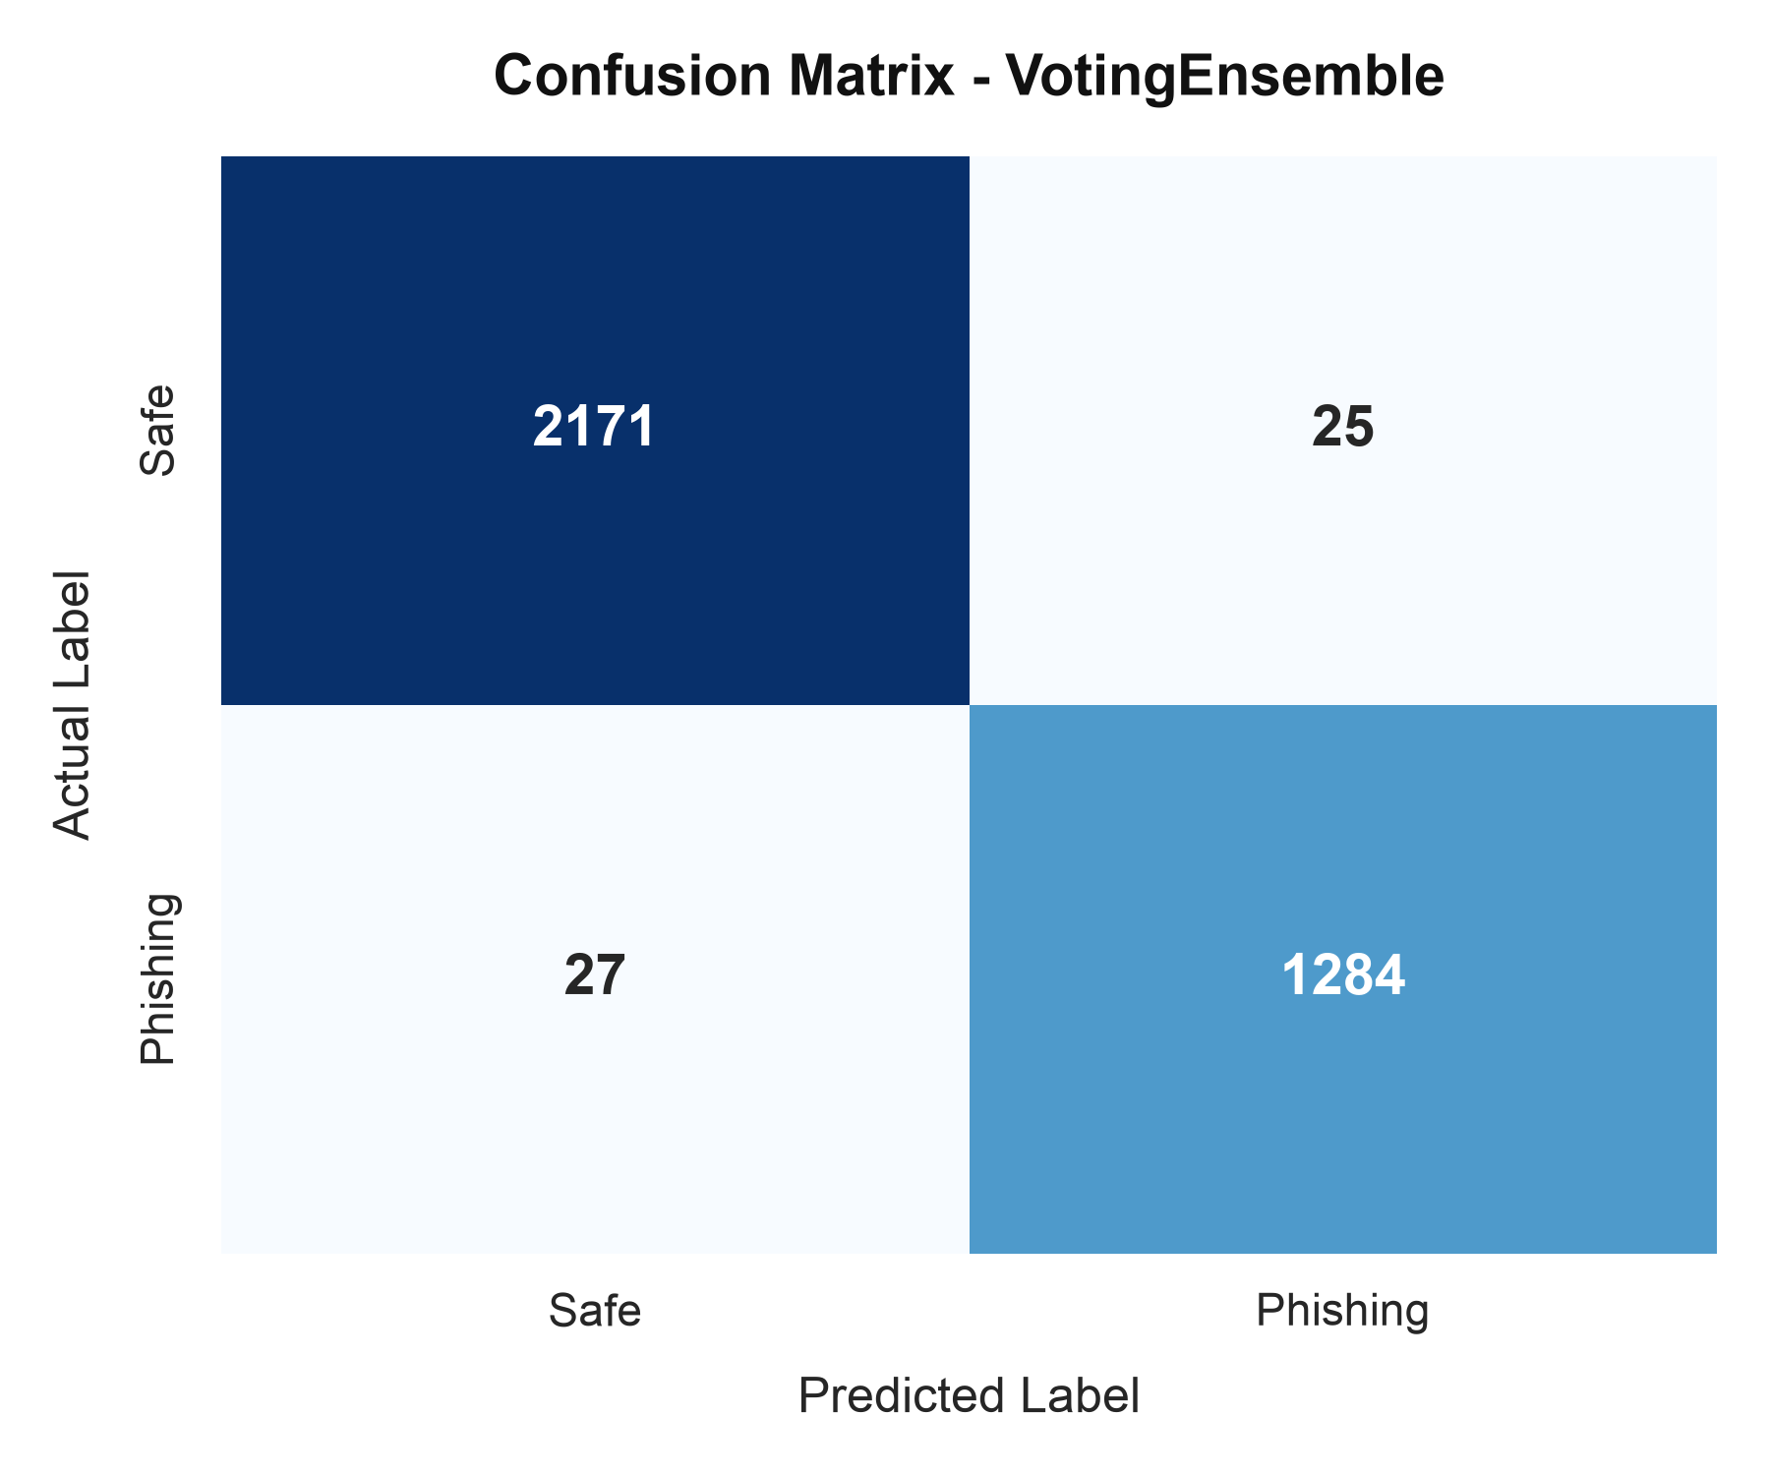
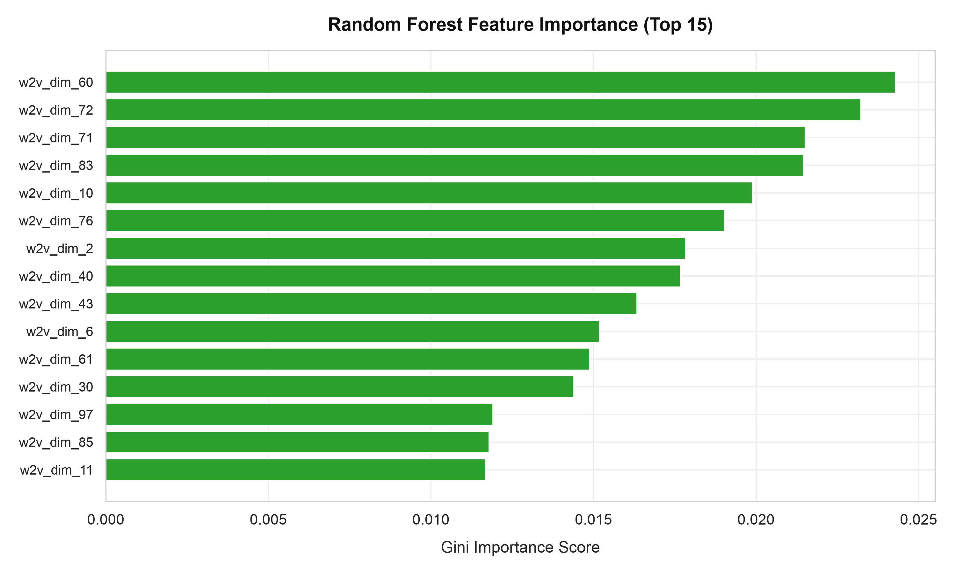
CYBERSECURITY · NLP · MACHINE LEARNING
Feature Importance and Confusion Matrix Analysis
Voting Ensemble — Confusion Matrix
Random Forest — Top 15 Feature Importance Drivers

Slide 9
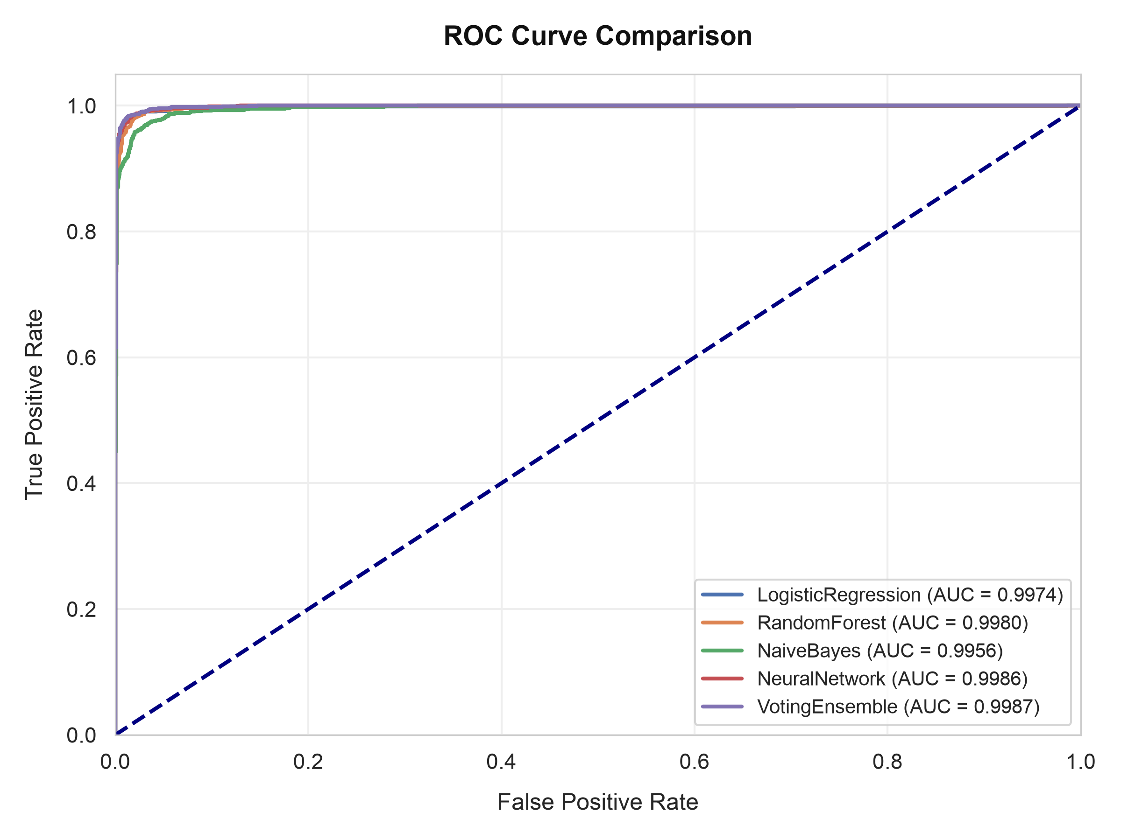
CYBERSECURITY · NLP · MACHINE LEARNING
Validation Curves: ROC Curve Comparison
Receiver Operating Characteristic (ROC) — All Classifiers
Validation Curve Interpretation
──────────────────────────────────
FPR vs TPR Plots the classifier's sensitivity against specificity across all decision thresholds.
AUC score A higher area under the curve indicates stronger discriminative power.
Leading model The Voting Ensemble consistently achieves the highest AUC across all folds.
CV robustness Stratified 5-fold validation ensures the results generalise beyond the training set.
Deployment Threshold can be adjusted live via the Streamlit dashboard probability sliders.

Slide 10
CYBERSECURITY · NLP · MACHINE LEARNING
Ethical Trade-offs and Production Considerations
Precision vs. Recall Dilemma
──────────────────────────────────
High Recall Captures more threats but increases the risk of quarantining legitimate business mail.
High Precision Protects inbox delivery but allows sophisticated phishing messages to pass undetected.
Routing strategy Emails scoring above 90% phishing confidence are quarantined; borderline cases are flagged for manual analyst review.
The Streamlit dashboard exposes adjustable thresholds for operator control.
Bias and Deployment Risks
──────────────────────────────────
Training bias Overemphasis on formatting cues may flag international newsletters as phishing.
Vocabulary drift The Word2Vec model requires periodic retraining as attacker language evolves.
Transparency Automated filtering decisions must be auditable and disputable by end-users.
Data privacy Email body analysis must comply with GDPR and applicable enterprise data policies.

Slide 11
CYBERSECURITY · NLP · MACHINE LEARNING
Summary and Future Work
Key Takeaways
──────────────────────────────────
Hybrid pipeline Combining TF-IDF, Word2Vec, and structural metadata yields state-of-the-art performance.
Best classifier The soft-voting ensemble achieved 98.52% Accuracy and 98.02% F1-Score on the test set.
Data quality Removing 1,115 duplicate emails was critical to prevent test-data contamination.
Validation Stratified 5-fold cross-validation and ROC curves confirm strong generalisation.
The project demonstrates that classical ML with careful feature engineering can rival deep-learning approaches at a fraction of the inference cost.
Future Directions
──────────────────────────────────
DistilBERT Replace static Word2Vec with contextual transformer embeddings for multi-sentence intent.
Email headers Integrate SPF, DKIM, and DMARC authentication results as additional metadata features.
REST API Expose a FastAPI inference endpoint for direct integration at the enterprise email gateway.
Active learning Continuously retrain on analyst-labelled uncertain predictions to reduce drift over time.

