Slide 1
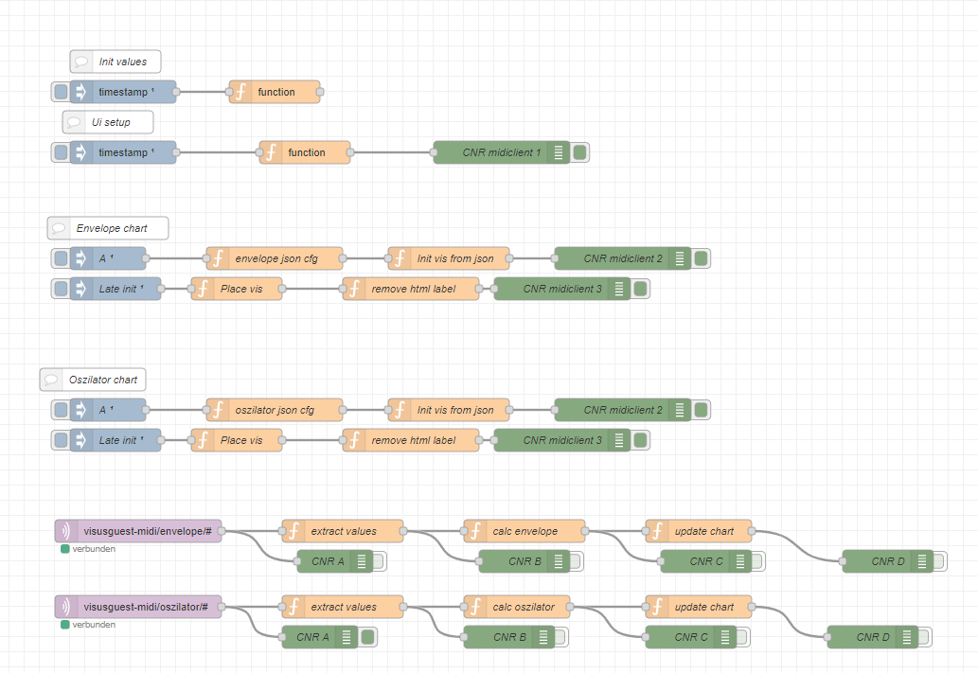
Default Initinitialization
Scheduled Initialization via Inject
Setup Envelope Visualization
Setup Oszilator Visualization
On Message
via MQTT In
Apply Button presses to Visualizations

