Slide 1
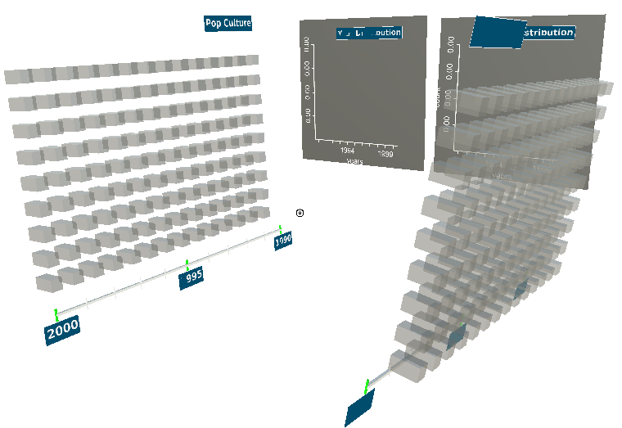
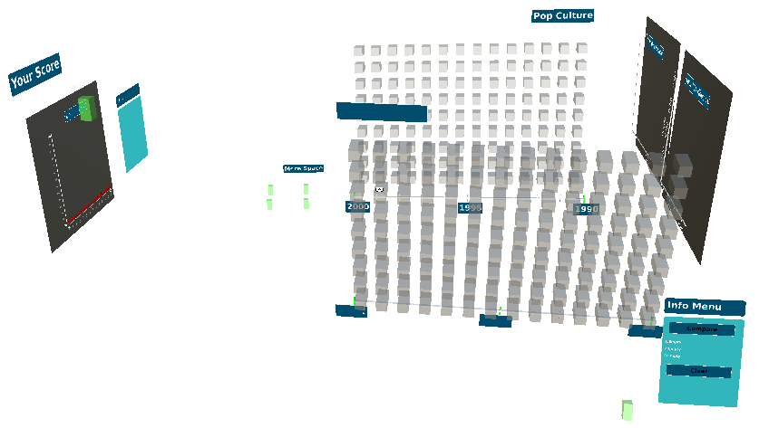
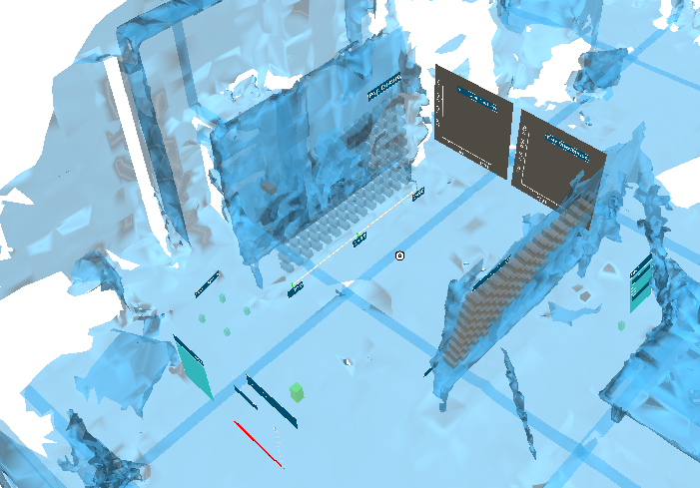
CouchDB
Mopop js implementation
Postrgres
Interactive Walls
(Name, Size, 3D Models,
Placement, Orientation, Slot configuration)
Interaction definitions
(Slot occupation, score calculation, LP detection)
Artists (Name, Year, Rating)
Songs(Album, Coverart, Id, Year, Sold records)
Environment loading and manipulation
Tables
(Name, Size, 3D Models,
Placement, Orientation, Slot configuration)
Visualization generation and placement
Image Recognition database (link to API for download)
Physical-Virtual
Model

