Slide 1
Car Data EDA
Ahmed Salah
Mohamed Ebrahem
Ahmed Ashraf

Slide 2
Columns contained in this data
Name: The name/model of the car.
Year: The manufacturing year of the car.
Selling Price: price of the car.
Km Driven: Total kilometers the car has been driven.
Fuel: Type of car’s fuel.
Seller Type: Who is selling the car (e.g. Dealer, Individual).
Transmission: Type of transmission (Manual or Automatic).
Owner: Ownership history.

Slide 3
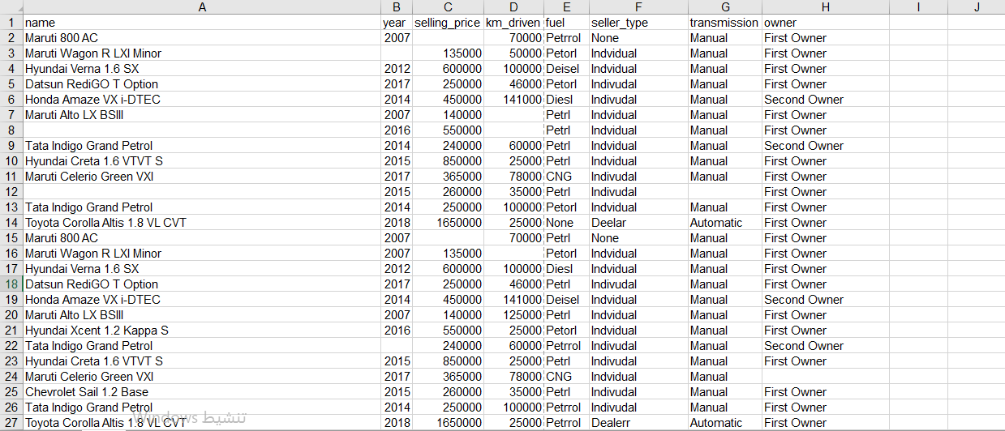
A preview of the data before cleaning

Slide 4
A preview of the data before cleaning

Slide 5
Our approach to clean the data
Standardize all corrupted values (e.g. Petorl, Diesl).
removing all duplicated values.
Handling missing values.
Removing all outliers and invalid values.

Slide 6
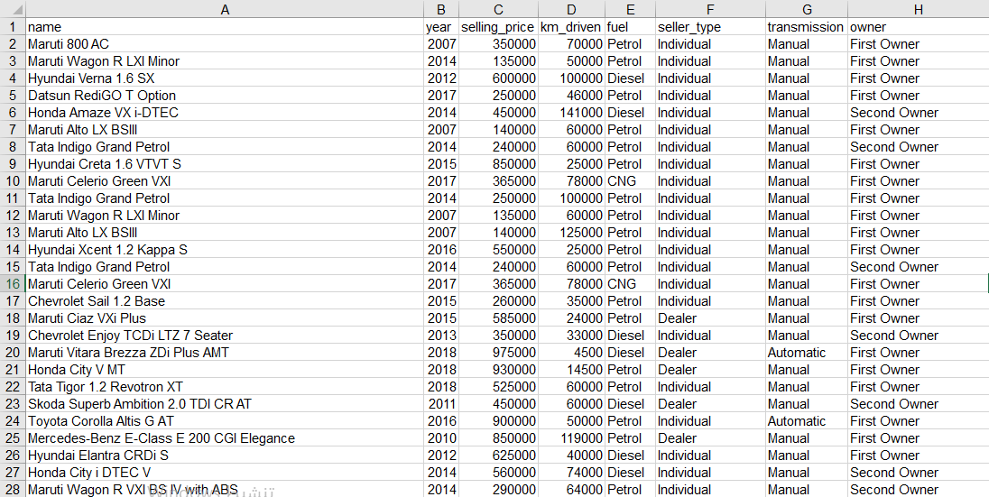
A preview of the data after cleaning

Slide 7
Visualizing data
&
Final insights

Slide 8
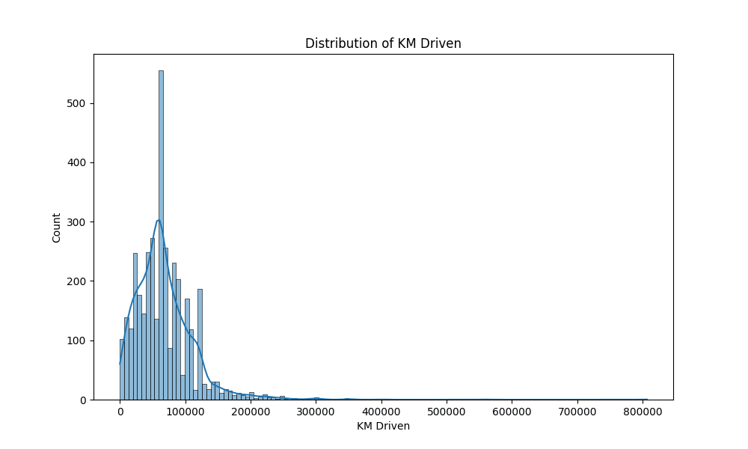

Slide 9
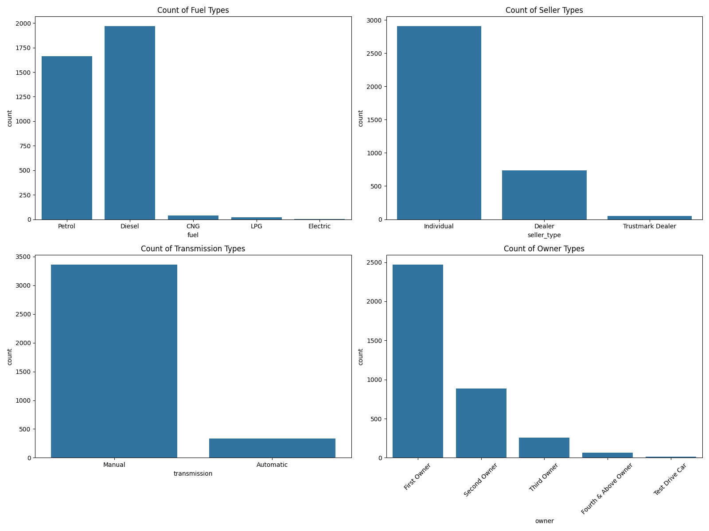

Slide 10
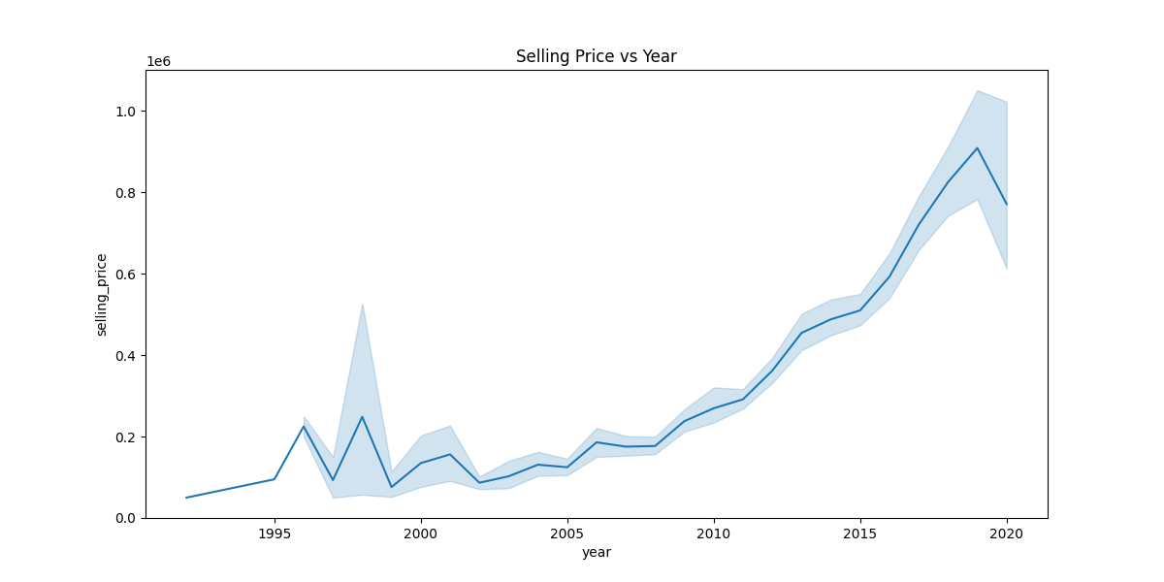

Slide 11
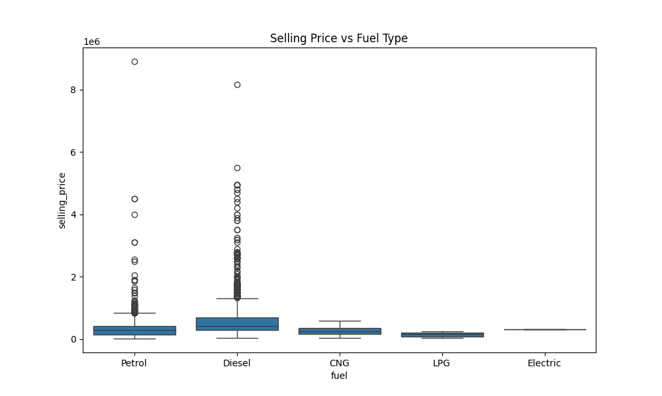

Slide 12
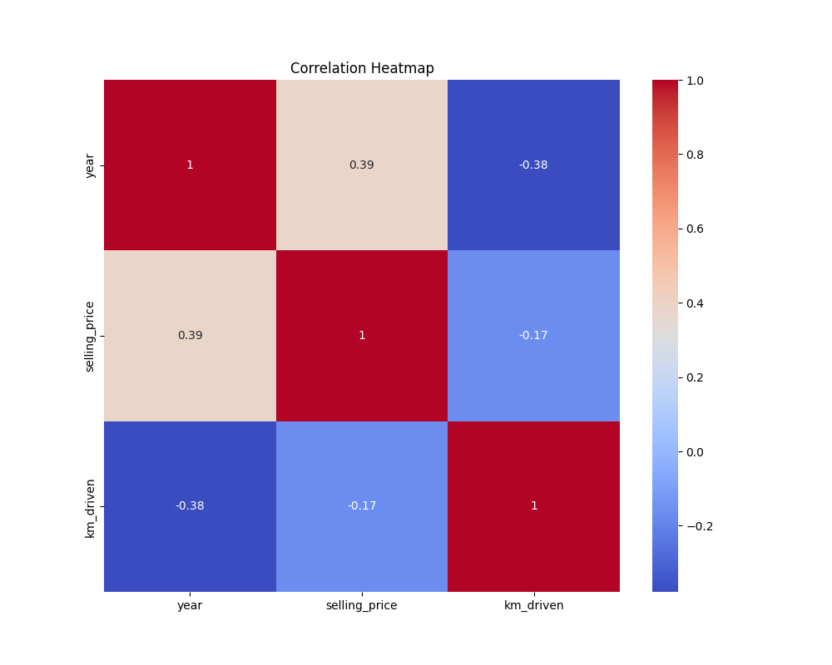

Slide 13
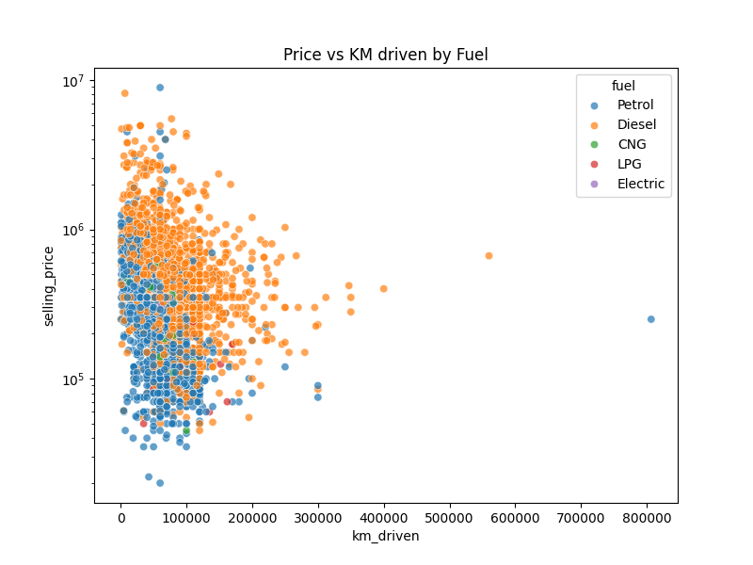

Slide 14
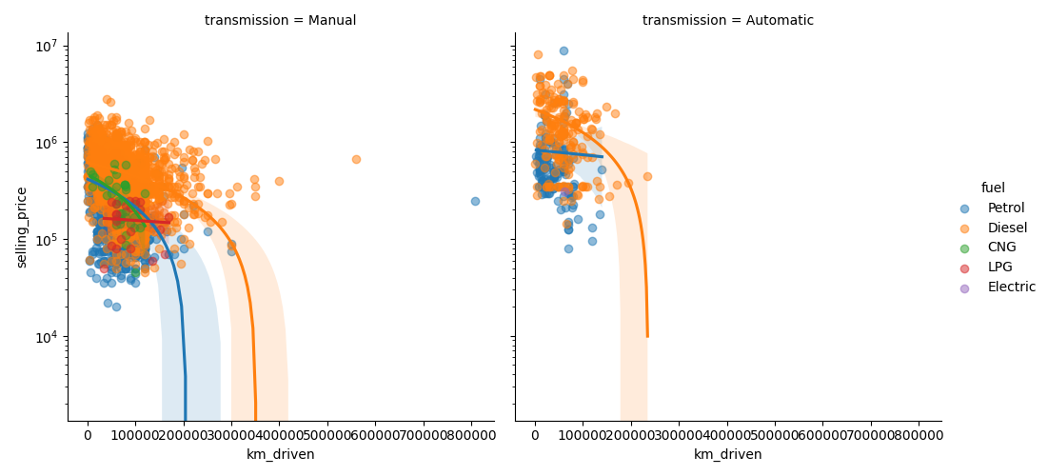

Slide 15
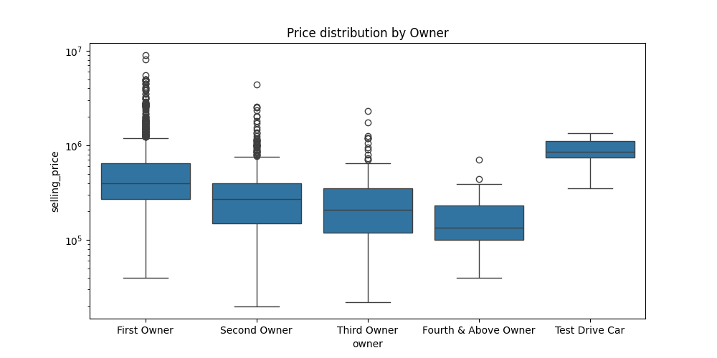

Slide 16
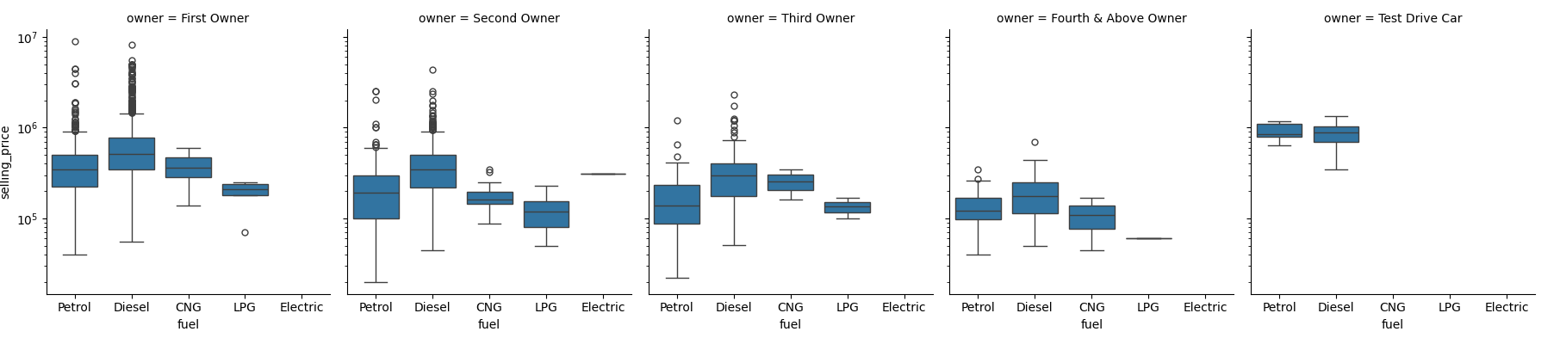

Slide 17
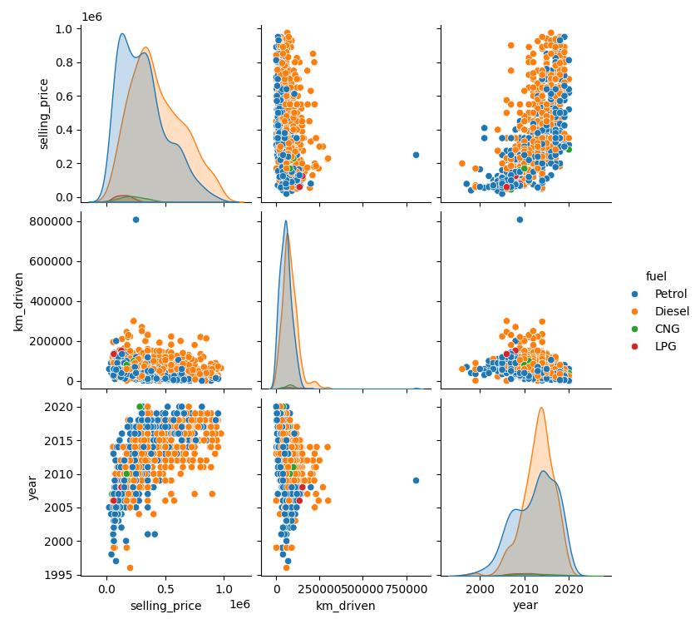

Slide 18
Final insights
The vast majority of cars run on Petrol or Diesel.
Most vehicles are sold by Individuals.
Manual transmission cars significantly outnumber Automatic cars.
Newer cars are sold for higher prices ,with a sharp increase after .2012
Diesel cars generally command a higher selling price compared to Petrol cars.
First Owner cars have the highest price distribution.
Automatic cars have higher selling price range compared to Manual cars.

Slide 19
?Any Questions

Slide 20
!Thank you

