Slide 1
Meshes
Presenter Name

Slide 2
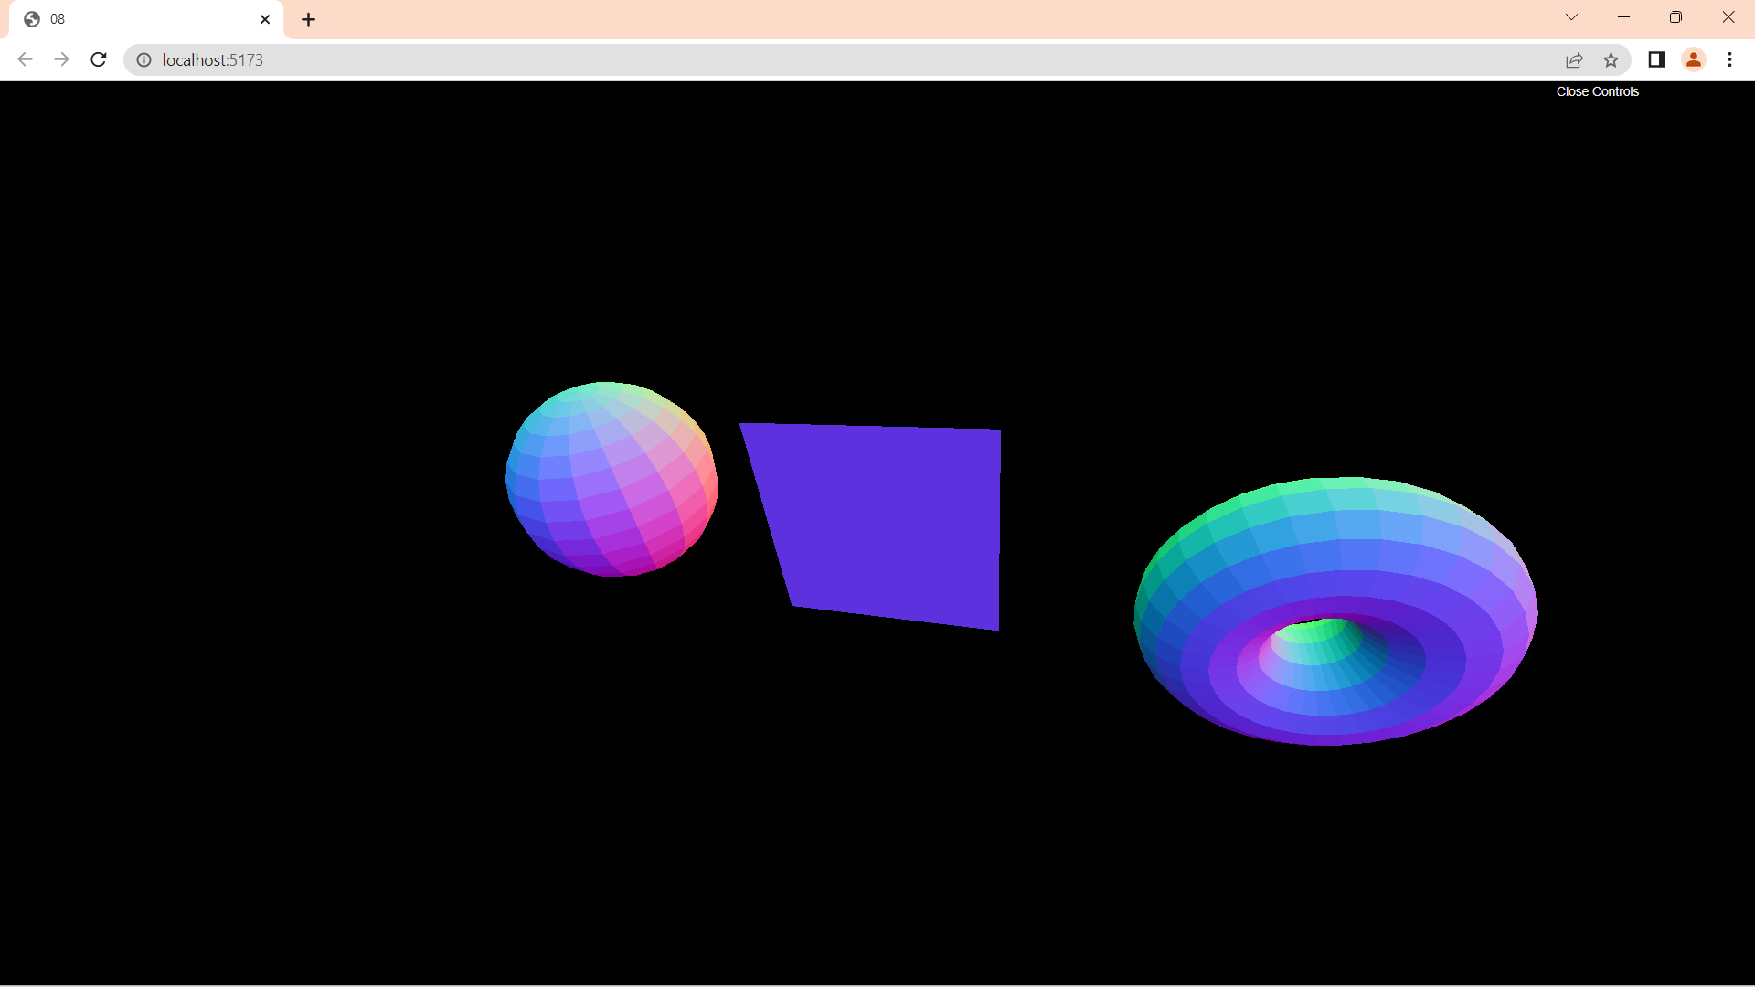
Normal
const material = new THREE.MeshNormalMaterial()
// material.wireframe = true
material.flatShading = true

Slide 3
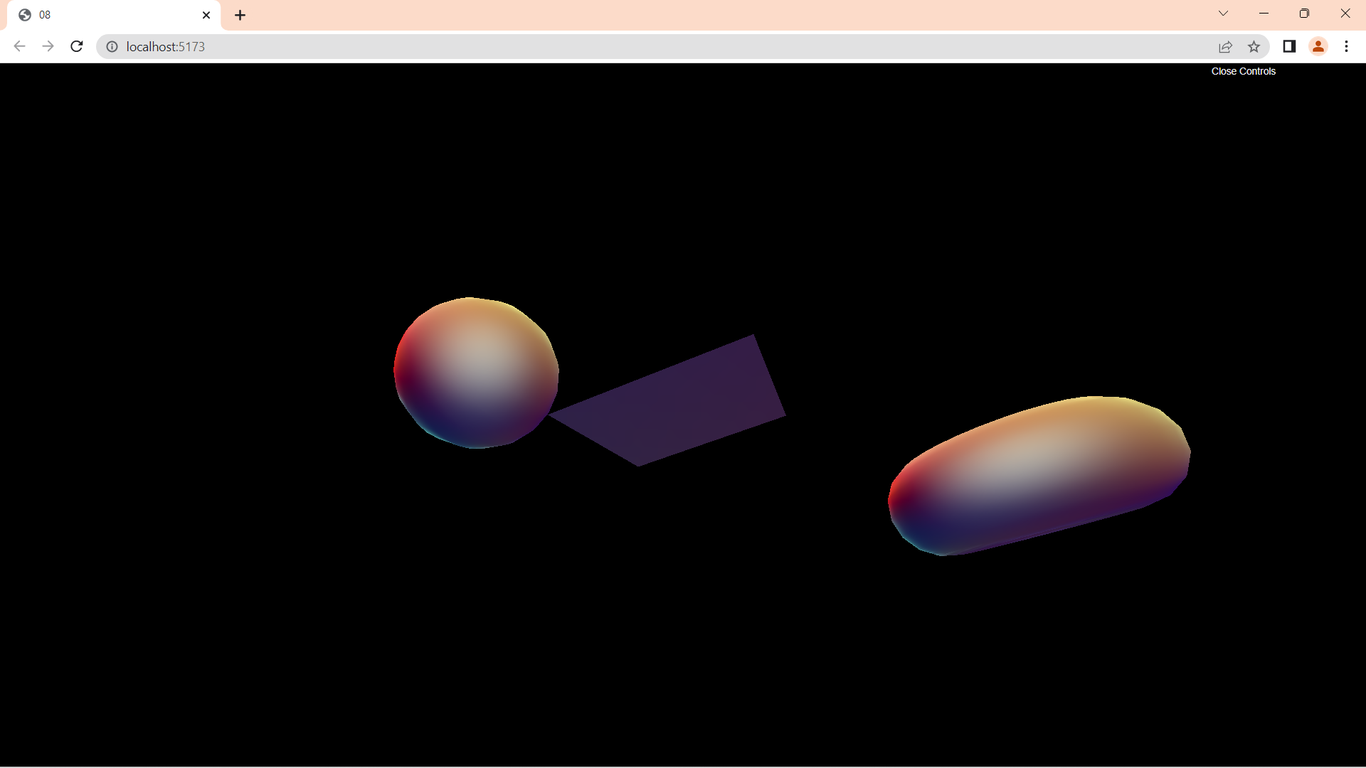
Matcap: it has its own geometry/Texture
const material = new THREE.MeshMatcapMaterial()
material.matcap = matcapTexture

Slide 4
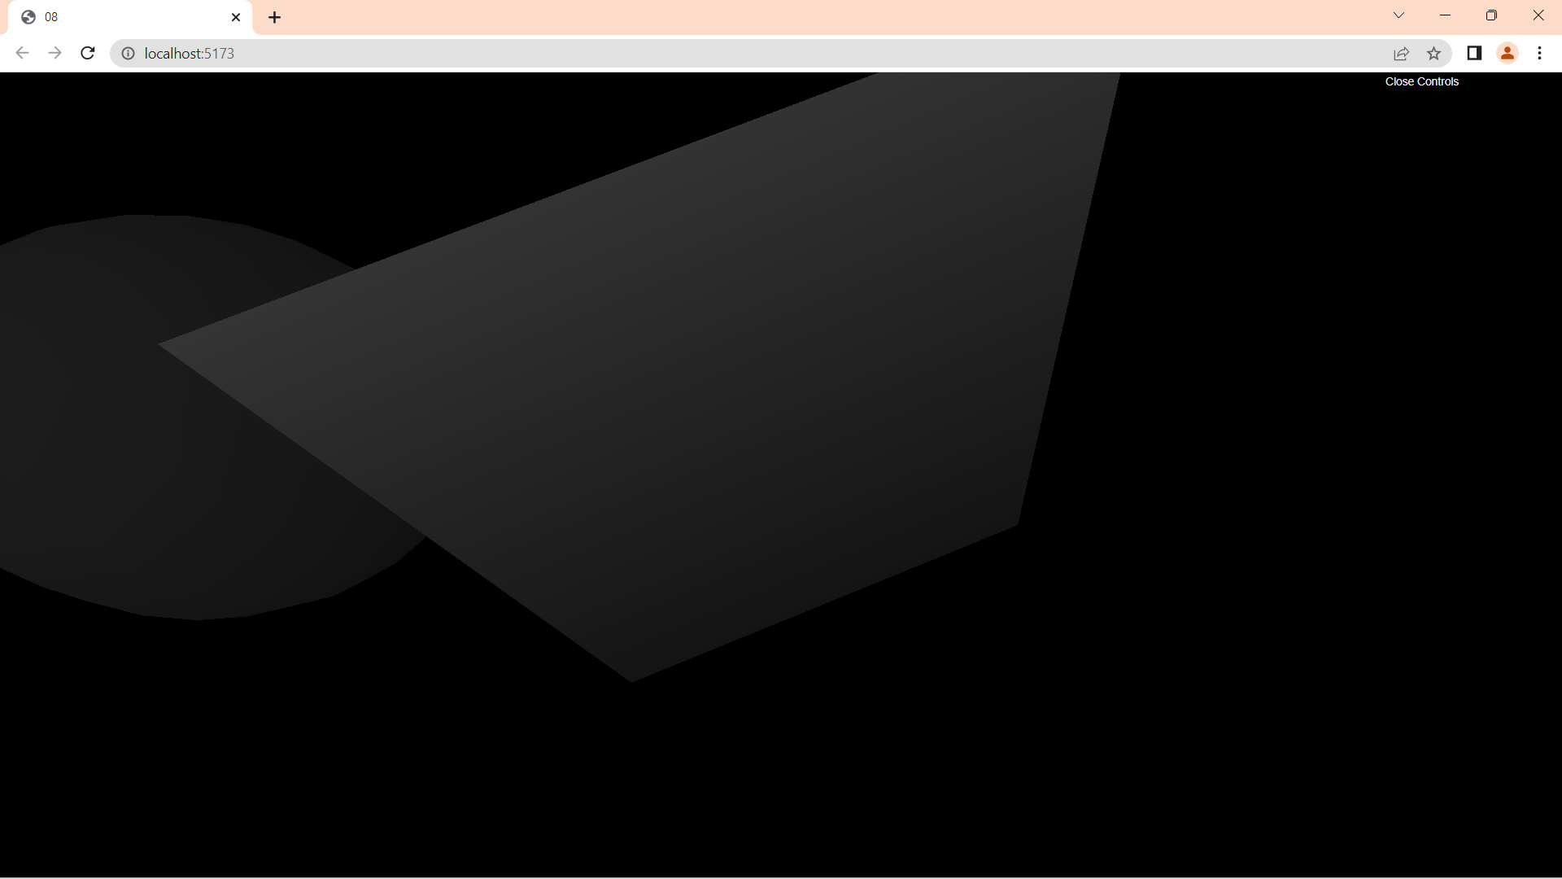
Depth: based on near and far values
const material = new THREE.MeshDepthMaterial()

Slide 5



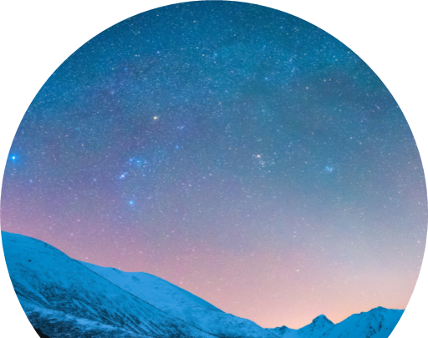
From now one we will need lights

Slide 6
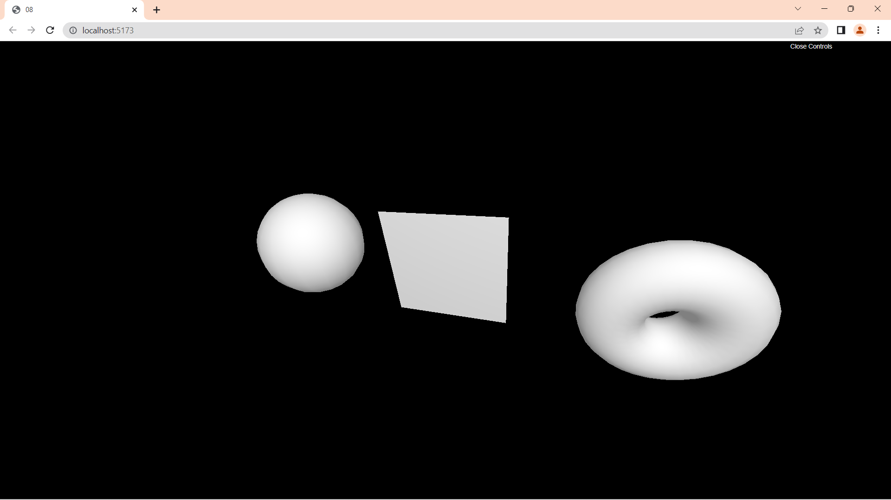
Lamber
const material = new THREE.MeshLambertMaterial()

Slide 7
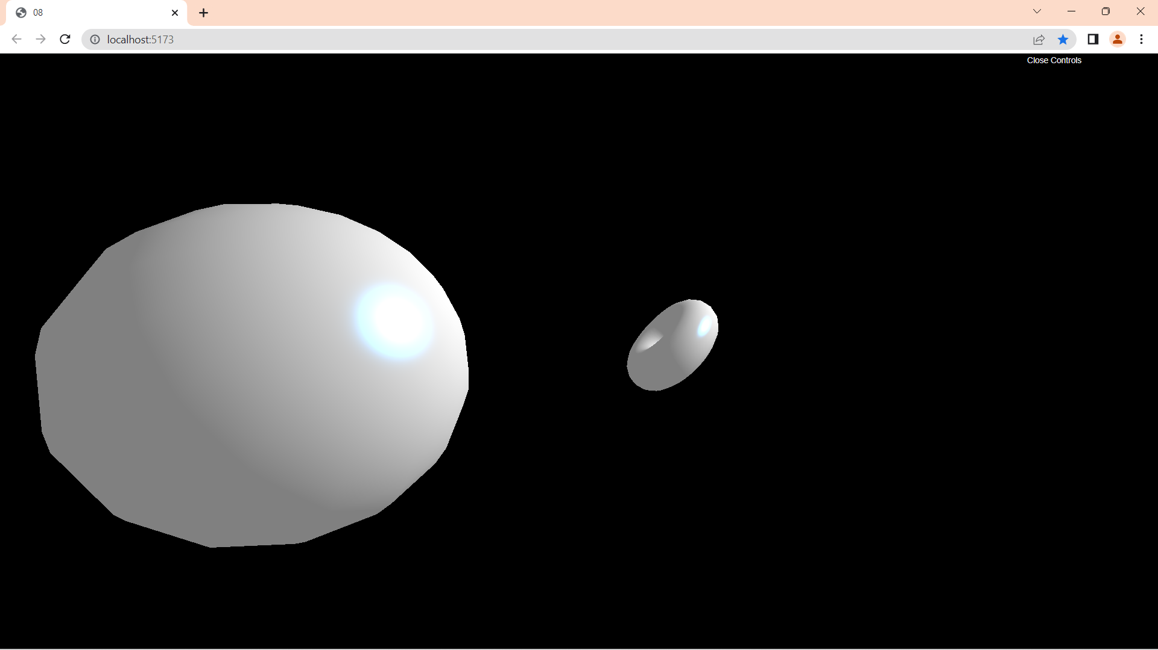
Phong
const material = new THREE.MeshPhongMaterial()
material.shininess = 100
material.specular = new THREE.Color(0x1188ff)

Slide 8
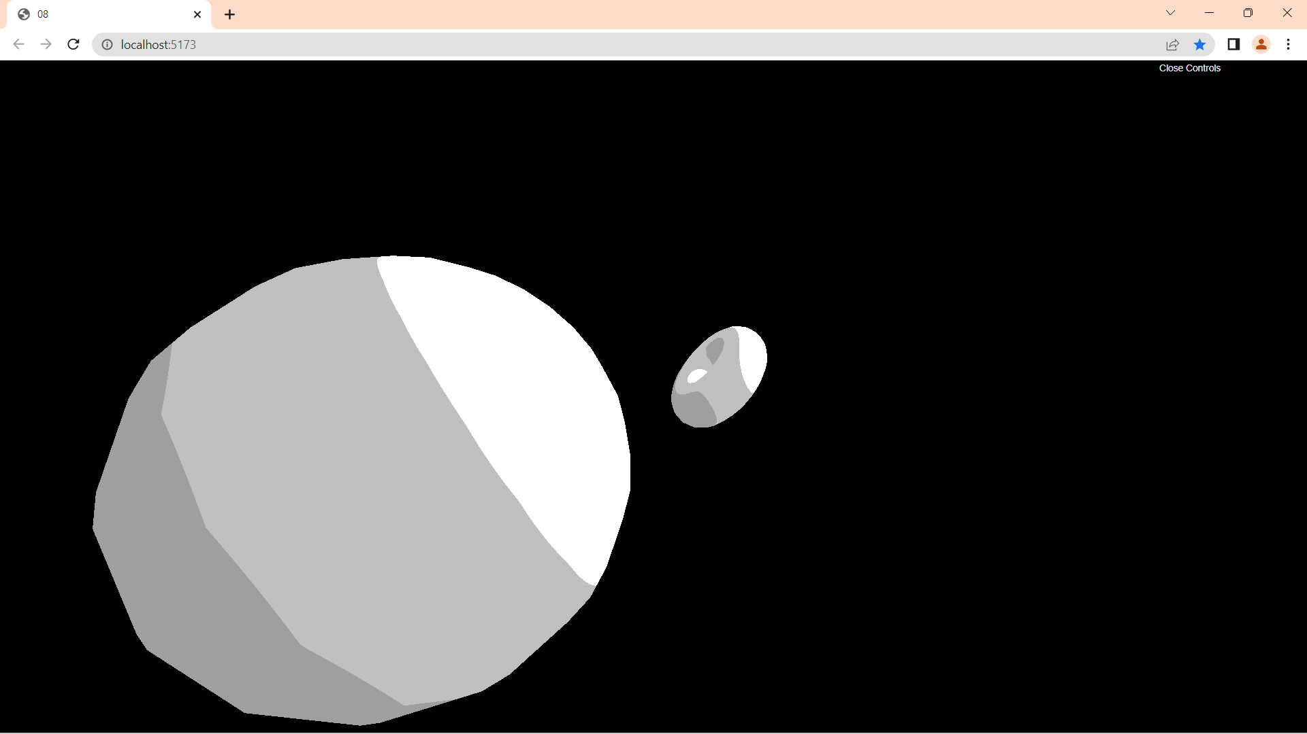
Toon: uses the gradient texture
const material = new THREE.MeshToonMaterial()
gradientTexture.generateMipmaps = false
gradientTexture.minFilter = THREE.NearestFilter
gradientTexture.magFilter = THREE.NearestFilter
material.gradientMap = gradientTexture

Slide 9
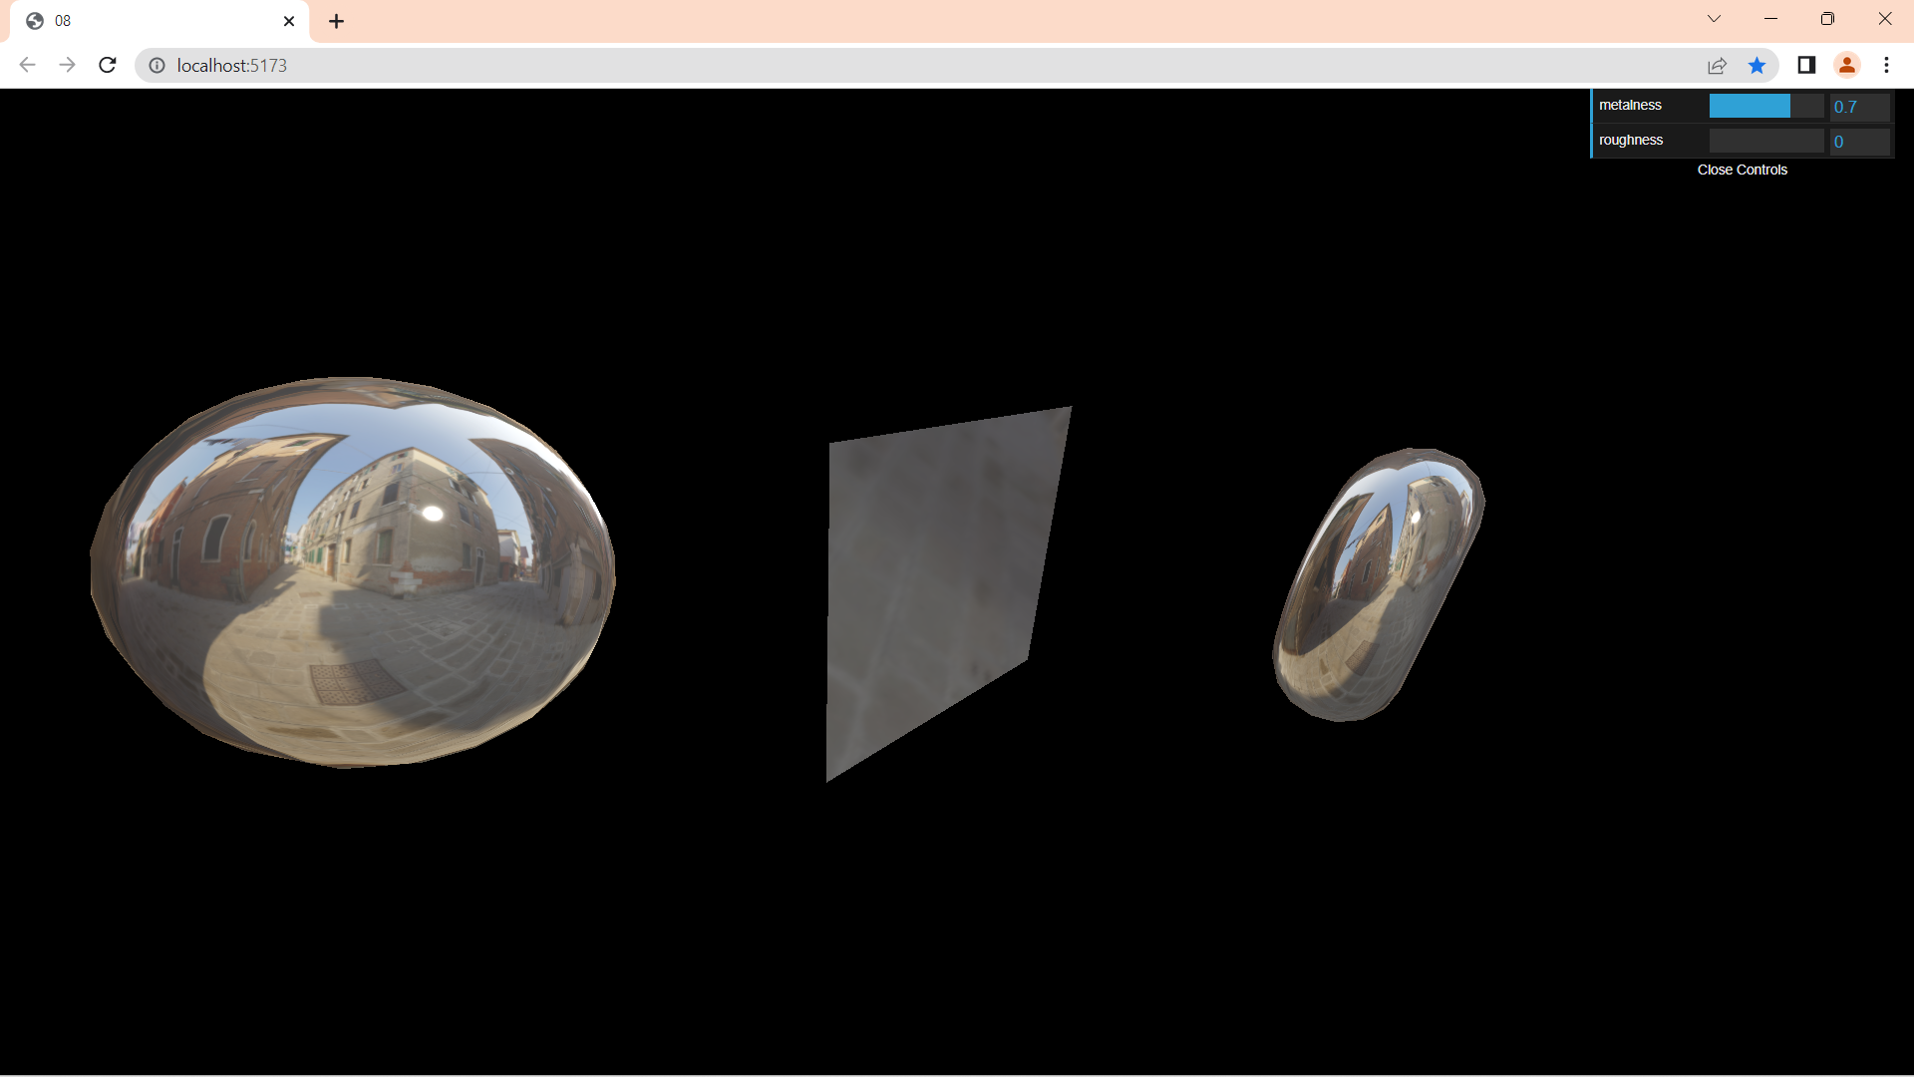
Environment Map: needs a cube texture loader
const material = new THREE.MeshStandardMaterial()
material.metalness = 0.7
material.roughness = 0.2
gui.add(material, 'metalness').min(0).max(1).step(0.0001)
gui.add(material, 'roughness').min(0).max(1).step(0.0001)
material.envMap = environmentMapTexture

Slide 10
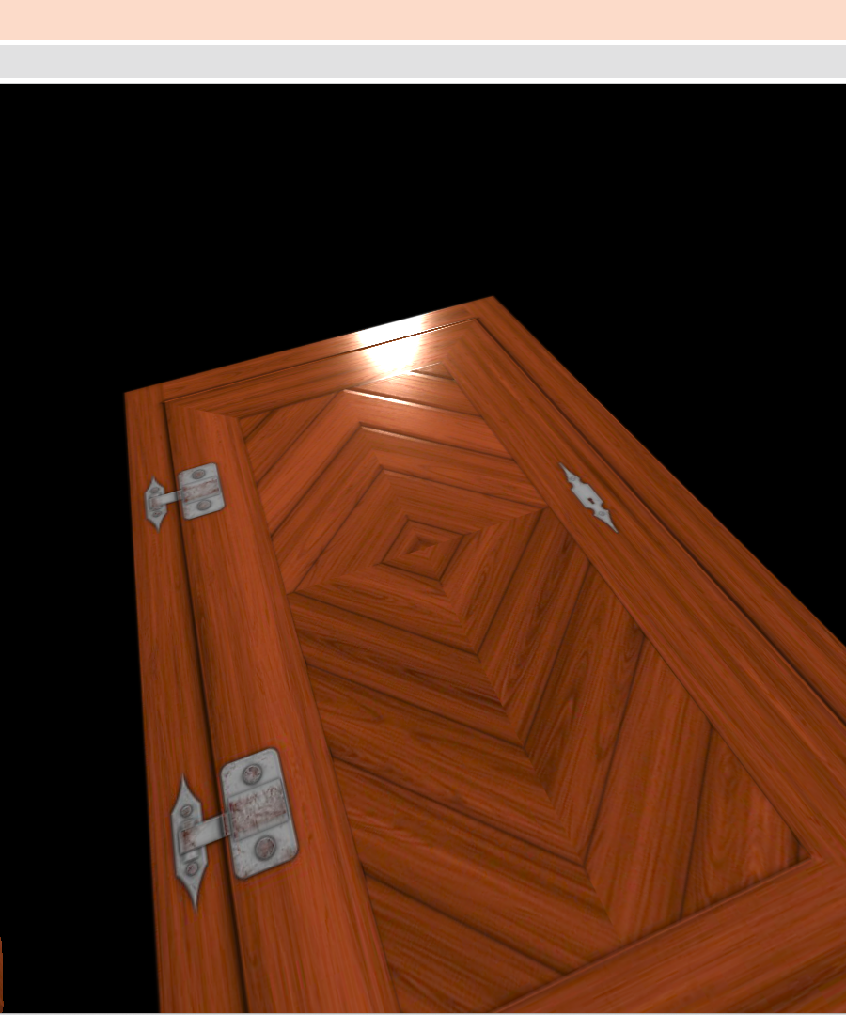
Standard
const material = new THREE.MeshStandardMaterial()
// material.metalness = 0
// material.roughness = 1
gui.add(material, 'metalness').min(0).max(1).step(0.0001)
gui.add(material, 'roughness').min(0).max(1).step(0.0001)
material.map = doorColorTexture
material.aoMap = doorAmbientOcclusionTexture
material.aoMapIntensity = 1
material.displacementMap = doorHeightTexture
material.displacementScale = 0.05
material.metalnessMap = doorMetalnessTexture
material.roughnessMap = doorRoughnessTexture
material.normalMap = doorNormalTexture
material.normalScale.set(0.5, 0.5)
material.transparent = true
material.alphaMap = doorAlphaTexture

Slide 11
Physical
Like the Standard with clear coat effect

