Slide 1
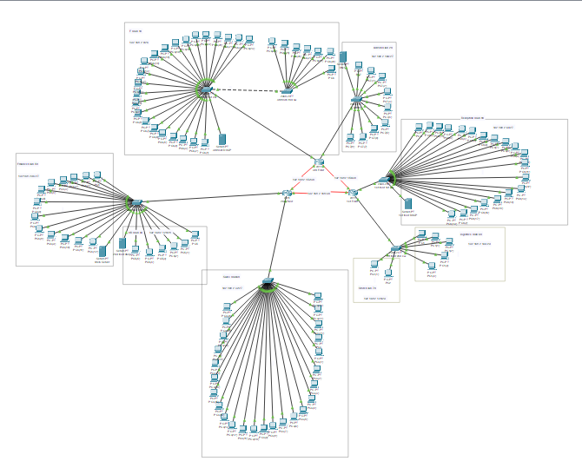
Hotel Network Infrastructure Design
Course: CIE 447 – Computer Networks
Semester: Spring 2025 Instructor: Dr Mohamed Samir Eng: Mohamed Saleh Eng Amira EzzEldein

Slide 2
Project Overview
Network Scope
3-floor hotel, scalable design
Subnetting
Address block 192.168.2.0/24 with VLANs
Routing Protocol
OSPF for inter-floor routing
Services
DHCP, DNS, Web servers deployed

Slide 3
Network Topology
Floors & Devices
Router Placement
Connections
VLANs
3 Floors, separate routers
All routers centralized on 3rd floor IT room
Serial DCE cables link routers
Consistent VLANs deployed across floors
Layer 2 switches connecting departments

Slide 4
Subnetting Strategy
Department
Subnet Mask
VLAN
IP Range
Reception
/27
80
192.168.2.64–95
Store
/29
70
192.168.2.120–127
Logistics
/29
60
192.168.2.136–143
Finance
/28
50
192.168.2.96–111
HR
/28
40
192.168.2.128–143
Sales
/27
30
192.168.2.32–63
Admin
/27
20
192.168.2.160–182
IT
/26
10
192.168.2.0–63

Slide 5
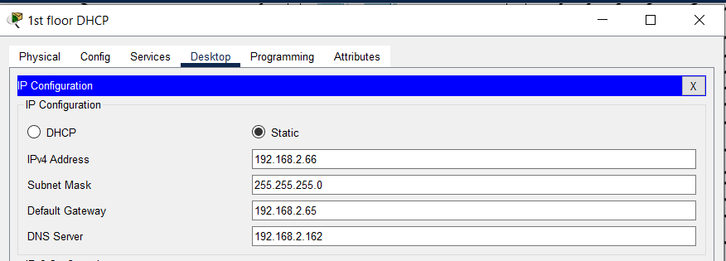
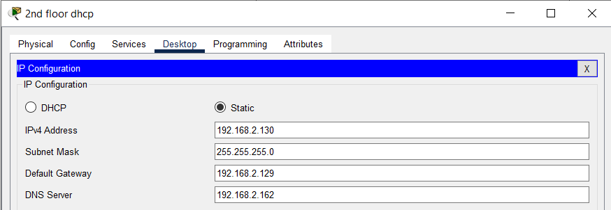
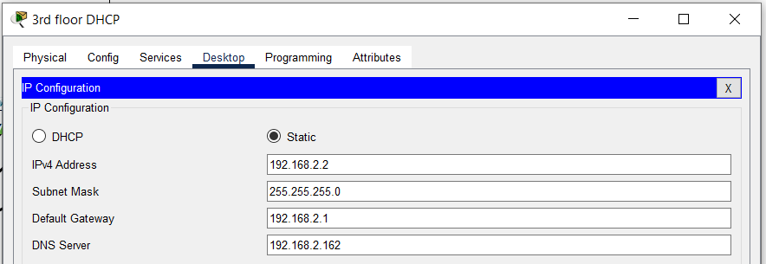
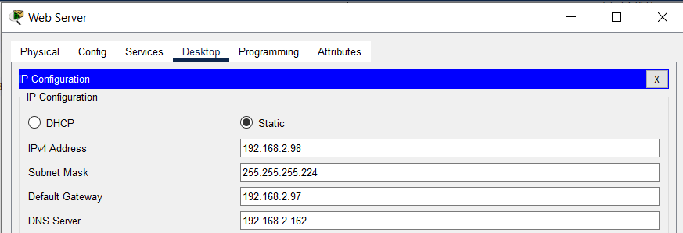
VLAN and Server Assignments
DNS Server
Web Server
VLAN 20, IP 192.168.2.114
VLAN 50, IP 192.168.2.98
DHCP Servers
VLAN 80 – 192.168.2.66
VLAN 40 – 192.168.2.130
VLAN 10 – 192.168.2.2

Slide 6
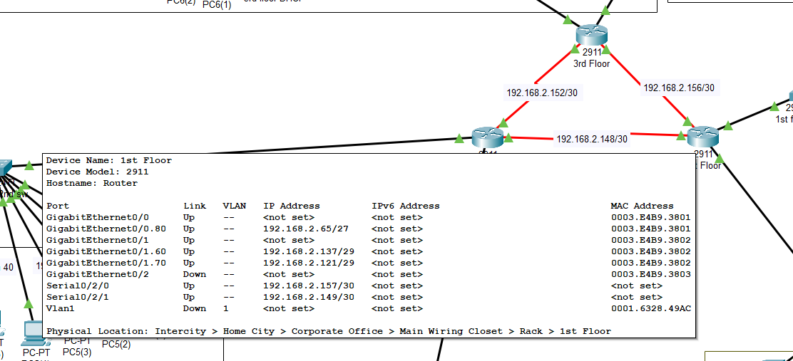
Routing Configuration
Routing Protocol
Router IDs
Router-on-a-Stick
Serial Link IPs
OSPF between routers for dynamic routing
Loopback interfaces assigned uniquely
Subinterfaces manage VLAN routing
R1-R2: 192.168.2.148/30
R2-R3: 192.168.2.152/30
R1-R3: 192.168.2.156/30

Slide 7
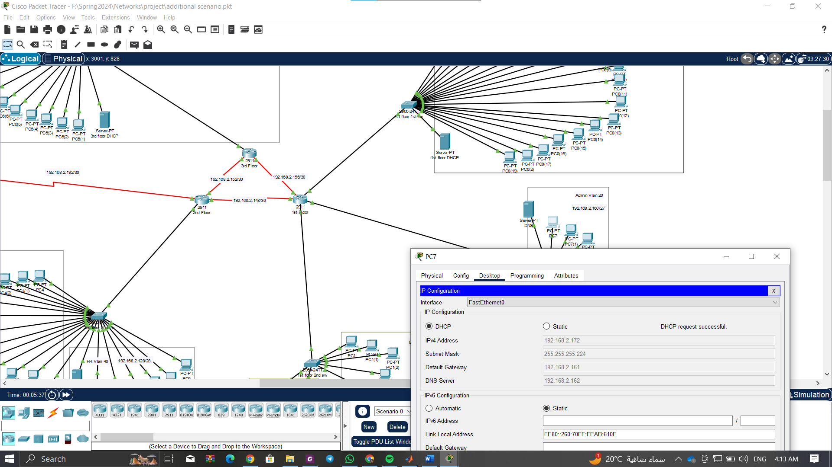
DHCP Pool Configuration
1
DHCP Setup
Subnet, gateway, DNS assigned per pool
2
Conflict Resolution
Admin VLAN subnet size adjusted to /28
3
Overlap Handling
Eliminated overlapping IP ranges
4
Testing
Dynamic client lease verification performed

Slide 8
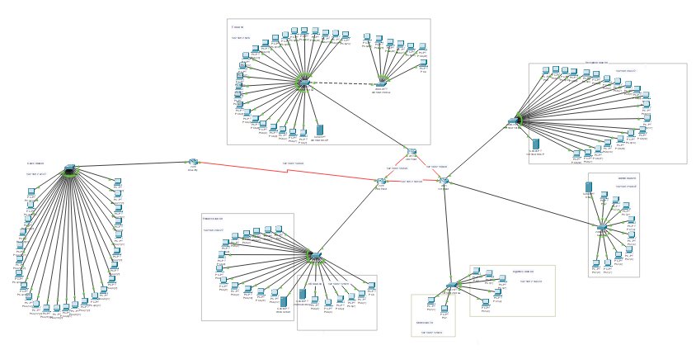
Relocation Scenario
Sales Department
Admin Department
Config Migration
Moved to headquarters with extended link connection
Moved to first floor, VLAN 20 reassigned
VLAN and DHCP pool shifted to floor 1 router

Slide 9
Implementation Steps for Relocation
Remove Old Config
Delete VLAN 20 subinterface on floor 3 router
Apply New Config
Add VLAN 20 on floor 1 router and DHCP server
Switch Port Updates
Reassign physical switch ports for Admin
Verification
Test connectivity and web access after changes

Slide 10
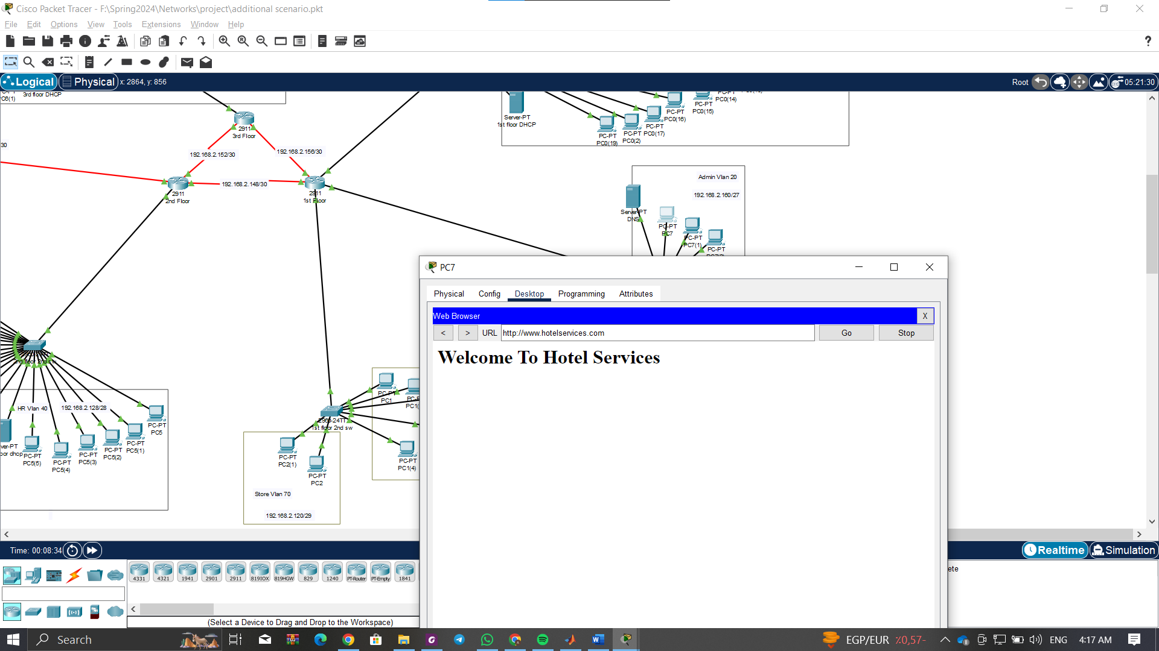
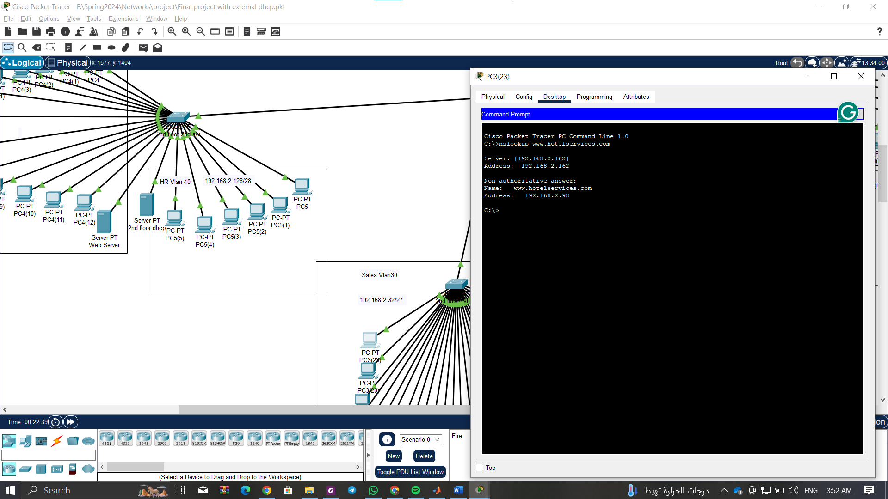
Testing and Verification
Connectivity
Website Access
DNS Functionality
Ping tests passed between all departments
Accessible: www.hotelservices.com
Resolves correctly for all clients
Routing
DHCP
OSPF routes verified via show commands
Leases correctly assigned to clients

Slide 11
Conclusion
Successfully designed a modular, scalable hotel network
Efficient use of subnets and VLANs
Dynamic routing with OSPF
DHCP and DNS functioning as expected
Network adapted seamlessly to relocation scenario

