Slide 1
CSE 360 · COMPUTER NETWORKS
Building a Network,
One Hop at a Time
Five Packet Tracer labs: from one LAN to VLANs
PRESENTED BY
PRESENTED TO
Anindya Saha
Abu Sayed Md. Mostafizur Rahman
Roll: 354
Professor
Nishat Tasnim
Lecturer
FOR
CSE-360 — Computer Networks Laboratory
Computer Science and Engineering, Jahangirnagar University · 2026/11/??
5 labs · 1 model
Sources: CSE 360 lab handouts 2, 4, 5, 6, 7 · Packet Tracer screenshots
01 / 17
Notes:
Good morning. I am [name], and this is a short walk through five Packet Tracer labs from CSE 360. The labs build one idea at a time: a single LAN, then a router, then several routers, then mixed serial and Ethernet links, and finally VLANs. Replace the bracketed fields with your name, ID, section, both teachers' names and positions, course code and title, department, university, and date before presenting.

Slide 2
CONCEPTS
One question decides the path
Is the destination inside my subnet?
SAME SUBNET · LAYER 2
DIFFERENT SUBNET · LAYER 3
ARP → switch
Gateway → router
IP address and mask match.
Send to the default gateway.
ARP finds the MAC address.
The router keeps the packet.
The switch forwards by port.
It chooses the next hop.
Every lab changes the topology, not the question.
Notes:
Every forwarding decision starts with one question: is the destination inside my subnet? If the IP address and mask match, the destination is local. The host uses ARP to find the MAC address, and the switch forwards the frame by its MAC table. If the destination is not local, the host sends the frame to its default gateway, which must be a router address in the same subnet. The router keeps the IP packet, rewrites the Layer 2 frame, and chooses the next hop from its routing table. Each router interface is a separate broadcast domain. Every lab changes the topology, but not this question.

Slide 3
CONCEPTS
The services on top
What the user sees, above the path.
DNS
HTTP
ICMP
name → IP
page transfer
ping / tracert
A record on the server
TCP port 80
reachability
Test bottom-up: link → ARP → ping → name → page.
IP works but the name fails: DNS is the problem.
Notes:
Above the path, three services explain what the user sees. DNS turns a name into an IP address using an A record. HTTP carries the page over TCP port 80. ICMP is what ping and tracert use to test reachability and the path. Troubleshoot bottom-up: check the link, then ARP, then ping the IP, then ping the name, then open the page. If the IP works but the name fails, DNS is the problem. If the name works but the page fails, HTTP or the file is the problem.

Slide 4
TOOLS
The lab bench
SOFTWARE
HARDWARE
Packet Tracer — topology, CLI, simulation
1841 routers · 2960 / 2950 switches
PuTTY / SSH — remote console
PC-PT and Server-PT hosts
Command prompt — ping, tracert, ipconfig, arp
Copper · console · serial links
Green = up · red = down
CLI: > user → # privileged → (config) → (config-if) · no shutdown brings a port up.
wr saves the running config. Console is local; Telnet and SSH are remote.
Notes:
These are the tools and devices in the labs. Packet Tracer gives us the topology, the device CLI, and simulation mode. PuTTY or SSH Secure Shell opens a remote console; the console cable is local access. The command prompt gives us ping, tracert, ipconfig, and arp. The routers are Cisco 1841s, the switches are 2960 or 2950, and the hosts are PC-PT or Server-PT. Links are copper, console, or serial. In the CLI, remember the ladder: user mode, privileged mode, global config, interface config. No shutdown is the same as Port Status On, and wr saves the running config. A green link is up; red is down.

Slide 5
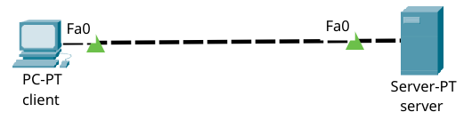
LAB 2 · CLIENT–SERVER
One cable, one subnet
Client 192.168.0.110/24 · Server 192.168.0.105/24
DNS and HTTP both run on the server.
Same subnet → ARP, then the switch. No gateway.
Notes:
Lab 2 starts with the simplest possible network. The client is 192.168.0.110/24, and the server is 192.168.0.105/24. The server runs both DNS and HTTP. Because both addresses are in the same subnet, the client does not need a gateway. It ARPs for the server, the switch forwards the frame, and the conversation stays local. Test the IP first, then the name. If the IP ping fails, the problem is the link, address, or mask, not DNS.

Slide 6
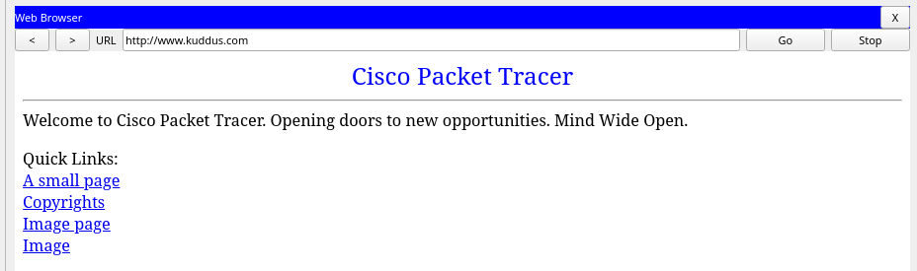
LAB 2 · DNS + HTTP
The name becomes a page
www.kuddus.com → 192.168.0.105
DNS resolves the name; HTTP returns the page.
Notes:
Now we open the browser on the client and go to www.kuddus.com. The client asks the DNS server for the A record, gets 192.168.0.105, and then sends the HTTP request to that address. The page loads, so both services work. In simulation mode you can see the DNS query happen before the HTTP exchange. If the name fails, check the DNS field, the DNS service, and the record. If the name works but the page does not, check the HTTP service and the file name.

Slide 7
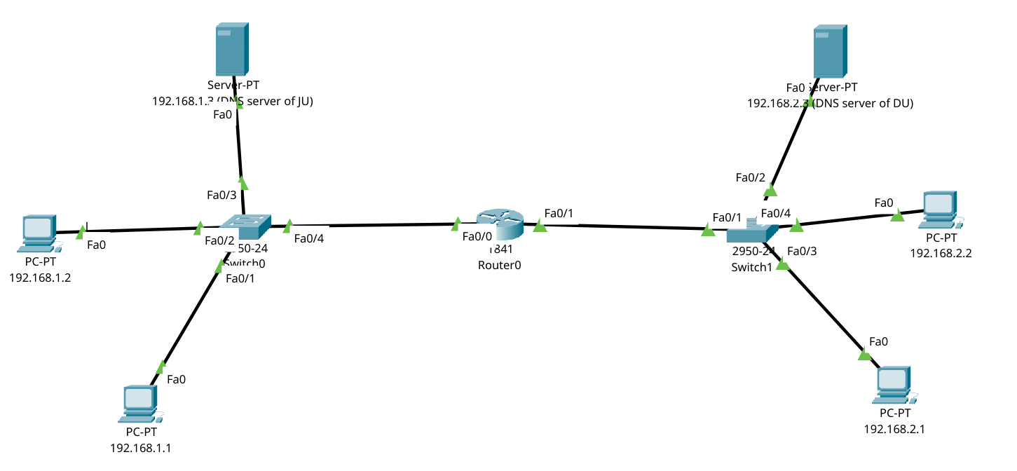
LAB 2 · FIRST ROUTER
A router is the exit from a subnet
Each PC's gateway is the router leg in its own subnet.
Notes:
Lab 2b adds one router between two campuses. JU is 192.168.1.0/24 and DU is 192.168.2.0/24. The router has one leg in each subnet, 192.168.1.4 and 192.168.2.4, and both interfaces must be no shutdown. Each PC uses the router leg in its own subnet as its default gateway. No routing protocol is needed because both networks are directly connected. A wrong gateway still lets the PC ping locally, but remote ping fails. That is the quickest way to spot the mistake.

Slide 8
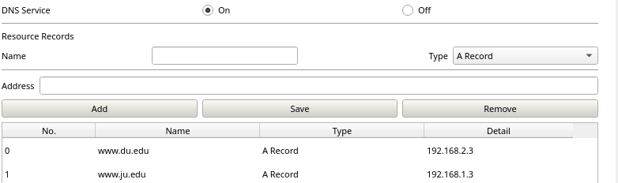
LAB 2 · DNS RECORDS
Both servers need both records
www.ju.edu → 192.168.1.3
www.du.edu → 192.168.2.3
Each server holds both A records. No forwarding.
Notes:
There is no DNS forwarding in this lab, so each server must hold both A records: www.ju.edu points to 192.168.1.3, and www.du.edu points to 192.168.2.3. The screenshot shows both entries in the record table, and the JU server carries the same pair. The DNS service must be on. Test from the far campus, not just locally: ping the remote PC, then resolve the remote name. A missing record or a wrong gateway will show up there.

Slide 9
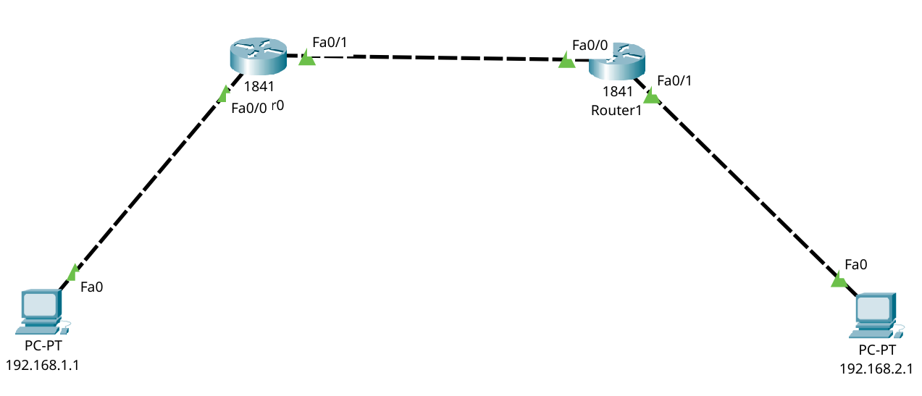
LAB 4 · TWO ROUTERS
Two routers create a transit network
Each router knows its two connected networks (C).
The far LAN needs a static route (S) in both directions.
Notes:
Lab 4 uses two routers and three networks: 192.168.1.0/24 on the left, 192.168.3.0/24 in the middle, and 192.168.2.0/24 on the right. Each router automatically knows its two connected networks, shown as C. The far LAN is not connected, so each router needs one static route, shown as S. R0 reaches 192.168.2.0/24 through 192.168.3.2, and R1 mirrors it. The next hop must be an address on a connected subnet. The reverse route is mandatory; without it, ping works one way only. The second version adds a hub and a middle PC, but the logic is the same: one route per remote network.

Slide 10
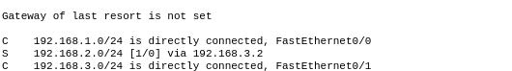
LAB 4 · ROUTING TABLE
Reading the routing table
C — directly connected
S — static route via 192.168.3.2
The next hop must be a connected address.
The reverse route is mandatory.
Notes:
This is the routing table on R0. The C lines are directly connected networks and appear automatically. The S line is the static route we added: 192.168.2.0/24 through 192.168.3.2. The gateway of last resort is not set, which is fine here because every destination is known. Read the table from the specific routes down. Show ip route is the first command to run when traffic stops. From privileged mode, wr saves the running config to startup.

Slide 11
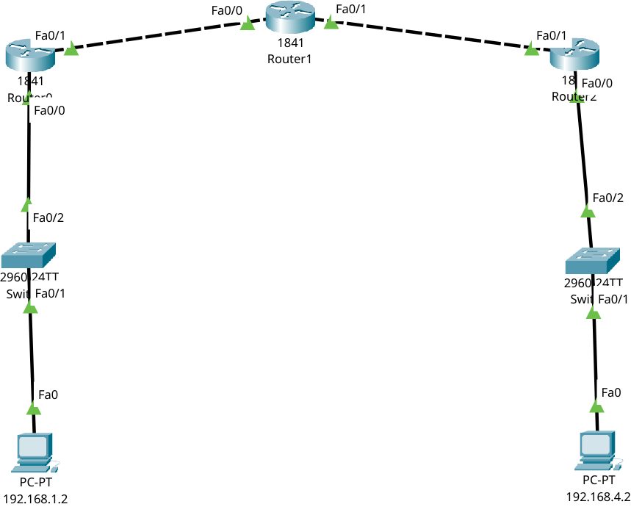
LAB 5 · THREE ROUTERS
Three routers, one rule
PC0 → R0 → R1 → R2 → PC1
Each router points only to the next hop.
4 subnets
3 routers
6 static routes
Tracert shows the path.
One missing reverse route = one-way traffic.
Notes:
Lab 5 adds a third router and a fourth subnet. PC0 is 192.168.1.2 and PC1 is 192.168.4.2. The packet crosses R0, R1, and R2, but each router only chooses the next hop. R0 needs routes to 192.168.3.0 and 192.168.4.0 through 192.168.2.2. R1 needs 192.168.1.0 through 192.168.2.1 and 192.168.4.0 through 192.168.3.2. R2 needs 192.168.2.0 and 192.168.1.0 through 192.168.3.1. Tracert shows the path. One missing reverse route gives one-way traffic.

Slide 12
LAB 5 · STATIC ROUTES
The command never contains the full path
R0(config)# ip route 192.168.3.0 255.255.255.0 192.168.2.2
R0(config)# ip route 192.168.4.0 255.255.255.0 192.168.2.2
R1(config)# ip route 192.168.1.0 255.255.255.0 192.168.2.1
R1(config)# ip route 192.168.4.0 255.255.255.0 192.168.3.2
R2(config)# ip route 192.168.2.0 255.255.255.0 192.168.3.1
R2(config)# ip route 192.168.1.0 255.255.255.0 192.168.3.1
6 lines for 3 routers.
Every new LAN adds a line on every router that needs it.
C = connected · S = static · do wr saves.
Missing reverse route → one-way traffic.
Notes:
Here are the six lines. Each one names a destination network, its mask, and the adjacent next hop. No line contains the full path. R0 sends everything for the right side to R1; R1 sends left traffic to R0 and right traffic to R2; R2 sends everything for the left side to R1. Six lines for three routers, and every new LAN adds a line on every router that needs to reach it. That is the cost of static routing, and the reason dynamic routing exists.

Slide 13
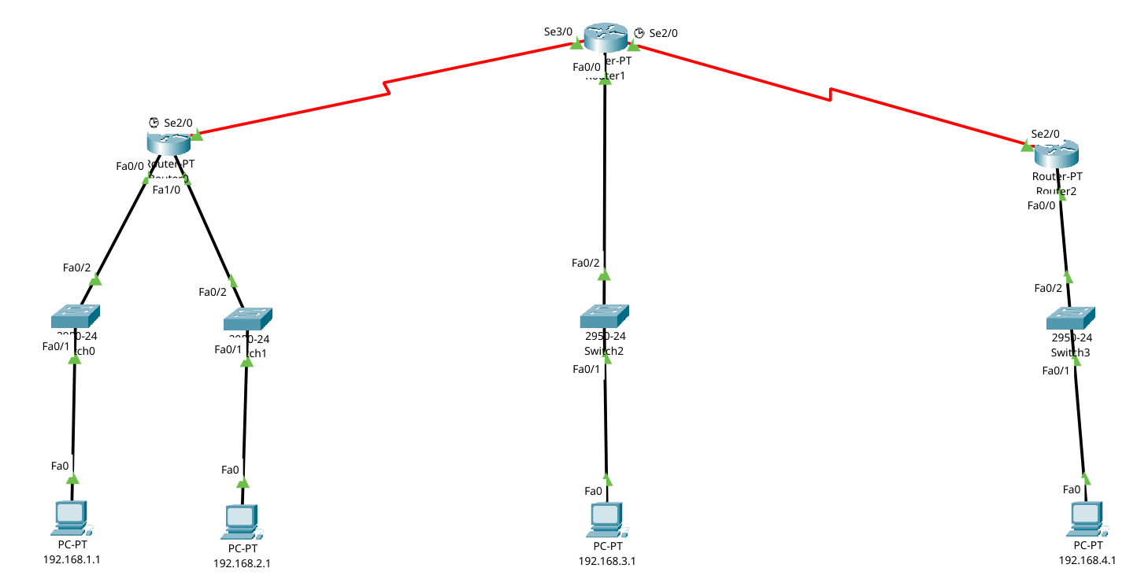
LAB 6 · MIXED MEDIA
More media, same forwarding logic
Notes:
Lab 6 is the complicated network. It has four LANs and two serial links, so six subnets, and three routers. The forwarding rule has not changed. What is new is the medium. The serial links in the screenshot are red because the interfaces are down. On each serial link, set the IP address, set the clock rate on the DCE side, and use no shutdown on both ends. Then each router still needs a static route for every remote network, with the next hop on an adjacent subnet.

Slide 14
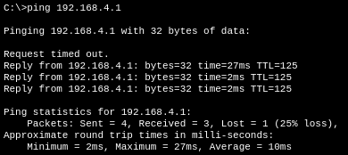
LAB 6 · 25% LOSS
The first ping can lose a packet
First: 3 of 4 replies · Repeat: 4 of 4.
ARP warm-up is normal. Retest before troubleshooting.
Notes:
The lab asks why the first ping loses twenty-five percent. Look at the console: the first ping sends four packets and receives three. The timeout is the ARP lookup: the first echo goes out before the destination MAC is known, so it is dropped. The repeat ping receives all four, so the link and route are fine. The arp -a command shows the MAC address, and tracert shows the path. The lesson is to repeat the test before troubleshooting. To reach one hundred percent, bring every link up, complete the routes in both directions, and test again.

Slide 15
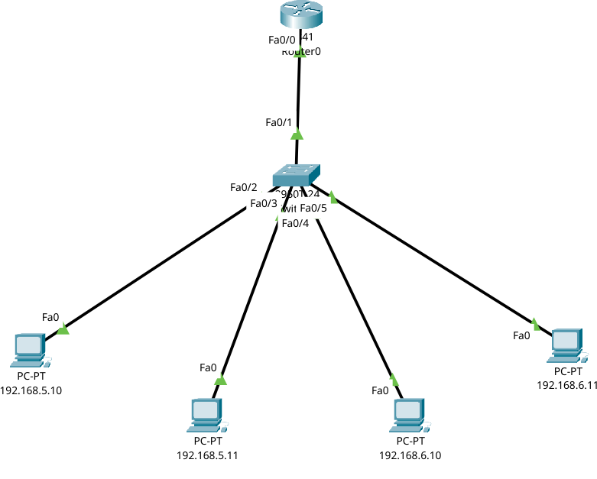
LAB 7 · VLANS
Segment at Layer 2, route at Layer 3
VLAN 10
192.168.5.0/24
VLAN 20
192.168.6.0/24
Access port = one VLAN.
Trunk = all VLANs, tagged 802.1Q.
One subinterface per VLAN = its gateway.
VLANs isolate broadcasts; they do not route.
Notes:
Lab 7 changes the segmentation. One switch is split into VLAN 10 and VLAN 20. VLAN 10 uses 192.168.5.0/24 and VLAN 20 uses 192.168.6.0/24. An access port belongs to one VLAN. The link to the router is a trunk, which carries both VLANs with 802.1Q tags. Same-VLAN traffic stays on the switch. Traffic between VLANs goes up the trunk to the router and back. The router needs one subinterface per VLAN, and that subinterface is the default gateway for the VLAN. The DHCP version adds one pool per VLAN with the matching default router.

Slide 16
LAB 7 · CONFIGURATION
One subinterface per VLAN
S(config)# interface fa0/2
S(config-if)# switchport mode access
S(config-if)# switchport access vlan 10
S(config)# interface fa0/1
S(config-if)# switchport mode trunk
R(config)# interface fa0/0.10
R(config-subif)# encapsulation dot1Q 10
R(config-subif)# ip address 192.168.5.1 255.255.255.0
# VLAN 20: fa0/0.20, dot1Q 20, 192.168.6.1
VLAN 20: same pattern, gateway 192.168.6.1.
Access = one VLAN · trunk = all VLANs tagged.
VLANs isolate broadcasts; subinterfaces route.
Notes:
On the switch, put the host ports in access mode and assign the VLAN, then make the uplink a trunk. On the router, create a subinterface for each VLAN, set encapsulation dot1Q with the VLAN number, and give it the gateway address. VLAN 20 follows the same pattern with 192.168.6.1. Show vlan brief confirms the port membership: VLAN 10 is on Fa0/2 and Fa0/3, and VLAN 20 is on Fa0/4 and Fa0/5. VLANs isolate broadcast domains, but they do not route by themselves. The router subinterfaces do the routing.

Slide 17
SYNTHESIS
Find the boundary, then read the table
Same subnet
ARP + switch
Lab 2
Different subnet
gateway + routing table
Lab 2, 4
More hops
next-hop static route
Lab 4, 5, 6
Different VLAN
802.1Q trunk + subinterface
Lab 7
Verify bottom-up: link → ARP → ping → name → page.
Questions?
Notes:
Everything reduces to one model. Same subnet: ARP and the switch. Different subnet: the gateway and the routing table. More hops: a next-hop static route on every router. Different VLAN: a trunk and a router subinterface. Static routes are explicit, symmetric, and manual. The first ping can lie because ARP warms up. Verify bottom-up: link, ARP, ping, name, page. Five labs, one model: find the boundary, then read the table. Thank you. Questions?

