Slide 1
CSE 360: Networking Experiments Overview
• Short walkthrough of the labs in slides 2, 4, 5, 6 and 7.
• Each section pairs the key ideas with results from my own Packet Tracer work.
• Concepts: LANs, device access, DNS and web, static routing, serial links, VLANs.
CSE 360 - Networking Experiments Overview | 1/11

Slide 2
How the labs fit together
• Slides 3-5: local networks, device access, DNS and web (from slide set 2).
• Slides 6-7: static routing with two routers, plus the hub variant (from slide set 4).
• Slide 8: three routers in series (from slide set 5).
• Slide 9: mixed Ethernet and serial network (from slide set 6).
• Slide 10: VLANs with router-on-a-stick, static and DHCP addressing (from slide set 7).
• Slide 11: the check toolkit used in every lab.
CSE 360 - Networking Experiments Overview | 2/11
Notes:
Wireless demo folded into slide 3; small 3-router sketch folded into slides 8-9; DHCP variant folded into slide 10.

Slide 3
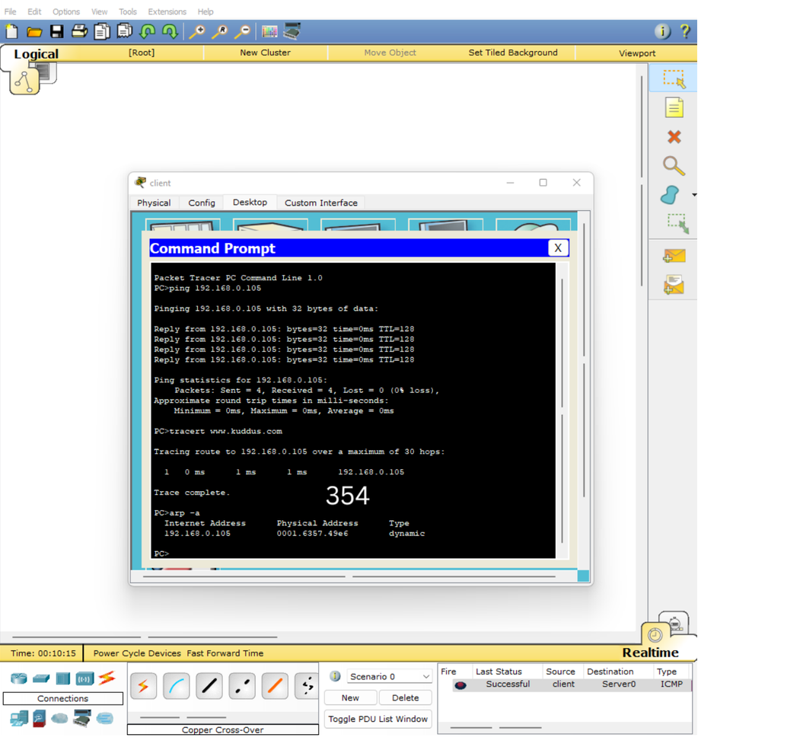
Same-subnet LANs: hub vs switch vs wireless
• Same mask 255.255.255.0 means same network, e.g. all 192.168.0.x talk with no router.
• Hub repeats everything to all ports; one conversation at a time, collisions possible.
• Switch learns MAC addresses and forwards only to the right port.
• Wireless is the same subnet idea without cables.
• Wait for green link lights (switch ports need ~30-60 s), then test with ping.
CSE 360 - Networking Experiments Overview | 3/11
Notes:
Topology plus ping reply from my lab.

Slide 4
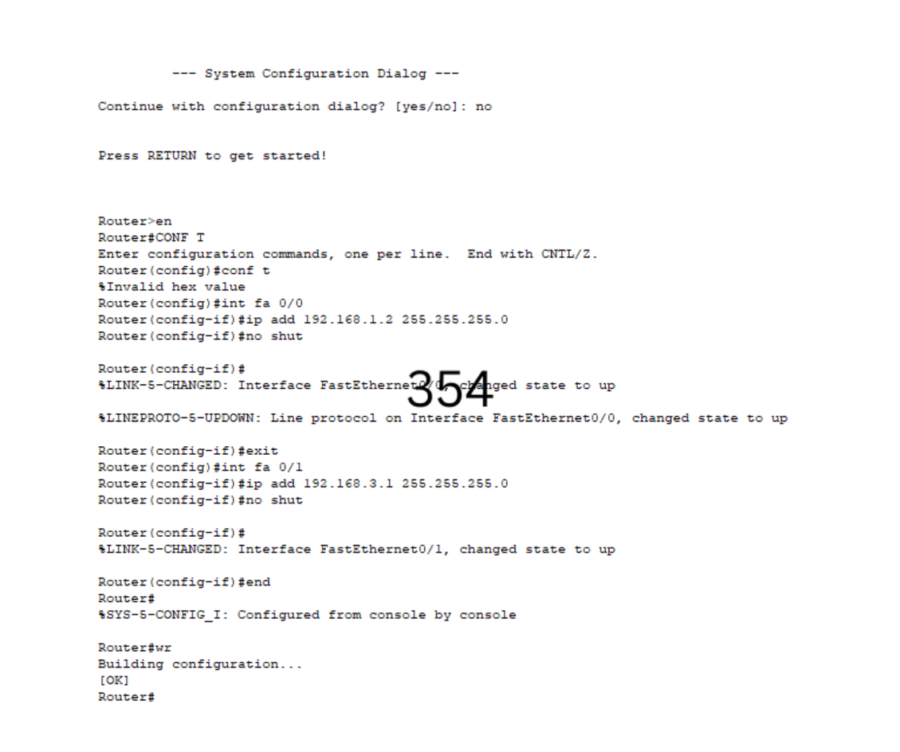
Talking to devices: console, passwords, Telnet, SSH
• Console cable + Terminal gives Switch> prompt directly on the box.
• Modes: user (>) , privileged (#) with enable, config with conf t.
• enable secret = password for > to #; line console 0 + login = console password.
• line vty 0 4 = 5 remote Telnet slots at once; SSH (PuTTY) is the encrypted equivalent.
• copy run startup-config (wr) saves, otherwise a reboot loses the work.
CSE 360 - Networking Experiments Overview | 4/11
Notes:
Terminal session from my lab.

Slide 5
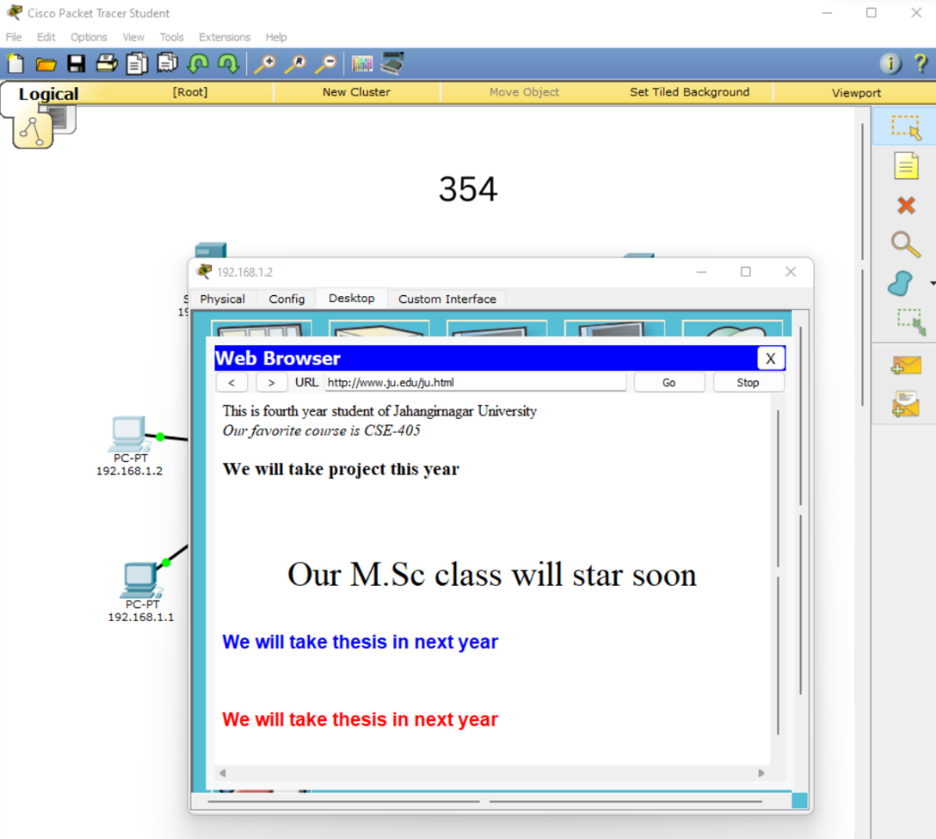
Client, DNS and web: JU / DU networks
• PC fields: IP + mask + gateway (local router leg) + DNS server (which server to ask).
• DNS A Record maps a name to an IP, e.g. www.ju.edu to 192.168.1.3. DNS Service must be On.
• HTTP service hosts ju.html / du.html. URL = name + file, e.g. http://www.ju.edu/ju.html.
• Router Fa0/0 192.168.1.4 and Fa0/1 192.168.2.4, both Port Status On.
CSE 360 - Networking Experiments Overview | 5/11
Notes:
My setup: JU 192.168.1.0/24 with DNS .1.3, DU 192.168.2.0/24 with DNS .2.3; both records on both servers.

Slide 6
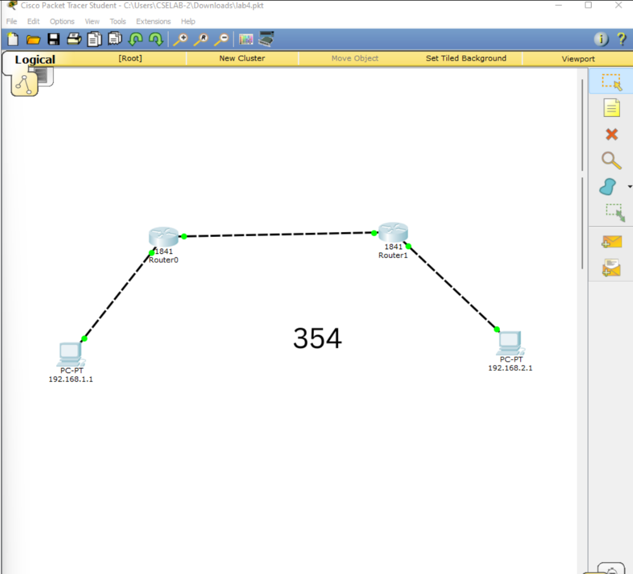
Static routing with two routers
• Three /24 networks: left LAN, middle router-to-router net, right LAN.
• Each interface: ip address + no shutdown (GUI: Port Status On).
• Connected routes (C) appear alone; remote nets need ip route <net> <mask> <next-hop>.
• Next hop must be directly reachable, e.g. 192.168.2.0 via 192.168.3.2.
• Read sh ip route: C = connected, S [1/0] = static. ping !!!!! = 5 replies.
CSE 360 - Networking Experiments Overview | 6/11
Notes:
Packet walk: PC -> gateway -> static via middle net -> far router -> direct delivery; MAC rewritten each hop, IP unchanged.

Slide 7
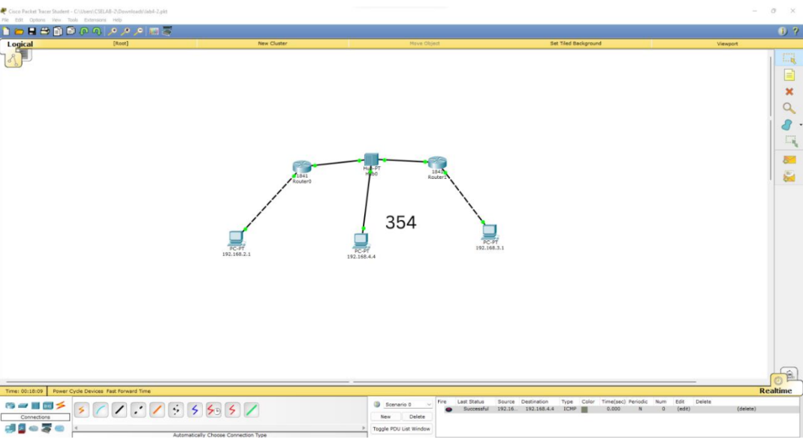
Variant: a host on a hub between routers
• Same routing idea; the new part is the shared middle subnet.
• Hub = one shared medium: Router0 leg + middle PC + Router1 leg all in 192.168.4.0/24.
• Each router still needs one static route to the far end only.
• Middle PC reaches both sides with no extra routes (it is directly connected).
• Same port rule: every used interface Port Status On.
CSE 360 - Networking Experiments Overview | 7/11
Notes:
Hub topology from my lab.

Slide 8
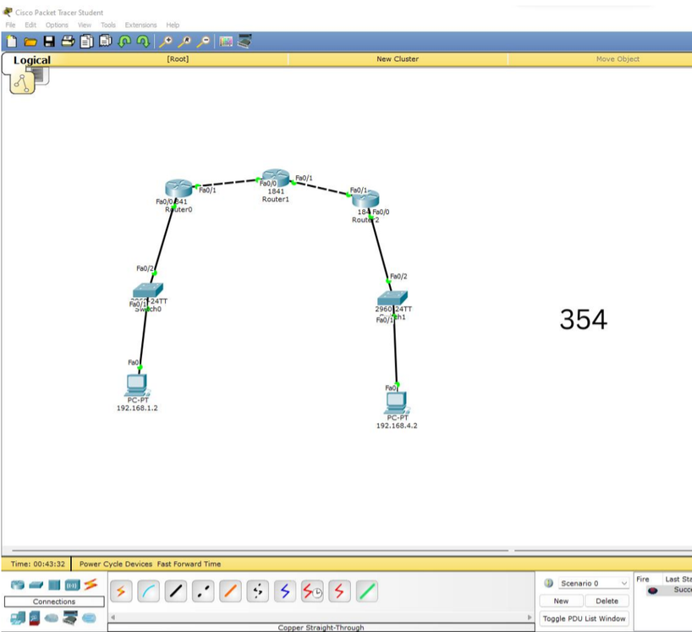
Three routers in series
• Four /24 networks end to end: 192.168.1.0 - .2.0 - .3.0 - .4.0.
• PC0 192.168.1.2 gw .1.1; PC1 192.168.4.2 gw .4.1.
• Each router learns 2 networks alone, so 2 static routes each (6 total).
• Verify PC0 to PC1 ping across 3 hops + simulation Successful.
CSE 360 - Networking Experiments Overview | 8/11
Notes:
Expt-5 lab from my files.

Slide 9
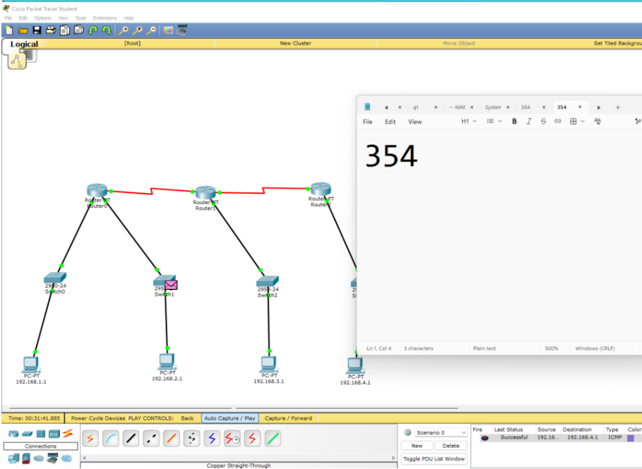
Mixed Ethernet + serial network
• Same static-routing logic, now with serial links (s2/0, s3/0) plus FastEthernet.
• tracert shows each hop.
CSE 360 - Networking Experiments Overview | 9/11
Notes:
Expt-9 lab from my files.

Slide 10
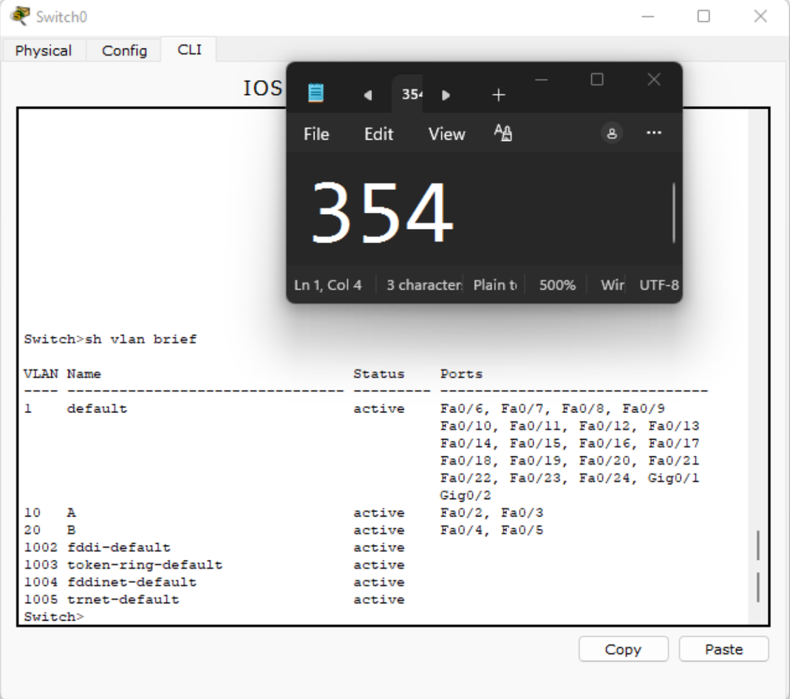
VLANs with router-on-a-stick
• VLANs split one switch into virtual LANs, e.g. VLAN 10 = A, VLAN 20 = B.
• PC ports = access mode (one VLAN); switch-to-router port = trunk (carries all).
• Router uses subinterfaces (fa0/0.10, .20) with encapsulation dot1q + one IP per VLAN.
• Same-VLAN PCs switch directly; cross-VLAN goes through the router.
• DHCP variant: pools per VLAN + excluded-address for router IPs; PCs set to DHCP.
CSE 360 - Networking Experiments Overview | 10/11
Notes:
Expt-7 lab.

Slide 11
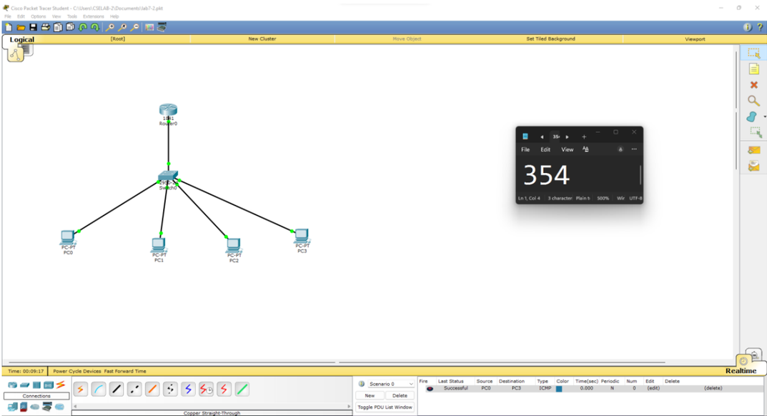
Checks used in every lab
• ping <ip/name>: IP first, then name (separates connectivity from DNS).
• tracert: lists each router hop; ipconfig: my own address; arp -a: learned MACs.
• Simulation mode: watch ICMP/ARP hop by hop; Successful = delivered.
CSE 360 - Networking Experiments Overview | 11/11
Notes:
One Successful simulation capture from my labs.

