Slide 1
Vigil: From Raw Transfers to Explainable Fraud Decisions
A multi-layered AI system for fintech fraud detection that is fast, fair, and honest.

Slide 2
The Problem: Fraud is a Story, Not a Rule
Four common scams, each with a distinct signature that simple rules can't catch without blocking innocent users:
Social Engineering: Urgent, large, night-time transfers to strangers from new devices.
Account Takeover (ATO): New device + location jump + rapid transfers after a password reset.
Mule Ring: Many senders → one receiver, round amounts, all within a tight time window.
Agent Anomaly: A cash-out agent suddenly moving 3x its normal volume.

Slide 3
Our Solution: A 3-Layer AI Ensemble
We turn every transfer into 26 features (velocity, deviation, novelty, network shape) and feed them to three separate AI models that vote on a suspicion score.
Model | What It Does | How It Learns | Weight
XGBoost Classifier | Recognizes known fraud patterns (e.g., scam, ATO). | Supervised: Trained on 50k labeled fraud/not-fraud cases. | 70%
IsolationForest | Detects brand-new, unseen fraud tricks. | Unsupervised: Trained only on normal transactions. | 20%
Graph Analysis | Catches mule rings by analyzing wallet relationships. | Network: Finds many senders → one receiver (fan-in). | 10%
Final Score = (0.7 × Classifier) + (0.2 × Anomaly) + (0.1 × Graph)

Slide 4
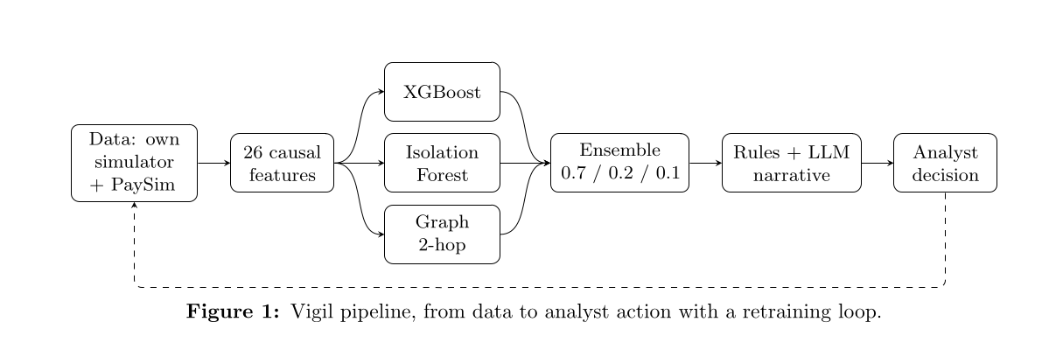
Our Pipeline at a Glance

Slide 5
From Score to Action: Kept Separate by Design
The math is honest and tunable. Business policy is editable without retraining.
01
02
03
Score > 0.85
Score 0.60 – 0.85
Score < 0.60
Hold transaction
Step-up Auth
Human Review
Review transaction
Allow transaction

Slide 6
Explaining the "Why": Three Layers of Honesty
Auditable Rules First: Plain facts an analyst can verify ("new device", "amount 15x average").
SHAP Values: Fairly divides credit for the score among features for this specific transaction (e.g., "receiver fan-in added +3.80 to suspicion").
Global Importance: A backfill for minimal installs.

Slide 7
Datasets Used For Testing
We’ve tested our model against our generated synthetic dataset and a larger dataset we’ve collected from Kaggle (PaySim) after adapting it a bit. No fine-tuning was done based on these datasets. The model never saw these datasets while training.
Dataset | Transactions | Fraud Cases | Key Signals
Generated Synthetic Dataset | 50,000 | ~2,000 | Device, location, reset, velocity, graph
PaySim Dataset | 108,213 | 8,213 | Amount, velocity, type, graph

Slide 8
Performance Metrics (Against Our Synthetic Dataset)
AUC
Industry-leading discrimination vs rule baseline 0.8119
0.9982
Recall@5%FPR
Vs baseline 0.2149; near-perfect detection
0.9938
Precision@100
Precision at top-100 candidates. The rule-based baseline gives 0.86
1.0
p95 Latency
Approximately 26 ms; production latency suitable for real-time flow.
25.9ms

Slide 9
Performance Metrics (Against PaySim Dataset)
AUC
Extremely good discrimination vs rule-based baseline 0.5049.
0.8985
Recall@5%FPR
Vs rule-based baseline of 0.00; significant improvement in detection.
0.6286
Precision@100
Precision at top-100 candidates (high early precision; exact value shown in full report). Rule based system gets 0.83
1.00
p95 Latency
Approximately 23 ms; production latency suitable for real-time flow.
23.2ms

Slide 10
The LLM: Narrator, Not Decider
Zero Detection: The LLM cannot see fraud or affect the score.
Grounded Summary: It receives a JSON bundle of already-computed facts and writes a plain-English (or Bangla) case summary for analysts.
Fenced In: A fixed template and input sanitization prevent hallucination and prompt injection.

Slide 11
One Request, Cradle to Grave
POST /score -→ Validate Input -→ Compute Past-Only Features
-→ 3 Models Score → Weighted Ensemble -→ Score Band
-→ Assemble Reasons -→ LLM/Template Narrates -→ Logged as LIVE Case
-→ Analyst Reviews in Console -→ Decision Logged for Retraining.
The whole end-to-end request life-cycle has a p95 latency of around 26ms.

Slide 12
Thank You
JU_MergeConflict
Anindya Saha
MD Muktadirul Haque Maruf
Twaha Rahman
Github: https://github.com/A7reus/Vigil

