Slide 1
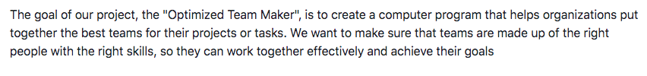

Optimised Team Maker

Slide 2
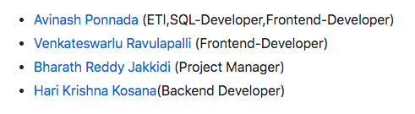
Team Member

Slide 3
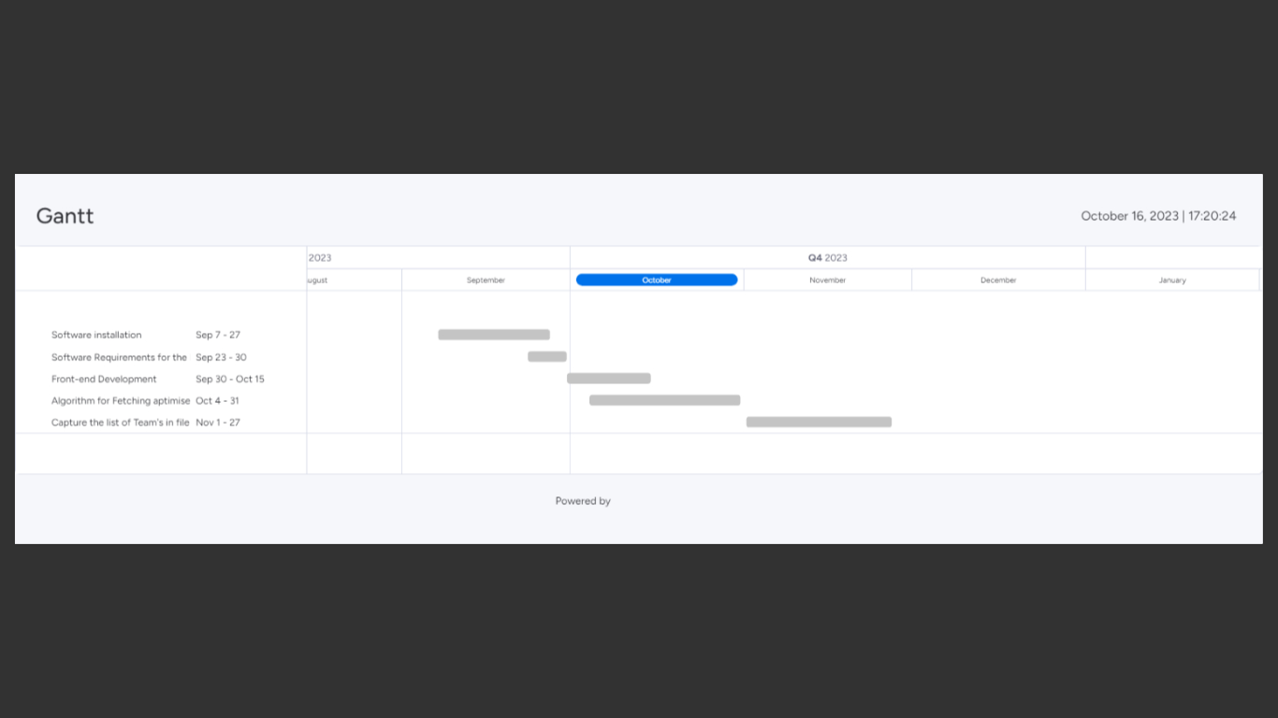
PROJECT TIMELINE

Slide 4
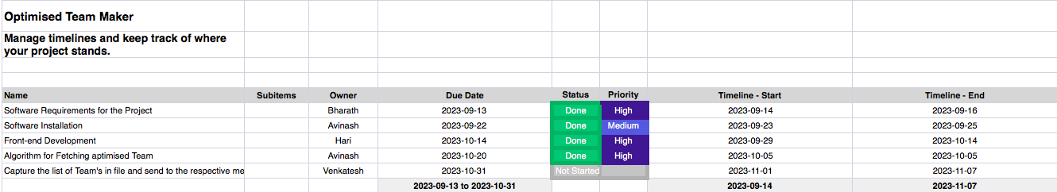
PROJECT TRACKER

Slide 5
TECHNOLOGIES USED
-TALEND OPEN STUDIO
-GOOGLE SURVEY
-PYTHON
-HTML,CSS

Slide 6
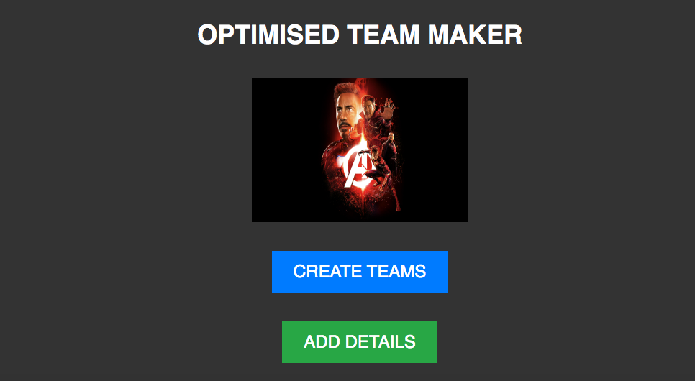

Slide 7
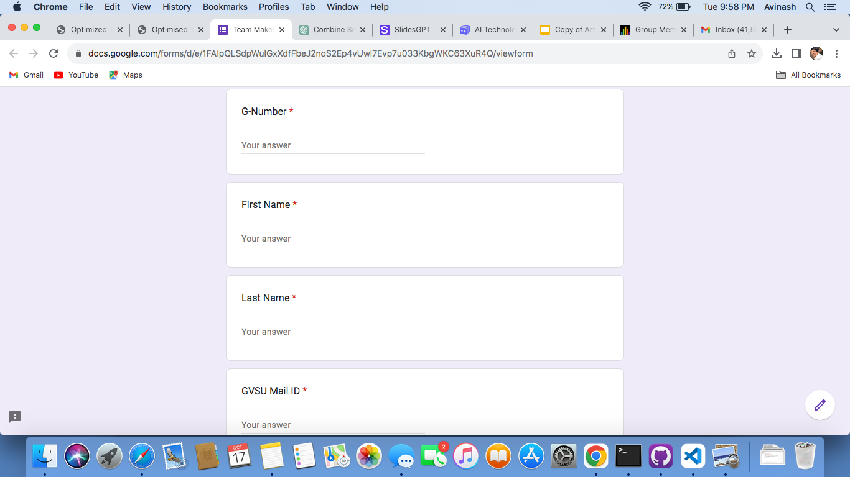

Slide 8
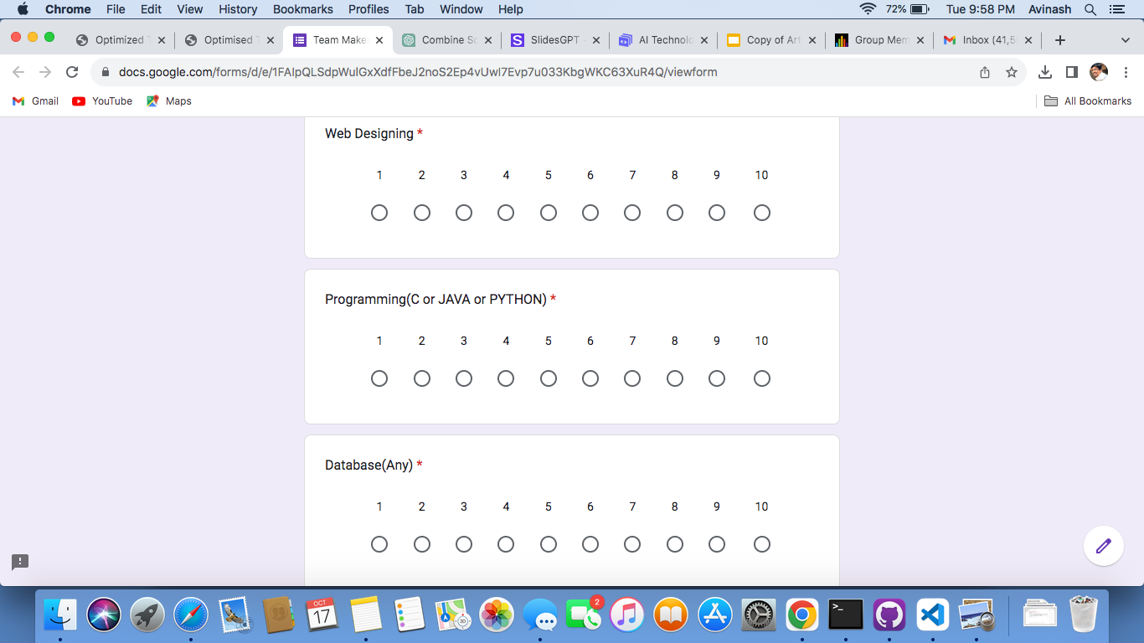

Slide 9
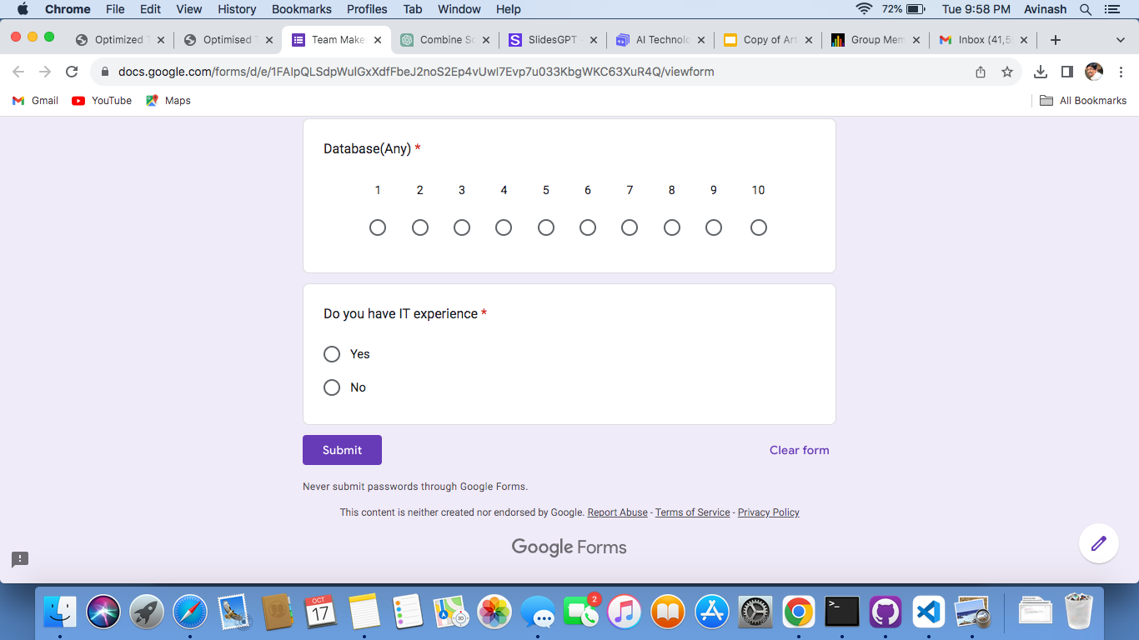

Slide 10
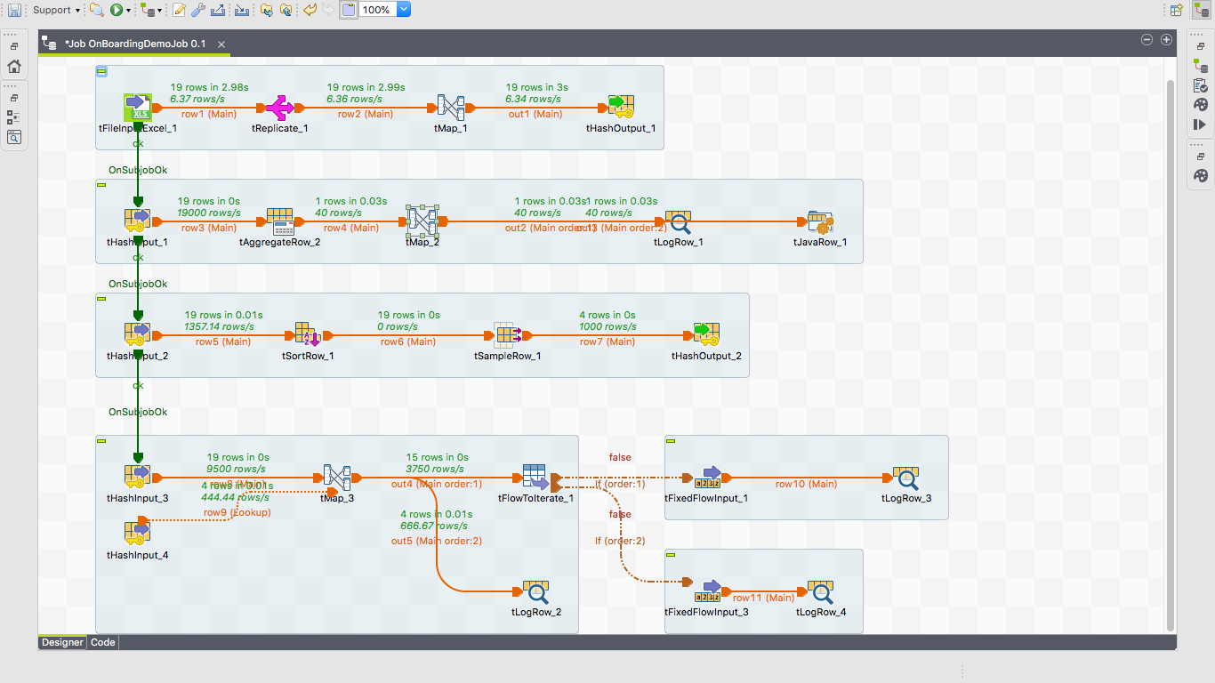

Slide 11
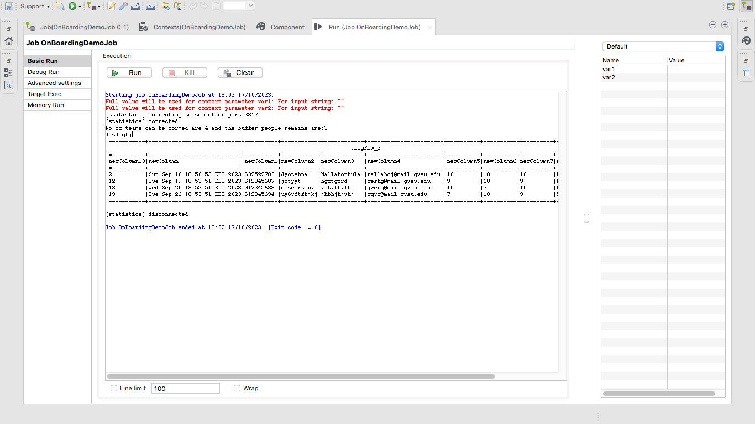

Slide 12
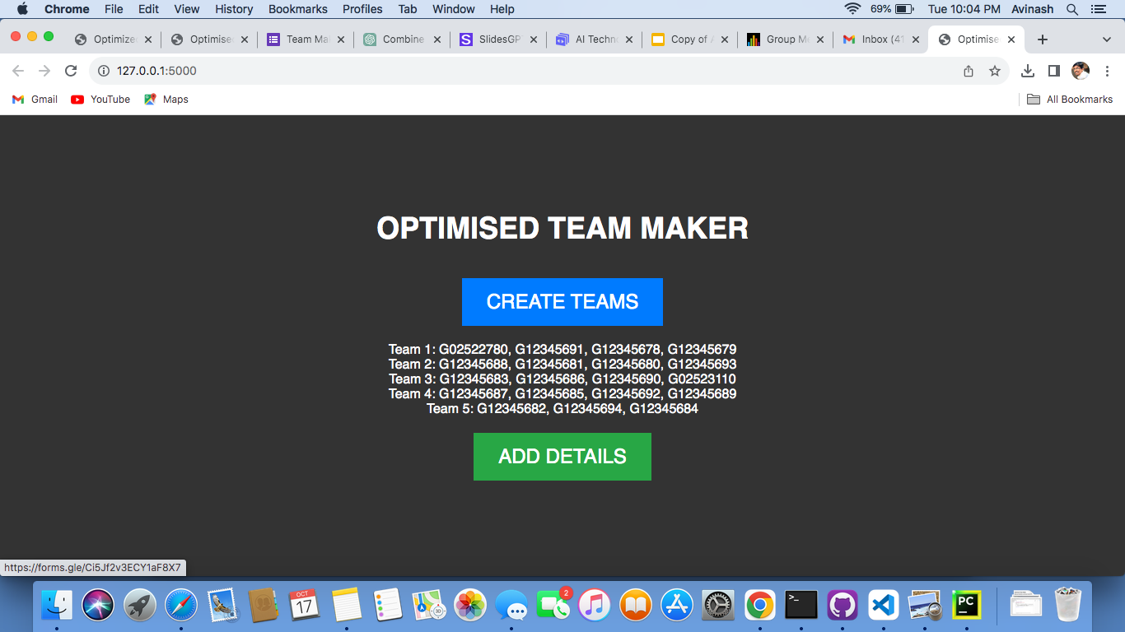

Slide 13
REST MODULES ARE IN PROGRESS

Slide 14
THANK YOU

