Slide 1

Jakarta Server Pages and
Servlets
SESSION: 1
Introduction to Web Applications

Slide 2
Objectives
Explain Web applications and their advantages
Describe the architecture and components of a Web application
Describe the role of HTTP protocol and its methods used for accessing Web pages
Describe the HTTP/3 protocol and its benefits over its predecessors
Explain different types of components used in developing a Java Web application
List the advantages and disadvantages of Servlets
Describe the sequence of events from request to response in a Java Web application
Explain the services provided by a Web container

Slide 3
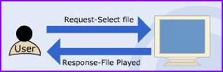
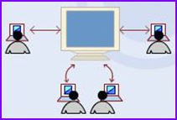
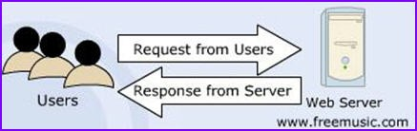
Introduction
Desktop Application
Networking Application
Web Application

Slide 4
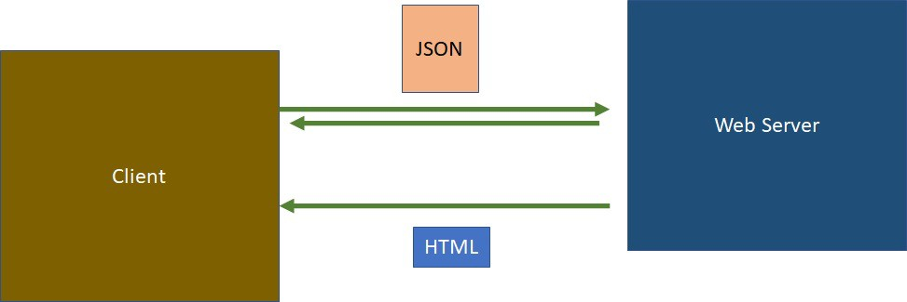



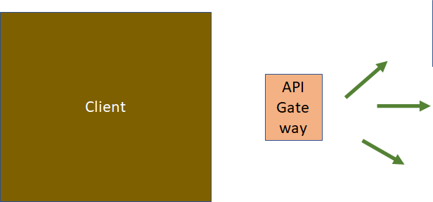
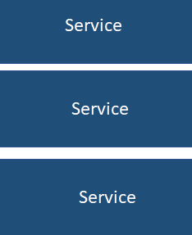

Web Applications and their Architecture
Web Applications Advantages
Easier access to information
Lower maintenance and deployment costs
Platform independence
SPA Architecture
Microservices Architecture
API
Gateway
Wider visibility

Slide 5




















Web Application Technologies
HTTP Methods
Get Post Put Delete Head Options Trace
Patch
Web Application Technologies
HTML
HTTP
Request
HTTP
Response
HTTP Protocol

Slide 6
HTTP/3 Protocol
Features of HTTP/3 Protocol
Faster Connections
Resuming Visits Instantly
Stronger Security
Reduced Lag
Smoother Network Switching

Slide 7


Java in the Web
Java Web Applications – Key Components
Java Web Application components
Servlet
Jakarta Server Pages (JSP)
Proprietary Web server API (ISAPI, NSAPI)
Server-side JavaScript
Servlets- Solution to CGI Problems
JSP
Prevalent
Server-Side Technologies

Slide 8










Merits and Demerits of Servlet
Merits
Demerits
Enhanced Efficiency
Safe and Cheap
Complicated Development Process
Extensive Knowledge Required
Dependency on Java Runtime
Powerful
Ease of use
Tight HTML- Java Connection
Lack of Modern Features
Portable

Slide 9
Web Application Workflow
Web Container/ Servlet Container
HTTP
Request
Forward Request
Call Servlet
Return Response
Client
Web Server
Servlet
Display Response
HTTP Response
Process Request Data
Generate Response
Request Object
Response Object

Slide 10
Capabilities of a Web Container
Servlet Container Lifecycle
Servlet container/Web container
Servlet
init()
Thread 1
service()
Thread 2
doget()
Thread 3
doput()
destroy()

Slide 11
Summary
An application is a collection of programs designed to perform a particular task. Different types of applications are designed for different purposes.
A Web application is a software application that runs on a Web server.
Web application architecture refers to the application logic distribution between a client and a server.
The primary technologies utilized for communication on the Web include HTML and HTTP. HTML serves as a presentation language, allowing Web designers to craft visually appealing Web pages.
The requests and responses sent to a Web application from one computer to another computer are sent using HTTP.
The HTTP request messages use the HTTP methods for transmitting request data over the Web.
Web applications are packaged in .war files, which allow the content of the Web application to be accessed from the application’s context root.
Servlets, while Java-friendly, pose challenges in development and maintenance due to their complexity and reliance on Java runtime.
Web container manages servlets, maps URLs to specific servlets, ensures access rights, and provides a runtime environment for Web components, facilitating efficient delivery of dynamic Web content.

