Slide 1

Jakarta Server Pages and
Servlets
SESSION: 3
Developing and Deploying a Web Application

Slide 2
Objectives
Explain Apache Tomcat server
Describe the lifecycle and directory structure of a Web application
Describe the process of Web application development with Eclipse IDE
Describe directory structure in Eclipse
Explain how to package a Web application
Describe the process to build and deploy a simple Web application using Eclipse and Apache Tomcat server

Slide 3

Overview of Apache Tomcat Server
Process Servlets and JSPs
Transform JSPs into Servlets
Monitor incoming client requests
Execute and unload servlet class
Responsibilities
of Apache Tomcat Server
Benefits of Apache Tomcat Server
Platform Independent Open-source Environment Lightweight
Well-Documented Highly Secure

Slide 4











Installing Apache Tomcat
Visit tomcat.apache.org Website.
Download 32/64-bit Windows
Service Installer.
Double-click the downloaded installer file.
Click Next in the setup dialog.
Accept the License Agreement.
Select components and click Next.
Enter User Name and Password.
Select JDK installation path.
Confirm destination folder and click install.
Go to localhost:8080 and check for the success page.
Click Finish and restart if prompted.

Slide 5

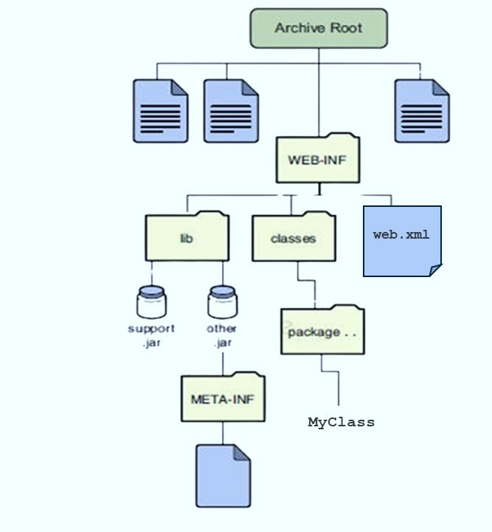





Lifecycle and Directory Structure of Web Applications
Web Application Lifecycle Directory Structure
Develop the Web component code.
Develop the Web application deployment descriptor.
Compile the Web application components and helper classes referenced by the components.
Optionally, package the application into a deployable unit.
Deploy the application into a Web container.
Access a URL, which references the Web application.

Slide 6











Web Application Development in Eclipse
Configuring Tomcat in Eclipse
Process of creating a new Dynamic Web Project in Eclipse
Open Eclipse, and navigate to Windows→ Show View→Servers.
Select File → New Project → Dynamic Web Project
Open Eclipse
Click the link for Servers.
In the Dynamic Web Project window, type the project name
Double-click Apache to define a new server.
Click Next
Choose Tomcat v10.1 Server and click Finish.
Double-click Tomcat server link.
Click Finish
Modify Tomcat admin and HTTP/1.1 ports, then save.

Slide 7
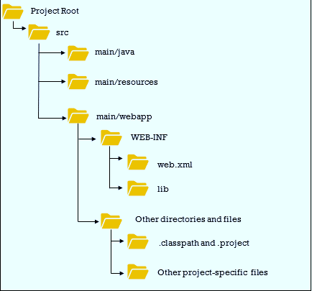
Directory Structure in Eclipse

Slide 8


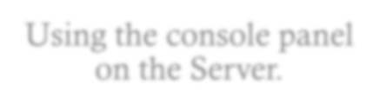

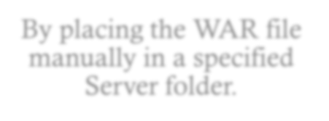
Packaging a Web Application
Deployment methods for the WAR file:
Elements of <web-app>
Using the console panel on the Server.
context-param
session-config
Servlet element
By placing the WAR file manually in a specified
Server folder.
welcome-file-list
taglib
error-page

Slide 9



Build and Deploy a Web Application Using Eclipse and Tomcat
Create Web application project.
Add .jsp file(s).
Run Web application.

Slide 10
Summary
Apache Tomcat is a free and open-source Web server and servlet container for Java-based programming applications such as Java servlets, Java Server Pages, Java Expression Language, Java WebSocket, and others.
Apache Tomcat is responsible for monitoring all incoming requests made by clients and loading the appropriate servlet classes in order to fulfill those requests.
The lifecycle of a Web application is the process of building, deploying, and running it.
All resources such as classes, servlets, static files, and so on are stored as a directory structure for better organization.
In the directory structure, the WEB-INF contains web.xml and Weblogic.xml. These are deployment descriptors.
Web apps are stored in a Web Archive (WAR) distinguishing them from other types of Java programs.
A WAR file contains all the contents of a Web application, it speeds up the process of delivering huge files across the network.
The Eclipse Web application project directory is structured in a standardized way to ensure organization and ease of management.

