Slide 1

Jakarta Server Pages and
Servlets
SESSION: 4
Jakarta Servlets

Slide 2
Objectives
Explain the Jakarta Servlet API
Explain the servlet architecture and lifecycle of Servlet
Describe the servlet mapping specifications
Explain methods of ServletRequest and HttpServletRequest interfaces
Explain methods of ServletResponse and HttpServletResponse interfaces
Describe use of response headers
Explain how to read text and binary data from a request
Explain ServletConfig and ServletContext interfaces
Explain Servlet context Attribute
Explain redirection of client requests
Explain RequestDispatcher interface
Explain error handling in Servlet
Explain uploading files with Jakarta Servlet technology

Slide 3






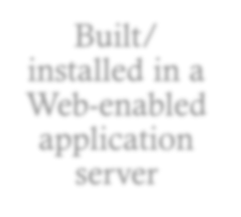
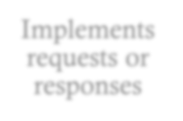




Introduction
Servlet
Web component
Managed by a container
Generates dynamic content
Platform- independent
Loads dynamically
Servlet Container
Built/ installed in a Web-enabled application server
Implements requests or responses
Decodes MIME
requests
Manages servelet lifecycle
Supports HTTP
protocol
Controls servlet environment

Slide 4

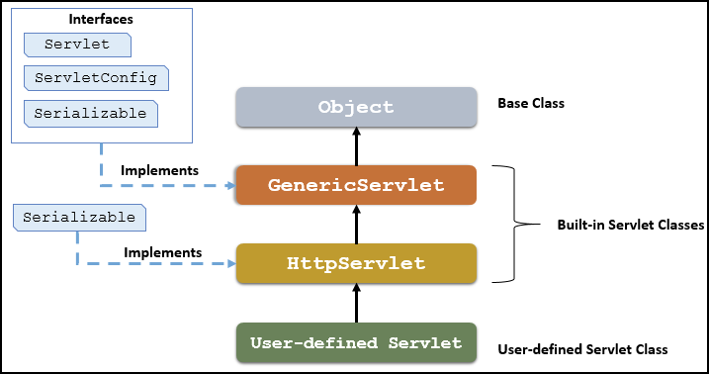
Servlet API
Packages containing classes related to developing and managing Servlets
jakarta.servlet
jakarta.servlet.http
GenericServlet Interfaces
Servlet Hierarchy
Servlet
ServletConfig Serializable

Slide 5






Servlet Lifecycle
Servlet Lifecycle
Servlet Lifecycle Methods
Instantiation
Initialization
3. Service
init()
service()
destroy()
Destroy
Unavailable

Slide 6
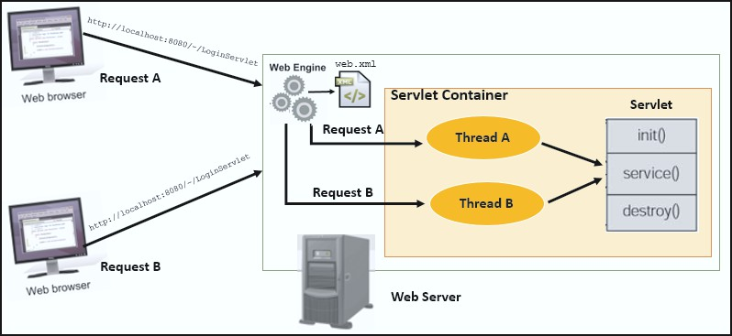









Servlet Architecture
Servlet Multithreaded Model
HTTP Specific Request Handling Methods
doGet() doPost() doPut() doDelete() doHead() doOptions() doTrace()

Slide 7
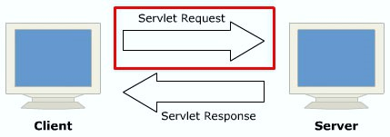












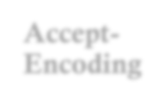
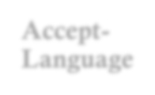




Handling Servlet Request
Servlet Request
HTTP Request Headers
Accept- Charset
Accept- Encoding
Accept- Language
Authorization
Accept
HTML Forms
Text input
Drop-down list input
Submit button

Slide 8
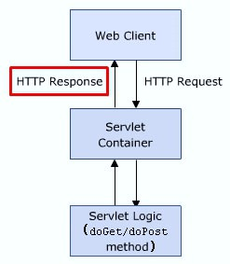
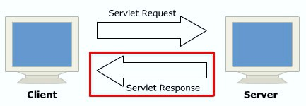
Handling Servlet Response
Servlet Response
HTTP Servlet Response

Slide 9










Response and Sending Headers
Response Headers
Sending Headers
addHeader()
addDateHeader()
Contains data about the server and file date, size, and type that the server sends back to the client.
addIntHeader()
containsHeader()

Slide 10


Reading Binary Data
Producing Text and Binary Data
Sending Text and Binary Data
public ServletOutputStream getOutputStream() throws IOException
public void print(boolean b)throws java.io.IOException
public java.io.PrintWriter getWriter() throws IOException
public void println(char c)throws java.io.IOException

Slide 11




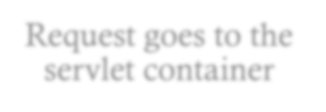
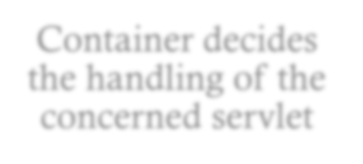



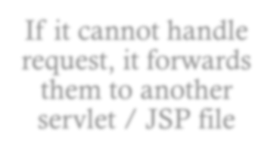
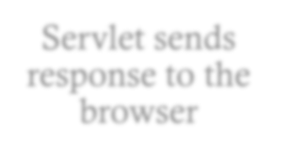
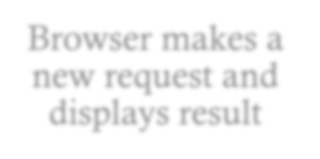



Redirecting Requests
Client makes a request
Request goes to the servlet container
Container decides the handling of the concerned servlet
If it cannot handle request, it forwards them to another servlet / JSP file
Servlet sends response to the browser
Browser makes a new request and displays result
Servlets of same application use these methods to share data:
forward ()
include ()

Slide 12
Initializing Servlets
Methods of ServletContext
Method | Description
public String getInitParameter(String name) | Returns parameter value for the specified parameter name.
public Enumeration getInitParameterNames() | Returns names of the initialization parameters of the context.
public void setAttribute(String name, Object object) | Sets given object in the application scope.
public Object getAttribute(String name) | Returns attribute for the specified name.
public Enumeration getInitParameterNames() | Returns names of the context's initialization parameters as an Enumeration of String objects.
public void removeAttribute(String name) | Removes attribute with the given name from the servlet context.

Slide 13
Error Handling in Servlets
Status Codes
Status Code | Associated Message | Meaning
301 | Moved Permanently | Document moved to separate location as mentioned in URL.
302 | Found | Temporary replacement of file from one location to the other as specified.
400 | Bad Request | The request placed is syntactically incorrect.
401 | Unauthorized | Authorization is not given to access a password- protected page.
404 | Not Found | Resource not found in the specified address.
408 | Request Timeout | Time taken by client is very long to send the request.
500 | Internal Server Error | Server is unable to locate the requested file due to servlet deletion or crash.

Slide 14




File Upload
When data is sent as form data or as multipart, files can be uploaded using these methods:
public Part getPart(String name)
public Collection<Part> getParts()

Slide 15
Summary
A servlet is a Web component based on Jakarta EE technology that is managed by a container and is responsible
for generating dynamic content.
The init(), service(), and destroy() methods are a servlet's lifecycle methods.
A GenericServlet class defines a servlet that is not protocol dependent. To have better control over required servlets, HttpServlet is extended to GenericServlet.
A servlet request contains the data to be passed between a client and the servlet. All requests implement the
ServletRequest interface, which defines the methods for accessing the relevant information.
A servlet response contains data to be passed between a server and the client. All responses implement the
ServletResponse interface. This interface defines various methods to process response.
You can use getInputStream() to retrieve the input stream as a ServletInputStream object.
ServletOutputStream provides an output stream for sending binary data to the client.
include methods along with RequestDispatcher interface. Inter-servlet communication can be used by the servlets to gain access to other currently loaded servlets and perform some tasks on other servlets.
Errors in Web applications with servlets are reported using sendError and setStatus methods. Errors are logged using the log method of ServletContext and forwarded to an error page using the RequestDispatcher interface.
A RequestDispatcher object is used to redirect the client request to a Web page on receiving an error message on the server.

