Slide 1

Jakarta Server Pages and
Servlets
SESSION: 5
Session Tracking

Slide 2
Objectives
Describe the stateless nature of HTTP and HTTP/3 protocols
Explain the necessity of tracking client identity and state
Explain the URL rewriting method for session tracking
Explain how to use hidden form fields
Explain the use of Cookie class and its methods
Explain how to store and retrieve information in a session
Describe the use of the HttpSession interface and its methods
Explain how to invalidate a session
Explain invalidating a session with Eclipse
Describe Java API with JSON binding
Explain JSON serialization

Slide 3
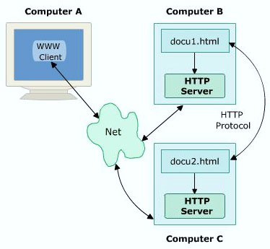
Introduction
Client-Server Model Using HTTP Protocol

Slide 4
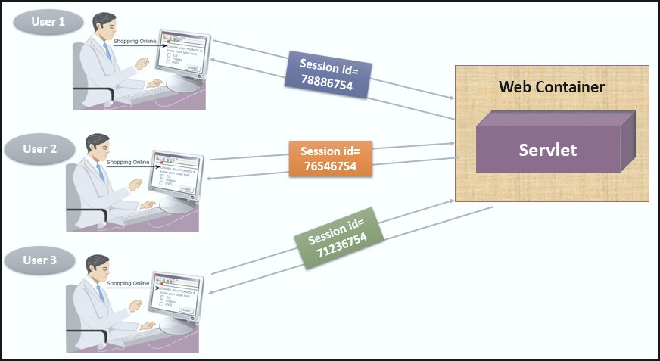
Session Tracking and its Techniques
URL
rewriting
Session Tracking Techniques
Hidden field
Cookie

Slide 5
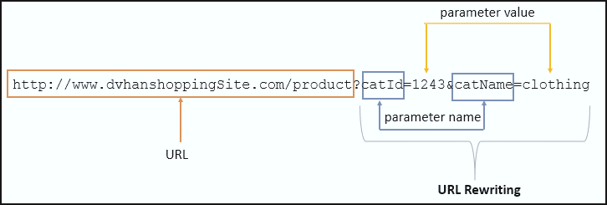



URL Rewriting
URL Rewriting Technique
Adds extra data at the end of URL to identify the session.
Lowest priority technique for session management.
Alternative for Cookies.

Slide 6







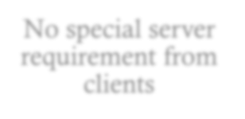

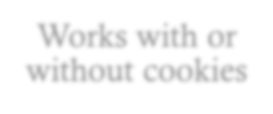
Hidden Form Fields
Hidden Form Fields are:
Advantages
Disadvantages
Placed within an HTML form
Supported in all browsers
Works only when the pages receives a request
Either a part of static HTML/dynamic form of servlets
No special server requirement from clients
Used to hold any kind of data
Not visible to the user
Not visible directly to the user
Not interpreted by the browser
Works with or without cookies

Slide 7
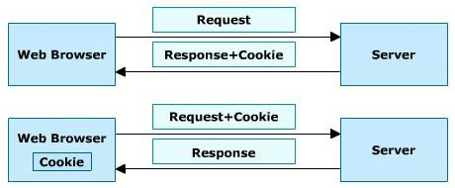

Cookies
Concept of Cookies
Cookie class provides three methods for security
public void setSecure()
public void setHttpOnly(boolean)
public boolean isHttpOnly()

Slide 8

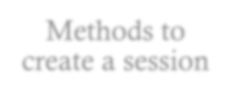
HttpSession
public Object getAttribute(String name)
public String getId()
public int getMaxInactiveInterval()
publicServletContextgetServletContext()
public void invalidate()
public boolean isNew()
public void setAttribute(String name, Object value)
public void removeValue(String name)
public void setMaxInactiveInterval(int interval)
Methods to create a session

Slide 9




Invalidate a Session
The invalidate()method helps avoid unauthorized hacking.
The invalidate()methods destroys data in a session that another servlet or JSP might require in future.
Sessions can be invalidated through code or manually using invalidate()method.
Sessions are invalidated for security and memory management.

Slide 10




JSON Binding
JSON Binding
JSON Serialization
Includes a binding layer that converts Java Objects to JSON messages and vice versa.
Provides an algorithm to convert Java classes to JSON objects.
Refers to converting objects to JSON string.
Encodes objects into a string.

Slide 11
Summary
Session tracking allows the server to keep track of successive requests made by the same client.
Some of the session tracking techniques are namely, URL rewriting, hidden field, and cookie.
Java Servlet specification provides a session tracking mechanism through jakarta.servlet. http.HttpSession object.
The URL rewriting technique adds some extra data at the end of the URL to identify the session.
Hidden form fields are used to pass data to the server-side resource invisibly from the user.
A cookie is a small piece of information sent by a server to the client’s Web browser. The cookies are stored on the client machine and are read back by the server on receiving a request for the same page.
To secure the cookies from hackers on the Web, you can configure cookies with two security settings namely, secure and HttpOnly.
The HttpSession interface is used to create a session between the client and server.
JavaScript Object Notation (JSON) is a format for data interchange.
JSON serialization refers to converting objects to JSON string. The process encodes objects into strings.

