Slide 1

Jakarta Server Pages and
Servlets
SESSION: 6
Jakarta Server Pages

Slide 2
Objectives
Define Jakarta Server Pages (JSP)
Outline the differences between servlet and JSP
Contrast Jakarta Server Pages against Java Server Pages
Explain the necessity for JSP
List the benefits of JSP
Identify the situations where to use JSP and servlets
Explain JSP architecture and lifecycle
Explain various elements in JSP
List and explain the use of directives in JSP
Describe changes in JSP 3.1
Explain procedure for integrating Jakarta servlet with JSP
Describe dispatching request from servlet to JSP

Slide 3
Introduction
JSP
Quick file modification
Accepts HTTP request
Cannot manage massive data processing Slow execution
Separates business logic and presentation logic Does not allow overriding the service()method Presents output in MVC architecture
Servlet
Delayed file modification
Accepts requests from any protocols, including HTTP Manages massive data processing
Faster execution
Implements both logic in a single servlet file Allows overriding the service()method Works as a controller in MVC architecture

Slide 4




















JSP Page
JSP is essential for:
Web Application Layers
Presentation
Application/Business
Data Access
Dynamic Content Generation
Simplified Development
Benefits of JSP
Code Reusability
Platform Independent
Scalability and Integration
Separation of Content Generation from Presentation
Support for Tag Libraries and Expression Language
Emphasis on Reusable Components
Simplified Page Development
Access and Instantiate JakartaBean Components Support for N-tier enterprise Application

Slide 5
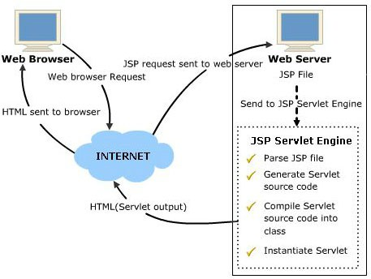






JSP Architecture and Lifecycle
JSP Architecture
Lifecycle Phases of JSP
Translation
Execution
Lifecycle methods
jspInit() jspService() jspDestroy()

Slide 6









Elements of a JSP Page
<%= Expression %>
Scripting Tags
<% code fragment %>
Scriptlets
<%! declaration code %>
Declarations
<%-- a JSP comment --%>
Comments

Slide 7

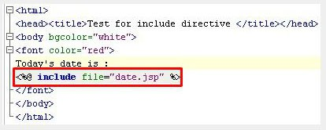









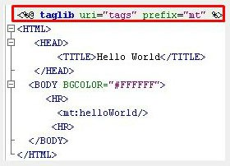
















Directive Tags
include Directive
Three directives of JSP are:
page
Controls page structure.
taglib Directive
include
Inserts content at runtime in a JSP page of another resource.
taglib
Allows JSP page to create custom tags.
7

Slide 8













JSP 3.1 New Features
Steps to integrate Jakarta Servlets with JSP
Create a Servlet
Major update in JSP 3.1
Create JSP Files
Configure Web Descriptor
Pass Data
Renaming of javax.servlet.jsp to
jakarta.servlet.jsp package
Handle Form Submission
Run and Test

Slide 9
Summary
JSP technology is used for developing dynamic Web sites and provides server-side scripting support for creating Web applications.
A JSP page is a mixture of standard HTML tags, Web page content, and dynamic content that is specified using JSP elements.
The JSP elements are expressions, scriptlets, comments, declarations, directives, and actions.
Directives are used to specify the structure of the resulting servlet and actions are JSP tags that transfer control to other server objects or perform operations on other objects.
A JSP scriptlet is used to embed Java code within an HTML code.
Servlets run faster than JSP since, JSP takes time to compile and convert the program into servlets.
The page directive is used to set the page attributes, such as the language to be used and encoding format.
The include directive is used to insert a file referenced in the directive into the JSP page.
The taglib directive links the JSP page to an XML document that describes a set of custom JSP tags and determines which tag handler class can implement the action of each tag.
Servlets and JSP work together to build Web applications, with Servlets handling backend tasks and JSP managing frontend presentation.

