Slide 1

Jakarta Server Pages and
Servlets
SESSION: 7
Filters and Annotations

Slide 2
Objectives
Explain the concept and working of filters
Describe the Servlet filter configuration
List the benefits of filters
Explain the Filter API interfaces and their methods
Explain Filter to Servlet mapping
Identify the use of wrapper classes in managing Servlets
Explain how to alter a request and response using filters
Describe the basic concept of annotations
List different types of annotations supported in Servlet API
Outline the steps to upload the file using HTML form elements
Explain the mechanism to upload files on the server using Servlet
Describe Server push in Servlet 6.0

Slide 3
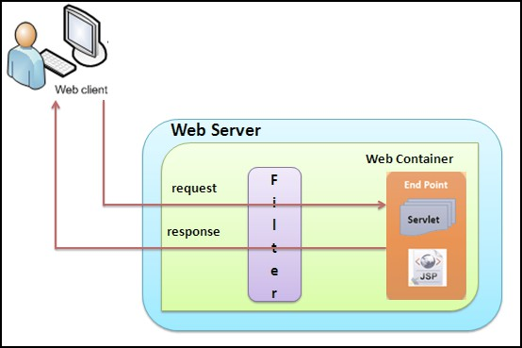
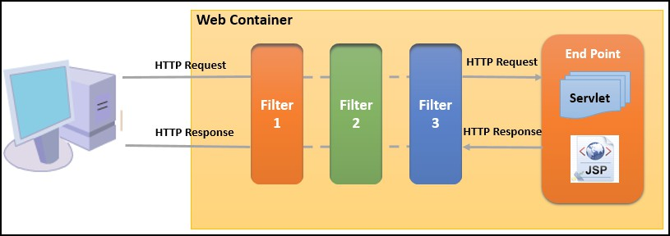
Introduction
Filters
Filter Chaining

Slide 4
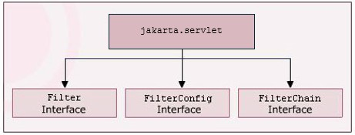
Filter API
Hierarchy of Filter API

Slide 5
Configuring Filters
<display-name>
<description>
<filter-name>
<filter-class>
<init-param>

Slide 6

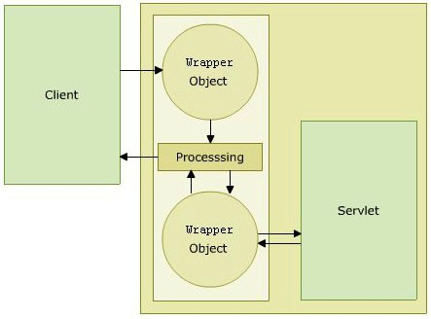
Manipulating Requests and Responses
Wrapper Objects

Slide 7










Introduction to Annotations
Ease of Use
Portability
Type Checking
Runtime Reflection

Slide 8



Uploading Files with Servlet
Values of enctype Attribute
HttpServletRequest
class methods
Methods of MultipartConfig Annotation
application/x-www- form-urlencoded
Part getPart(String name)
fileSizeThreshold
multipart/form- data
Collection<Part> getParts()
maxFileSize
text/plain
maxRequestSize
location

Slide 9






Server Push Technology in Servlet 6.0
Referred to as push technology.
Available in HTTP/2 protocol.
Responsibility of the PushBuilder interface.

Slide 10
Summary [1-2]
The filterer acts as an interface between the client and servlet inside the server. It intercepts the request or response to and from the server. More than one filter can also exist between a client and a servlet. This is called a filter chain.
The Filter API is a part of the servlet package. It contains interfaces namely, Filter, FilterConfig, and FilterChain.
All the information about the filter is described within the <filter> element inside the web.xml file. The filter also is to be mapped to the servlet for which it will function. This is done by assigning the URL name and servlet name inside the <filter-mapping> element.
The request and response to and from the servlet are manipulated by the filter. The wrapper object of RequestWrapper or ResponseWrapper classes created by the filter intercepts the request or response and sends it to the filter.
Annotation can be defined as metadata information that can be attached to an element within the code to characterize it. Annotation can be added to program elements such as classes, methods, fields, parameters, local variables, and packages.

Slide 11
Summary [2-2]
The jakarta.servlet.annotation package contains a number of annotations, Servlets, filters, and listeners. Apart from this, Servlet API also supports several dependency injection annotations.
The file can be uploaded on the server using following two ways namely, Client-side file upload and Server-side file upload.
The jakarta.servlet.annotation.MultipartConfig annotation is specified on a Servlet class to provide file information to the server while uploading its content.
Server Push allows the server to push the Website resources to the client pre-emptively.

