Slide 1

Jakarta Server Pages and
Servlets
SESSION: 8
Database Access and Event Handling

Slide 2
Objectives
Explain database handling in Servlets using JDBC 4.3
Describe JPA and its role
Describe connecting database using JPA
Explain the significance of session handling and session events
Identify different types of listener interfaces used in Servlets
Explain JDBC versus JPA

Slide 3


Introduction
Part of the Java SE platform.
Enables a Web application to interact with a DBMS.
Using JDBC API
Using Object Relational Mapping
(ORM) API
A persistence mechanism
Helps in accessing relational databases.
Maps the Java objects to database tables.

Slide 4
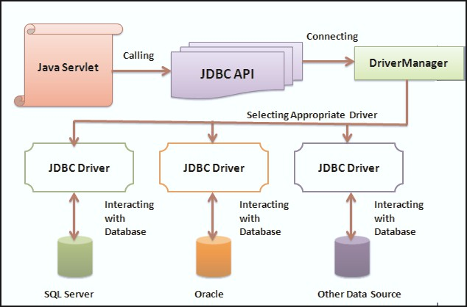
JDBC API
JDBC Architecture

Slide 5




Enhancements in JDBC
java.sql.connection. beginRequest()
java.sql.connection. endRequest()
Informs the driver that a request is about to start.
Informs the driver that a request is about to end.

Slide 6
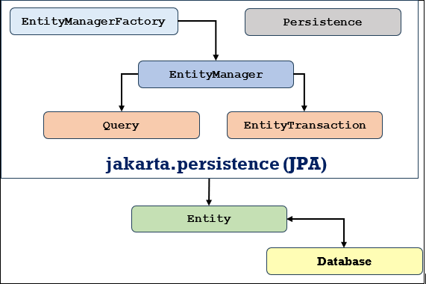

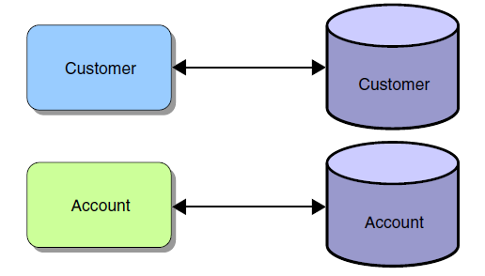
Java Persistence API (JPA)
Mapping of Java Objects to Tables
Primary Components of JPA

Slide 7

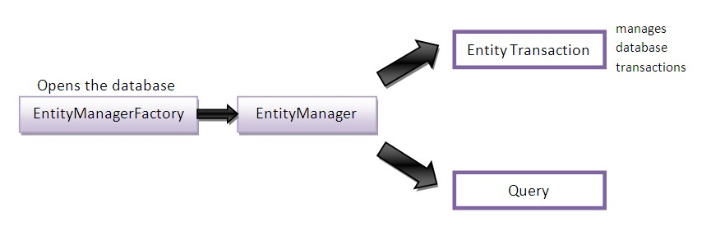
EntityManager in JPA

Slide 8





DAO Pattern for Databases
Separates business logic from database access for easier maintenance.
Encapsulates data access implementation in DAO classes using JDBC API.
Importance of DAO pattern
Enhances flexibility and independence between application layers.
Utilizes DAO for performing data access functions such as insertion and retrieval in business services.

Slide 9
JDBC versus JPA
JDBC | JPA
Database-dependent. | Database-independent.
Uses queries based on database. | Uses single query for different databases.
Development is slower. | Development and productivity is good.
Does not support POJO model. | Supports POJO model programming.
Java cache is required. | Uses too levels of cache for better performance.
Full SQL query is written to associate database tables. | Annotations are used to create associations.

Slide 10



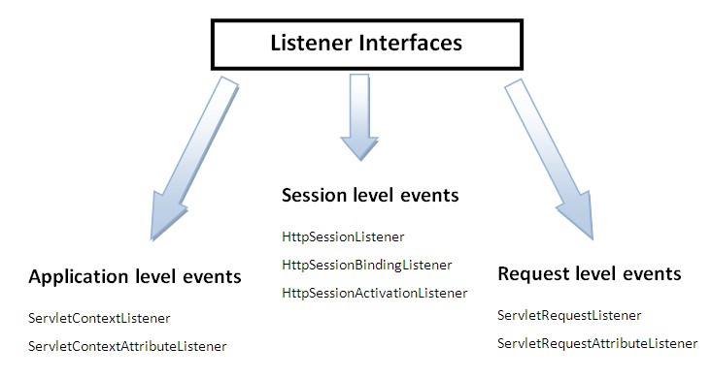








Session Event Handling
Listener Interfaces
ServletContextListener
ServletContextEvent
ServletContextAttributeListener ServletContextAttributeEvent HttpSessionAttributeListener HttpSessionBindingListener HttpSessionBindingEvent HttpSessionListener HttpSessionActivationListener HttpSessionEvent

Slide 11
Summary
The most common operation performed by the Servlet is storing and retrieving database information.
Java provides several mechanisms using which data can be accessed from the database using JDBC or JPA.
The JDBC API provides classes and interfaces that allow a Web application to access and perform operations on the databases.
The JDBC 4.3 API is an improvement in JDBC API, it includes both the java.sql and javax.sql packages.
JPA is an ORM technology that persist the entities in the database.
Java annotations or XML are used to define the mapping of entity to existing database tables.
In JPA, persistent objects are referred as Entities. Entities are plain old Java objects that are persisted to relational databases or legacy systems.
A persistence context represents a set of managed entity instances that exist in a particular data store.
The DAO pattern provides the easy maintenance of the applications by separating the business logics from the database access.
The events in a servlet life cycle is monitored by defining listener objects. These objects methods get invoked when life cycle events occur.

