Slide 1

Jakarta Server Pages and
Servlets
SESSION: 9
Asynchronous Servlet Communication

Slide 2
Objectives
Explain necessity for Asynchronous Servlet
Describe advantages and use of Asynchronous servlet
Explain how to create Asynchronous Servlet and Asynchronous Listener
Explain how to create an asynchronous JavaScript client using XMLHttpRequest object
Explain the necessity of non-blocking I/O support in Servlet
Explain how to implement non-blocking I/O in asynchronous Servlet
Explain necessity for protocol upgrade
Elaborate on the process of protocol upgrade in a Servlet

Slide 3



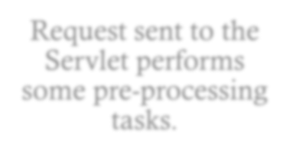
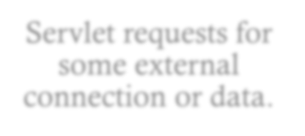







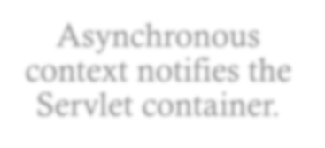
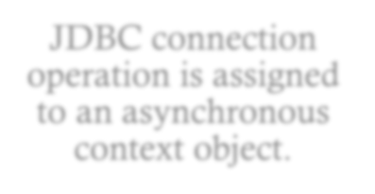


Introduction
Request sent to the Servlet performs some pre-processing tasks.
Servlet requests for some external connection or data.
Servlet receives the request parameters.
Asynchronous context notifies the Servlet container.
JDBC connection operation is assigned to an asynchronous context object.
Servlet returns back to the pool.

Slide 4
Handling Asynchronous Servlet
void start(Runnable run)
ServletRequest getRequest()
ServletResponse getResponse()
void complete()
void dispatch(String path)
AsyncContext Class
void onStartAsync (AsyncEvent event)
void onComplete (AsyncEvent event)
void onError (AsyncEvent event)
void onTimeout (AsyncEvent event)
AsyncListener Interface

Slide 5
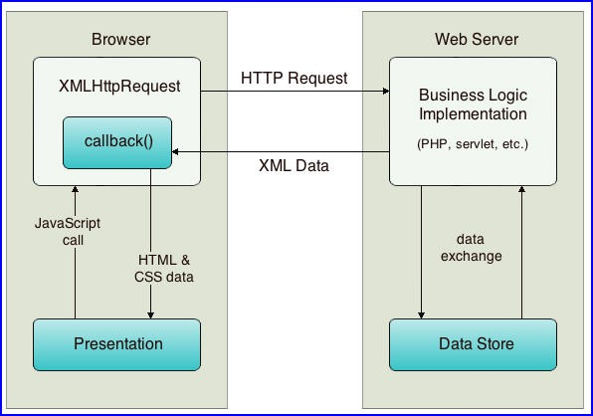
Server Push Mechanism in Servlet
Asynchronous Communication in Web Application

Slide 6









Non-Blocking Input/Output in Servlet
Process the request and the response.
Assign a read and/or a write listener to I/O streams.
Obtain an input stream and/or an output stream.
Enable the asynchronous mode for the Servlet.

Slide 7


Protocol Upgrade Processing
Upgrading to HTTP 1.1 Protocol
Clients can switch protocols using the Upgrade header in HTTP/1.1.
Persistent connections in HTTP/1.1 allow multiple request over a single connection.
HTTP/1.0 was stateless, while HTTP/1.1 supports persistent connections.
An HTTP response with status 101 indicates successful protocol switching.

Slide 8
Summary [1-2]
The architecture of the Servlet is based on multithreaded model. In this model, the Web container normally creates a pool of threads ready to serve the client with the Servlet instance.
The Java Servlet API provides asynchronous processing support for servlets and filters in Web applications.
In asynchronous processing, a Servlet thread waiting for a resource is released by the container and returned to the pool.
The interface jakarta.servlet.AsyncContext is used to process the request asynchronously within the Servlet.
To handle these events, the AsyncContext object can be registered with the AsyncListener interface.
The mechanism of sending the data asynchronously from the Web server to the client without redrawing the whole page, is referred to as server push.
One of the most popular programming approaches used in modern Web applications to push the server data to the client is performed using AJAX mechanism.
The AJAX mechanism works with an XMLHttpRequest object that is used to pass the requests and responses asynchronously between the client and server.

Slide 9
Summary [2-2]
Servlet API provides non-blocking I/O support for Servlets and filters to process input and output asynchronously in the request.
With Servlet 3.0 API, the HTTP protocol has been upgraded from HTTP 1.0 to HTTP 1.1. HTTP 1.0 was a stateless protocol, whereas HTTP 1.1 can persist the connection between the client and the server.

