Slide 1

Jakarta Server Pages and
Servlets
SESSION: 10
JSP Implicit Objects and Standard Actions

Slide 2
Objectives
Explain the concept of implicit objects in JSP
List various types of implicit objects in JSP
Explain how to use the request and response objects
Identify use of the out object
Describe how to use the session object
Explain the application object
Identify the use of pageContext object
Explain how to use the page and config objects
Outline the concept of standard actions in JSP
Describe how to use the <jsp:include> and <jsp:forward> elements

Slide 3









Introduction
Types of Implicit Objects
Input and Output Objects
Controls page input and output.
Scope Communication and Control Objects
Provides access to all the objects available in
the given scope.
Provide information about the page
context.
Handles errors in a
JSP page.
Servlet Objects
Error Object

Slide 4





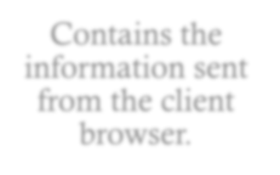
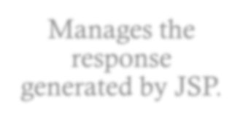
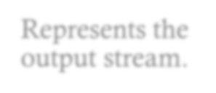


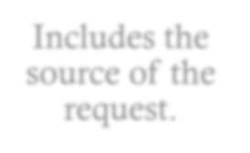
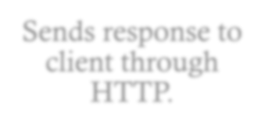
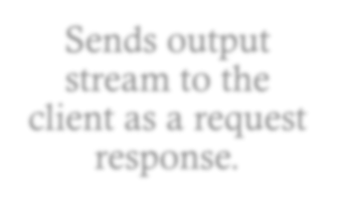
Input and Output Objects
request
response
out
Contains the information sent from the client browser.
Manages the response generated by JSP.
Represents the output stream.
Includes the source of the request.
Sends response to client through HTTP.
Sends output stream to the client as a request response.

Slide 5





Scope Communication Objects
session
Provides all the objects available in the JSP pages.
application
Shares the data between all the application pages.
pageContext
Allows user to access all the implicit objects.

Slide 6

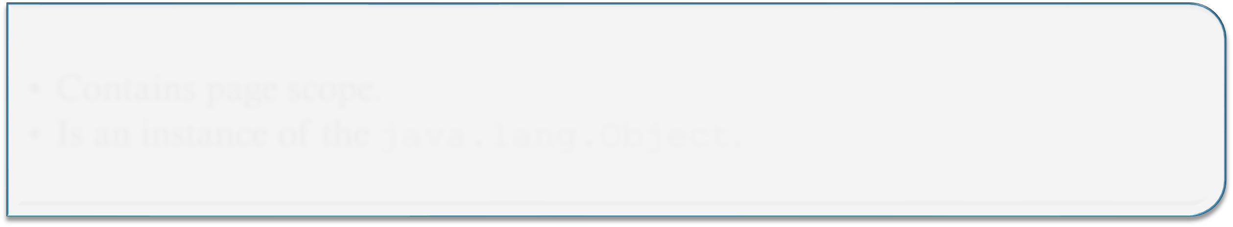

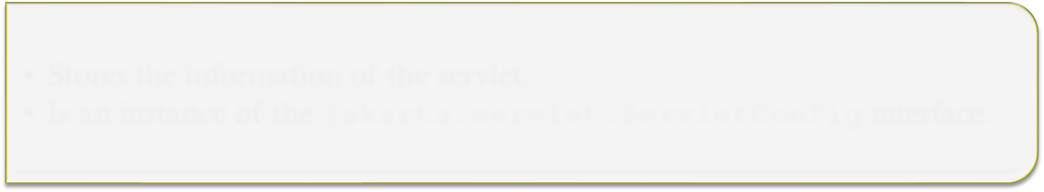
Servlet Objects
Contains page scope.
Is an instance of the java.lang.Object.
page
Stores the information of the servlet.
Is an instance of the jakarta.servlet.ServletConfig interface.
config

Slide 7




error Object
public String getMessage()
public void printStackTrace( PrintWriters )
public String toString()
Methods
<jsp:include>
<jsp:forward>
<jsp:param>
<jsp:text>
Standard Actions

Slide 8







JSP Directives
page
Specifies properties for a whole JSP page.
include
Inserts content of another resource in a JSP page at run time.
taglib
Specifies the tag library used for custom tags.

Slide 9
Summary
Implicit objects are a set of Java objects that are available in every JSP page.
Pre-defined variables are accessible within the scripting elements in the JSP pages.
The input object represents the data passed through an HTTP request and the output object represents what is sent back to the client in response.
The session object provides all the objects available in the JSP pages within the session.
The application object is used to share the data between all the application pages.
JSP directives are a form of messages that provide comprehensive information about the JSP page. During JSP translation phase, these directives inform the Web container on how to convert a Web page into a Servlet.
Servlet and JSP pages can process multiple threads simultaneously. The isThreadSafe option helps to identify whether a JSP page is thread-safe or not.

