Slide 1

Jakarta Server Pages and
Servlets
SESSION: 11
Model-View-Controller Architecture

Slide 2
Objectives
Describe JSP models
Describe the advantages and disadvantages of Model1
Describe the advantages and disadvantages of Model2
Explain the Model-View-Controller (MVC) architecture
Explain the relationship between the components of MVC
Explain Controller and its use
Explain View and its use
Explain Model and its use
Identify how to develop a Web application based on MVC architecture
Describe MVC and CDI
Identify MVC events

Slide 3


Introduction
JSP Models
Address the problem of tightly-coupled presentation and business logic in servlets.

Slide 4
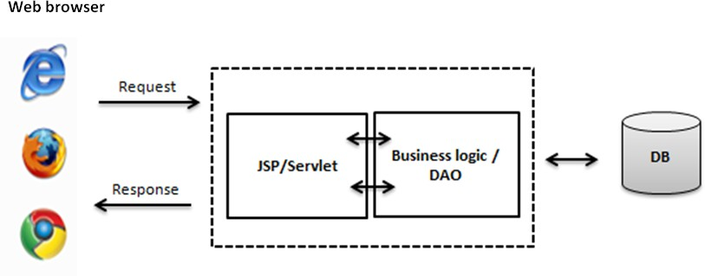
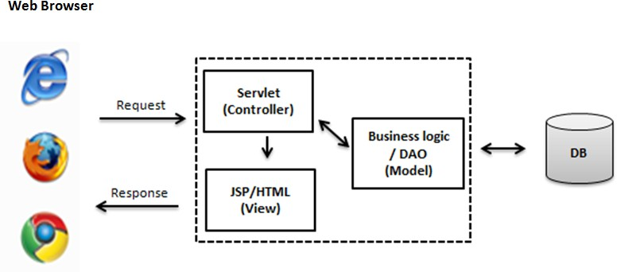
JSP Models
Model1 Architecture
Model2 Architecture

Slide 5

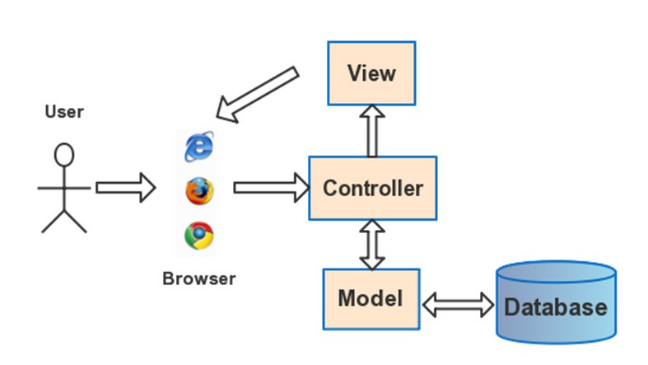
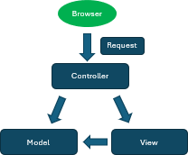
Model-View-Controller (MVC)
Components in MVC Architecture
MVC Design Pattern

Slide 6
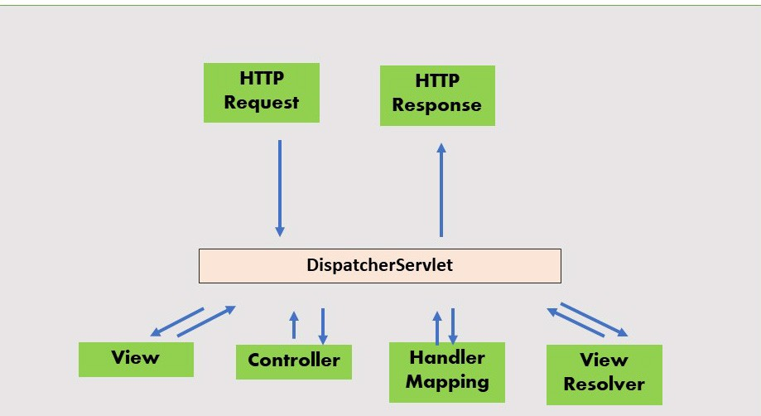
Spring MVC Architecture
Spring MVC Flow Diagram

Slide 7
Summary
The JSP specification presents two approaches for developing Web applications namely, JSP Model I and JSP Model II.
JSP Model II is also known as MVC.
MVC is a software design pattern, which can be used to design medium and large sized applications.
Three components of MVC are: Model, View, and Controller.
In MVC Web application, servlet acts as controller, which receives the request from client.
The view handles presentation of the content on the Web page and could be an HTML file or a JSP file.
The Model component contains the business logics and functions that manipulate the business data.
The Web container transfers control to event listeners in Jakarta EE to listen to events related to Servlets, JSP, and so on.
ActionListener is an example of an event listener associated with a GUI element such as JButton.

