Slide 1

Jakarta Server Pages and
Servlets
SESSION: 12
JSP Expression Language

Slide 2
Objectives
Explain how to use script expressions in JSP
Describe the implicit objects used in EL
Describe various operators used in EL
Explain how to create static method and tag library descriptor using EL
Explain how to access EL functions within JSP
Explain the concept of boxing and unboxing
Explain how to coerce a value to string or number type

Slide 3
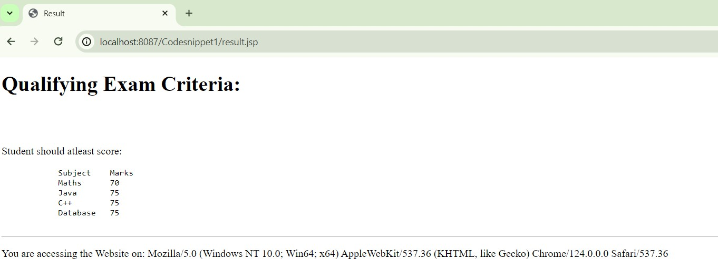
Expression Language
Expression Language

Slide 4




EL Implicit Objects
pageContext
Provides access to page attributes.
servletContext
Specifies the JSP page, servlet, and Web components contained in the same application.
session
Represents the session created for the client sending a request.
request
Represents the request accepted by the JSP page from client.

Slide 5


EL Operators
Category
Operators
Variable
. and []
Arithmetic
+, - (binary), *, / and div, % and mod, - (unary)
Conditional
A ? B : C
Relational
==, eq, !=, ne, <, lt, >, gt, <=, le, >=, ge
Logical
and, &&, or, ||, not, !
Empty/Null checking
empty

Slide 6




Functions Using EL
Creating ‘static' Methods
Creating Tag Library Descriptor
Modifying Deployment Descriptor
Accessing EL Functions within JSP

Slide 7







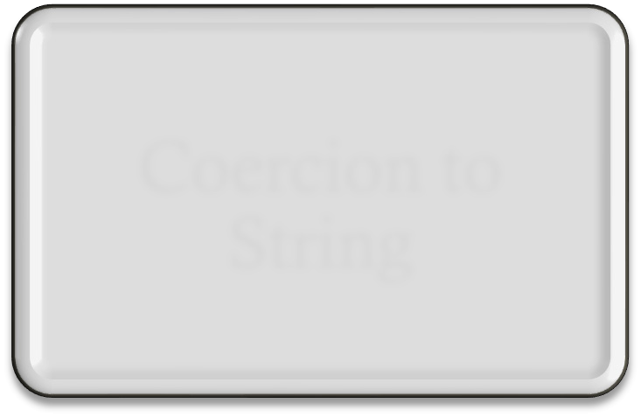
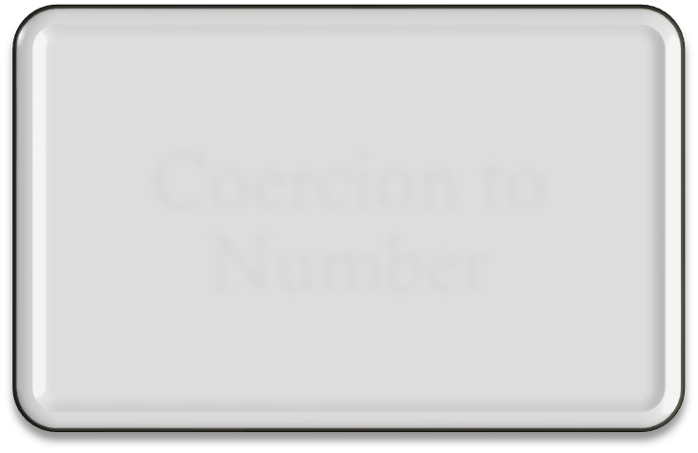
Coercion
Coercion
Boxing and Unboxing
Coercion to String
Coercion to Number

Slide 8
Summary
EL is simple and robust. It can handle both expressions and literals, which are constants and are assigned some memory location.
EL is a great help to the page authors in accessing and manipulating the application data without mastering the complexities of the programming language such as Java and JavaScript.
JSP implicit objects are a standard set of classes. The user creates an instance of an implicit object to use available methods and variables.
Operators are used to perform different arithmetic, relational, and logical operations. Dot operator (.) or [] is used to access value of a variable. Various operators used in Expression Language are arithmetic operators, relational operators, logical operators, empty operators, and dot operators.
In Expression language the static java methods can be called within the EL expression. To access the function using EL, the function must be implemented as a static function in a java class.
The TLD file uses XML syntax to map the name of functions defined in a class with EL. Setting the value of the
<el-ignored> element in the deployment descriptor can explicitly change the default mode.
The accessing of the function created in a TLD file using a JSP file is possible by importing the TLD file using the taglib directive.
Coercion means that the parameters are converted to the appropriate objects or primitives automatically. Coercion is an implicit type conversion.

