Slide 1

Jakarta Server Pages
and Servlets
SESSION: 13
Standard Tag Library and Internationalization

Slide 2
Objectives
List the advantages of using JSTL
Describe different tag libraries available in JSTL
Explain how to configure the JSTL library in Eclipse
Explain general-purpose tags
Explain decision-making in the tags
Explain iteration tags in the core tag library
List different tags available in the SQL tag library
Recall in brief concept of internationalization and localization
Explain the resource bundling mechanism and resource bundle for various locales
Explain various formatting techniques in servlets for internationalization
Explain Reactive JAX-RS Client API

Slide 3


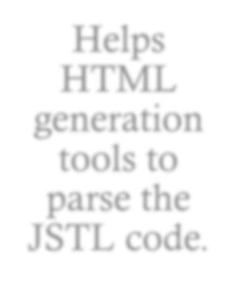
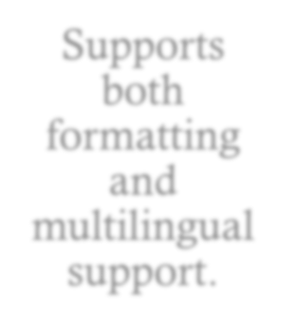
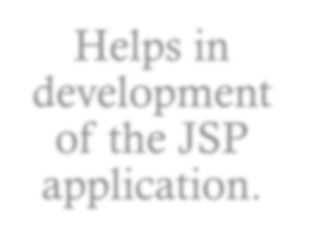
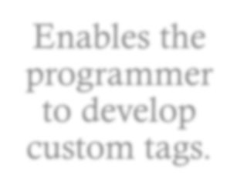

Introduction
Advantages of JSTL
Helps HTML
generation
tools to parse the JSTL code.
Supports both formatting and multilingual support.
Helps in development of the JSP application.
Enables the programmer to develop custom tags.
Saves development time.

Slide 4

jakarta.servlet.jsp.tagext
Map construction sequence of taglib
taglib Map in web.xml
Implicit Map Entries from TLDs TLDs in JAR files in WEB-INF/lib
TLDs under WEB-INF
Implicit Map Entries from the Container

Slide 5









Core Tag Library
General-Purpose Tags
Decision-Making Tags
Iteration Tags
<c:set>
<c:if>
<c:forEach>
<c:remove>
<c:choose>
<c:forTokens>
<c:out>
<c:catch>

Slide 6





SQL Tag Library
Functionalities of JSTL SQL Tag
Passing database queries
Provides users with access to the SQL tag library
database.
Accessing query
results
Allows users to access results for queries.
Database Modifications
Helps in modifying database.

Slide 7





Internationalization and Localization
Internationalization
Refers to designing and developing an application that can be deployed internationally.
Also referred to as I18N.
Localization
Refers to adapting of the application for a particular region or locality.

Slide 8
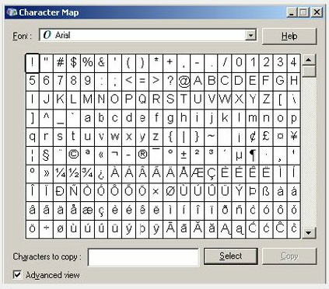


Unicode
Unicode Table
Coding system that has codes for all the major languages of the world.
Includes punctuation marks/ symbols/classical and historical texts.
16-bit character encoding.
Simple and fast.
Allows java to handle international characters.

Slide 9







Locale
Country: Represents the country code and is case insensitive.
Language: Represents the local language and is case insensitive.
Script: Represents the script and is case insensitive.

Slide 10

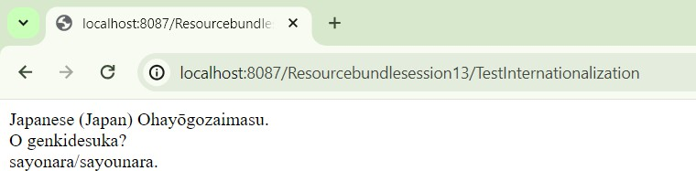
Resource Bundles
getBundle()
getKeys()
getLocale()
getObject()
getString()
ResourceBundle
Methods
Output Demonstrating Internationalization

Slide 11





Formatting in Servlets
DateFormat
DateFormat.Field
DateFormatSymbol
DateFormatter
SimpleDateFormat
Formatting Dates
getCurrencyCode()
getSymbol()
getInstance(Locale locale)
format(double number)
getCurrency()
getInstance()
parse()
setCurrency()
Formatting Currency
Formatting Numbers
Formatting Percentages
getPercentInstance()
getPercentInstance(Locale inLocale)
Formatting Messages
MessageFormat
MessageFormat.Field

Slide 12
Summary [1-2]
The JSTL tag library helps Web designers to integrate the Java technology code into JSP, by writing a simple code.
The tag extension API in the JSP adds the tag functionalities to the language. It includes information on the tag library and its tags.
taglib directive on a JSP page informs the Servlet that the page uses a tag library.
The Tag extension API in the JSP adds the tag functionalities to the language.
The Tag interface defines the lifecycle and the methods to be invoked at the start and end tag.
The URI in the taglib directive points to a context relative path; this path hosts components that starts with / and is called the TLD resource path.
JSTL provides decision-making tags to support conditions in a JSP page.
The BodyTag interface extends IterationTag and adds new functionality that lets the tag handler evaluate its body content in a temporary buffer.
JSTL is based on XML, which is very similar to HTML.

Slide 13
Summary [2-2]
The use of tag libraries, such as JSTL, helps people involved in the application development to focus on their area of expertise.
Internationalization can be defined as the method of designing an application that can be adapted to a region or a language without much change in the technology
Localization is a process of making a product or service, language, culture, and local ‘look-and-feel’ specific.
Internationalization of server side code reduces the task of writing multiple versions of a class for different locales.
Resource bundles are used to achieve the locale specific output.
Internationalization requires formatting of dates, numbers, currencies, and messages with the help of resource bundle.

