Slide 1

Jakarta Server Pages
and Servlets
SESSION: 14
Securing Java Web Applications

Slide 2
Objectives
Explain the necessity for and features of securing Web applications
Describe Jakarta EE Security API
Describe the HTTP basic, digest, client, and form-based authentication method of ensuring security
Explain how to configure users in Tomcat
Explain how to specify authentication mechanisms using annotations
Describe the steps to implement declarative security
Explain the steps to implement programmatic security
Describe the HttpServletRequest methods for identifying users
Explain the use of SSL certification

Slide 3
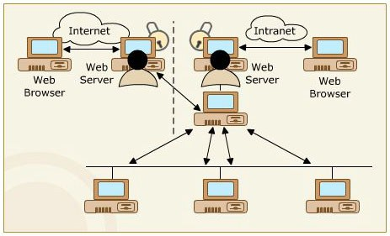










Introduction
Unauthorized Access on the Internet
Pillars of Security/Security Mechanisms
HTTP basic authentication method
HTTP digest authentication method
Form-based authentication method
HTTPS client authentication method

Slide 4
Jakarta EE Security API
Establishes servlet annotations.
Inspects the application code for programmatic security flaws.
Launches a Web-based authentication process.
Assures that all servlet and EJB containers share the same security context.

Slide 5
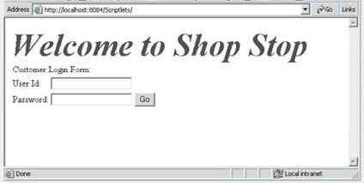
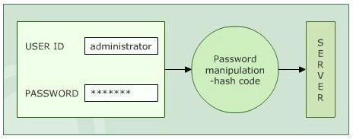
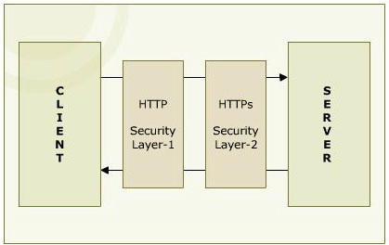
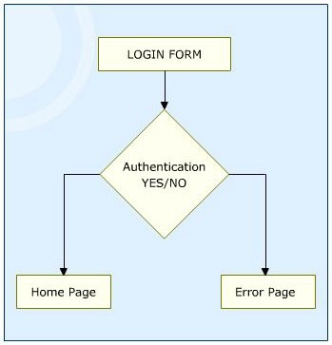
Authentication Mechanisms
HTTP Basic Authentication
HTTP Digest Authentication
HTTP Client Authentication
Form-based Authentication

Slide 6
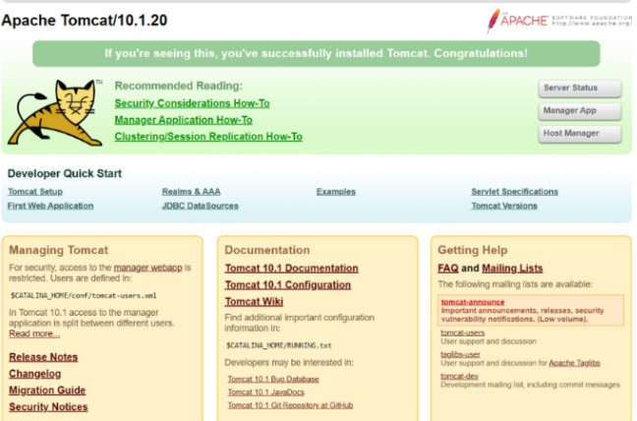
Authentication in Jakarta EE
Home Page of Tomcat Web Server
Authentication Mechanisms
<auth-method>
<realm-name>
<form-login-config>
<form-login-page>

Slide 7




Declarative Security
Ignores the programming constraints.
Requires little change in security model.
Easily maintainable.
Advantages
Provides access to all or denies.
Gives access only if the password matches.
Cannot use both Form-based and basic authentication for the same page.
Disadvantages

Slide 8





Programmatic Security
Check for an authorization request header.
Get the string with encoded username/password.
Reverse the base64 encoding.
Check the username and password.
If authentication fails, send the proper response to the client.
Servlet Annotations.

Slide 9

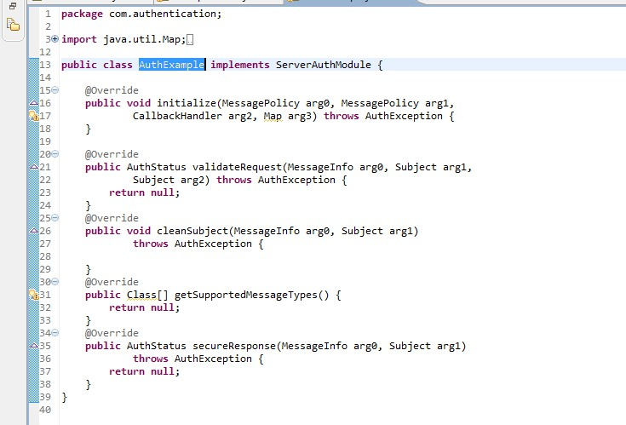




ServerAuthModule Interface
Initialize()
getSupportedMessageTypes() ValidateRequest() SecureResponse() CleanSubject()

Slide 10
SSL Certification
Authentication
Encryption
Data Integrity
Trust Indicators

Slide 11
Summary
A Web application is an application, which is accessed with the help of a Web browser.
The reason for popularity of Web applications is the ability to maintain them without changing the client computers. When you access the Web, hackers can get your information. So, to keep your information secret, it is necessary to secure Web applications.
There are four authentication Mechanisms available. These are HTTP Basic Authentication, HTTP Digest Authentication, HTTPS Client Authentication, and Form-Based Authentication.
In modern Jakarta EE applications, using annotations to configure security settings has become a common practice.
Traditional web.xml file can still be used for security configuration in Jakarta EE applications, offering flexibility and backward compatibility for applications.
The declarative security provides security to a resource with the help of server configuration.
Programmatic security authenticates the users and grants access to the users.
An SSL certificate authenticates a Website and encrypts data between servers and browsers, ensuring security, data integrity, and user trust through HTTPS and visual indicators such as padlock icon.

