Slide 1

Jakarta Server Pages
and Servlets
SESSION: 15
Building an Application Using JSP and Servlet

Slide 2
Objectives
Explain the process of creating a Dynamic Web application using JSP and Servlet
Describe connecting a database using JPA
Describe the steps to connect the JSP application to a MySQL database

Slide 3
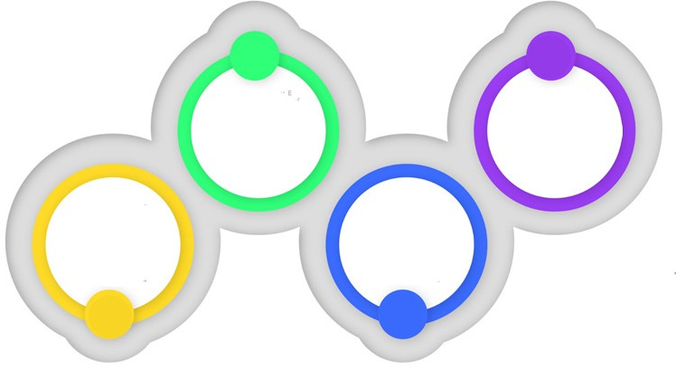

Overview
Employee Information Application
View employee details
Delete employee details
Add new employee details
Update employee details
User

Slide 4
Application Sitemap
Login.jsp
Login jsp page for admin login
LoginServlet.java
Home.jsp
TestServlet.java
Servlet file for handling Login.jsp page
JSP file to perform Add, View, Update, Delete functionality
Servlet file for handling Home.jsp functionality

Slide 5



Steps to Create the Employee Information Application
Step 1
Step 2
Connect application to database
Step 3
Run application
Create Dynamic Web
Page application

Slide 6
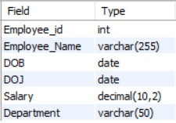
Creating MySQL Database
employee_data Table Structure

Slide 7
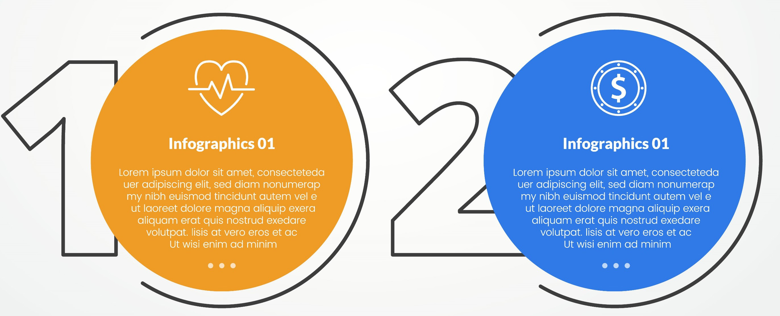
Creating Employee Information Application
Installing necessary JAR files in the project
Creating essential files within the project

Slide 8

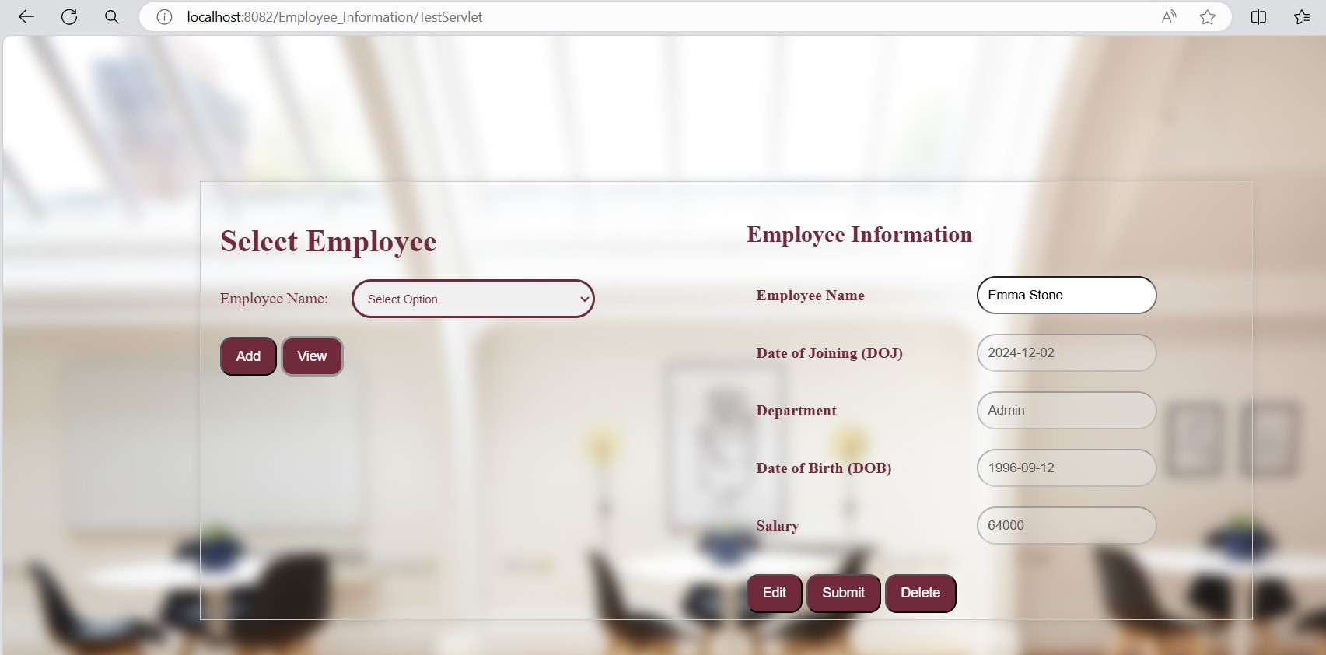



Running the Application
Right-click Login.jsp
Home Page of Employee Information Application
Select Run As → Run on Server
Enter Username: Admin, Password: admin123
Click Login

Slide 9
Summary
A simple employee information application is created using Jakarta Server Pages, Servlets, and a MySQL database called employee_information.
Steps to create the Employee Information application involve creating a Dynamic Web Page application, connecting the application to database, and running the application.
The prerequisite to creating the Employee Information application is to create a database in MySQL.
Two processes to create Employee Information application involve installing necessary JAR files in the project and creating essential files within the project.
The required source code files, including Login.jsp for admin login, LoginServlet.java for handling login page, Home.jsp for Add, View, Update, Delete functionality, and TestServlet.java for managing Home.jsp functionality.
Steps to run the application involve logging in using the provided credentials and navigating through various pages to add, view, edit, and delete employee details, and observing the corresponding changes in the interface.

