Slide 1
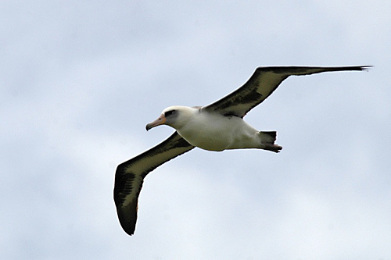
COS30082 · APPLIED MACHINE LEARNING · ASSIGNMENT 1
Bird Species
Classification on CUB-200
Andy Wei Jian CHU
Student ID: 104401283
Swinburne University of Technology
Streamlit: streamlit run app.py
PyTorch
ConvNeXt
Streamlit
Slide 1
Notes:
Hello everyone; welcome to COS30082 Applied Machine Learning, Assignment 1.
My name: Andy Wei Jian CHU; Student ID: 104401283.
Project: Fine-Grained Bird Species Classification on CUB-200.
Roadmap: FGVC challenge → ResNet-50 vs ConvNeXt-Tiny → overfitting strategies → code walkthrough → evaluation metrics → Streamlit demo.

Slide 2
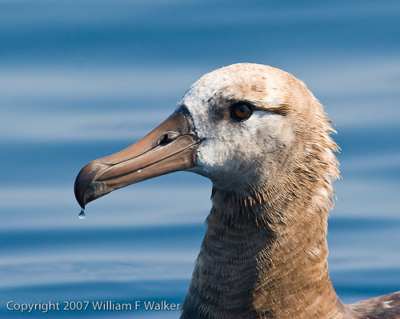
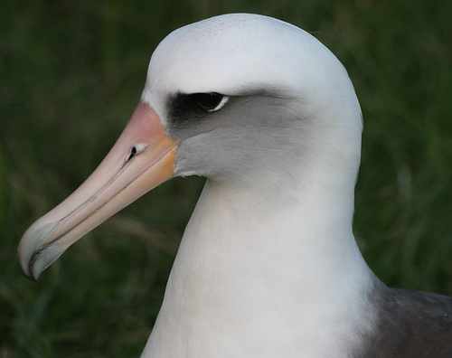
02 · PROBLEM
Fine-Grained Visual Categorization
LOW INTER-CLASS VARIANCE
DATASET STATS
200 species
4,829 training images (~24 / class)
1,204 test images
Laysan
Albatross
Black-footed
Albatross
High Intra-class Variance
Severe Overfitting Risk
Pose, lighting, background, and occlusion vary widely within each species. Model easily memorizes non-bird cues.
~24 images per class. Deep nets quickly latch onto sky, leaves, or branches instead of subtle anatomy.
Slide 2
Notes:
Task is fine-grained visual categorization, not generic object classification.
Need classify among 200 bird species.
Dilemma 1: low inter-class variance — sister species look almost identical.
Differences are tiny/local: beak curvature, eye rings, wing bars.
Dilemma 2: high intra-class variance + overfitting risk.
Only ~24 training images per class.
Deep networks may memorize backgrounds: sky, leaves, branches.
Therefore methodology must prevent background memorization and focus on subtle bird anatomy.

Slide 3
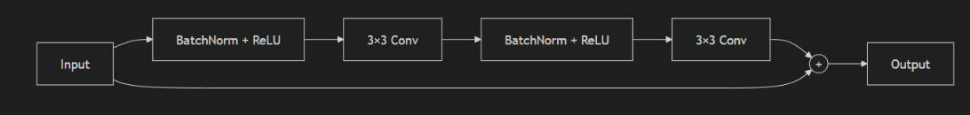
03 · METHODOLOGY
Architecture Comparison
ResNet-50 vs ConvNeXt-Tiny · Frozen feature extraction + End-to-end fine-tuning
ResNet-50
ImageNet-1K pretrained
• Localized 3×3 convolutions
• Small early receptive field
• ~24.5M parameters
• Custom 200-class head + 0.3 dropout
ConvNeXt-Tiny
Modern CNN + ViT principles
• 7×7 depthwise convolutions
• Large early receptive field
• ~28.0M parameters · LayerNorm + GELU
• Custom 200-class head + 0.3 dropout
Slide 3
Notes:
Compare ResNet-50 and ConvNeXt-Tiny under two regimes: frozen feature extraction and end-to-end fine-tuning.
Gives four configurations: frozen vs fine-tuned within each architecture; architecture comparison at each regime.
ResNet-50: ImageNet-1K pretrained; residual connections solve vanishing gradients.
Limitation: localized 3×3 convolutions → small early receptive field; diffuses fine-grained detail.
ConvNeXt-Tiny: modern CNN using Vision Transformer principles.
Uses large 7×7 depthwise convolutions → larger receptive field from first stage.
Captures whole-body plumage and bill shape simultaneously.
Inverted bottleneck: expands hidden channels by 4× → avoids spatial detail bottleneck.
Uses LayerNorm + GELU instead of BatchNorm + ReLU → stabilizes feature learning.
Both models: custom 200-class head with 0.3 dropout.

Slide 4
04 · REGULARIZATION
Overfitting Mitigation Suite
1. Stratified Split
2. Data Augmentation
85 / 15 train–val
4,104 train · 725 val
Every species proportionally
represented for early stopping
RandomResizedCrop 224×224
RandomHorizontalFlip
ColorJitter (B/C/S)
RandomErasing
3. Label Smoothing
4. Optimizer & Schedule
Cross-Entropy ε = 0.1
Soft targets across classes
Reduces overconfidence
on ambiguous species
AdamW λ = 0.01
Differential LR (1e-4 / 5e-4)
Cosine Annealing + AMP
~1.8 GB VRAM on RTX 2050
Slide 4
Notes:
Four-part regularization suite.
Stratified 85/15 split: 4,829 → 4,104 train / 725 validation.
Ensures all 200 species represented proportionally; reliable early stopping; test set untouched.
Domain-aware augmentation:
Random Resized Crop → scale invariance / telephoto zoom simulation.
Color Jitter → brightness, contrast, saturation; prevents daylight/canopy memorization.
Random Erasing → hides patches; forces multiple independent visual cues.
Label Smoothing Cross-Entropy, ε = 0.1 → avoids overconfident hard labels; helps ambiguous species.
AdamW, weight decay 0.01; differential learning rates; Cosine Annealing; FP16 AMP.
Trained efficiently on local RTX 2050 GPU.

Slide 5
05 · IMPLEMENTATION
Code Walkthrough
dataset.py
models.py
train.py
evaluate.py
CUB200Dataset class
Stratified 85/15 split
Train transforms vs. eval
(resize + center crop)
build_model factory
ResNet-50 / ConvNeXt-Tiny
Parameter groups
(backbone 1e-4 (0.0001), head 5e-4(0.0005))
AMP autocast + GradScaler
~1.8 GB VRAM
Val Top-1 + Ave Class Acc
Best-weight checkpointing
Official metric formulas
Top-1 Accuracy
Average Class Accuracy
Confusion pair export
Slide 5
Notes:
Codebase is modular.
dataset.py: CUB200Dataset; stratified split; torchvision transforms; deterministic evaluation with resize/center crop.
models.py: factory builds ResNet-50 or ConvNeXt-Tiny with pretrained weights; swaps classifier head.
Parameter groups: backbone fine-tuned gently at 1e-4; new head learns at 5e-4.
train.py: torch.cuda.amp.autocast() + GradScaler().
Cuts VRAM to ~1.8 GB; fits 4 GB VRAM without memory spikes.
Each epoch: validation Top-1 and Average Class Accuracy; checkpoint best weights.
evaluate.py: implements exact rubric metrics.

Slide 6
06 · RESULTS
Experimental Results
Official 1,204 test images · Production baseline (4-way comparison pending)
Model
Top-1 Acc
Ave Class Acc
Δ Top-1
ResNet-50 (Fine-tuned)
80.65%
80.11%
—
ConvNeXt-Tiny (Fine-tuned)
89.53%
89.36%
+8.88%
Train–Val Gap (Top-1)
Common Confusion Pairs
ResNet-50: 15.83 pts
ConvNeXt-Tiny: 11.20 pts
No unregularized ablation saved;
cannot attribute gap reduction
to individual regularizers.
Common Tern → Arctic Tern (×3)
Chuck-will’s-widow ↔ Whip-poor-will
Acadian ↔ Least Flycatcher
No image annotations; no causal
attribution to lighting / pose.
Slide 6
Notes:
Results shown: current production baseline on official 1,204 test images.
New four-way comparison pending completion of twelve isolated runs.
Evaluate both required metrics: Top-1 Accuracy and Average Accuracy per Class.
Current baseline: ConvNeXt-Tiny outperformed ResNet-50.
ResNet-50: 80.65% Top-1, 80.11% Average Class Acc.
ConvNeXt-Tiny: 89.53% Top-1, 89.36% Average Class Acc.
Absolute gain: +8.88% Top-1, +9.25% Average Class Acc.
Saved histories: final train–validation Top-1 gap = 15.83 pts ResNet-50, 11.20 pts ConvNeXt-Tiny.
No saved unregularized ablation → do not claim how much each regularizer changed the gap.
Saved ConvNeXt errors: Common Tern → Arctic Tern three times; several pairs with two errors in one direction.
No image annotations explaining errors → do not attribute to lighting, pose, or plumage.

Slide 7
07 · DEMONSTRATION
Streamlit Web Application
● ● ● localhost:8501 — Bird Species Classifier
Home
Model
Experiment
Upload photo or select
official test image
→ Identify bird species
→ Top-1 + confidence
→ Top-5 probability chart
Official metrics
Top-1 Accuracy
Average Class Accuracy
Architecture summary
Checkpoint info
Setup overview
Saved figures
Interactive seed compare
Model-selection
conclusion
Slide 7
Notes:
Demo integrated Streamlit app.
Home page: upload bird photo or select official test image.
Click Identify bird species.
Output: top-1 prediction, confidence percentage, top-five probability chart.
Model page: official Top-1 and average per-class accuracy.
Experiment page: setup, saved figures, interactive seed comparison, final model-selection conclusion in one workflow.

Slide 8
08 · CONCLUSION
Key Takeaways
01
FGVC addressed
Low inter-class / high intra-class variance handled via architecture + regularization
02
ConvNeXt-Tiny superior
89.53% Top-1 · 89.36% Ave Class Acc (+8.88% / +9.25% over ResNet-50)
03
Regularization suite
Measured in histories; no causal ablation claimed. Pending 12-run comparison.
04
Complete deliverables
Modular code · 4-page report · Streamlit app · this presentation
Slide 8
Notes:
Project has documented production baseline using ConvNeXt-Tiny + rigorous regularization suite.
Achieves 89.53% Top-1 and 89.36% Average Class Accuracy.
12-run frozen-vs-fine-tuned comparison remains pending.
Any promotion will be based on validation average class accuracy before official test evaluation.
Addressed FGVC challenges on CUB-200.
ConvNeXt-Tiny outperformed ResNet-50 in current baseline.
Regularization measured in saved histories; no causal ablation claimed.
Deliverables: modular Python code, 4-page report, Streamlit app, presentation.
Thank audience; code, checkpoints, documentation, and app available in submission repository.

