Slide 1



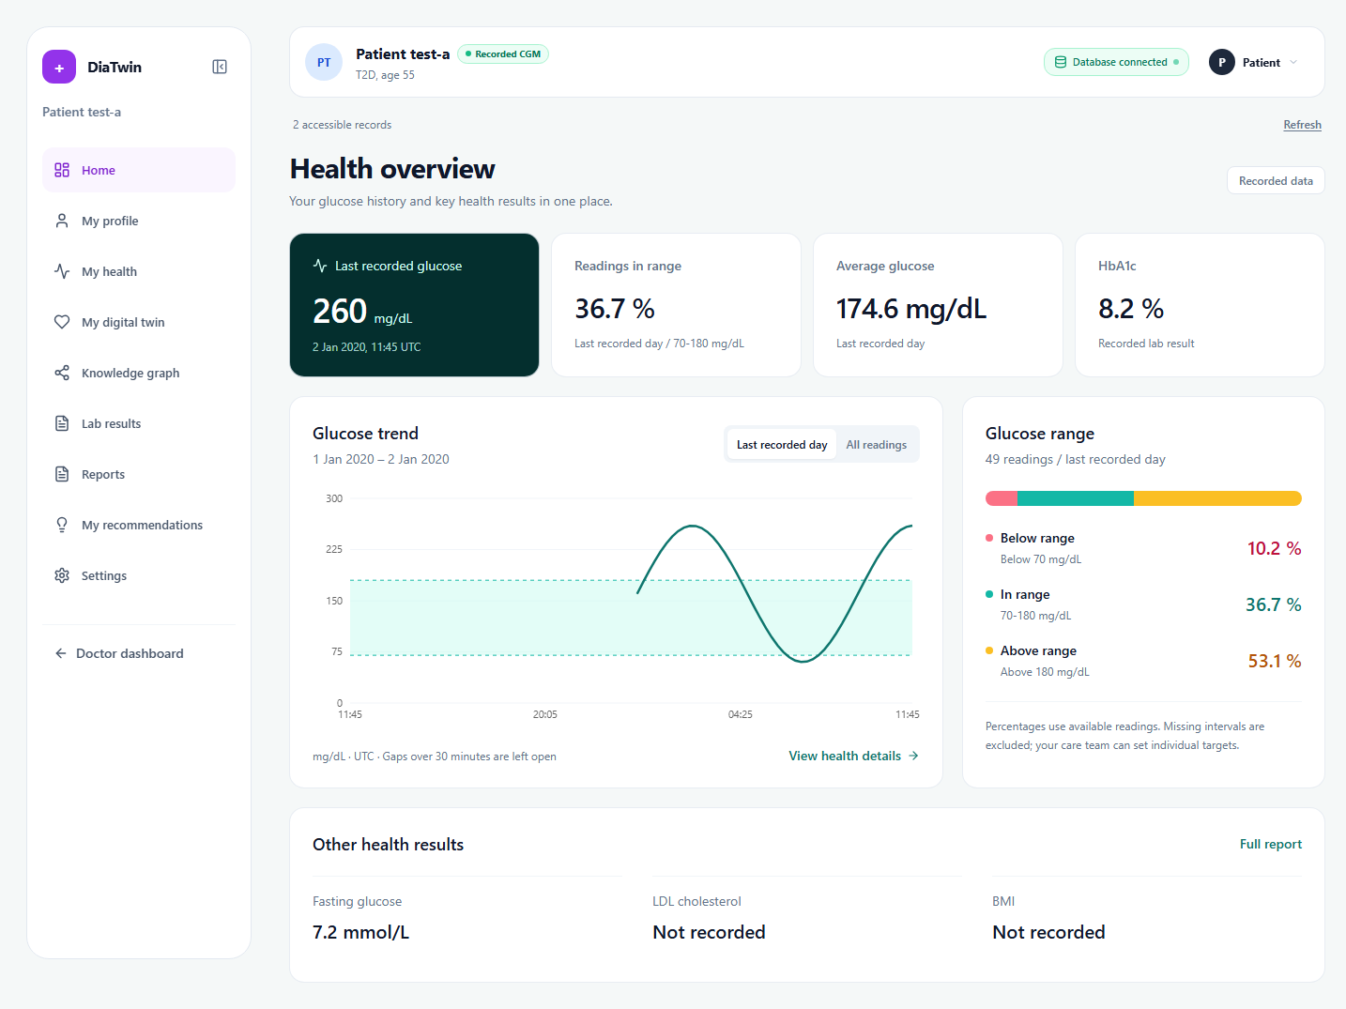
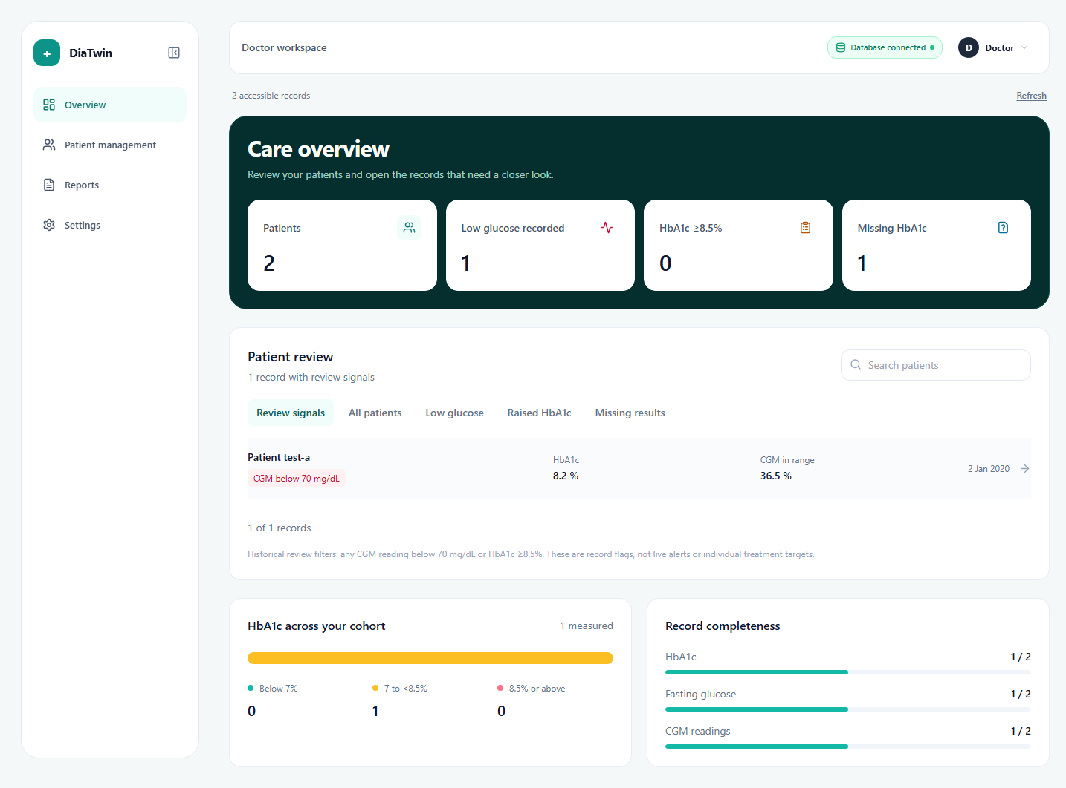
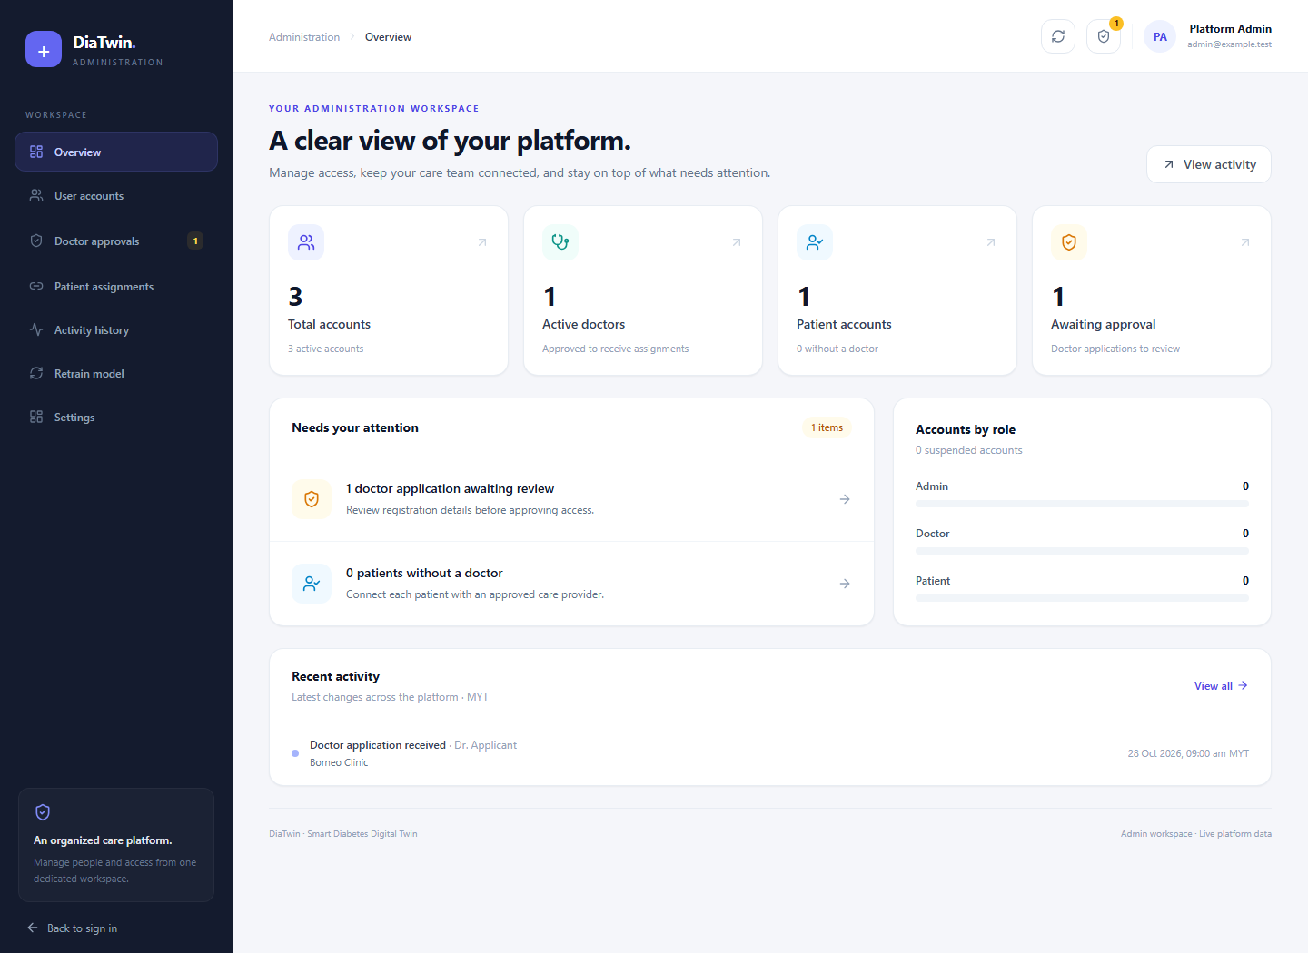
FINAL YEAR PROJECT | WEB PLATFORM
Smart Diabetes Digital Twin
Personalised Health Management Platform
Swinburne University of Technology Sarawak Campus
Supervisor: Ts. Dr. Vong Wan Tze
One platform. Three connected workspaces.
Bring diabetes records, glucose monitoring and model forecasts into one website. Patients review their health, doctors follow assigned records, and administrators manage access and model operations.
01 Patient workspace
02 Doctor workspace
Understand recorded health and explore glucose forecasts.
Review the cohort and open records that need attention.
Health overview: recorded trends and glucose range.
Care overview: review filters and patient drill-down.
Health dashboard, profile and glucose monitoring.
My digital twin: 6 h / 12 h GRU forecasts and what-if comparisons.
Save predictions to Lab results; review reports and settings.
Search and filter assigned patient records.
Review glucose records, missing results and reports.
Open the patient's workspace for detailed review.
03 Administrator workspace
Accounts and care-team access
Review Doctor applications, manage users, and assign patients to approved doctors.
Activity history and model retraining
Track platform changes and retrain the GRU using the latest Supabase CGM records.
Patient review workflow
1 Sign in
2 Review
Authorized records
Glucose history
3 Explore
4 Save
Website screenshots use synthetic test records.
Patient digital twin
Results and reports
React + TypeScript | Flask API | Supabase | GRU forecasting | Neo4j | github.com/AA-4499/FYP-A-Sep-2026
Notes:
Source: https://github.com/AA-4499/FYP-A-Sep-2026 ; TrainingModel commit 841319a.
Based on user-supplied FYP_Poster.pptx. Original slide dimensions and university marks retained. Empty second slide removed. All headings, descriptions and workflow elements are editable native PowerPoint objects; screenshots and generated background are embedded images.
Doctor-side Digital twin menu and route have been removed. My digital twin remains in the patient workspace. Lab results contain saved model predictions, not measured laboratory tests. Model outputs and what-if scenarios are exploratory and are not clinically validated treatment recommendations. The knowledge-graph recommendation interface remains a prototype. Successful online retraining updates online predictions; repository/browser models are fixed snapshots.
Screenshots were captured from the current local website with synthetic test records; their displayed numbers are not research evaluation results. No student name, email, clinical accuracy or patient-outcome claim was supplied or invented.
Next work: held-out patient forecasting evaluation, scenario validation and clinician-reviewed recommendation delivery.
Generated background: built-in ImageGen; prompt saved alongside source assets.

