Slide 1











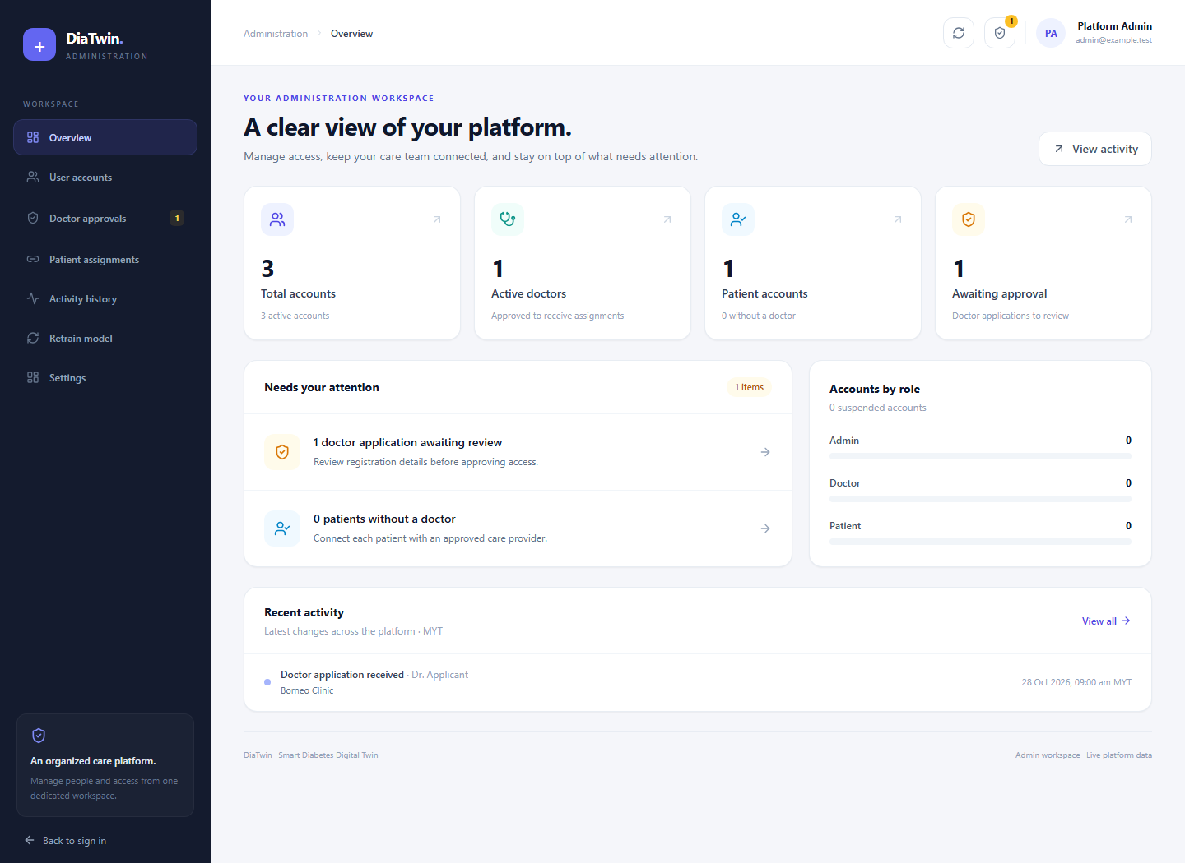
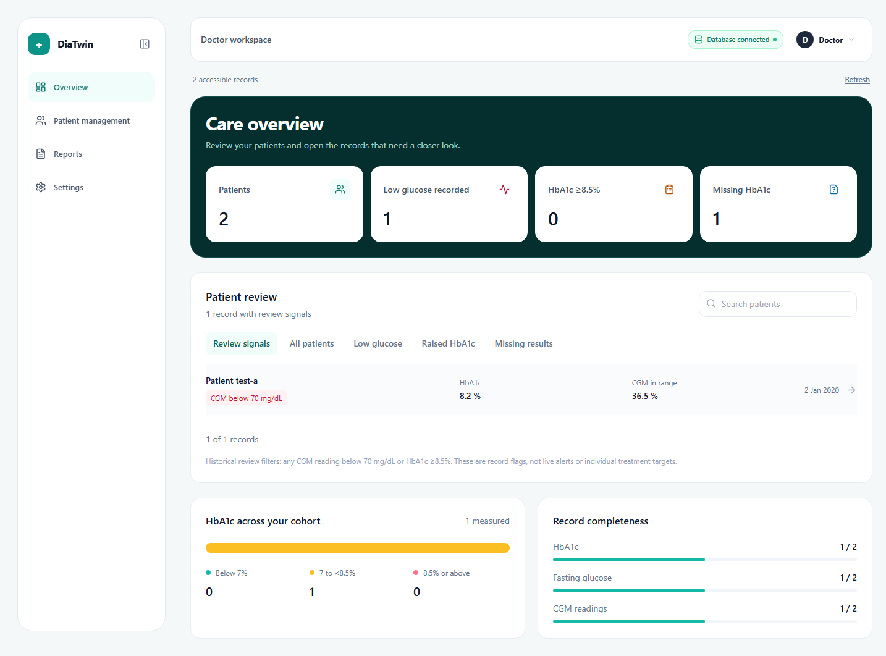
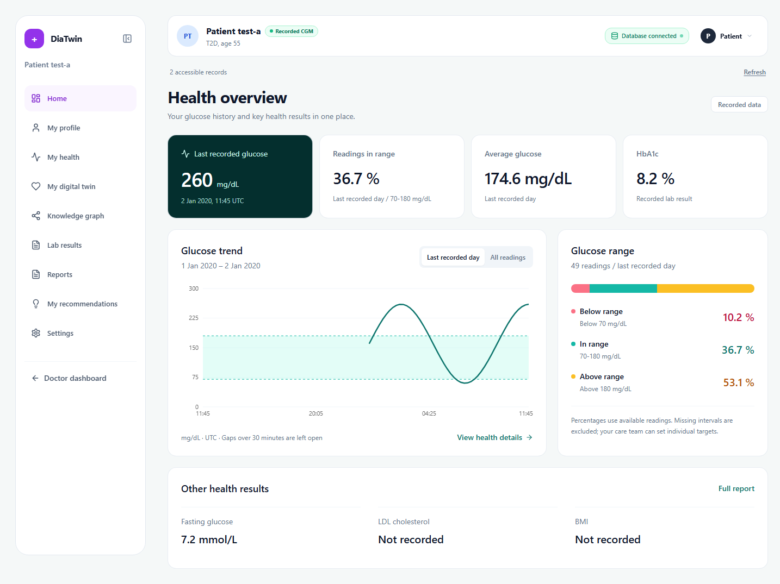
Smart Diabetes Digital Twin
Personalised Health Management Platform
Andy Wei Jian CHU | Fa Zhen NG | Jit Heng BOON
Elijah Benjamin Sing Cheng TAN | Jody LAW
Swinburne University of Technology Sarawak Campus
Supervisor: Ts. Dr. Vong Wan Tze
Introduction
Methodology
Diabetes care involves changing clinical measurements, lifestyle records and risk factors. Disconnected observations make it difficult to understand how a patient's health state evolves. This project uses the ShanghaiT2DM longitudinal dataset to build a patient-centric digital representation of health over time, bringing patient records, trends, predictive analytics and medical knowledge into a coherent workflow for healthcare professionals and researchers.
A modular, iterative approach combines longitudinal data engineering, predictive modelling and traceable medical knowledge. The planned user journey is shown below; advanced stages remain development targets.
Target end-to-end workflow
01
02
03
Select patient
View health history
Assess current
risk
Problem
06
05
04
Patient records, risk factors and simulated outcomes need a connected, interpretable view that clearly separates observed health information from model-generated estimates.
View digital twin state
Personalised insights
Explain key factors
Project aim
07
08
09
Develop an integrated, patient-centric digital twin that represents changing diabetes health states and connects longitudinal history, risk assessment, explainability, personalised insights, scenario exploration and reporting in one complete workflow.
Create what-if scenario
Compare
outcomes
Generate health report
Research and development objectives
Data preparation and patient state
1. Link longitudinal records to patient-specific state tracking.
2. Combine prediction, XAI and knowledge-graph context.
3. Support monitoring, scenario comparison and reporting.
KNIME standardises patient_summary and patient_detail, retaining identifiers, timestamps, units and missing entries. The source preparation covered 109 workbooks and 112,287 parseable CGM rows.
Results
Predictive modelling and evaluation
Train a GRU on 24 historical steps (6 h) to predict the next 15-minute reading. Evaluate against persistence. Investigate a separate conditional model for 12 h trajectories.
15-minute glucose forecasting (mg/dL)
Metric | GRU | Persistence
MAE | 3.81 | 5.93
RMSE | 5.28 | 8.78
Clinical context and explainability
Neo4j stores medical concepts and source-linked relationships with review status. SHAP feature explanations and risk-based personalised insights remain planned objectives, beyond the Sprint 1 prototypes.
Same 22,401 held-out windows; chronological testing on later observations from known records. These are next-step results, not 6 h or 12 h accuracy.
Application integration and verification
Longer-horizon trajectory MAE (mg/dL)
React/TypeScript, Flask and Supabase integrate patient records, monitoring, forecasting and graph views. Test role/assignment access and separate measured, predicted and simulated outputs.
Method | 3 h | 6 h | 12 h
Persistence | 22.91 | 29.77 | 34.64
Initial GRU, corrected recursion | 22.22 | 27.66 | 29.70
Conditional GRU (7 fields) | 20.55 | 22.98 | 24.77
Core twin: data-driven health-state tracking. A 3D body view is a secondary enhancement; autonomous diagnosis and prescription generation are outside scope.
Matched comparison: 108 forecast starting points, without future meal or insulin plans. Unseen-patient generalisation remains untested.
Conclusions
Knowledge-graph prototype
Sprint 1 established the data and application foundations for the planned patient-centric twin. GRU forecasting improved on persistence in the reported tests, and a traceable knowledge-graph prototype was integrated. These are research-stage results: the complete risk/XAI/insight workflow, unseen-patient forecasting and reliable intervention simulation remain to be completed or validated.
37
42
15
medical concepts
proposed relations
relation types
All 42 relationships were candidate_for_review; none were reviewed at the report check. Relationship-based interpretation remains restricted.
Recommendations
Evaluate forecasts on patients excluded from training.
Investigate inconsistent meal and insulin responses.
Review graph evidence; develop risk and SHAP modules.
Complete scenario, access-control and usability validation.
Notes:
Sources: User-supplied visual reference, Smart Diabetes Digital Twin poster.png. Research content and numeric tables retained from the existing FYP_Poster_Research_Aligned.pptx. Original editable file provides the physical canvas, masters, university marks and medical background. The target workflow includes planned stages. Forecasting results and knowledge-graph review limitations are retained exactly as supplied.
Research sources retained from the existing revision: COS40005 Team and Project Plan, 27 September 2026, Part 2. Sprint Report 1, updated 30 October 2026, sections 2.1–2.6 and 3.3–3.4. Source code: https://github.com/AA-4499/FYP-A-Sep-2026

