Slide 1

Why?
We avoid the overheads created when involving Datacom to package and distribute new packages.
One Python installation can access and use multiple versions of a package (otherwise, this can only
be achieved with much more complicated virtualenv setups).
Can be used for ad hoc scripts just as easily as for distributed applications.
If a package is missing, the error message is clear and simple.
Disadvantages:
We must extract the developers installer and create our own (this is actually really easy).
A couple of lines of code are required in the entry code of an application.
Thirty party code expects packages to be on the path, and therefore also requires these extra lines
Usage:
Run our selectPackage installer (N:\General\Software\Python\Packages)
Run our custom installers for the required packages (same location)
Add the following lines to the entry code to your application
On production systems with the packages installed as the developers intended
a stub script (selectPackageStub) is available to put in place instead.

Slide 2
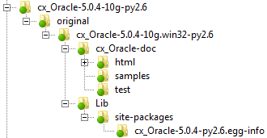

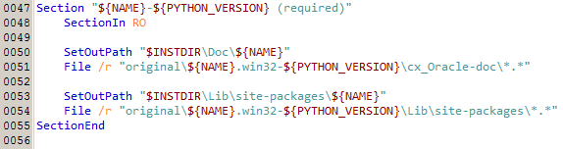
The folder structure of an unpacked installer:
The (relevant parts of the) source code of our installer:

Slide 3
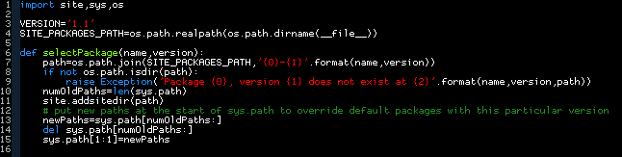
The code of selectPackage:
Links:
Universal Extractor: http://legroom.net/software/uniextract
- Used to extract installers from developers
NSIS: http://nsis.sourceforge.net/Main_Page
- Used to build our installers
HM NIS Edit: http://hmne.sourceforge.net/
- Editor for NSIS code

