Slide 1
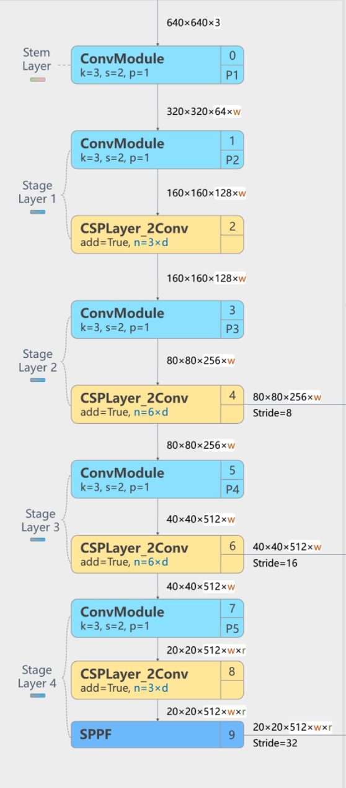
[from, repeats, module, args]
[输入, 重复次数, 模块名, 参数] #层数-层名/下采样倍数
图像尺寸（假设w=r=1）
输出：640*640*3
- [-1, 1, Conv, [64, 3, 2]] # 0-P1/2
320*320*64
- [-1, 1, Conv, [128, 3, 2]] # 1-P2/4
160*160*128
- [-1, 3, C2f, [128, True]]
160*160*128
- [-1, 1, Conv, [256, 3, 2]] # 3-P3/8
80*80*256
- [-1, 6, C2f, [256, True]]
80*80*256(输出)
- [-1, 1, Conv, [512, 3, 2]] # 5-P4/16
40*40*512
- [-1, 6, C2f, [512, True]]
40*40*512(输出)
- [-1, 1, Conv, [1024, 3, 2]] # 7-P5/32
20*20*1024
- [-1, 3, C2f, [1024, True]]
20*20*1024
- [-1, 1, SPPF, [1024, 5]] # 9
20*20*1024(输出)

Slide 2
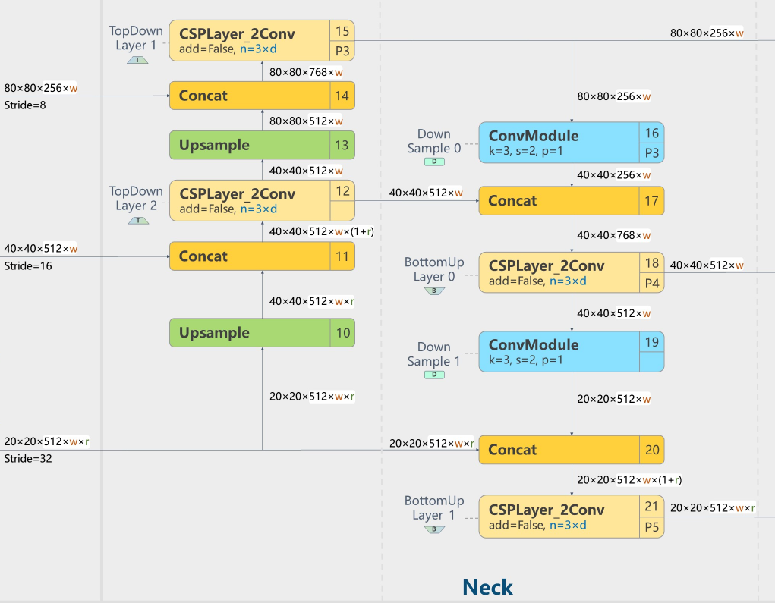
输出
40*40*1024
40*40*1536
40*40*512
80*80*512
80*80*768
80*80*256
40*40*256
40*40*768
40*40*512
20*20*512
20*20*1536
20*20*1024
- [-1, 1, nn.Upsample, [None, 2, 'nearest']]
- [[-1, 6], 1, Concat, [1]] # cat backbone P4
- [-1, 3, C2f, [512]] # 12
- [-1, 1, nn.Upsample, [None, 2, 'nearest']]
- [[-1, 4], 1, Concat, [1]] # cat backbone P3
- [-1, 3, C2f, [256]] # 15 (P3/8-small)
- [-1, 1, Conv, [256, 3, 2]]
- [[-1, 12], 1, Concat, [1]] # cat head P4
- [-1, 3, C2f, [512]] # 18 (P4/16-medium)
- [-1, 1, Conv, [512, 3, 2]]
- [[-1, 9], 1, Concat, [1]] # cat head P5
- [-1, 3, C2f, [1024]] # 21 (P5/32-large)

Slide 3
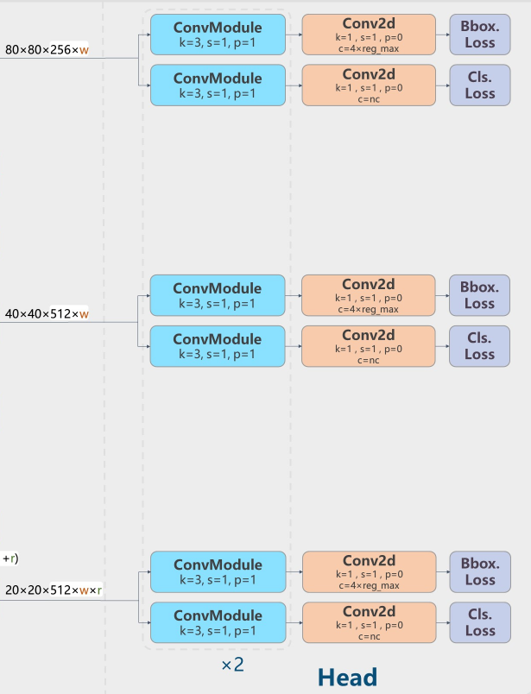
- [[15, 18, 21], 1, Detect, [nc]] # Detect(P3, P4, P5)
Neck部分在yaml文件中并没有过多体现，更多地体现在了Detect模块的源码部分，这里不进行够多赘述。

