Slide 1
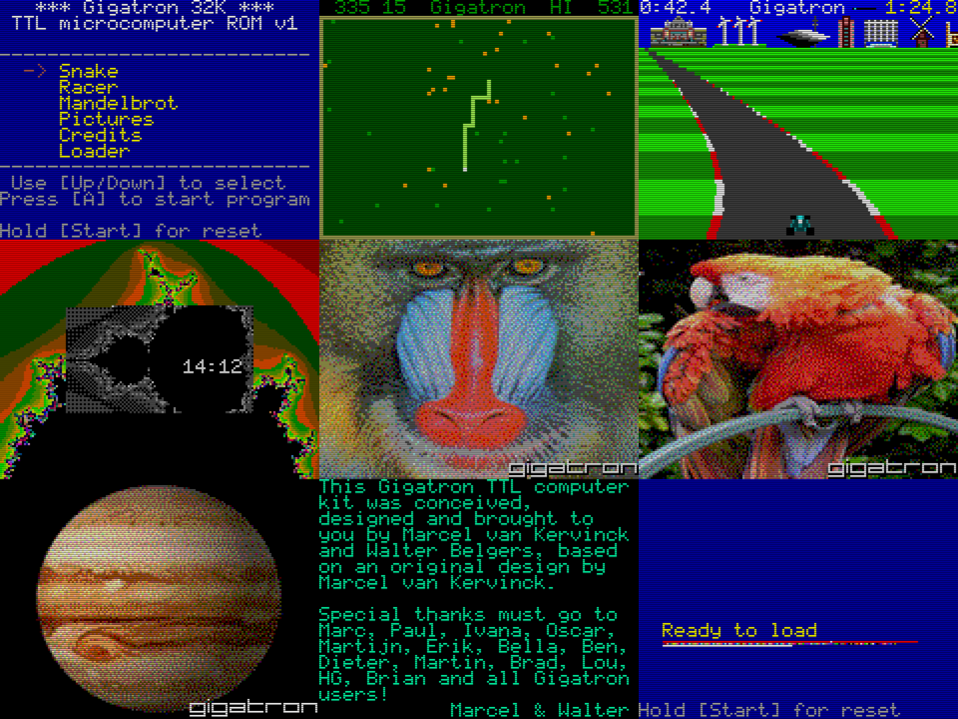
EPROM contents of Gigatron TTL computer
VGA video
driver
16-bit application processor: vCPU
Cold start sequence
4 channel
sound driver
8-bit application processor: v6502
Entropy
mixer
Blinkenlight
sequencer
5x8 bitmap font
Game controller
driver
RAM expander and SPI driver
ROM acceleration (memory, sprites)
Reset
interrupt
Virtual hardware
< 10%
File storage
> 90%

