Slide 1
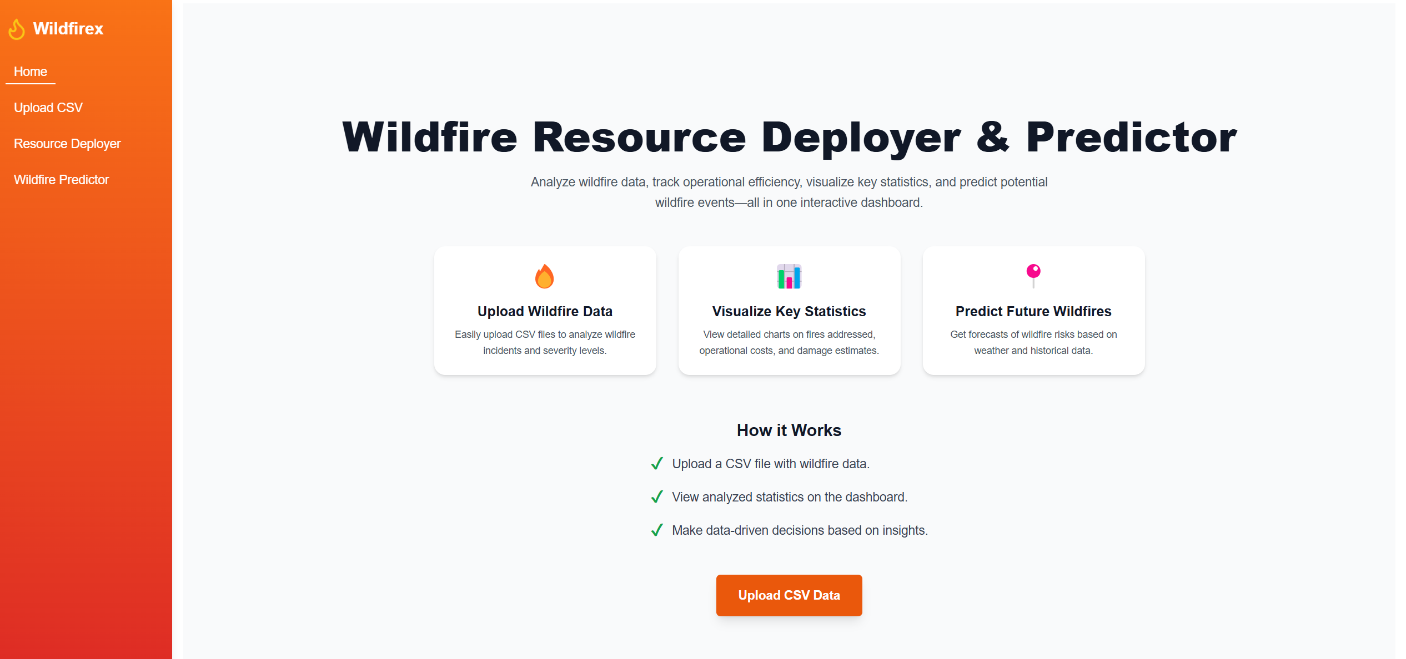
Broskies: Wildfirex
By Abdullah Amir & Abdul Rehman

Slide 2
Assumptions
Units can be only allocated once (28 total)
The predicted optimal output might not be 100% accurate.

Slide 3
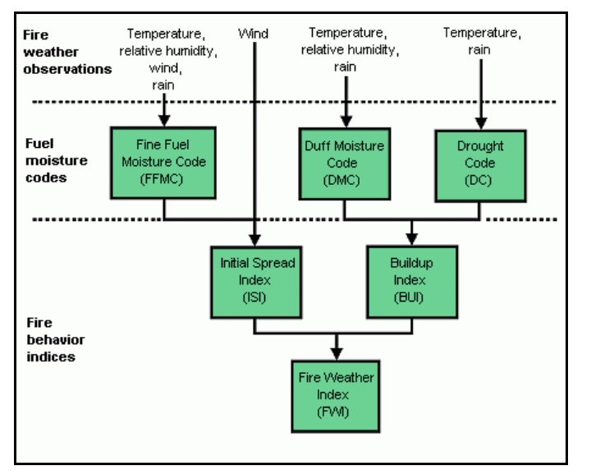
Use of AI for project
ChatGPT was used as search engine for quickly finding how some parameters work.
Used XGBoost model to predict wildfires.
Employed FWI (Canadian Forest Fire Weather Index) system modelling as features to predict likelyhood of wildfire.
https://cwfis.cfs.nrcan.gc.ca/background/summary/fwi
Saved model for inference.
Used chronological data splitting to ensure no data
leakage.

