Slide 1
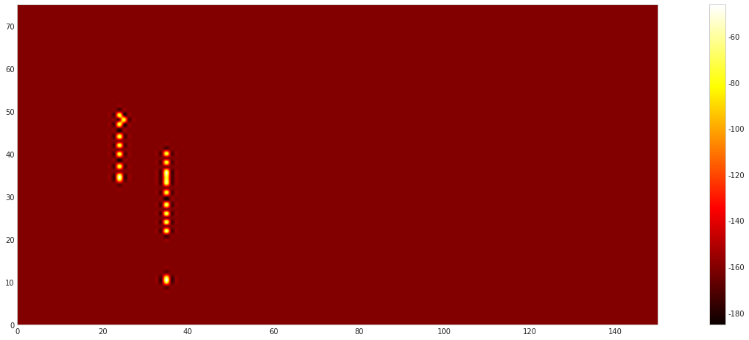
hash 137
name Huawei AP-436d
mac 58:2a:f7:6a:2e:27

Slide 2
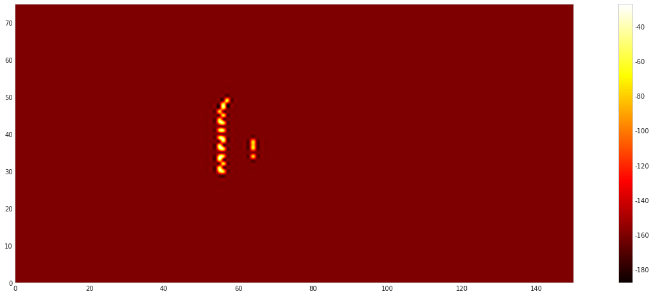
hash 138
name LGQPDA
mac aa:69:6c:73:5f:cb

Slide 3
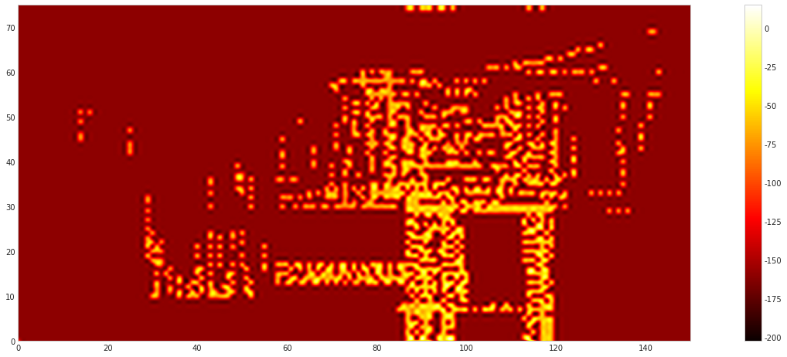
hash 151
name XMZYL-link
mac 70:f9:6d:c0:aa:10

Slide 4
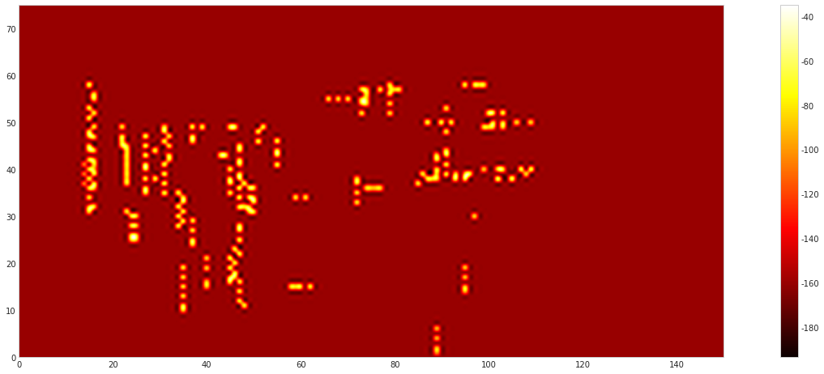
hash 152
name XMZYL-link
mac 70:f9:6d:c1:3e:d0

Slide 5
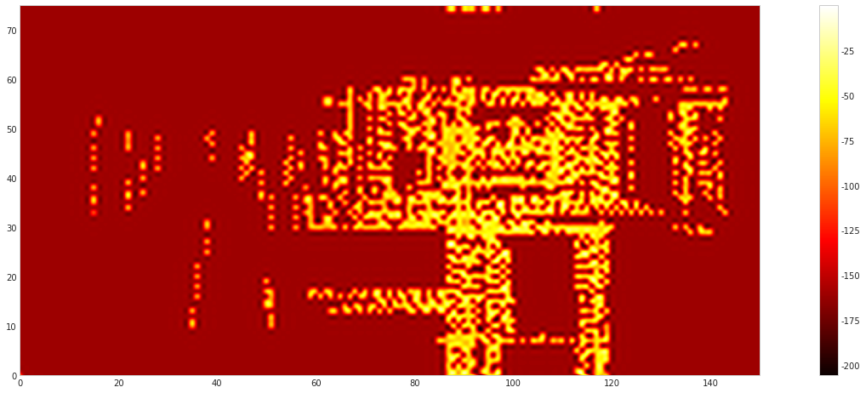
hash 153
name XMZYL-link
mac 70:f9:6d:c1:3d:70

Slide 6
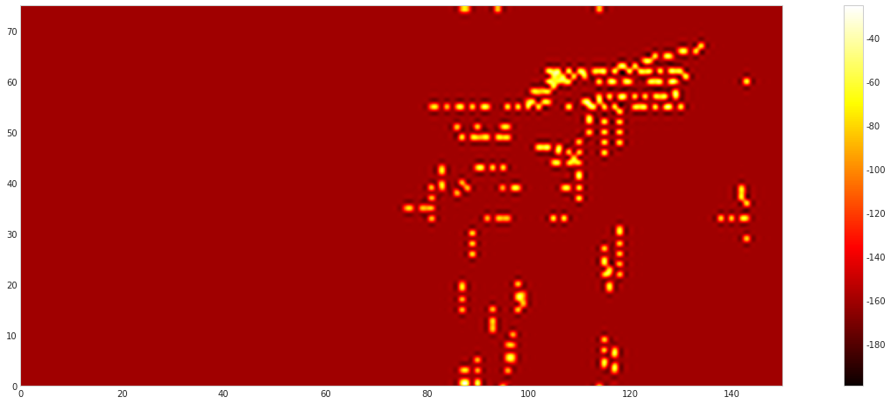
hash 156
name ysy
mac 00:1a:95:a7:ce:34

Slide 7
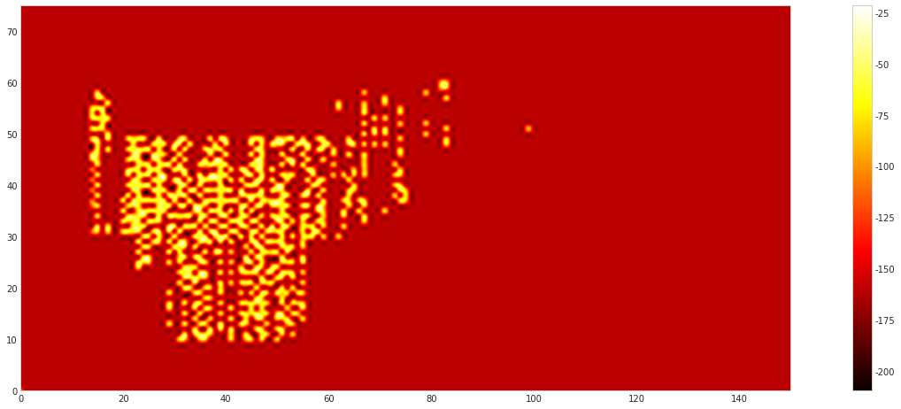
hash 157
name ZMI wrs
mac 74:a3:4a:a1:b2:f4

Slide 8
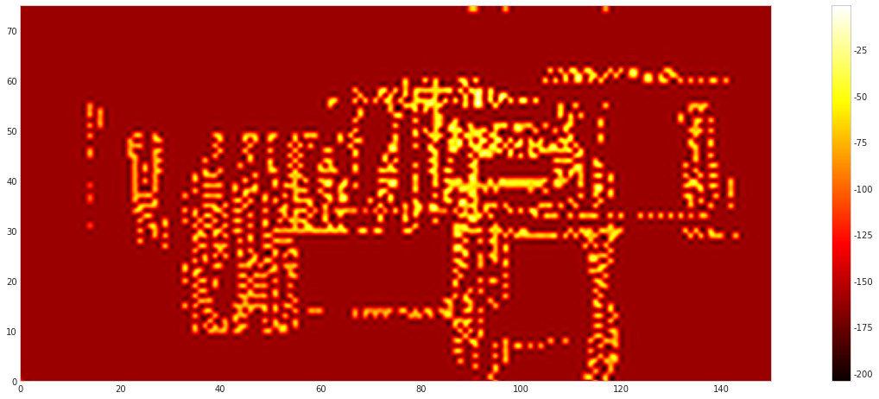
hash 166
name NaN
mac 00:01:7a:76:e4:44

Slide 9
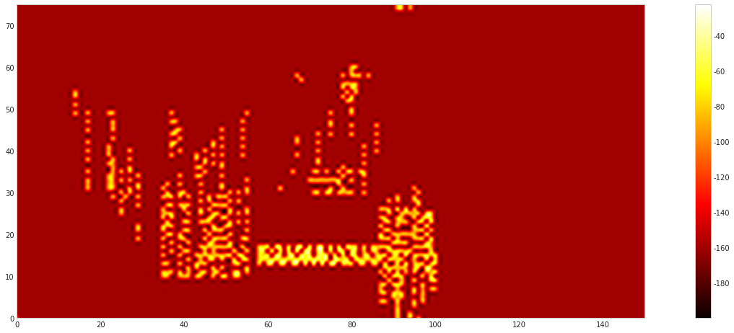
hash 18
name 301wifi
mac 70:f9:6d:c3:13:e0

Slide 10
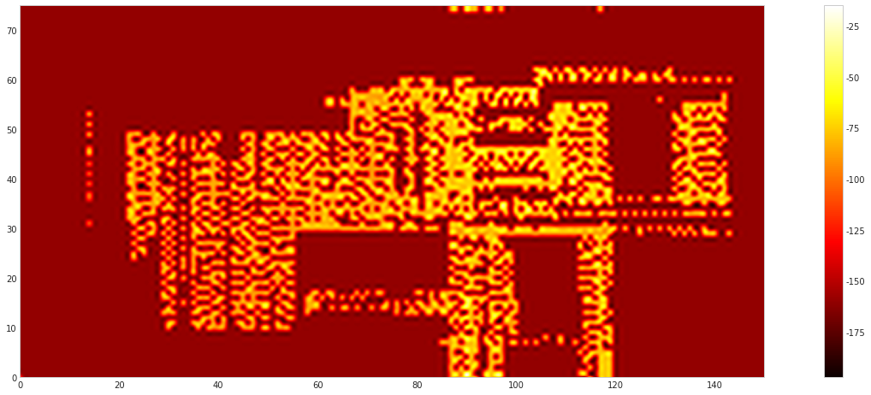
hash 20
name 301wifi
mac 70:f9:6d:bb:36:80

Slide 11
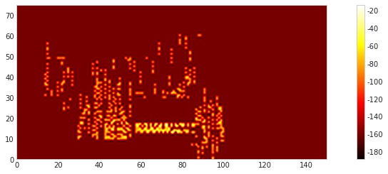
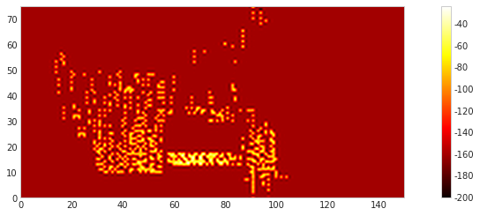
hash 24
name 301wifi
mac 70:f9:6d:ba:a0:f0

Slide 12
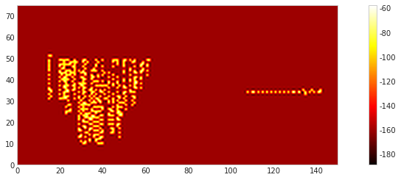
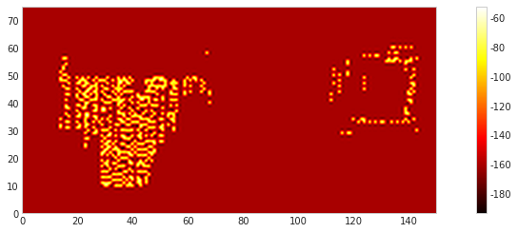
hash 29
name 301wifi
mac 70:f9:6d:bb:36:90

Slide 13
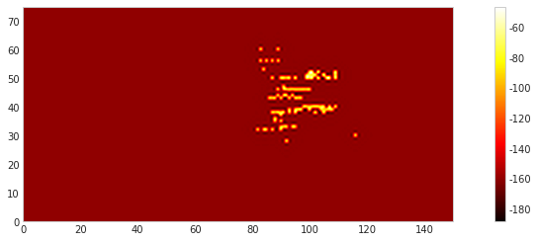
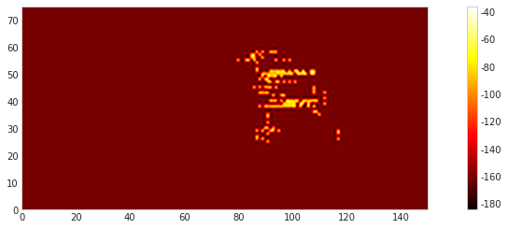
hash 81
name 301wifi
mac 70:f9:6d:c0:b2:50

