Slide 1
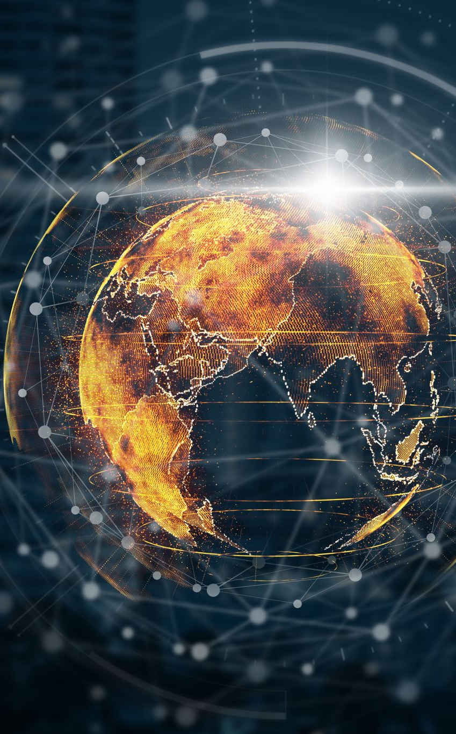
MAGMA – A Smart Tool for Mapping and Understanding the Earth

Slide 2
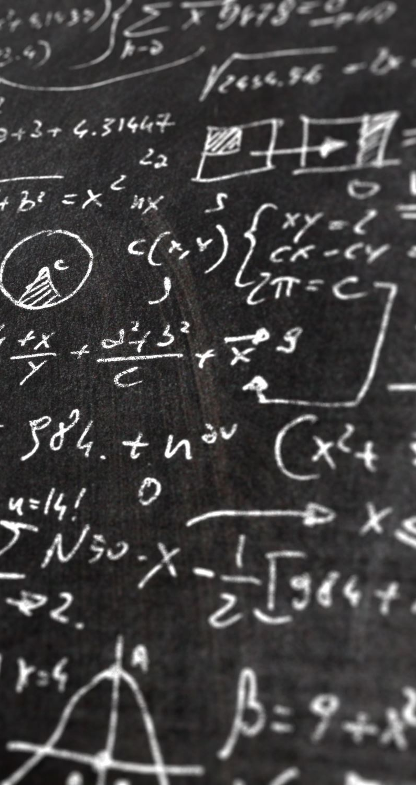
The Problem:
Accessing Complex Geological Data is Difficult: Current mapping tools and geological resources are fragmented, often difficult for non-specialists to use, and lack real-time, actionable insights.
Limited Tools for Quick, Clear Insights: Non-experts and professionals from various fields struggle to interpret geological data or map features without specialized knowledge, leading to confusion and inefficiencies.

Slide 3
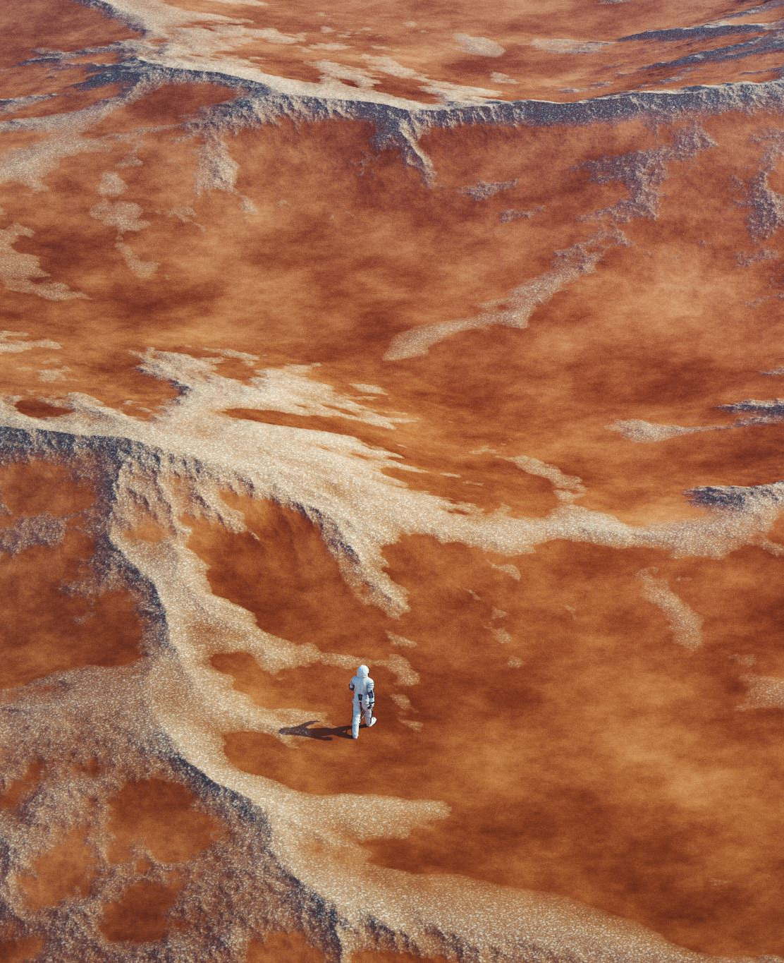
System Demonstration
Interactive and Easy-to-Use Mapping Tool: MAGMA allows users from all backgrounds to explore geological and topographic maps, providing interactive views of Earth’s features with no specialized training.
AI-Powered Descriptions: You can click on any location and instantly receive AI-generated geological insights, making complex geological data easy to understand, even if you don’t have a geologist’s background.
Street View Integration: Take a virtual walk through the terrain using Google Street View to visualize the landscape as if you were standing right there – helping you connect theory with real-world geography.

Slide 4
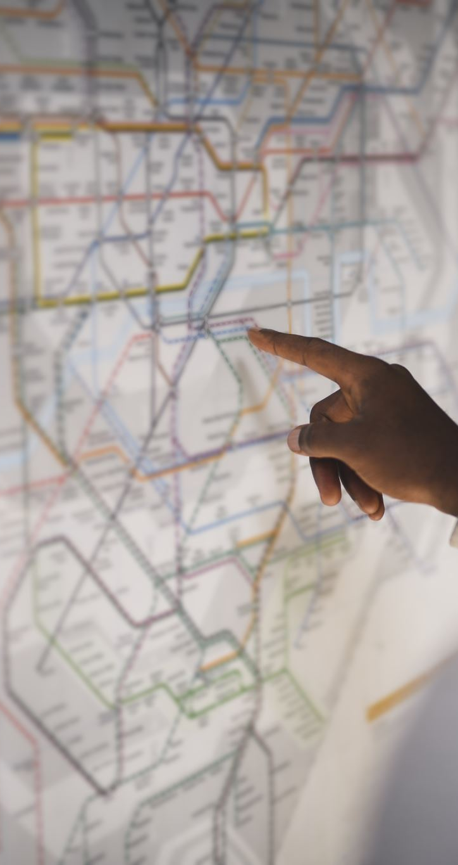
How It Works
User-Friendly Interface: Accessible for all users, whether you’re a student curious about Earth’s structure, a professional needing quick insights, or a researcher exploring data.
Real-Time Geological Data: MAGMA pulls from databases like Macrostrat and Google Street View to give live, relevant information, allowing anyone to interact with geological data easily.
AI-Powered Analysis: The system uses DeepSeek AI to transform complex geological concepts into simple, understandable language – whether you want to know about rock types, environmental contexts, or land formation histories.

Slide 5

Future Vision
A Tool for Everyone: MAGMA can be used by students as an engaging way to learn about the Earth, by professionals needing quick geological insights for projects, and by researchers looking for reliable, real-time data.
Augmented Reality (AR) Integration: Imagine using a phone or AR glasses to overlay geological information directly onto the physical environment while out in the field. This feature would be groundbreaking for both educational and professional purposes.
Mobile Accessibility: A mobile version of MAGMA would allow users to access geological data and analysis while on-site, enabling fieldwork with real-time analysis, a perfect tool for professionals in remote locations.

