Slide 1

Fine-tuning pretrained scGPT for bioinformatics service in the biotech industry
Team 75
Old Dominion University
Admera Health

Slide 2

scGPT
A foundational model for single cell genomics analysis
Pre-trained on 33 million cells.
Notes:
scGPT is an advanced Python package designed for single-cell multi-omic data analysis, leveraging pretrained foundation models to enhance various downstream tasks. Built upon a generative pre-trained transformer architecture, scGPT has been trained on an extensive dataset of over 33 million human cells, encompassing 51 organs and 441 studies from the CELLxGENE collection

Slide 3

Admera Health
Admera Health, established in 2014 and headquartered in South Plainfield, New Jersey, is a molecular diagnostics company specializing in genomic and bioinformatic services.

Slide 4
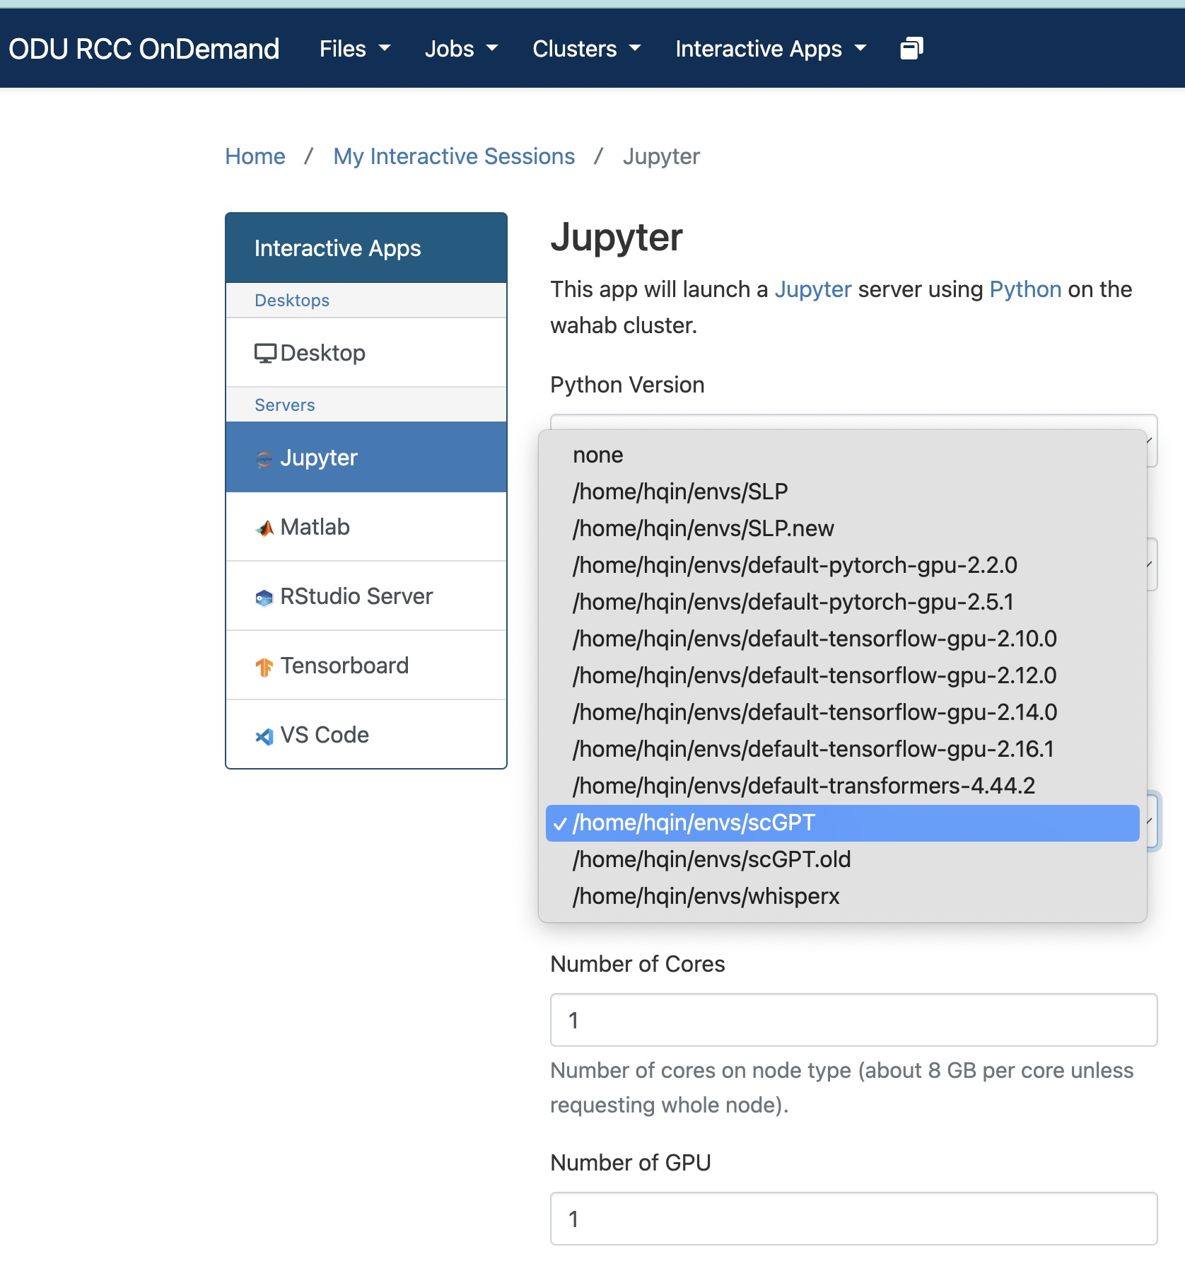
Building a virtual environment for scGPT on a university cluster.

Slide 5
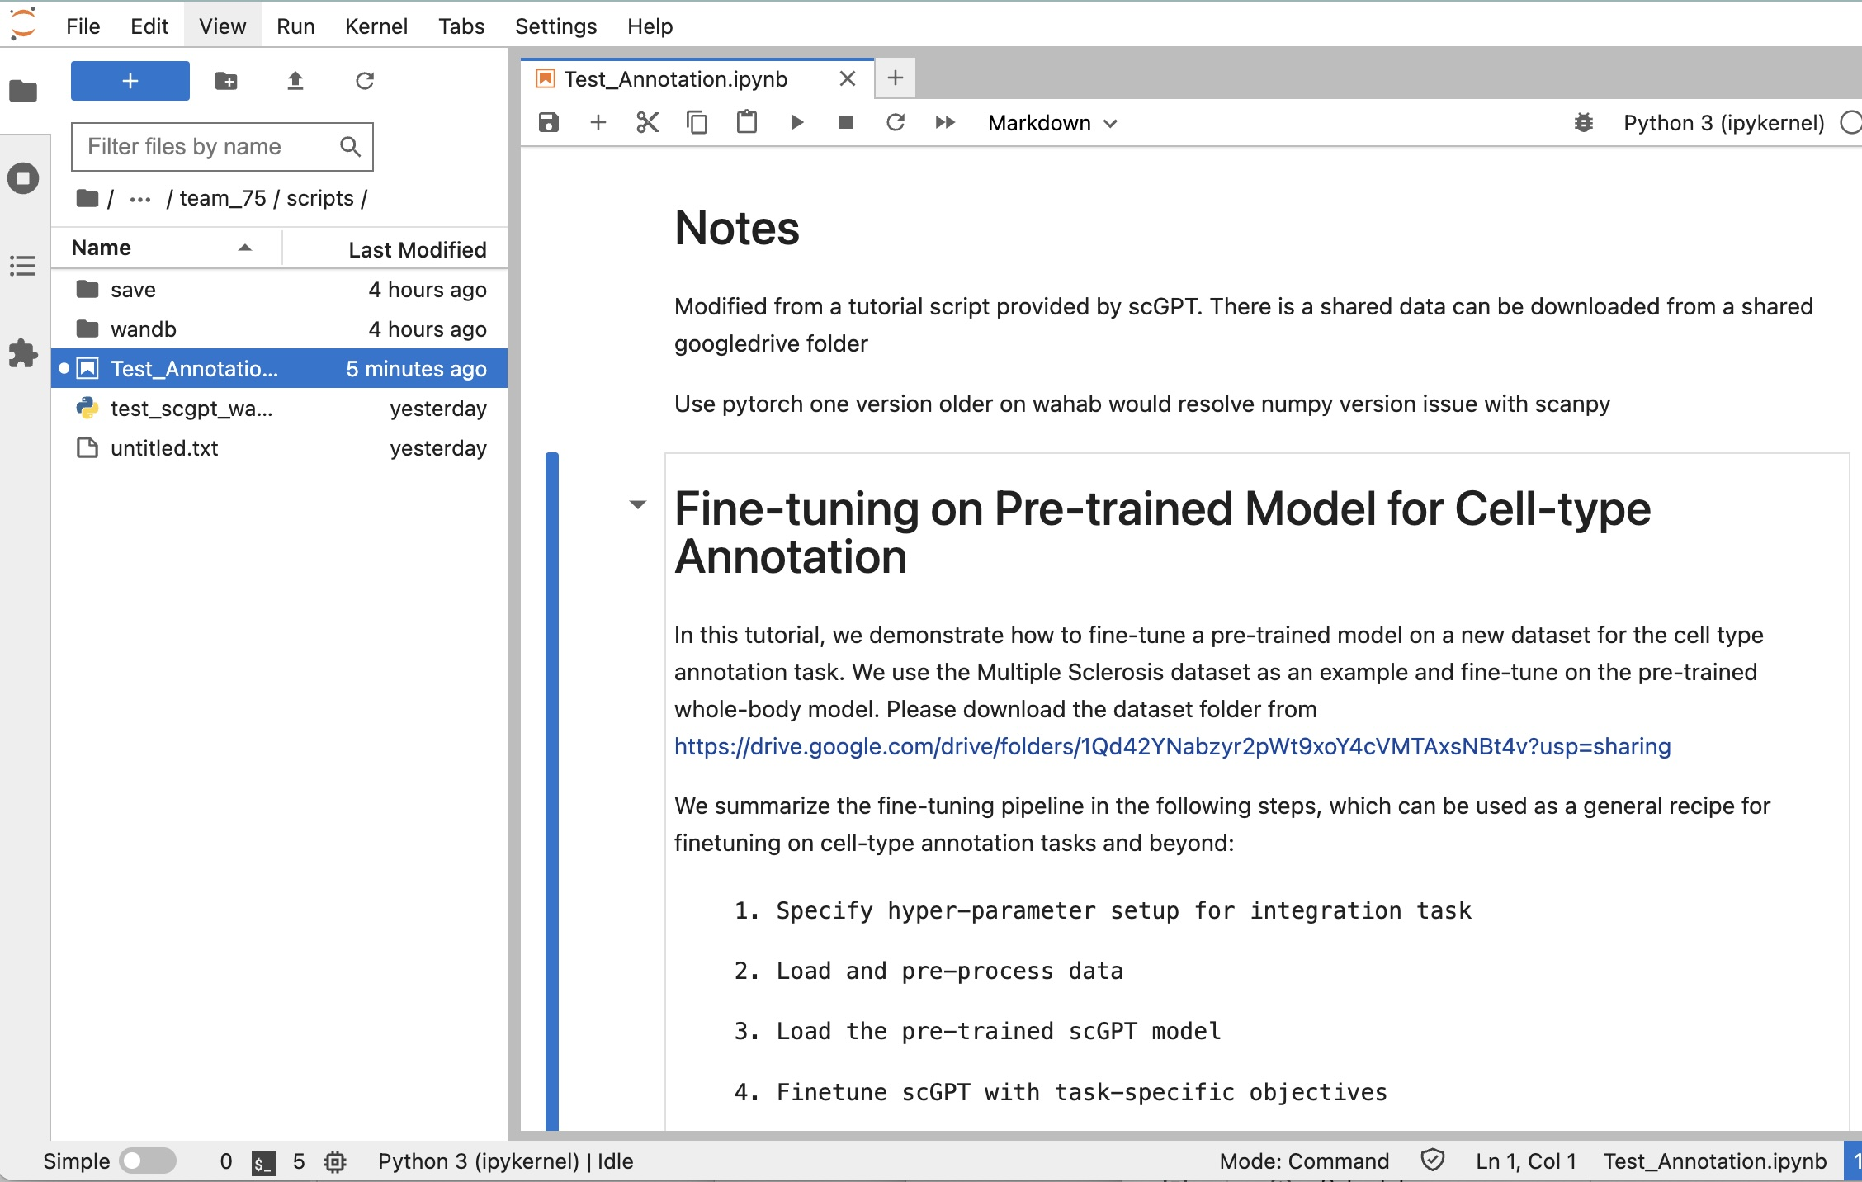

Slide 7
Thanks

