Slide 1

MPC Controller Tuning for Least Energy Quadrotor Missions
MTP Phase – 2 Presentation
Presented by :
Arya Mallick (Roll No. 234102501)
Under the guidance of :
Dr. Chayan Bhawal
Electronics & Electrical Engineering
Indian Institute of Technology Guwahati Guwahati – 781039, India

Slide 2

MOTIVATION
Electronics and Electrical Engineering
Indian Institute of Technology Guwahati
To formulate a model predictive controller for a drone and tune its parameters to track a least energy trajectory for a given mission.
2

Slide 3
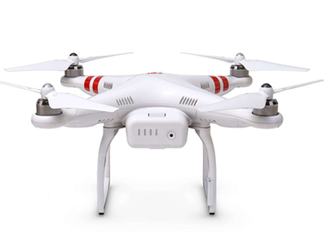
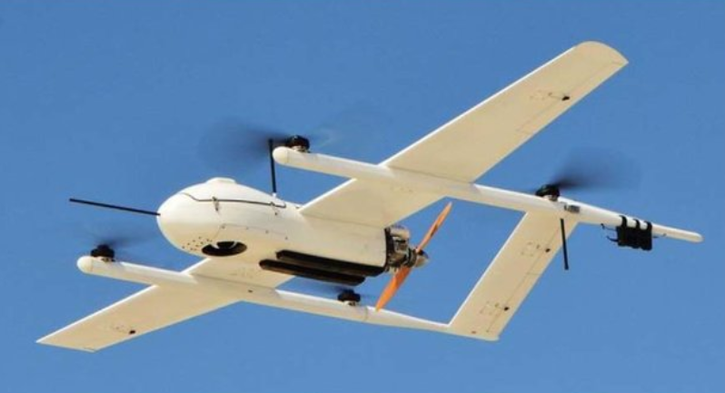
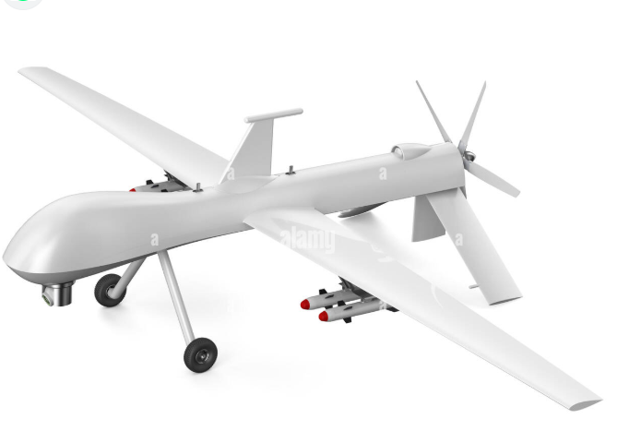
UAVs:
Electronics and Electrical Engineering
Indian Institute of Technology Guwahati
ROTARY WING UAVS:
FIXED WING UAV: HYBRID TYPE:
DUE TO THE SIMPLICITY OF DESIGN AND LOW COST. ROTARY WINGED UAV IS MOST COMMON. VTOL CAPABILITY.
USED WIDELY IN SURVEILLANCE, DEFENCE, AGRICULTURE, TRANSPORT, EMERGENCY OPERATIONS.
WHAT ARE THE DOWNSIDES?
1)DUE TO THE ABSENCE OF WINGS, WILL CRASH TO THE GROUND IN THE CASE OF A LOW POWER SUPPLY. UNLIKE OTHERS, IT CAN'T GLIDE IN AIR.
2)ALSO, IT'S A LESS STABLE MODEL THAN ITS OTHER COUNTERPARTS.
WHAT'S THE SOLUTION? ENERGY OPTIMIZATION!!!
TO REACH A MISSION ENDPOINT, WE NEED TO FIND THE LEAST ENERGY-OPTIMAL TRAJECTORY (ALREADY DONE BY PhD RESEARCHER - PARAJ GANCHAUDHARI).
TO DESIGN AN EFFECTIVE CONTROLLER THAT CAN TRACK THIS OPTIMAL PATH WHILE ENSURING MINIMUM ENERGY CONSUMPTION.
3

Slide 4
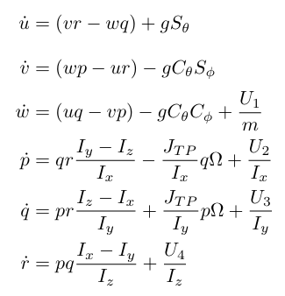
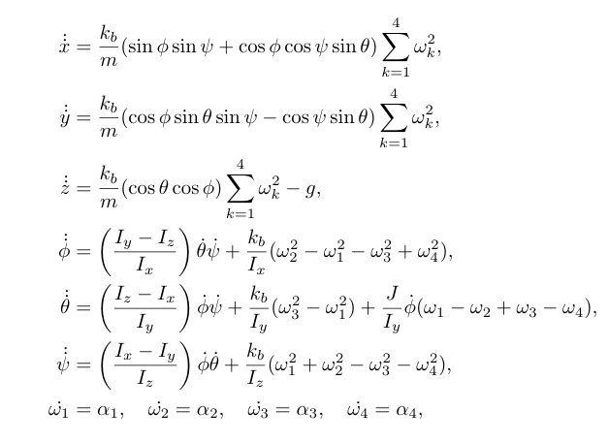
QUADCOPTER DYNAMICS :
Electronics and Electrical Engineering
Indian Institute of Technology Guwahati
DYNAMICS IN B-FRAME:(intuitive for us)
DYNAMICS IN E-FRAME:(useful for controller) )
Apply R and T matrices
Forces in play:
1) Gravity effect
2) Gyroscopic effect
3) Actuator forces (U1_thrust) & torques (U2 (roll torque), U3 (pitch torque), U4 (yaw torque))
4) Centrifugal forces
4

Slide 5
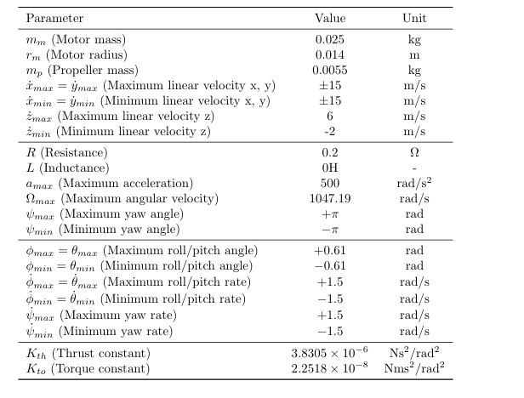
DJI PHANTOM 2
Electronics and Electrical Engineering
Indian Institute of Technology Guwahati
TABLE OF PARAMETERS USED IN THE NUMERICAL SIMULATION:
DJI PHANTOM 2 DRONE
mass= 1.3 kg
Ix=Iy=0.142
Iz=0.081
5

Slide 6
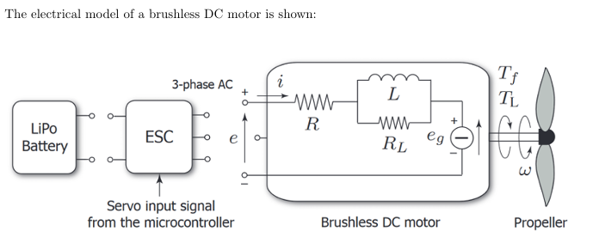
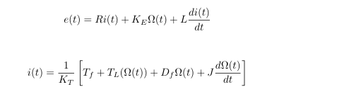
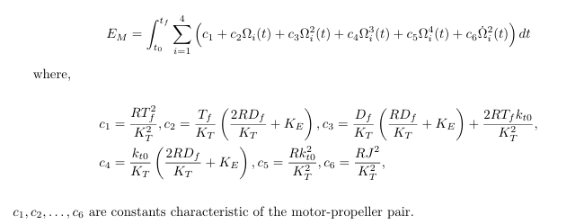

REFERENCE TRAJECTORY GENERATION
Electronics and Electrical Engineering
Indian Institute of Technology Guwahati
OBJECTIVE:
minimize
minimize
Ω(t0) = Ω(tf)
Subject to system dynamics and state and actuator constraints
6

Slide 7
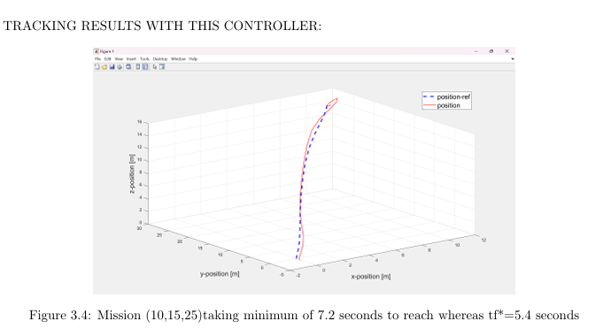
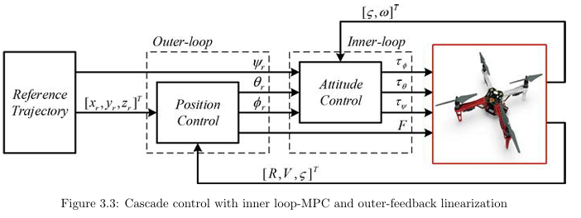
CONTROLLER STRUCTURE
Electronics and Electrical Engineering
Indian Institute of Technology Guwahati
ISSUES WITH THIS CONTROL STRUCTURE:
1)FAILS TO TRACK THE LEAST ENERGY PATH
2) INNER LOOP MUST OPERATE AT AT LEAST 4 TO 5 TIMES HIGHER FREQUENCY THAN OUTER LOOP. SO TO REDUCE COMPUTATION BURDEN IN THE INNER LOOP IT USUALLY USES HOVER LINEARIZED ATTITUDE DYNAMICS.
3) THUS SMALL TILT ANGLES MEANS SLOW PATHS AND OUR RESULTS CONFIRM, THAT THIS CONTROL MODEL FAILS TO TRACK AN ENERGY OPTIMAL PATH(USUALLY QUITE FAST)
9

Slide 8
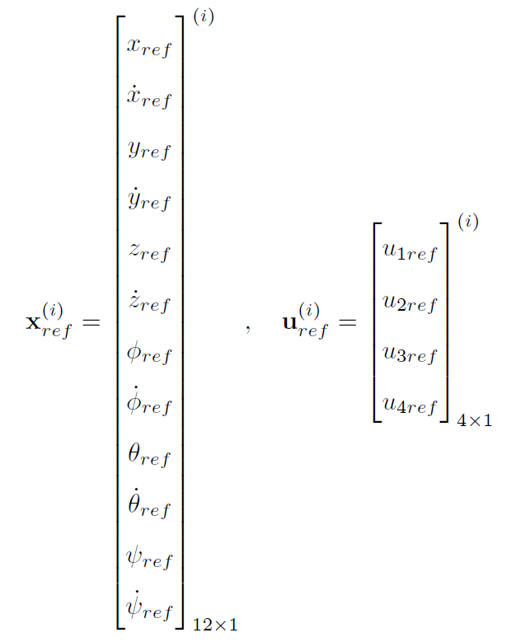
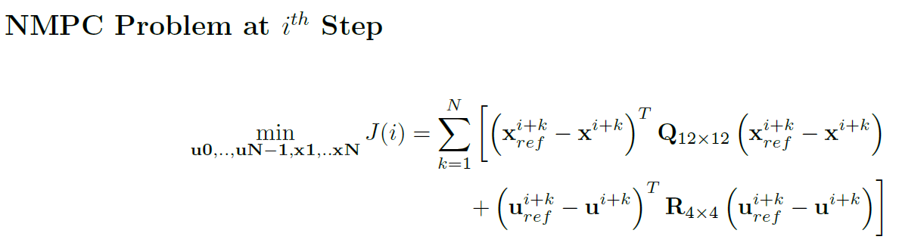

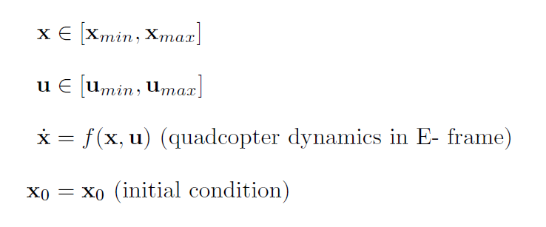
NMPC STRUCTURES:
Electronics and Electrical Engineering
Indian Institute of Technology Guwahati
PARAMETERS OBTAINED FROM GENETIC ALGORITHM OPTIMIZATION:
Q=diag([0.0986,0.7171,0.0014,0.0361,0.0434,0.3169,2624,635,77.7,54,0,0])
R=diag[(9e-8,9e-8,9e-8,9e-8)],
N=20 Ts(sampling time)=0.08 seconds
14

Slide 9
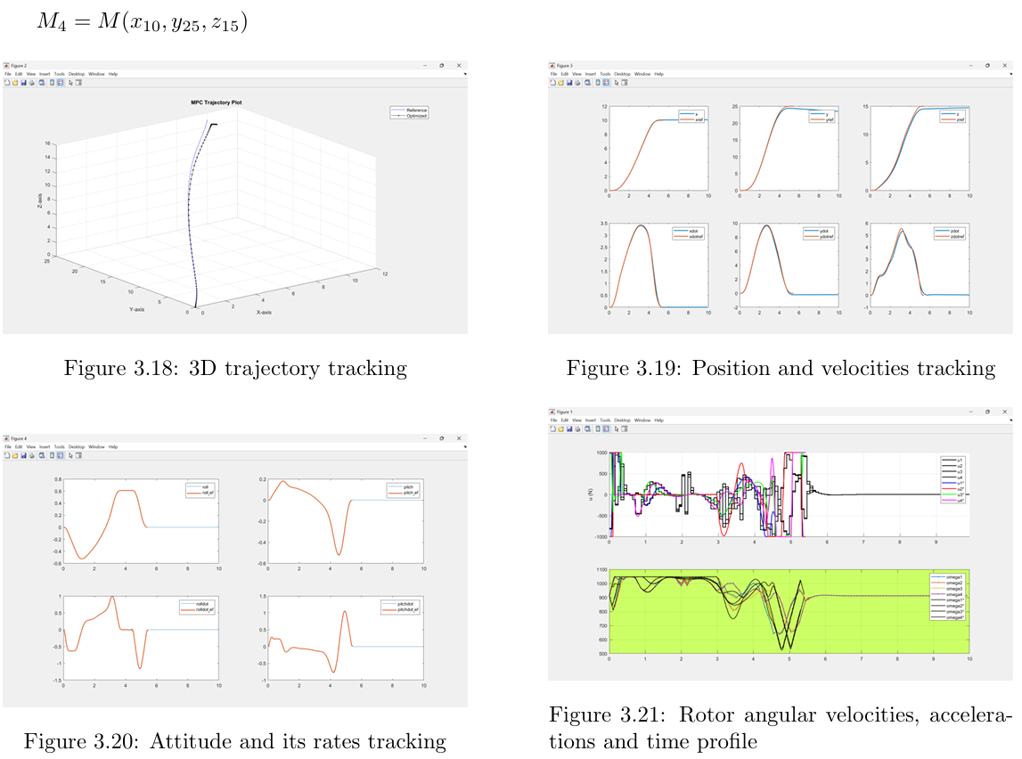
SIMULATION RESULTS:
Electronics and Electrical Engineering
Indian Institute of Technology Guwahati
15

Slide 10
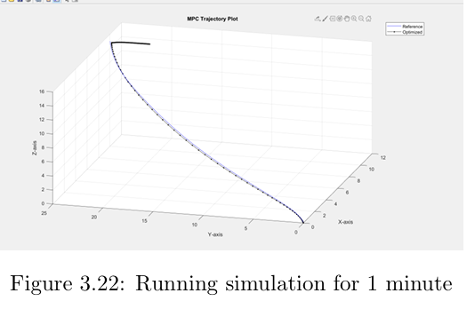
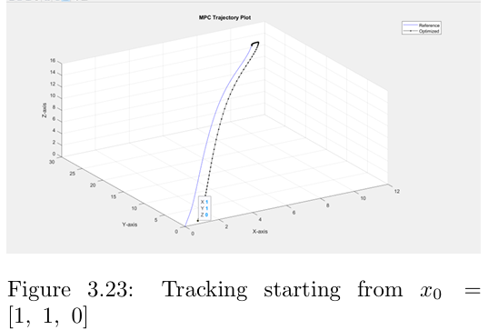
ISSUES:
Electronics and Electrical Engineering
Indian Institute of Technology Guwahati
The controller exhibits poor stabilisation and isn't robust to disturbances. This is due to heavier weights on attitudes; it tracks open-loop reference attitudes but fails to generate optimal attitudes by itself.
10

Slide 11
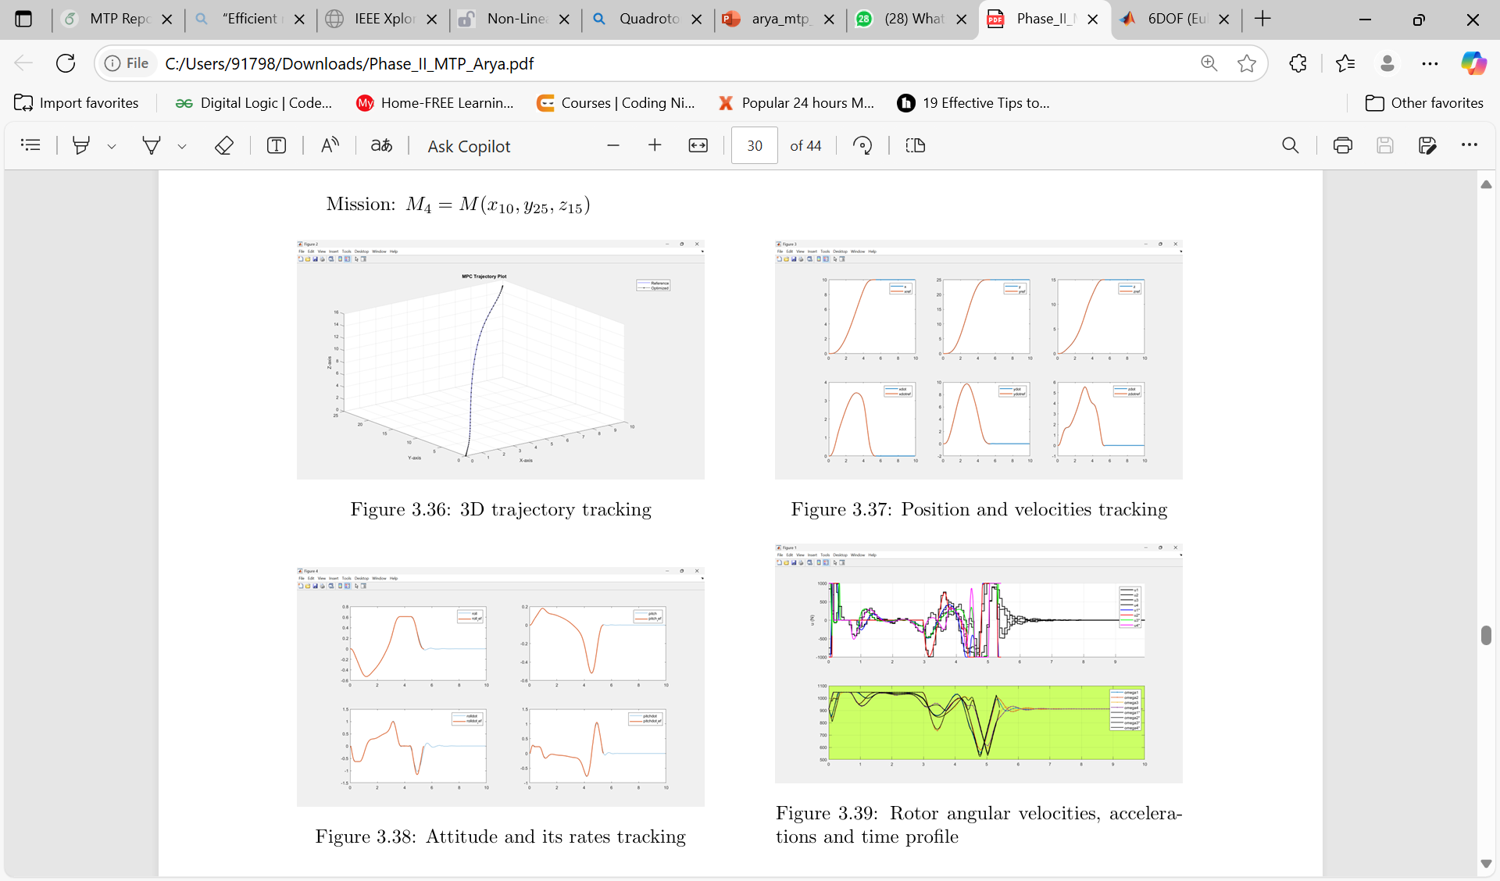
CONTD....
Electronics and Electrical Engineering
Indian Institute of Technology Guwahati
2nd set of parameters obtained from G.A. optimisation:
Q=diag([149700, 5741400, 61100, 161200, 325100, 879200, 1020, 413, 2054, 611, 0, 0]),
R=diag([0.001, 0.001, 0.001, 0.001]),
N =14
ISSUES:
1)Although tracking and stabilisation occur properly, it happens at the cost of extra energy consumption.
2) Again, due to the presence of open-loop attitude references, suboptimal attitude calculation occurs during disturbance, leading to poor tracking.
11

Slide 12
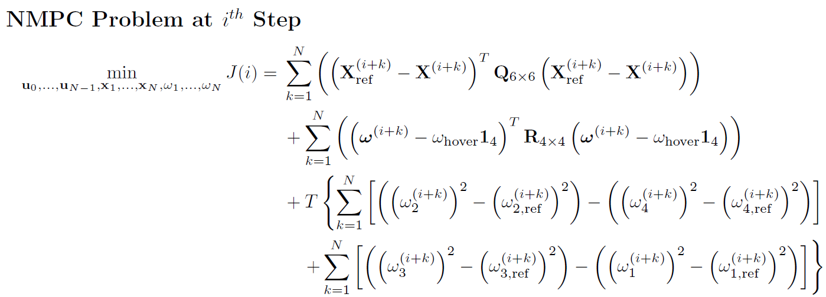
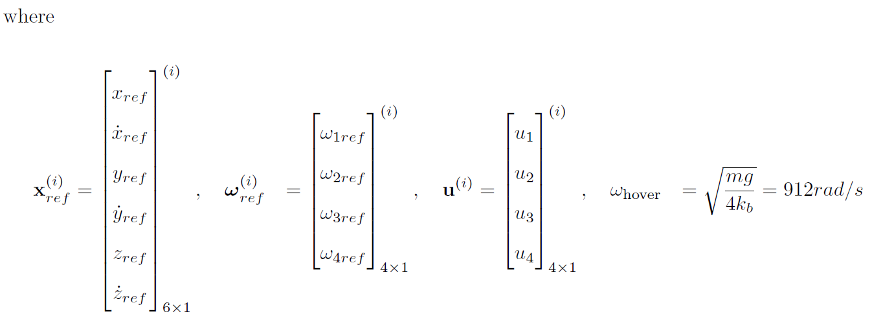

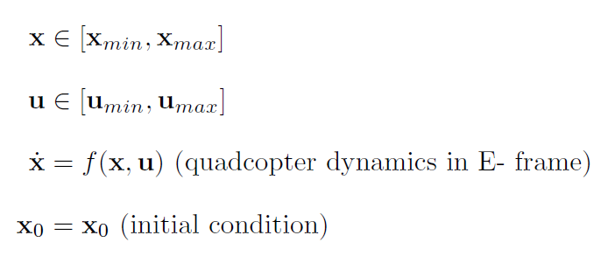
CONTD….
Electronics and Electrical Engineering
Indian Institute of Technology Guwahati
MANUALLY TUNED PARAMETERS:
Q=diag([90000000,90000000,90000000,90000000,90000000,90000000])
R=diag([5, 5,5 ,5]), T=0.0001
N=12
17

Slide 13
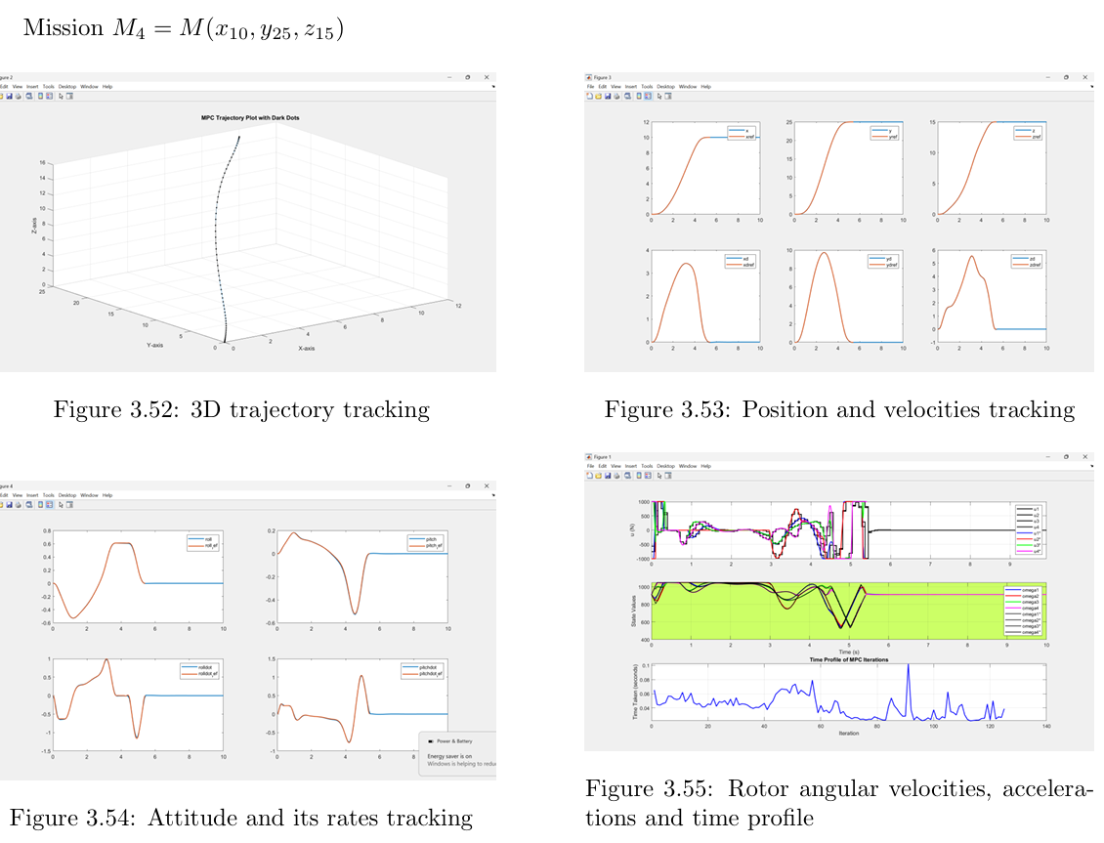
SIMULATION RESULTS :
Electronics and Electrical Engineering
Indian Institute of Technology Guwahati
18

Slide 14
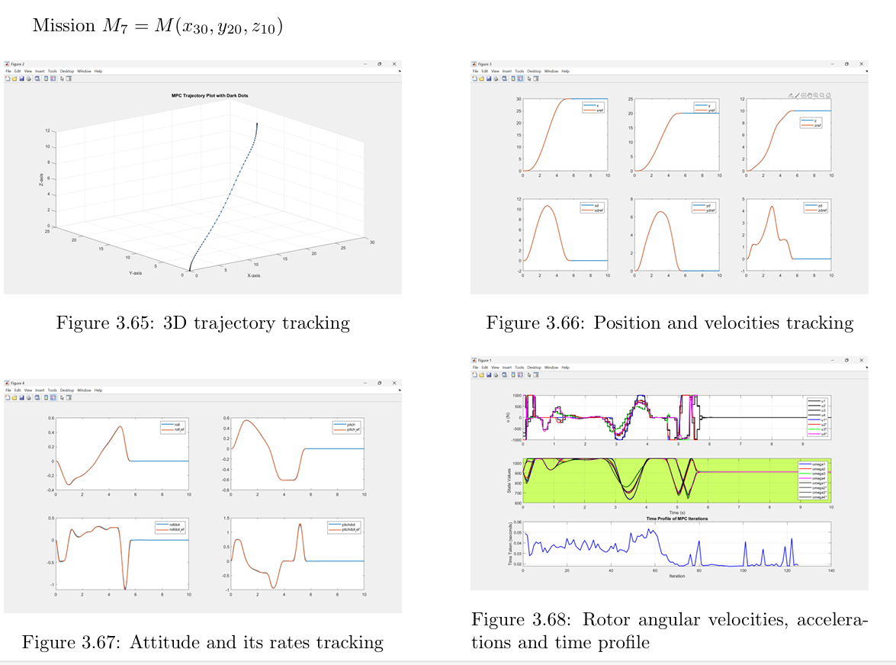
SOME OTHER 3D MISSIONS:
Electronics and Electrical Engineering
Indian Institute of Technology Guwahati
1

Slide 15
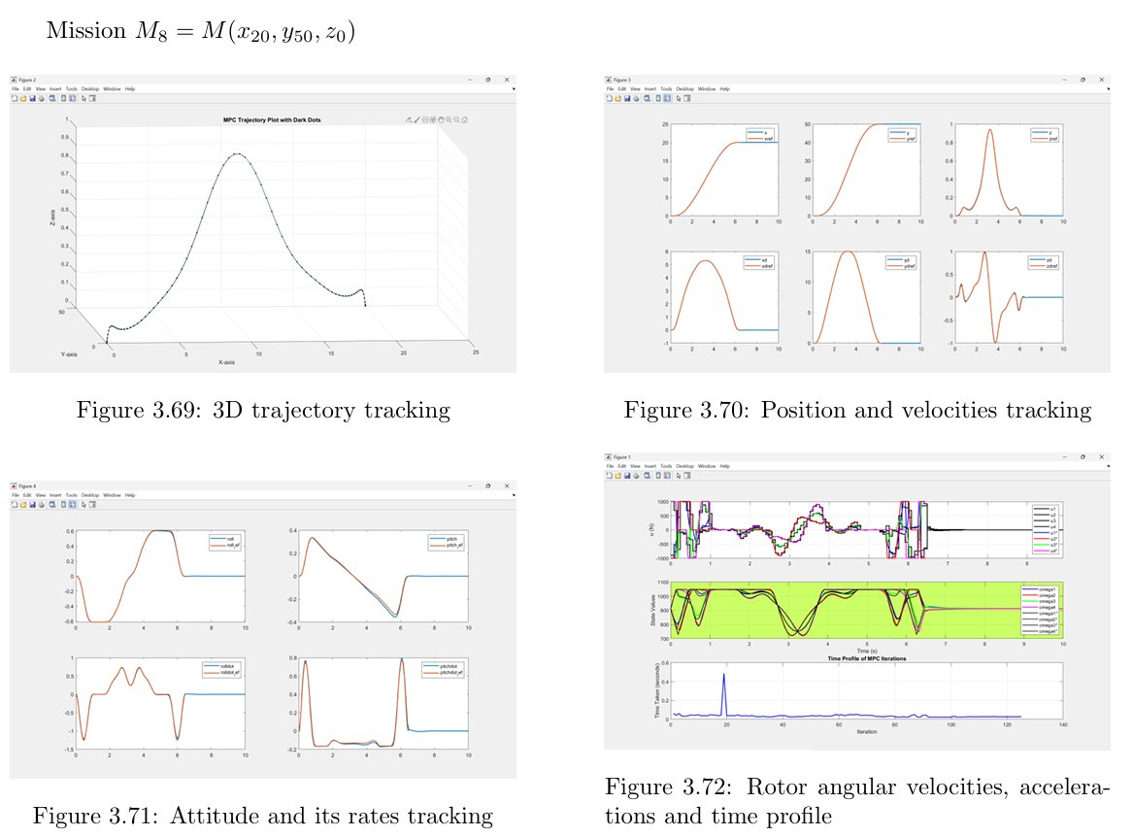
SIMULATION OF 3D MISSION:
Electronics and Electrical Engineering
Indian Institute of Technology Guwahati
19

Slide 16
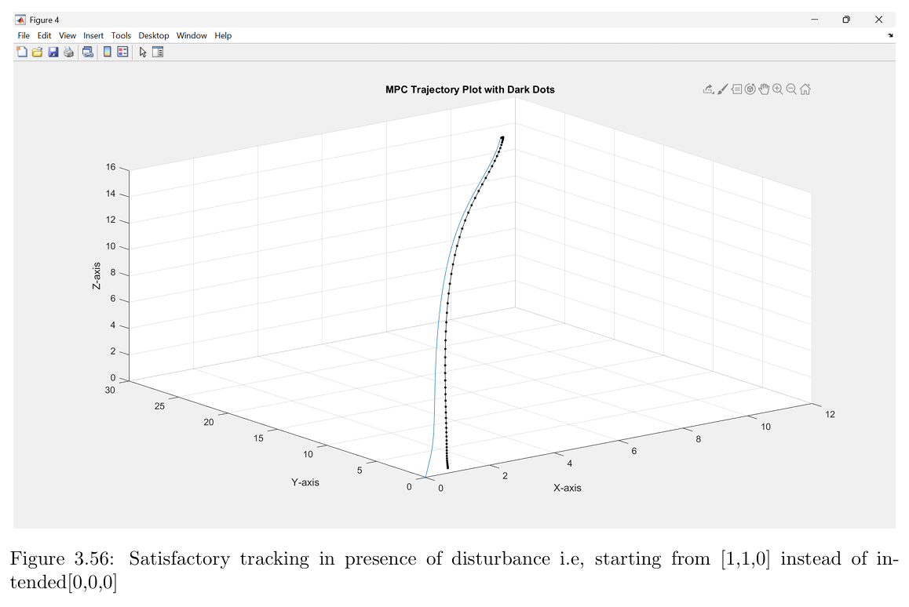
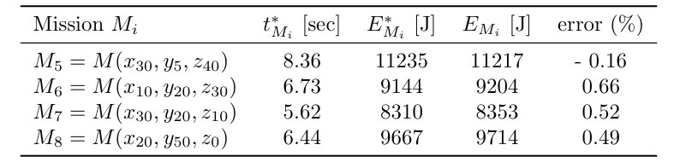
REMARKS:
Electronics and Electrical Engineering
Indian Institute of Technology Guwahati
Good tracking and stabilization
Low /near optimal energy consumption
Also relatively fast convergence in presence of disturbances
METHODS USED:
1) We have used the multiple shooting method as the transcription method for solving the NMPC.
2) For the discretisation of dynamics, we have used the RK-4 (Runge Kutta 4th order) method.
3)And we used CAsadi’s IPOPT solver to solve the NMPC optimization.
20

Slide 17
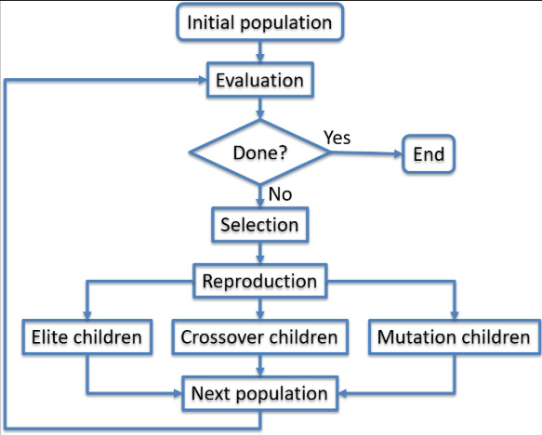
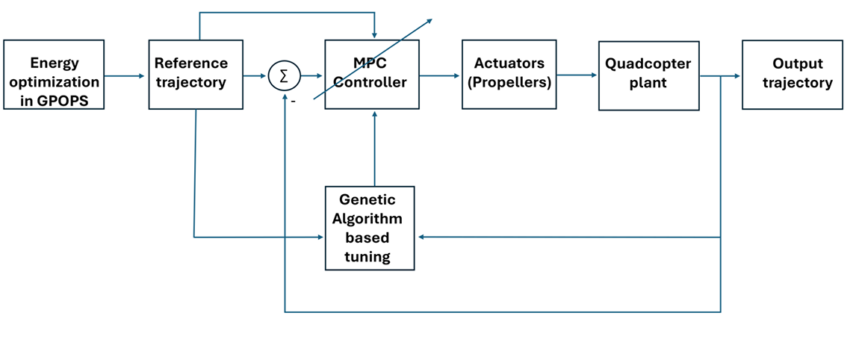
GENETIC ALGORITHM BASED TUNING
Electronics and Electrical Engineering
Indian Institute of Technology Guwahati
WORKING PRINCIPLE OF GENETIC ALGORITHM
8

Slide 18
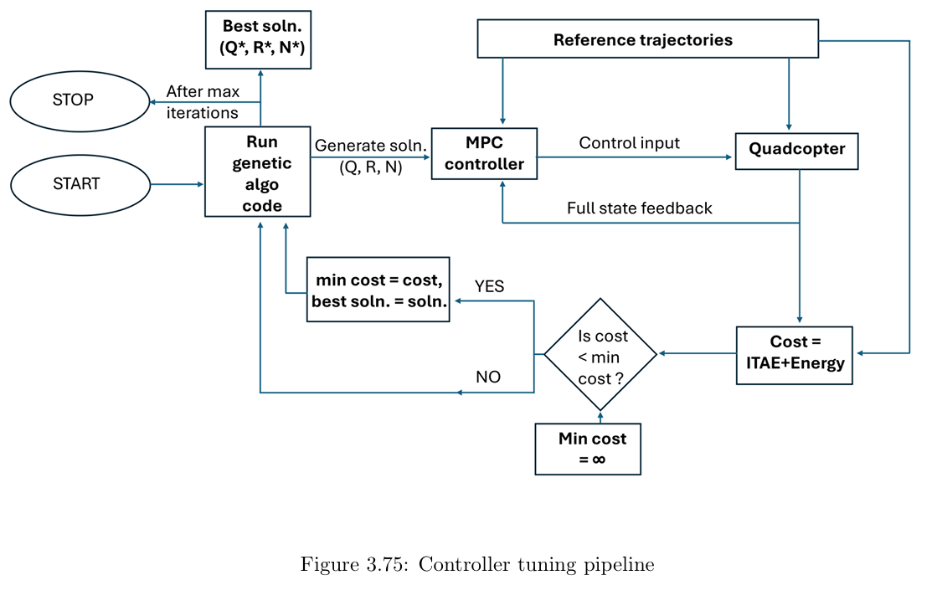
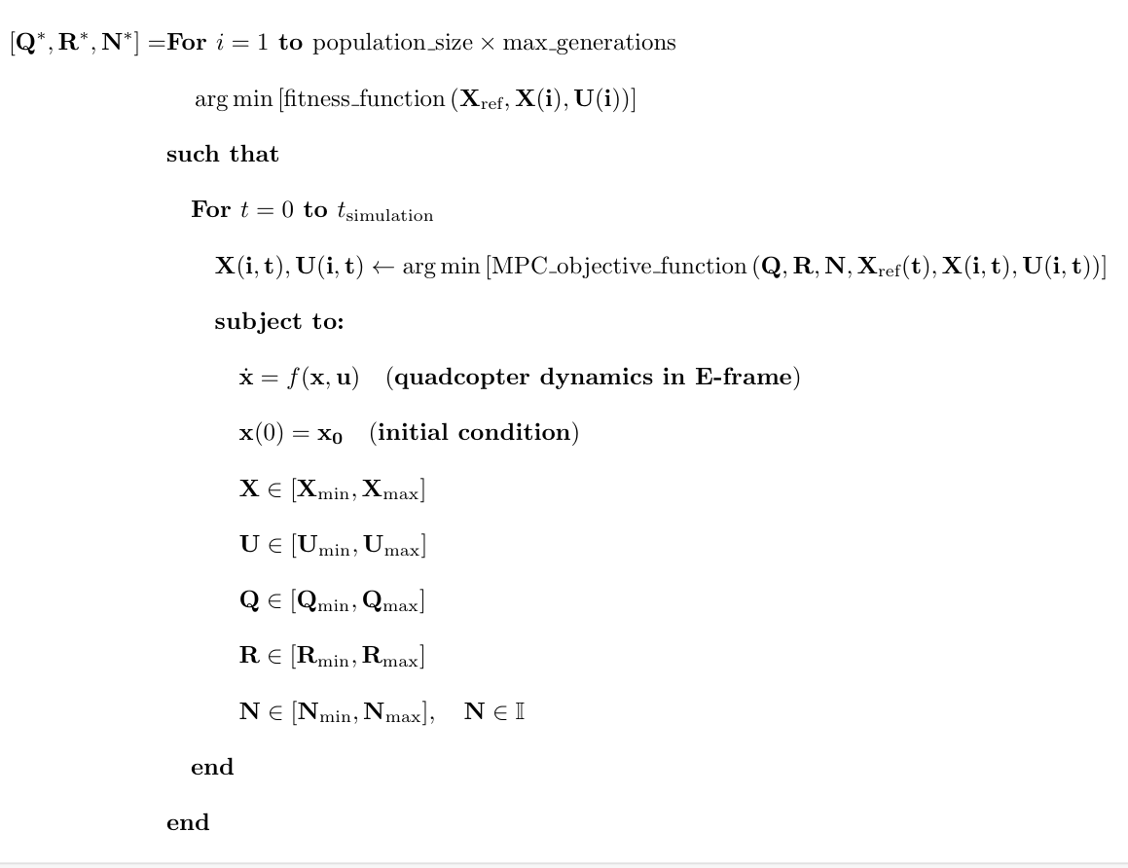
CONTD...
Electronics and Electrical Engineering
Indian Institute of Technology Guwahati
Used: Max_generations=20;
Population size=30
12

Slide 19
CONCLUSION AND FUTURE SCOPE
Electronics and Electrical Engineering
Indian Institute of Technology Guwahati
Conclusion: Successfully addressed key areas like:
Controller structures for tracking least energy path
Genetic algorithm based parameter tuning
Future Scope:
Implemention in hardware
We check the practical feasibility of this NMPC CONTROLLER structure in real time hardware. By integrating sensors and estimators in closed we can check the overall performance.
The formulation presented here can be extended to other UAVs.
Also with development of better parameter tuning algorithms, we many get better results.
22

Slide 20
Electronics and Electrical Engineering
Indian Institute of Technology Guwahati
Thank you
23

