Slide 1
<Τίτλος>
Μανδελιάς Αλέξιος
Τσίρμπας Δημήτριος

Slide 2
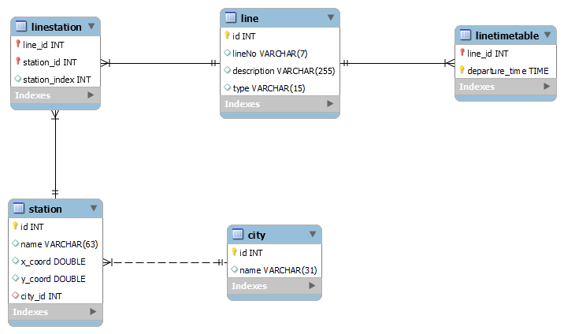
ER Diagram

Slide 3
Model-View-Controller Architecture

Slide 4
// AbstractEntity.java
abstract class AbstractEntity {
private final int id;
public AbstractEntity(int id) { this.id = id; }
public int getID() { return id; }
}
// ETown.java
public class Town extends AbstractEntity {
private final String name;
public Town(int id, String name) {
super(id);
this.name = name;
}
public String getName() { return name; }
}

Slide 5
// Model.java
public void insertTown(ETown town) throws SQLException {
final String qInsertToCity = "INSERT INTO City(name) VALUES ('@2')";
Connection conn = null;
Statement stmt = null;
try {
conn = DriverManager.getConnection(url, user, password);
stmt = conn.createStatement();
stmt.execute(qInsertToCity.replace("@2", town.getName()));
} finally {
stmt.close();
conn.close();
}
}

Slide 6
// Model.java
public List<ETown> getTowns(ELine line) throws SQLException {
final String qSelectAllTowns = "SELECT C.* FROM City AS C";
final String qSelectTownsByLine = "SELECT DISTINCT C.id, C.name FROM City AS C "
+ "JOIN Station AS S ON S.city_id = C.id "
+ "JOIN LineStation AS LS ON LS.station_id = S.id "
+ "JOIN Line AS L ON L.id = LS.line_id "
+ "WHERE L.id=@1";
final String qFinalisedQuery;
if (line == null) qFinalisedQuery = qSelectAllTowns + " ORDER BY C.name;";
else {
final String id = String.valueOf(line.getId());
qFinalisedQuery = qSelectTownsByLine.replaceAll("@1", id)
+ " ORDER BY C.name;";
}
final List<ETown> townsFromDatabase = new LinkedList<>();
Connection conn = null;
Statement stmt = null;
ResultSet rs = null;
// ...continued

Slide 7
// Model.java
public List<ETown> getTowns(ELine line) throws SQLException {
// ... continued
final List<ETown> townsFromDatabase = new LinkedList<>();
Connection conn = null;
Statement stmt = null;
ResultSet rs = null;
try {
conn = DriverManager.getConnection(url, user, password);
stmt = conn.createStatement();
rs = stmt.executeQuery(qFinalisedQuery);
while (rs.next())
townsFromDatabase.add(new ETown(rs.getInt("C.id"), rs.getString("C.name")));
} finally {
rs.close(); stmt.close(); conn.close();
}
return townsFromDatabase;
}

Slide 8
// Controller.java
public void getTowns(ELine line) {
try {
final List<ETown> towns = model.getTowns(line);
view.updateViewWithTowns(towns);
} catch (final SQLException e) { view.updateViewWithError(e); }
}
public void insertTown(Requirements params) {
final ETown newTown = new ETown(-1, params.getValue("Name", String.class));
try { model.insertTown(newTown); }
catch (final SQLException e) { view.updateViewWithError(e); }
}
public Requirements getInsertTownRequirements() {
final Requirements reqs = new Requirements();
reqs.add("Name", StringType.NON_EMPTY);
return reqs;
}

Slide 9
// AbstractView.java
protected void getAllTowns() {
controller.getAllTowns();
}
protected final void insertTown() {
Requirements params = controller.getInsertTownRequirements();
fulfillRequirements(params, "Insert Town Parameters");
if (params.fulfilled())
controller.insertTown(params);
}
protected abstract void fulfillRequirements(Requirements params, String prompt);

Slide 10
// OASAView.java
public void updateViewWithTowns(List<ETown> towns) {
final JPanel contentPanel = getContentPanel();
final JPanel townPanel = getDisplayPanel();
for (final ETown town : towns)
townPanel.add(factory.getETownRepresentation(town));
contentPanel.add(getCenteredLabel("Towns"), BorderLayout.NORTH);
contentPanel.add(getJSPForPanel(townPanel), BorderLayout.CENTER);
this.contentPanel = contentPanel;
}

Slide 11
// ConsoleView.java
public void updateViewWithTowns(List<Etown> towns) {
final FormatBuffer buffer = new FormatBuffer("Please select a town: \n");
for (final ETown town : towns)
buffer.format(factory.getETownRepresentation(town));
out.print(buffer);
final ETown selected = towns.get(getAnswer(1, towns.size()) - 1);
out.printf("Select what you want to access from the town: %s%n", selected.getName());
out.println("Show all lines going through this town");
out.println("Show all stations in this town");
out.println("Return to homepage");
doWithAnswer(
() -> super.getLinesByTown(selected),
() -> super.getStationsByTown(selected),
this::updateViewWithHomepage
);
}

Slide 12
Interaction Diagrams

Slide 13
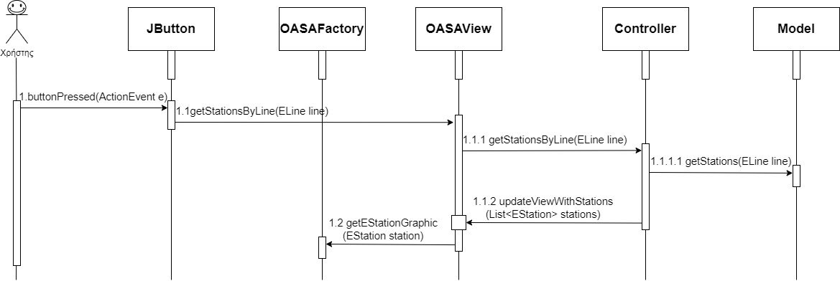
SELECT Interaction Diagram

Slide 14
INSERT Interaction Diagram
TODO

Slide 15
Design Patterns

Slide 16
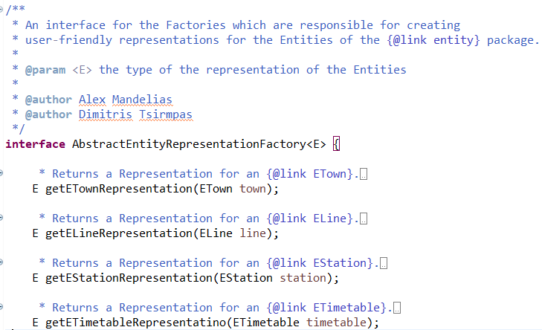
Abstract Factory Pattern
Μας χρησιμεύει στο να παράγουμε ομοιόμορφα μηνύματα προς τον χρήστη, είτε αυτά είναι σε μορφή γραφικών ή κειμένου (String).

Slide 17
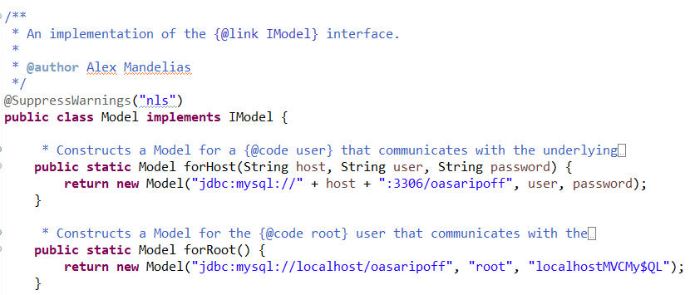
Factory Method Pattern
Χρησιμοποιούμε στατικές μεθόδους για την δημιουργία αντικειμένων.
Χρησιμοποιείται για την ελεγμένη κατασκευή του Model, δηλαδή την εγκαθίδρυση της σύνδεσης με την βάση δεδομένων.

Slide 18
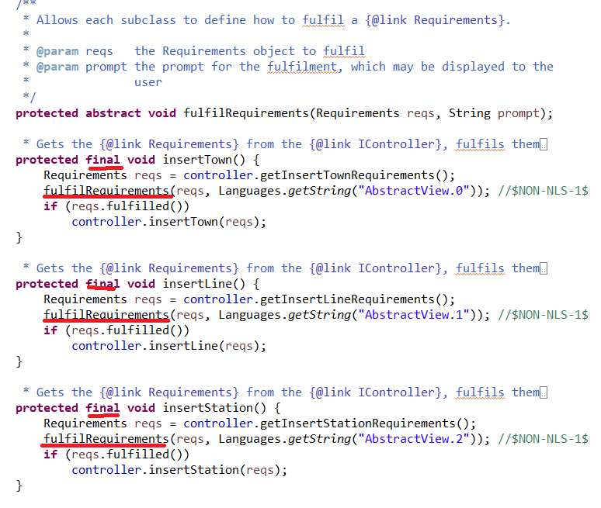
Template Method Pattern
Δεν αφήνουμε τις υποκλάσεις να κάνουν override κατευθείαν τις κύριες μεθόδους της υπερκλάσης, αλλά μόνο βοηθητικές τις οποίες καλούν οι κύριες.
Χρησιμοποιείται για την πολυμορφική κατασκευή των παραμέτρων για την φόρμα του χρήστη.

Slide 19
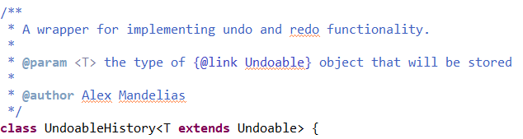
Command Pattern
Αποθηκεύουμε τις αλλαγές της κατάστασης του View έτσι ώστε να μπορούμε να τις αναιρέσουμε / ξανά εκτελέσουμε.
Χρησιμοποιείται για την λειτουργία των κουμπιών next/previous στη γραφική διεπαφή.

Slide 20
Ερωτήσεις

